Slide 1
File Structures Mini Project Progress
Project By:
DEEPANSHU BACHLOO (1MV19IS018)
PRATHAM PAI B M (1MV19IS044)
SUSHANTH S RAO (1MV19IS059)

Slide 2
INDEX
Introduction
File Structures
Project we chose
Why we chose this Project?
Programming Language we’ll use
Roadmap
Concepts Used
Conclusion

Slide 3
INTRODUCTION
File Structure is a combination of representations for
data in files
operation to access the data
File Structure is the organization of data in secondary storage structures such as disks

Slide 4
Why we chose this project?
PROJECT Title we chose
“Coaching Institute Management System”
We want to do a project that will be helpful in the real world. Coaching Institutions have been plummeting in growth due to the rise of academically ambitious students in India. The infrastructure size of these coaching academies range from small independent teachers to sizeable institutes like a mini school. Thus, it becomes necessary for them keep track of data of their students and teachers. We are hopeful to implement the project that will solve the problem using the concepts of file structures

Slide 5
Programming Language We’ll Use
C++
We have decided to use C++ language to write the code. The reason being it has powerful Standard Template Library and Header Files to manipulate and operate the files. Also since we are learning the lab programs in C++, it would beneficial for us to implement the code

Slide 6
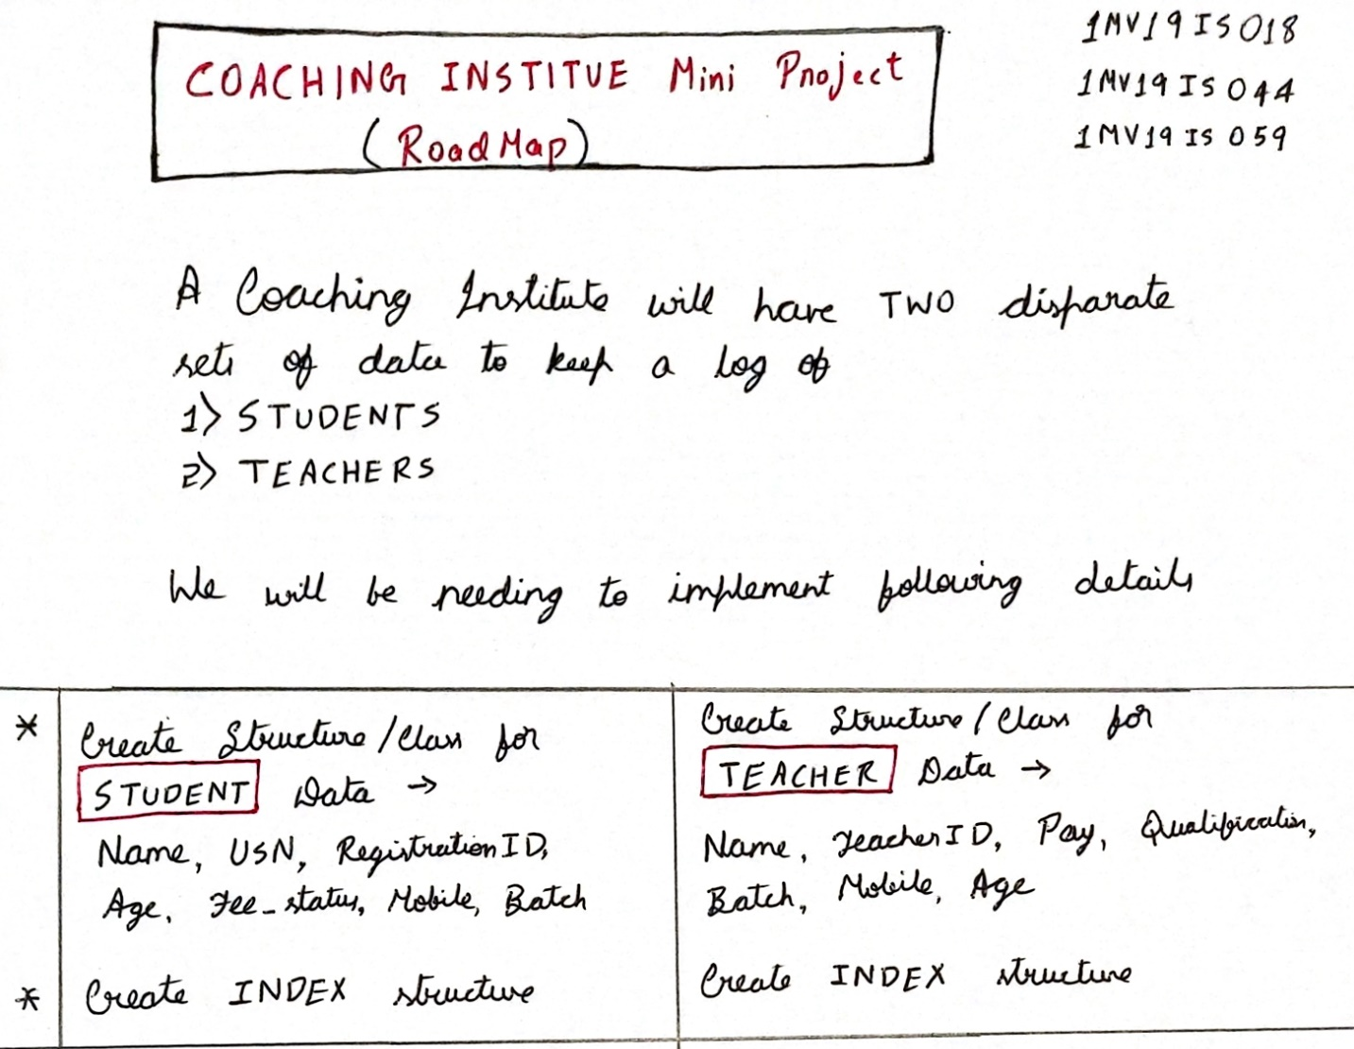
ROADMAP

Slide 7
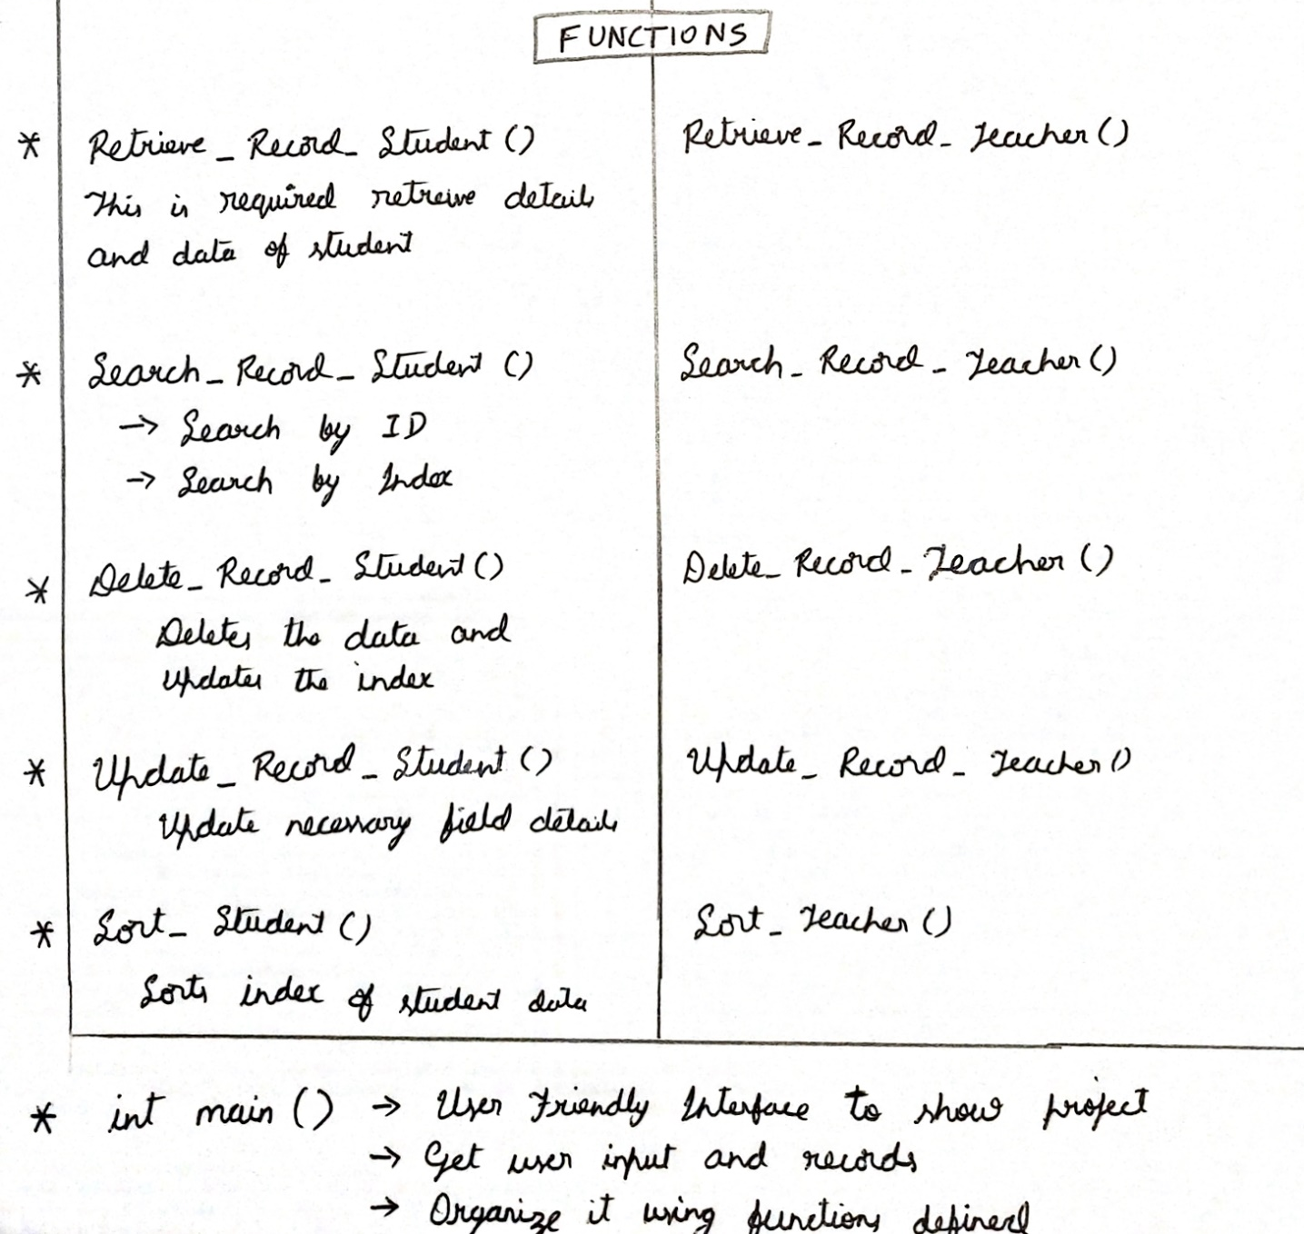

Slide 8
Concepts Employed
We will make use of the file structures concept of “Indexing” in our project. There are different types of indexing.
A primary index is built for a file (the data file) sorted on its key field, and itself is another sorted file (the index file) whose records (index records) are of fixed-length with two fields. The first field is of the same data type as the ordering key field of the data file, and the second field is a pointer to a disk block.
A secondary index is a sorted file of records (either fixed-length or variable-length) with two fields. The first field is of the same data type as an indexing field, the second field is either a block pointer or a record pointer. A file may have more than one secondary index

Slide 9
Conclusion
This is our Project Progress so far. Our code is half completed. We are confident to finish it within a week and test it. We will add more details and features along the way if we deem its necessary

