Slide 1
ImaGE MEDIA ORGANIZATION Website
A Presentation about the overview of the website project

Slide 2
OVERVIEW of the Project
The project is to implement the “Photography Website” which allows the publishment of photos on the web
The photos are organized inside the album. It provides the functionality of
The front end is developed using HTML and CSS used for styling
The backend is developed using PHP which is used to create dynamic web page
The database is built using MySQL and hosted using phypmyadmin and it stores the user authentication details and the user data and content
Javascript is used to add additional features and make the site interactive
adding photos
adding albums
moving photos
downloading
archiving

Slide 3


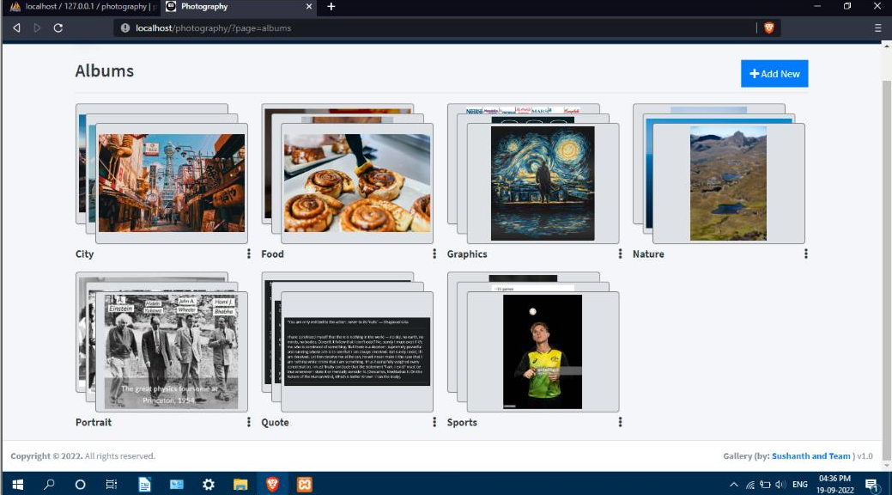

Slide 4
SYSTEM ARCHITECTURE
User login or register
Access to the library of photos, with homepage displaying statistics
Organized Albums users can view and edit
Photos can be added, downloaded, archived, or deleted
User Profile can be customized by the user

Slide 5
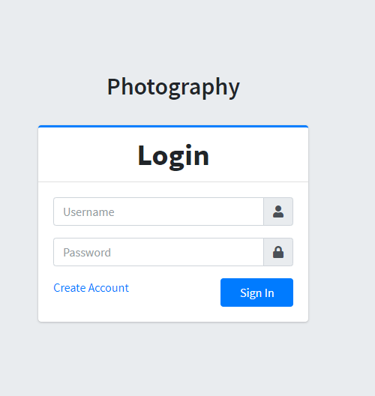
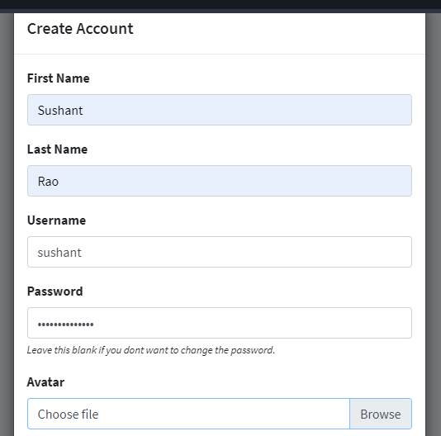
IMPLEMENTATION
Login form Registration form

Slide 6
Organised Albums

Slide 7
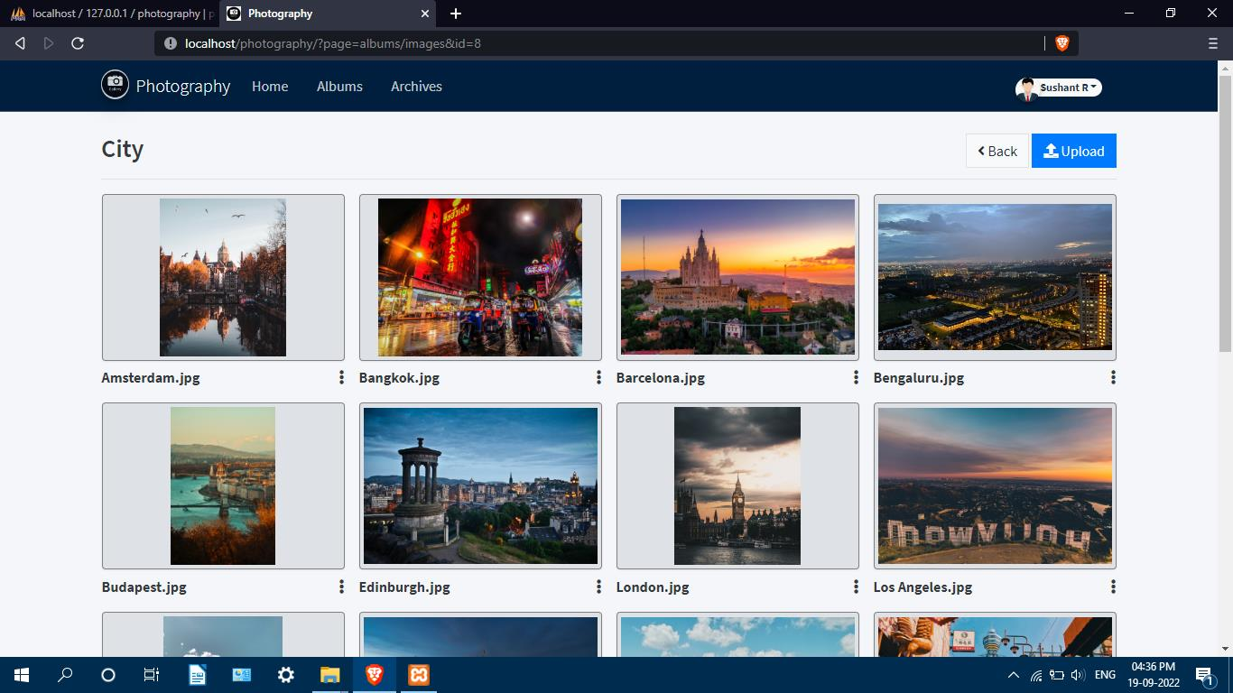
Content of an Album

Slide 8
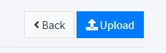
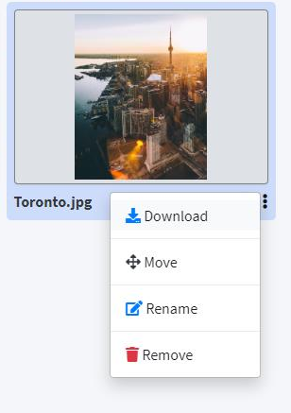
Functionality: Add, Move, Download, Delete

Slide 9
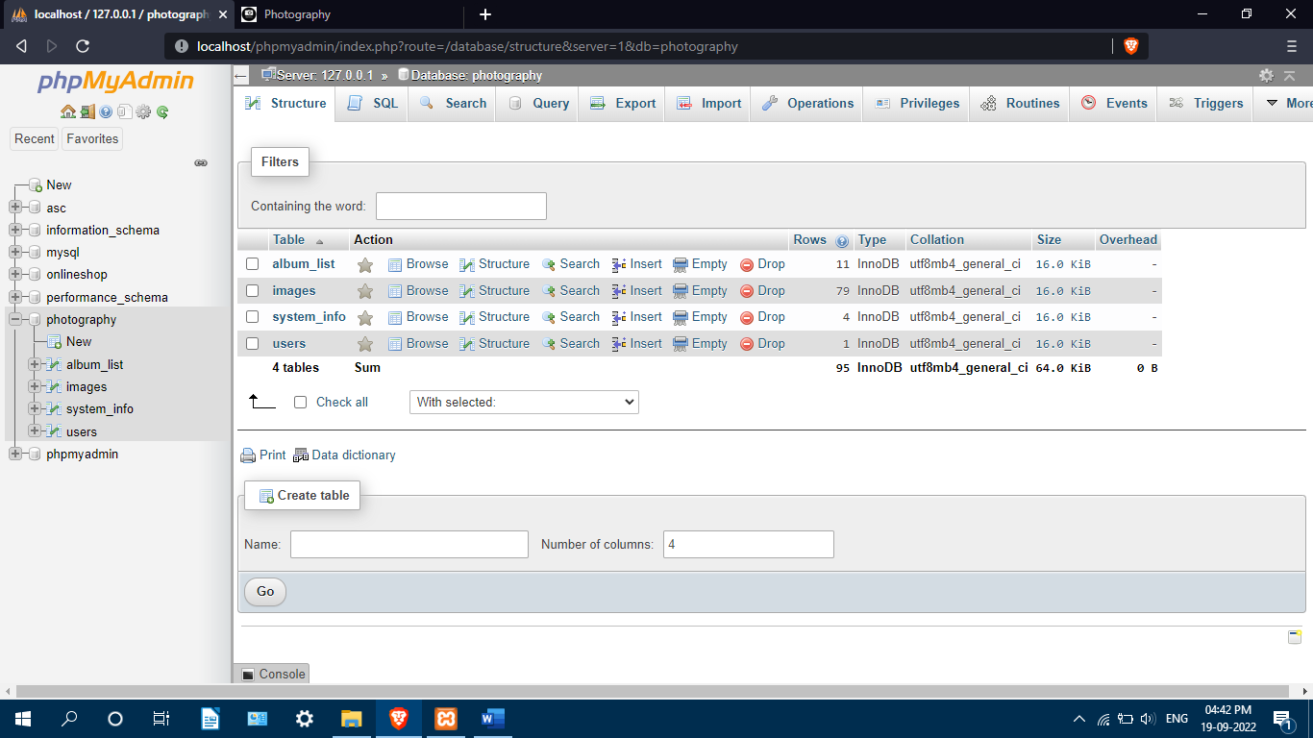
Database

Slide 10
CONCLUSION
This website will be found helpful to many of the users who will increase their productivity. The package was designed in such a way that future modifications can be done easily
There is always a room for improvement in any software however efficient the system may be. The important thing is that the system should be flexible enough for future modifications. The system has been factored into different modules to make system adapt to the further changes. Every effort has been made to cover all user requirements make it user friendly.

