Slide 1
Custom Memory Allocator: Dynalloc

Slide 2
Introduction
What is Dynamic Memory Allocation?
Definition:
Memory allocation that occurs at runtime, as opposed to compile-time.
Importance:
Allows programs to efficiently use memory based on current needs.
Because in modern programming, memory needs can vary significantly during program execution.

Slide 3
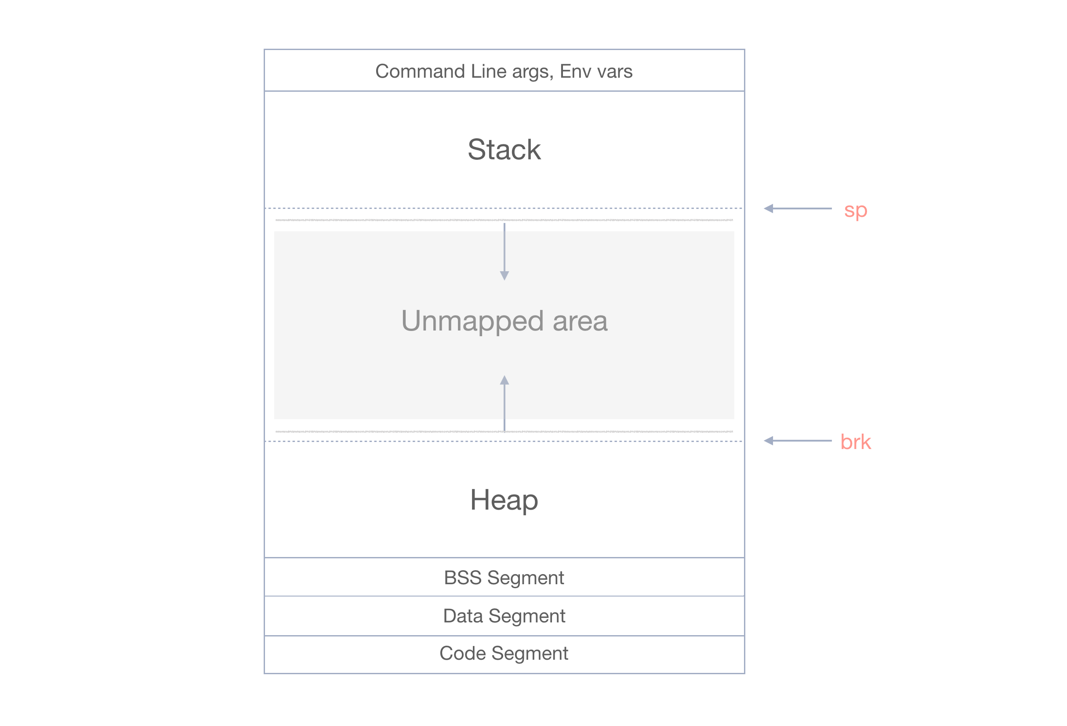
Introduction
Go, change the world
Static Memory:
Stack
Dynamic Memory:
Heap

Slide 4
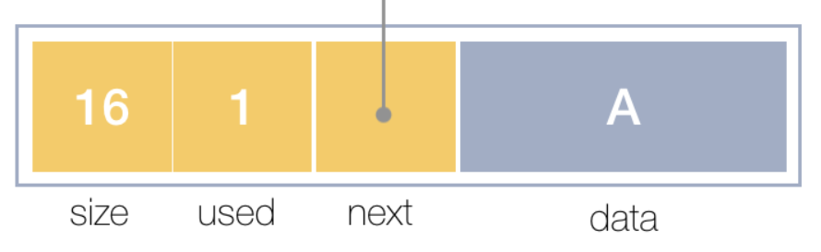
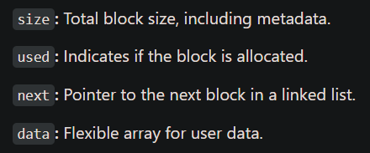
Structure of a Block:

Slide 5

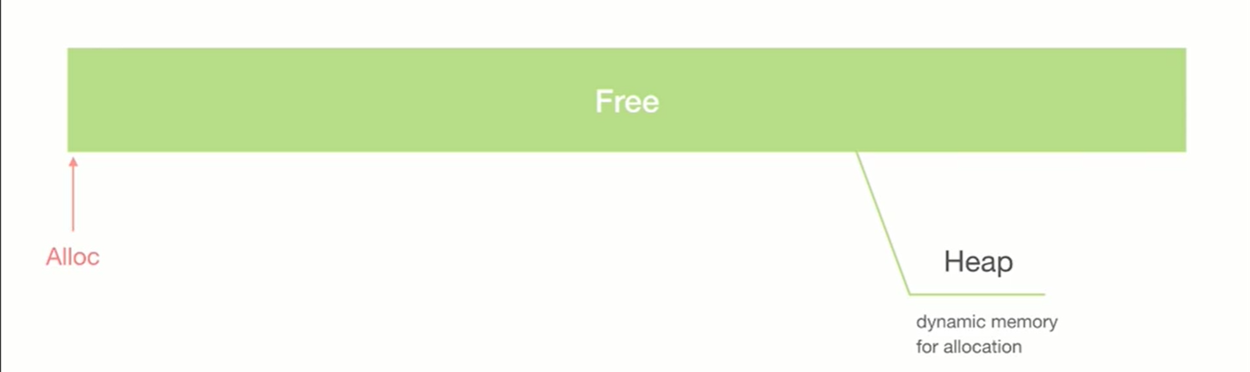
Allocation of Heap
Go, change the world
RV College of
Engineering
Initial Heap

Slide 6
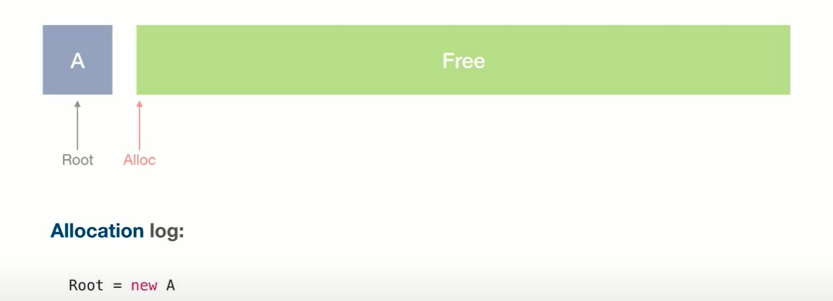
Allocation of Heap
Go, change the world
RV College of
Engineering
Allocation of Block

Slide 7
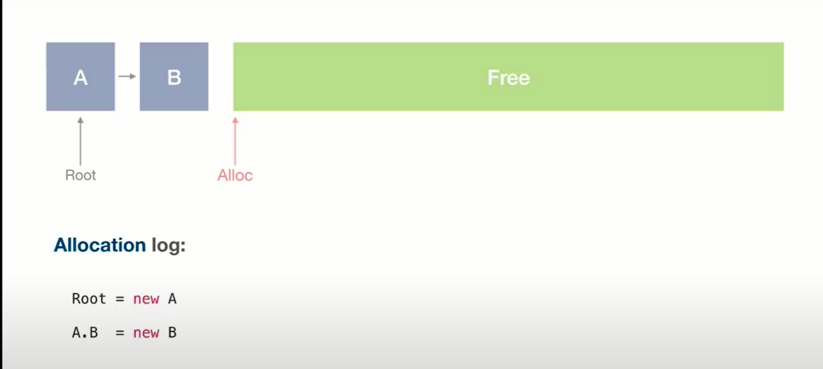
Allocation of Heap
Go, change the world
RV College of
Engineering
Allocation of Block (Blocks are linked through list)

Slide 8
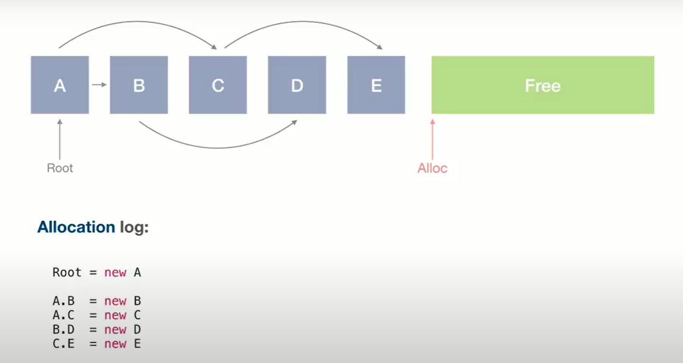
Allocation of Heap
Go, change the world
RV College of
Engineering

Slide 9
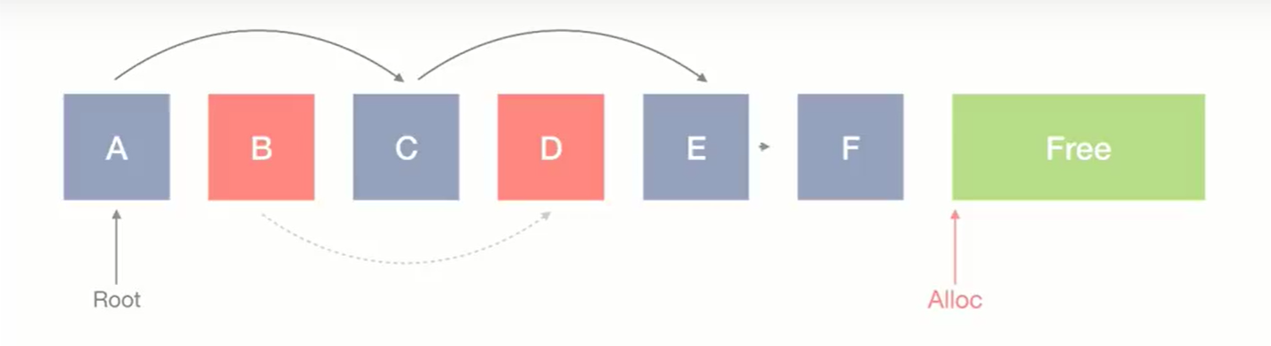

Allocation of Heap
Go, change the world
RV College of
Engineering

Slide 10
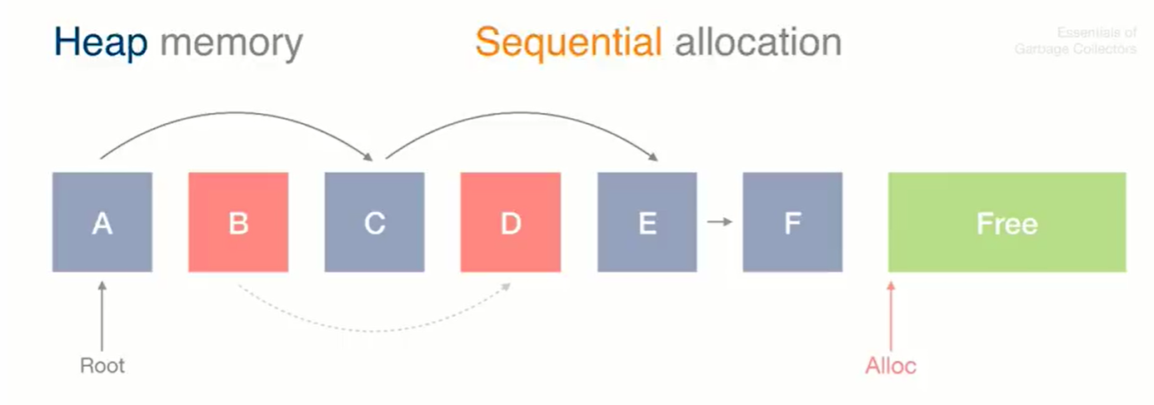
Allocation of Heap
Go, change the world
RV College of
Engineering
Sequential Allocation
The block is allocated newly on the heap sequentially
It is inefficient, as it doesn’t reuse the freed memory blocks
But it is fast with respect to performance and time complexity

Slide 11
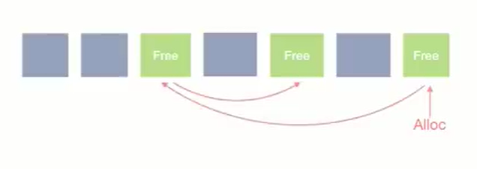
Allocation of Heap
Go, change the world
RV College of
Engineering
Strategy of Searching in Free List Allocation
In free list allocation, we maintain a list-like structure of free blocks
We use first-fit strategy as it is performance efficient
It searches the list, and returns the first freely available block

Slide 12
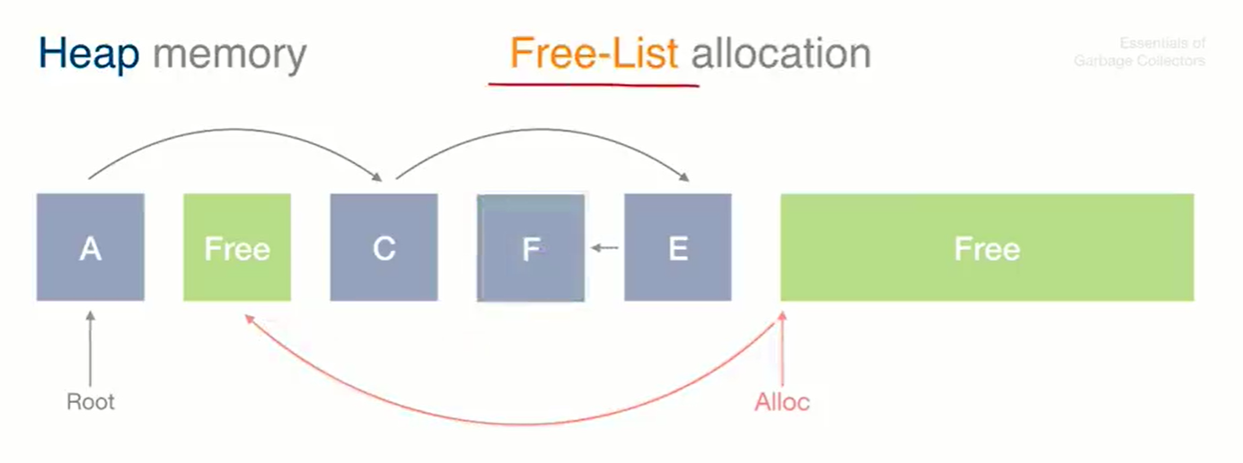
Allocation of Heap
Go, change the world
RV College of
Engineering
Free List Allocation
The freed blocks is searched in a list and allocated if they exist
It is efficient, as it reuse the freed memory blocks
It has performance overhead of searching

Slide 13
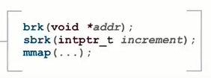
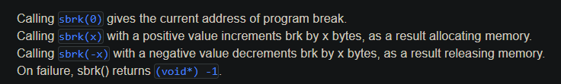
Implementation
Go, change the world
RV College of
Engineering
Memory Allocation on the Heap
Heap grows upward, from lower to upper address. The top of the heap is known as program break (brk)
System Calls to control the Heap

Slide 14
Implementation
Go, change the world
RV College of
Engineering
Implemented the custom dynamic memory allocator in a header file, dynalloc.h
The header file can be included and it provides the following functions user can utilize to allocate memory dynamically
dynalloc(n);
where n is the number of bytes of memory to be allocated and it returns a
pointer to the start of the memory
free(p);
deallocates the memory pointed to by p

Slide 15
Working
Go, change the world
RV College of
Engineering
Demonstrated in the following video

Slide 16
Conclusion
Go, change the world
RV College of
Engineering
Developed a custom memory allocator capable of handling dynamic memory requests.
Implemented alignment, block management, and efficient memory reuse.
Utilized system calls to request and manage memory from the operating system.

Slide 17
Thank You
Go, change the world
RV College of
Engineering

