Slide 1
PID Thermal Control for Heavy-Duty Trucks
Keeping the engine at 90 °C with a feedback controller modelled and simulated in MATLAB
Presented by: Sushanth Bibi (24BME0501), Ganishk Mohanraj (24BME0500), Aromal Kannan (24BMV0048) , Gayatri Korambil (24BME0545)
Course: Control Systems
Department: School Of Mechanical Engineering, VIT Vellore
Project Guide: Dr. Geetha Mani
15th October 2026

Slide 2
1. Problem Statement and Objectives
PROBLEM
OBJECTIVES
System: the coolant temperature of a heavy-duty truck engine, which must stay in a narrow band. [1]
Too hot (above 105 °C): coolant boils, oil breaks down and engine parts are damaged. [3]
Too cold (below 80 °C): thick oil raises friction, so the engine burns more fuel and emits more CO₂. [3]
To control: hold the coolant at about 90 °C despite changes in engine load.
Model the engine cooling system as two transfer functions (fan path and load path), using only published data. [1]–[5]
Design a PID controller, with gains calculated by the SIMC tuning rule, to hold 90 °C. [6]
Simulate the engine load rising from 30 % to 70 % in MATLAB, with and without the PID. [8]
Compare no PID and PID on peak temperature, steady-state offset and settling time.
CONTROL SYSTEMS COURSE PROJECT | PID THERMAL CONTROL FOR HEAVY-DUTY TRUCKS
2

Slide 3
2. Background and Related Work
Today's truck cooling is purely mechanical:
Wax thermostat: opens gradually from 82 to 95 °C, so it acts like a P-only controller. It settles near 84 °C and never reaches 90 °C. [3]
On/off fan clutch: fully on at 96 °C, off at 90 °C. This bang-bang control makes the temperature swing. [2]
Belt-driven pump: follows engine speed, not cooling demand, so it wastes energy when little cooling is needed. [3]
Control concept: a P controller needs an error to produce any output, so it always leaves a steady-state offset. The integral term removes it; the derivative term damps the peak. [7]
This project: replaces the mechanical parts with one PID controller; in the model the PID drives an electric radiator fan (0–4.5 kg/s of air). [2], [3]
Related studies: electronic PID/LQR engine cooling control [3]; radiator and fan sizing for trucks and buses [2]; lumped-mass coolant warm-up model [4].
CONTROL SYSTEMS COURSE PROJECT | PID THERMAL CONTROL FOR HEAVY-DUTY TRUCKS
3

Slide 4
3. System Model and Methodology
SYSTEM MODEL
METHOD
Input / output: fan air flow y (0–4.5 kg/s), engine load L (%) → coolant temperature T_c (°C)
Fan path: G(s) = 38.1 / ((851s + 1)(11.3s + 1)) [1]–[5]
Load path: Gd(s) = 2.0 / (851s + 1) [1], [2]
Plant: T_c = 90 − G(s)·Δy + Gd(s)·ΔL, linearised around 90 °C, 30 % load, y0 = 1.58 kg/s
Source: energy balance C·dT/dt = Q − ε·ṁ·c_p·(T − T_air) [3]; engine [1]; heat, flow and fan [2]; properties [5]
Controller: e = T_c − 90 °C; y = Kp·e + Ki·∫e dt + Kd·de/dt [7]
Tuning: SIMC rule: Kp = 2.48, Ki = 0.044, Kd = 22.4 [6]
Additions: 0.01 s derivative filter; pump fixed at 3.25 kg/s, so the PID drives the fan only [2]
Tools: one MATLAB script: tf, feedback, lsim, pole [8]
Tests: load 30 → 70 %, rising linearly over 60 s; no PID vs PID
Block, coolant and oil are lumped as one mass (C = 720 kJ/K, 851 s lag); the coolant takes 11.3 s to go round the loop. [4]
CONTROL SYSTEMS COURSE PROJECT | PID THERMAL CONTROL FOR HEAVY-DUTY TRUCKS
4

Slide 5
4. Block Diagram / Experimental Setup
A closed loop with negative feedback
Disturbances: engine load,
speed, outside temperature
↓
Set-point
90 °C
+
e
PID
controller
y
Electric fan
air flow 0–4.5 kg/s
u
Engine + cooling
system (the plant)
→
Σ
→
→
→
→
T_c
coolant temp
↑
−
measured by a temperature sensor (feedback)
Error: e = T_c − 90 °C, so a hotter engine gives a positive error and more cooling. [7]
Control action: the PID turns e into the fan air flow y = 1.58 kg/s + PID output (limit 4.5 kg/s). The pump runs at a fixed 3.25 kg/s. [2]
Fig. 1. Closed-loop thermal control of the engine coolant temperature (simulation only, no hardware).
CONTROL SYSTEMS COURSE PROJECT | PID THERMAL CONTROL FOR HEAVY-DUTY TRUCKS
5

Slide 6
5. Experimental / Simulation Setup
Software: MATLAB script (pid_truck_cooling.m). Simulation only; no hardware or sensors were used.
MATLAB: plant and PID built as transfer functions; feedback() closes the loop; pole() confirms all closed-loop poles lie in the left half-plane, so the loop is stable. [7]
Load input: 30 % for 20 s, then rising linearly to 70 % over 60 s; simulated with lsim() for 30 minutes.
Two cases: no PID (load → temperature = Gd) and with PID (Gd / (1 + C·G)); settling = time to stay within ±0.1 K of 90 °C.
Plant numbers: C = 720 kJ/K, ε = 0.533, τc = 851 s, τr = 11.3 s, K_fan = 38.1 K per kg/s, K_load = 2.0 K per %, all calculated in the script from [1], [2], [5].
Gains: Kp = 2.48, Ki = 0.044, Kd = 22.4 (SIMC: Kc = 1.98, τI = 45 s, τD = 11.3 s). [6]
CONTROL SYSTEMS COURSE PROJECT | PID THERMAL CONTROL FOR HEAVY-DUTY TRUCKS
6

Slide 7
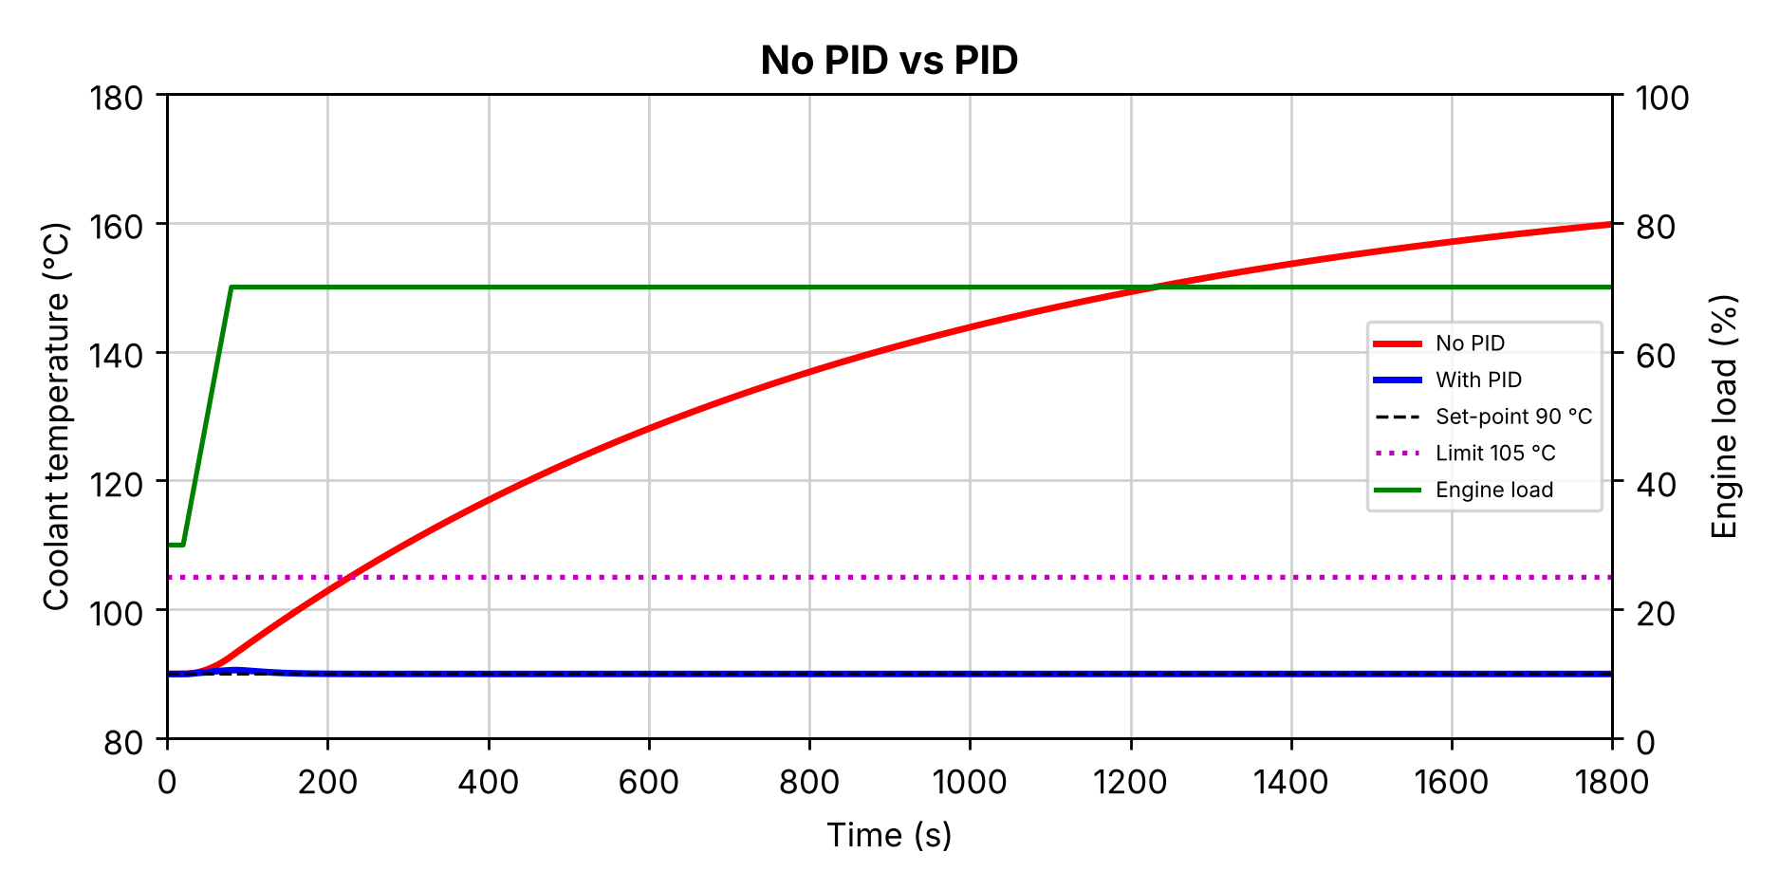
6. Results: No PID vs PID
LOAD 30 → 70 %, 30 MINUTES
EXPLAIN THE RESULT
No PID passes the 105 °C limit after about 4 minutes and reaches 160 °C after 30 minutes.
Why the extra 68 kW of engine heat is not removed; it would only level off at 170 °C.
PID holds the coolant at 90 °C for the whole 30 minutes.
Objective met: the PID keeps the engine well below the 105 °C limit at all times.
Fig. 2. Coolant temperature with no PID and with PID; engine load on the right axis (MATLAB).
CONTROL SYSTEMS COURSE PROJECT | PID THERMAL CONTROL FOR HEAVY-DUTY TRUCKS
7

Slide 8
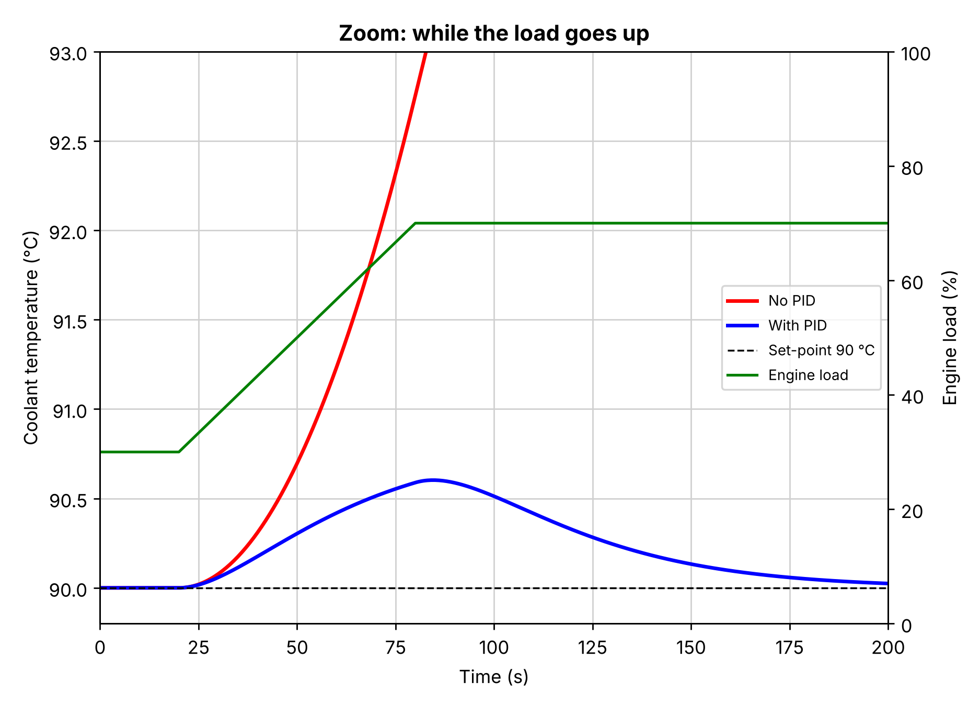
6. Results: Zoom on the Load Rise (cont.)
FIRST 200 SECONDS
EXPLAIN THE RESULT
Test: load rises linearly from 30 to 70 % between 20 s and 80 s, like a truck starting up a hill.
No PID leaves the graph (above 93 °C) at about 85 s and keeps rising.
PID peaks at 90.60 °C at about 85 s, just after the load stops rising.
Recovery: back within 0.1 K of 90 °C at 159 s. The fan rises from 1.58 to 3.7 kg/s (peak 3.96), below its 4.5 kg/s limit.
Fig. 3. Zoom on the first 200 s, while the load rises from 30 to 70 % (MATLAB).
CONTROL SYSTEMS COURSE PROJECT | PID THERMAL CONTROL FOR HEAVY-DUTY TRUCKS
8

Slide 9
7. Performance Comparison and Discussion
Same plant and load: no PID vs PID
Controller | Peak rise | After 30 min | Passes 105 °C | Settling (±0.1 K) | Offset
No PID | 69.8 K | 159.8 °C | after 227 s | never* | 69.8 K
PID | 0.60 K | 90.00 °C | never | 159 s | 0
* No PID never settles: it keeps rising towards 170 °C (90 + 40 × 2.0). Settling: time to stay within ±0.1 K of 90 °C.
The PID removes the offset (0 K vs 69.8 K with no PID) and keeps the peak to 0.60 K. Fan effort: the fan air flow rises from 1.58 to 3.7 kg/s, within its 4.5 kg/s limit. [2]
Limitations: linear one-mass model; data from different published sources (truck engine, bus radiator); 60 s load ramp chosen by us; simulation only.
CONTROL SYSTEMS COURSE PROJECT | PID THERMAL CONTROL FOR HEAVY-DUTY TRUCKS
9

Slide 10
8. Conclusion and Future Work
CONCLUSION
FUTURE WORK
Modelled the cooling system with two transfer functions built only from published data, and tuned the PID with the SIMC rule.
Load 30 → 70 % in 60 s: with the PID the coolant peaks at 90.60 °C and returns to 90 °C with zero offset (within 0.1 K at 159 s).
With no PID the engine passes 105 °C after about 4 minutes and reaches 160 °C after 30 minutes.
Scope: linear model, simulation only, data from published sources.
Add the radiator and oil temperatures and the valve, pump and fan split range to the model.
Validate the model with measurements from a real engine.
Try a predictive controller (MPC) that uses the road ahead to save fan energy.
CONTROL SYSTEMS COURSE PROJECT | PID THERMAL CONTROL FOR HEAVY-DUTY TRUCKS
10

Slide 11
9. MATLAB Program (1/3)
%% PID Temperature Control of a Truck Engine
% How the coolant temperature changes when the engine load goes up,
% first with no controller, then with a PID controller.
% Sushanth Bibi (24BME0501), Ganishk Mohanraj (24BME0500)
%
% Sources
% [1] Volvo Trucks, Fact sheet D13C460 EU5SCR-M, 2010
% [2] G. S. Rosa et al., "Dimensioning procedure of coolant radiators for
% trucks and buses", COBEM 2009
% [3] M. Mohamed et al., "Performance of electronically controlled
% automotive engine cooling system using PID and LQR control
% techniques", IOSR J. Engineering 8(6), 2018, pp. 16-25
% [4] A. Haury, J. Volkering, "Modelisation of the engine coolant
% warming-up behavior", MSc thesis 2011:13, Chalmers
% [5] Engineering ToolBox, specific heat and density tables
% [6] S. Skogestad, "Simple analytic rules for model reduction and PID
% controller tuning", J. Process Control 13 (2003) 291-309
clc;
clear;
close all;
%% Data from the sources
P = 338; % engine power [kW] [1]
m_eng = 1121; % engine dry weight [kg] [1]
V_c = 38; % coolant volume [L] [1]
V_o = 33; % oil volume [L] [1]
cp_fe = 0.46; % cast iron [kJ/kg K] [5]
rho_w = 0.96531; % water at 90 °C [kg/L] [5]
cp_w = 4.2053; % water at 90 °C [kJ/kg K] [5]
rho_o = 0.900; % lubricating oil [kg/L] [5]
cp_o = 1.67; % mineral oil [kJ/kg K] [5]
cp_a = 1.006; % air [kJ/kg K] [5]
beta = 0.5; % heat to coolant / engine power (0.45-0.55) [2]
m_w = 3.25; % coolant flow [kg/s] [2]
T_w = 100; % radiator rating: water in [°C] [2]
T_a = 30; % radiator rating: air in [°C] [2]
% Fan air flow = where system curve meets fan curve, Fig. 6 of [2]:
% system: 25.105x^2 + 76.084x - 3.7131, fan: -1.9147x^2 - 457.51x + 2945
mf_max = max(roots([25.105+1.9147, 76.084+457.51, -3.7131-2945])); % = 4.50 kg/s
%% Transfer function numbers from the energy balance [3]
% Block + coolant + oil as one mass [4]:
% C_th*dT/dt = Q_engine - eff*m_fan*cp_a*(T - T_a)
CONTROL SYSTEMS COURSE PROJECT | PID THERMAL CONTROL FOR HEAVY-DUTY TRUCKS
11

Slide 12
9. MATLAB Program (2/3)
C_th = m_eng*cp_fe + V_c*rho_w*cp_w + V_o*rho_o*cp_o; % heat capacity [kJ/K]
eff = beta*P/(mf_max*cp_a*(T_w - T_a)); % radiator effectiveness
H = beta*P*0.30/(90 - T_a); % heat removed per K at 90 °C, 30 % load [kW/K]
tau_c = C_th/H; % engine time constant [s]
tau_r = V_c*rho_w/m_w; % coolant loop time [s]
K_fan = eff*cp_a*(90 - T_a)/H; % K per kg/s of fan air
K_load = beta*P/100/H; % K per % load
%% Plant
% Fan path: fan air flow [kg/s] -> coolant temperature [K]
num = K_fan; % = 38.1
den = conv([tau_c 1],[tau_r 1]); % (851s+1)(11.3s+1)
G = tf(num, den)
% Load path: engine load [%] -> coolant temperature [K]
numd = K_load; % = 2.0
dend = [tau_c 1]; % (851s+1)
Gd = tf(numd, dend)
%% PID controller (SIMC tuning rule [6])
Kc = tau_c/(K_fan*tau_r);
tauI = min(tau_c, 4*tau_r);
tauD = tau_r;
Kp = Kc*(1 + tauD/tauI) % = 2.48
Ki = Kp/(tauI + tauD) % = 0.044
Kd = Kp*tauI*tauD/(tauI + tauD) % = 22.4
C = tf(Kp, 1) + tf(Ki, [1 0]) + tf([Kd 0], [0.01 1]); % Kp + Ki/s + Kd*s
%% Engine load: 30 % for 20 s, then rises linearly to 70 % over 60 s
t = (0:0.5:1800)'; % 30 minutes
t_ramp = 60; % time for the load to rise [s]
dL = 40*min(max(t - 20, 0)/t_ramp, 1); % change in load from 30 % [%]
load_pct = 30 + dL; % engine load [%]
% Without PID: load -> temperature = Gd
T_noPID = lsim(Gd, dL, t);
% With PID: load -> temperature = Gd / (1 + C*G)
D = Gd * feedback(1, C*G);
T_PID = lsim(D, dL, t);
%% Figure 1: 30 minutes
figure;
yyaxis left;
CONTROL SYSTEMS COURSE PROJECT | PID THERMAL CONTROL FOR HEAVY-DUTY TRUCKS
12

Slide 13
9. MATLAB Program (3/3)
plot(t, 90 + T_noPID, 'r-', t, 90 + T_PID, 'b-', 'LineWidth', 2);
hold on;
plot(t, 90*ones(size(t)), 'k--', t, 105*ones(size(t)), 'm:');
ylabel('Coolant temperature (°C)');
ylim([80 180]);
yyaxis right;
plot(t, load_pct, 'g-', 'LineWidth', 1.5);
ylabel('Engine load (%)');
ylim([0 100]);
grid on;
xlim([0 1800]);
title('No PID vs PID');
xlabel('Time (s)');
legend('No PID', 'With PID', 'Set-point 90 °C', 'Limit 105 °C', 'Engine load', 'Location', 'east');
%% Figure 2: zoom on the load increase
figure;
yyaxis left;
plot(t, 90 + T_noPID, 'r-', t, 90 + T_PID, 'b-', 'LineWidth', 2.5);
hold on;
plot(t, 90*ones(size(t)), 'k--');
ylabel('Coolant temperature (°C)');
ylim([89.8 93]);
yyaxis right;
plot(t, load_pct, 'g-', 'LineWidth', 1.5);
ylabel('Engine load (%)');
ylim([0 100]);
grid on;
xlim([0 200]);
title('Zoom: while the load goes up');
xlabel('Time (s)');
legend('No PID', 'With PID', 'Set-point 90 °C', 'Engine load', 'Location', 'east');
%% Results
disp(['No PID: temperature after 30 min = ', num2str(90 + T_noPID(end), '%5.1f'), ' °C']);
disp(['With PID: highest temperature = ', num2str(90 + max(T_PID), '%5.2f'), ' °C']);
disp(['With PID: temperature after 30 min = ', num2str(90 + T_PID(end), '%5.2f'), ' °C']);
poles = pole(feedback(C*G, 1)) % all negative real parts -> stable
% Inference:
% Without a PID, the extra load keeps heating the engine: it passes the
% 105 °C limit after about 4 minutes and keeps rising. With the PID, the
% temperature rises by only 0.6 °C while the load goes up, and is back at
% exactly 90 °C about 80 s after the load stops rising.
CONTROL SYSTEMS COURSE PROJECT | PID THERMAL CONTROL FOR HEAVY-DUTY TRUCKS
13

Slide 14
10. References and Acknowledgment
REFERENCES
ACKNOWLEDGMENT
[1] Volvo Trucks, “Fact sheet D13C460 EU5SCR-M,” 2010.
[2] G. S. Rosa et al., “Dimensioning procedure of coolant radiators for trucks and buses,” COBEM, 2009.
[3] M. Mohamed et al., “Performance of electronically controlled automotive engine cooling system using PID and LQR control techniques,” IOSR J. Engineering, vol. 8, no. 6, pp. 16–25, 2018.
[4] A. Haury and J. Volkering, “Modelisation of the engine coolant warming-up behavior,” MSc thesis 2011:13, Chalmers.
[5] Engineering ToolBox, property tables (specific heat, density).
[6] S. Skogestad, “Simple analytic rules for model reduction and PID controller tuning,” J. Process Control, vol. 13, pp. 291–309, 2003.
[7] N. S. Nise, Control Systems Engineering.
[8] MathWorks, MATLAB Control System Toolbox documentation (tf, feedback, lsim, pole).
[Project guide : The authors acknowledge the guidance provided by Dr. Geetha M.
Code: pid_truck_cooling.m (MATLAB), listed in full in Section 9.
Questions?
CONTROL SYSTEMS COURSE PROJECT | PID THERMAL CONTROL FOR HEAVY-DUTY TRUCKS
14

