Slide 1
PID Thermal Control for
Heavy-Duty Trucks
CONTROL SYSTEMS
Keeping the engine at 90 °C with a feedback controller
modelled and simulated in MATLAB & Simulink
Sushanth Bibi
Ganishk Mohanraj
24BME0501
24BME0500
Notes:
Introduce the team and the topic. One line: "Our project is about controlling the temperature of a heavy-duty truck engine. We modelled the engine's cooling system in MATLAB and Simulink and designed a PID controller that keeps the engine at 90 °C, then compared it with the cooling system trucks use today."

Slide 2
An engine has to stay in a narrow temperature band
THE PROBLEM
Too hot
Just right
Too cold
above 105 °C
about 90 °C
below 80 °C
Coolant boils, the oil breaks down, engine parts get damaged.
Thin oil, low friction, good efficiency. This is our set-point.
Thick oil, more friction, so the engine burns more fuel and emits more CO₂.
PID Thermal Control for Heavy-Duty Trucks · 2
Notes:
The cooling system's job is to keep the engine in a narrow band. Too hot and the engine is damaged. Too cold and the oil is thick, friction rises and the truck burns more fuel. The sweet spot is about 90 °C, and that is the set-point our controller will hold. The question is: how well does today's cooling system hold it, and can a PID controller do better?

Slide 3

The conventional cooling system is purely mechanical
TODAY'S TRUCKS
Wax thermostat
On/off fan clutch
Belt-driven pump
Opens gradually from 82 to 95 °C. It acts like a P-only controller, so it settles near 84 °C and never reaches 90 °C.
Switches fully on at 96 °C and off at 90 °C. This bang-bang control makes the temperature swing.
Spins with the engine, not with the cooling demand, so it wastes energy when little cooling is needed.
Our goal: replace this with one PID controller that drives an electric valve, pump and fan.
PID Thermal Control for Heavy-Duty Trucks · 3
Notes:
Today's system has three mechanical parts. The wax thermostat opens in proportion to temperature, which makes it a proportional-only controller, and a P controller always leaves a steady-state offset: it settles around 84 °C instead of 90. The fan clutch is on/off, which causes temperature swings. The pump is belt-driven and just follows engine speed. Our goal is to replace all three with electric actuators driven by one PID controller.

Slide 4
Four steps from physics to results
METHOD
1
2
3
4
Model
Design
Simulate
Compare
Energy balance simplified to two transfer functions
PID with filter, output limit and anti-windup
Set-point and load steps in MATLAB, same loop in Simulink
P only vs PI vs PID: offset, peak and settling time
PID Thermal Control for Heavy-Duty Trucks · 4
Notes:
Our method has four steps. First, model the cooling system: we start from the energy balance and simplify it to two transfer functions, one for the cooling command and one for the engine load. Second, design a PID controller with a derivative filter, an output limit and anti-windup. Third, simulate two classic tests in MATLAB, a set-point step and a load step, and build the same loop in Simulink. Fourth, compare P only, PI and PID using offset, peak and settling time.

Slide 5



A closed loop with negative feedback
THE SYSTEM
Disturbances: engine load, speed, outside temperature
Set-point
+
e
PID
y
Split range
u
Engine + cooling
T_c
Σ
90 °C
controller
valve · pump · fan
system (the plant)
coolant temp
−
measured by a temperature sensor (feedback)
PID Thermal Control for Heavy-Duty Trucks · 5
Notes:
This is the whole control system. We measure the coolant temperature T_c and subtract it from the 90 °C set-point at the summing junction. That gives the error e. The PID turns the error into one output y. The split-range block turns y into three actuator commands u: valve, pump and fan. These act on the engine and cooling system, which we call the plant. Disturbances such as engine load and outside temperature also act on the plant, and we cannot control them. The sensor feeds T_c back, closing the loop. This is negative feedback: if the engine gets hotter, the controller cools harder.

Slide 6
One temperature is enough for a simple model
THE STATES
T_c
T_r
T_o
Engine coolant
Radiator
Engine oil
How hot the engine is. The variable we control: target 90 °C, limit 105 °C.
Not a separate state. Modelled as a 4.7 s lag between the cooling command and the engine.
Left out of the simple model. It changes too slowly to matter for the PID.
Heat path: engine → coolant (T_c) → radiator (T_r) → outside air. The engine block adds a 509 s lag. In the code the only output is T_c.
PID Thermal Control for Heavy-Duty Trucks · 6
Notes:
A real cooling system has three temperatures: the engine coolant T_c, the radiator coolant T_r and the oil T_o. To keep the model simple we only keep T_c, the one we control. The radiator becomes a short lag of 4.7 seconds: that is roughly the time the coolant spends inside the radiator. The engine block is a large mass of iron and coolant, so it gives a long lag of about 509 seconds, roughly 8.5 minutes. The oil is left out because it changes slowly and does not change how we design the PID.

Slide 7
Two transfer functions describe the plant
THE PLANT MODEL
G(s) = 78.2 / ((509s + 1)(4.7s + 1))
Cooling path: one more unit of cooling command lowers T_c by 78 K, through the radiator and engine lags
Gd(s) = 2.17 / (509s + 1)
Load path: 1 % more engine load raises T_c by 2.17 K, through the engine lag only
T_c = 90 − G(s)·Δy + Gd(s)·ΔL
Linearised around 90 °C, 30 % load and 25 °C air, where the cooling command is y0 = 0.83
τ = heat capacity ÷ heat removal rate · K = heat input ÷ heat removal rate · all inputs on slide 15
PID Thermal Control for Heavy-Duty Trucks · 7
Notes:
Starting from the energy balance, heat in minus heat out, we linearise around the normal operating point: 90 °C, 30 % engine load and 25 °C outside air. Every number comes from published data. The engine and its coolant have a heat capacity of about 352 kJ per kelvin, from the Volvo D13 mass and coolant volume and textbook specific heats. At 30 % load the engine puts 45 kW into the coolant, so to hold 90 °C with 25 °C air the cooling must remove 45 kW over 65 K, which is 0.69 kW per kelvin. The time constant is heat capacity divided by that, 352 / 0.69 = 509 seconds. The radiator lag is its heat capacity divided by the coolant flow, about 4.7 seconds. The gains come the same way: 1 % load is 1.5 kW, divided by 0.69 gives 2.17 K. G(s) is the cooling path and Gd(s) the load path, written in MATLAB with num, den, conv and tf.

Slide 8
The PID law
THE CONTROLLER
e = T_c − 90 °C
y = Kp·e + Ki·∫e dt + Kd·de/dt
P · proportional
I · integral
D · derivative
Reacts to the present error. Fast, but on its own leaves an offset.
Adds up past error. Removes the steady-state offset.
Reacts to how fast the error changes. Damps the peak.
PID Thermal Control for Heavy-Duty Trucks · 8
Notes:
The error is the coolant temperature minus 90 °C. We use T_c minus T_ref, not the other way round, because our actuators remove heat: hotter means a positive error, which means more cooling. The PID output is the sum of three terms. P is proportional to the present error. It reacts fast, but a P controller always leaves an offset, because it needs some error to produce any output. I integrates past error, so it keeps pushing until the error is exactly zero; that removes the offset. D looks at how fast the error is changing, so it acts early and damps the peak. In the MATLAB code the PID is built by adding three transfer functions: Kp, Ki over s, and Kd s over 10 s plus 1.

Slide 9
Three additions make it work on a real system
THE CONTROLLER
Split range
Anti-windup
Derivative filter
One output y (0–3) for three actuators. The model only limits y to 0–3:
When the actuators are already at their limit, the integral stops adding up. Without it, I grows huge and the temperature overshoots.
A 1 s low-pass filter on the D term, so sensor noise is not amplified.
y | actuator
0 → 1 | valve opens
1 → 2 | pump speeds up
2 → 3 | fan runs
SIMC gains
Kp = 0.34
Ki = 0.0041
Kd = 1.52
N = 1
PID Thermal Control for Heavy-Duty Trucks · 9
Notes:
A textbook PID needs three additions on a real system. First, split range: one PID output from 0 to 3 is shared across three actuators in order of energy cost: valve, then pump, then fan. In our simple model we only keep the total command inside 0 to 3. In the load-step test the command goes from 0.83 to about 2.2, so the pump is fully on and the fan just starts. Second, anti-windup: when the output is at its limit, the integral stops adding up; in Simulink this is the clamping option of the PID block. Third, a 1-second low-pass filter on the derivative so sensor noise does not make the actuators jitter; in Simulink that is the filter coefficient N = 1. The gains were not guessed: they come from the SIMC tuning rule by Skogestad, 2003. For our plant it gives Kp = engine time constant divided by plant gain times the chosen closed-loop time of 20 seconds, the integral time is 4 times 20 = 80 seconds, and the derivative time equals the radiator lag. Converted to parallel form that is Kp 0.34, Ki 0.0041 and Kd 1.52.

Slide 10
The MATLAB code, section by section
IMPLEMENTATION
Section | What it does
Physical data | Engine, coolant and material data, plus stated assumptions
Derived constants | τ = C / H and gains K; PID gains from the SIMC rule
Transfer functions | G(s) and Gd(s) with num, den, conv and tf
Controllers | P, PI and PID built as transfer functions
Closed loop + poles | feedback() for set-point and load; pole() checks stability
Experiment 1 | Set-point step 90 → 95 °C with step() and stepinfo()
Experiment 2 | Load step 30 → 80 %: peak, offset and settling time
PID Thermal Control for Heavy-Duty Trucks · 10
Notes:
All the MATLAB code is in one file, pid_truck_cooling.m, split into sections. The first section lists the physical data with its source, and the assumptions we had to make. The next section calculates the time constants and gains from that data, and then the PID gains with the SIMC rule, so no number is typed in by hand. Then the plant transfer functions are defined with num, den and tf, and the three controllers P, PI and PID. feedback() closes the loop, and pole() prints the closed-loop poles: all of them are in the left half of the s-plane, so all three loops are stable. Experiment 1 is a set-point step analysed with step() and stepinfo(). Experiment 2 is a load step, where we find the settling time by walking backwards from the end of the response, the same method as in the time-domain lab.

Slide 11
The same loop, built in Simulink
IMPLEMENTATION
Block | Role
Step → Set-point | 90 °C, steps to 95 °C at 1200 s
Sum (+ −) | Error e = T_c − T_ref
PID Controller | P 0.344, I 0.0041, D 1.52, N 1; limits −0.83 to 2.17; clamping
Transfer Fcn G(s) | Cooling path: −78.2 / (2383s² + 513.8s + 1)
Step → Transfer Fcn Gd(s) | Load +50 % at 600 s through 2.17 / (509s + 1)
Constant + Sum (+ + +) | T_c = 90 + cooling effect + load effect
Bias | Cooling command y = 0.83 + PID output
Mux → Scope | T_c with the set-point, and the cooling command
Solver ode4, fixed step 0.1 s, 30-minute run · built by hand
PID Thermal Control for Heavy-Duty Trucks · 11
Notes:
We built the same loop by hand in Simulink. The Step block gives the set-point, 90 °C, stepping to 95 °C at 1200 seconds. The Sum block subtracts the set-point from the coolant temperature to get the error. The PID Controller block has the same gains as the MATLAB code, a filter coefficient of 1, output limits and clamping anti-windup. The limits are minus 0.83 and 2.17 because the block outputs the change from the normal command of 0.83, so the real command stays between 0 and 3. The cooling transfer function has a minus sign because more cooling lowers the temperature. A second Step adds 50 % engine load at 600 seconds through Gd(s). The plant output is 90 plus the two effects, and it is fed back to the error block. The Scope shows the temperature and the cooling command. [Add a screenshot of the model and the Scope here.]

Slide 12
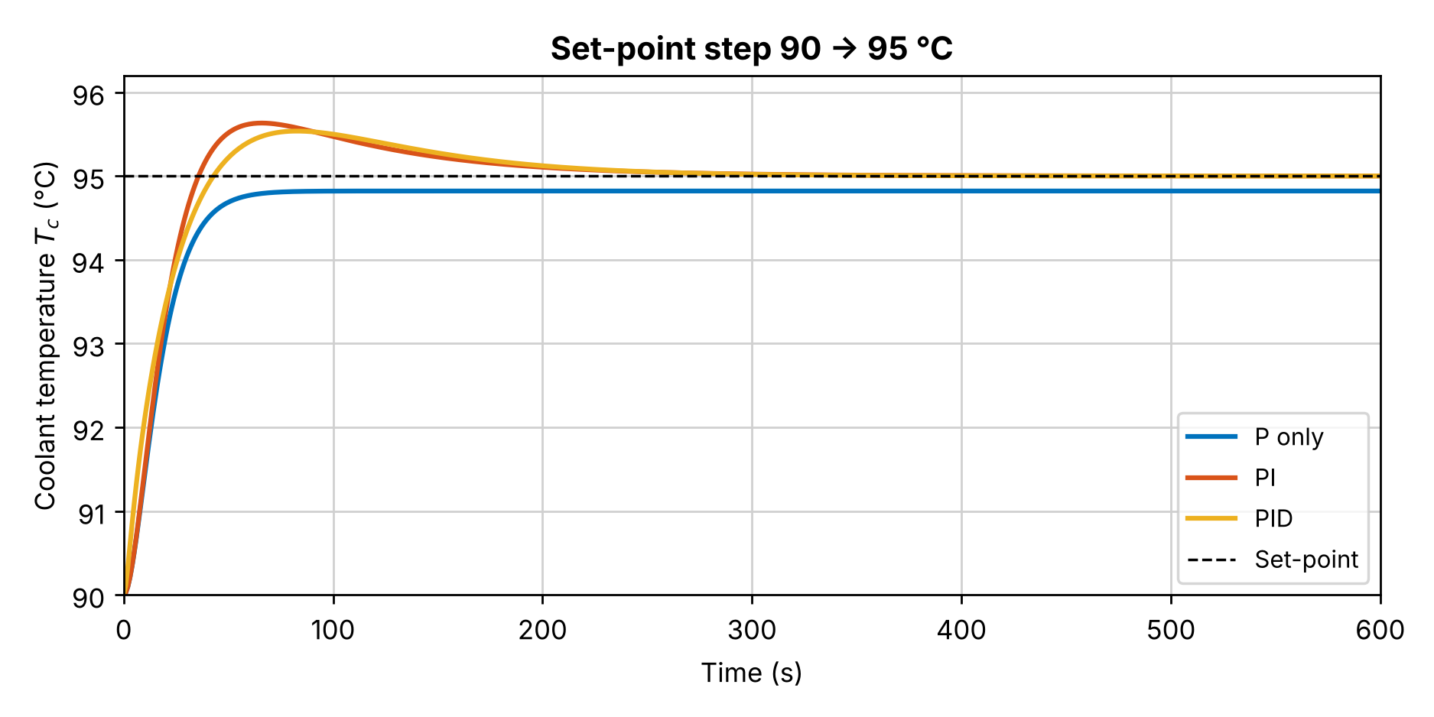
The temperature follows a new set-point
EXPERIMENT 1 · SET-POINT 90 → 95 °C
Tracking
PID reaches 95 °C with 10.7 % overshoot and settles in about 212 s.
P only
Stops at 94.8 °C, a 0.2 K offset. PI and PID remove it.
PID Thermal Control for Heavy-Duty Trucks · 12
Notes:
First test: we change the target from 90 to 95 °C and compare P only, PI and PID, using step() and stepinfo() in MATLAB. P only never quite reaches 95: it stops at about 94.8 °C, a small steady-state offset of 0.2 K, because it needs an error to produce any output. The offset is small here because the plant gain is large. PI removes the offset with 12.6 % overshoot. The full PID removes the offset and lowers the overshoot to 10.7 %, settling within 2 % in about 212 seconds. The closed-loop poles printed by pole() all have negative real parts, so all three loops are stable.

Slide 13
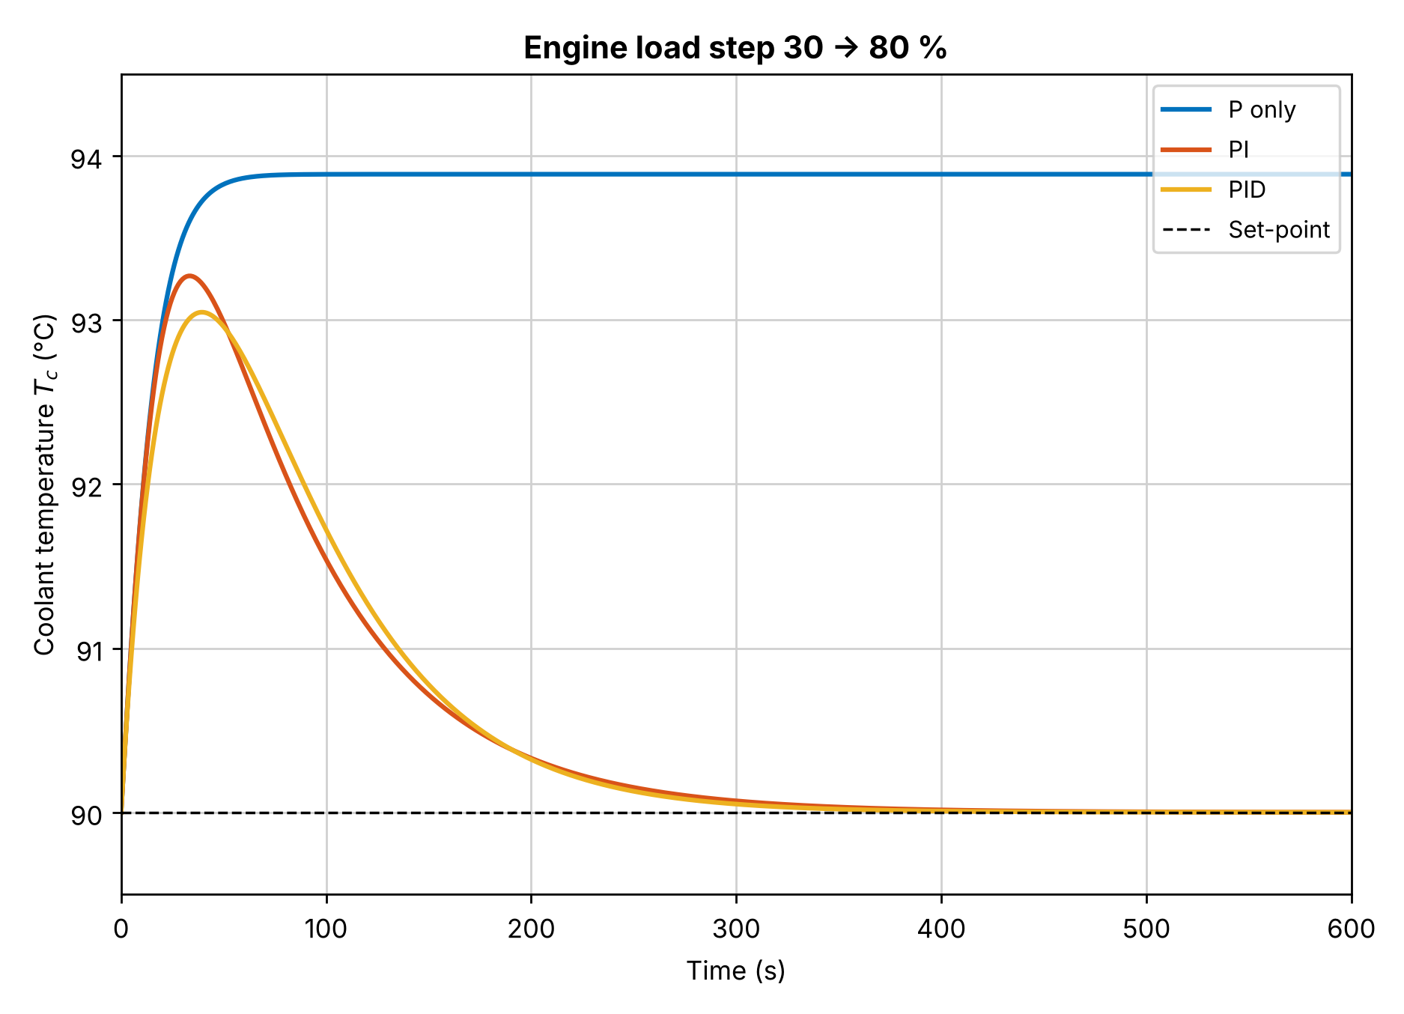
I removes the offset, D trims the peak
EXPERIMENT 2 · LOAD STEP 30 % → 80 %
Ctrl | Peak | Settle | Offset
P only | 3.9 K | 27 s | 3.9 K
PI | 3.3 K | 173 s | 0
PID | 3.0 K | 175 s | 0
P alone needs an error to produce output, so it settles 4 K too hot. Adding I brings it back to exactly 90 °C. Adding D cuts the peak by about 7 %.
PID Thermal Control for Heavy-Duty Trucks · 13
Notes:
Second test, the one that matters most for a truck. At time zero the engine load jumps from 30 to 80 percent, as if the truck hits a hill. That adds 75 kW of heat to the coolant. P only settles about 3.9 degrees too hot and stays there: that is the steady-state offset, exactly as theory predicts, and it is also why today's wax thermostat, which is a mechanical P controller, never reaches its target. Adding the integral term brings the temperature back to exactly 90 °C in about three minutes. Adding the derivative term lowers the peak from 3.3 to 3.0 K. Settling time here is the time to stay within ±0.5 K. The benefit of D is small because thermal systems are slow and smooth, which is why many industrial temperature loops use PI only. During this test the PID raises the cooling command from 0.83 to about 2.2, still below the limit of 3.

Slide 14



What we learned
CONCLUSIONS
What worked
Limitations
Next step
PID holds 90 °C with zero offset. P only, like today's wax thermostat, stays 4 K too hot. D cuts the peak by about 7 %.
Linear model with one temperature: no oil, no separate valve, pump and fan. Some inputs are assumed (slide 15).
Add the radiator and oil temperatures, validate with engine data, then try a predictive controller (MPC) that uses the road ahead to save fan energy.
PID Thermal Control for Heavy-Duty Trucks · 14
Notes:
To conclude: the PID holds the engine at 90 °C with no steady-state offset. A P-only controller, which is how today's wax thermostat behaves, stays about 4 degrees too hot after a load step, and adding D cuts the temperature peak by about 7 %. The limitations: our model is linear and keeps only the coolant temperature, so it has no oil temperature and does not model the valve, pump and fan separately. Most inputs come from published data, but a few are assumptions, listed on the next slide. The next steps are adding the radiator and oil temperatures, validating the model against real engine data, and then trying a predictive controller, MPC, which uses the road ahead to plan cooling.

Slide 15
Where the numbers come from
DATA SOURCES
Value | Source
338 kW, 1121 kg, 38 L coolant | Volvo D13C460 engine fact sheet
150 kW to coolant (105 °C, 45 °C air) | Worsztynowicz (2017), heavy-duty cooling modules
c_p: coolant 3.5, iron 0.46, Al 0.91 kJ/kg·K | Engineering ToolBox property tables
150 kW ≈ 18 % of fuel energy | Heywood, ICE Fundamentals: 17–26 % (cross-check)
Kp, Ki, Kd | SIMC tuning rule, Skogestad (2003)
50 % mass, 26 L, 30 kg, 250 L/min, 25 °C | Our assumptions
τc 509 s, τr 4.7 s, K 78.2 and 2.17 | Calculated in pid_truck_cooling.m
PID Thermal Control for Heavy-Duty Trucks · 15

Slide 16
Thank you
Questions?
Notes:
Likely questions. Where do the numbers come from? The engine data is from the Volvo D13 fact sheet, the heat rejection from a heavy-duty cooling paper, the material properties from standard tables, and the PID gains from the SIMC rule; the few assumptions are listed on slide 15. Why is D so small? Thermal systems are slow and smooth, so D adds little, which is why many temperature loops use PI. Why only one temperature? A simple linear model is enough to show what P, I and D each do; the full model is our next step. Is the model validated? Not against real engine data yet. Why e = T_c minus T_ref? Our actuators remove heat, so hotter must give a positive output. Why does a P controller leave an offset? It needs a non-zero error to produce a non-zero output; the integral removes it.

