Slide 1
CO₂ Emission Rating by Vehicles Using Machine Learning
Mini Project
K. Sushanth(N210274)
S.Sowmya Nageswari (N210154)
CO₂ Emission Rating by Vehicles

Slide 2
Topics / Outline
Problem Statement & Objectives Literature Survey
Workflow Diagram
Techniques and Methods (overview)
Methodology Algorithms
Visualization
Results & Tables
References
CO₂ Emission Rating by Vehicles

Slide 3
Problem Statement & Objectives
Project Domain : Predictive Modelling and Environmental
Data Analytics
Problem Statement : To develop a machine learning-based model that can accurately predict the CO2 emission of vehicles using various performance parameters like engine size , fuel type ,cylinders and identify whether a vehicle exceeds environmental emission standards for CO2.
Need For Selecting :
1. Rising environmental Pollution
2. Manual Testing is slow and Inefficient
3. Need for automated prediction using ML
4. Lack of Existing Accurate ML Solutions
CO₂ Emission Rating by Vehicles

Slide 4
Literature Survey (I)
S .No | Name Of Paper | Year | Algorithms used | Limiatations
1. | Predicting CO2 Emission Levels Using ML Techniques | 2021 | SVM, Linear Regression, Random Forest | Lower accuracy with linear models ,poor generalization across different vehicles, Model struggle with complex relationships.
2. | Vehicle Fuel Consumption and Emission Prediction Using XGBoost | 2020 | XGBoost, Gradient Boosting | Requires large datasets, sensitive to tuning, very complex to interpret boosted trees.
3 | Fuel Consumption and CO₂ Estimation Using Regression Models | 2018 | Multiple Linear Regression, Polynomial Regression | Poor performance on nonlinear data ,lower accuracy compared to ensemble methods , Polynomial regression can overfit .
CO₂ Emission Rating by Vehicles

Slide 5
Literature Survey (II)
 | Name of Paper | Year | Algorithms used | Limitations
4. | CO₂ Emission Rating by Vehicles Using Data Science (IEEE INOCON) | 2023 | Random Forest, AdaBoost, XGBoost | limited sample size , deployment challenges , no deep-learning comparison.
5. | A Machine Learning Framework for Automobile Emission Classification | 2019 | Decision Trees, Random Forest, KNN | KNN struggles with high-dimensional data , overfitting in decision trees , no deployment or real-time system proposed.
CO₂ Emission Rating by Vehicles

Slide 6
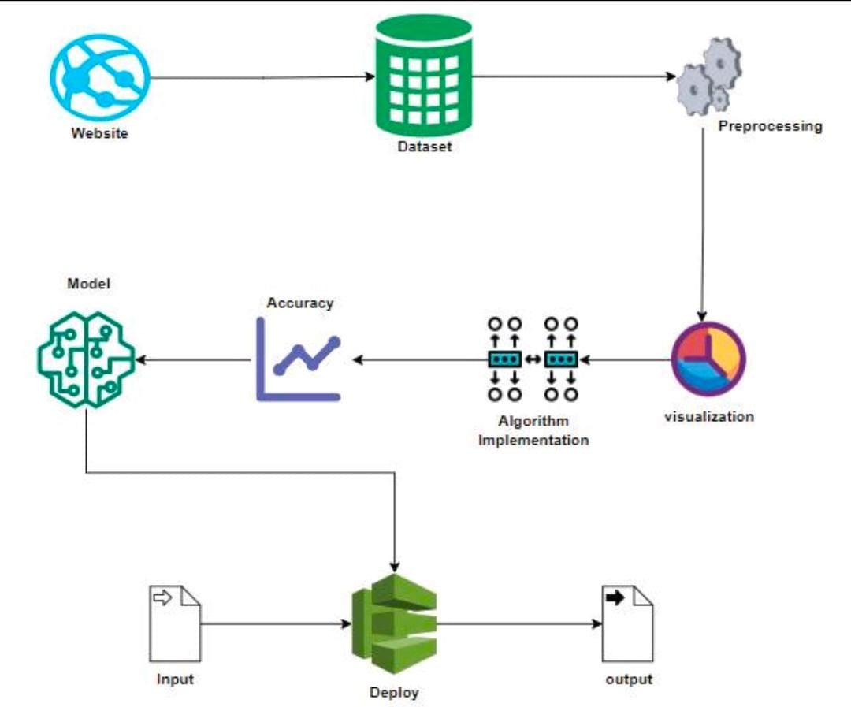
Work Flow Diagram
CO₂ Emission Rating by Vehicles

Slide 7
Techniques & Methods (Overview)
Data Collection : Collected Canada dataset from kaggale having 7380
vehicles records with 10 parameters like engine size ,cylinders ,fuel
type ,fuel consumption..etc.
Data Cleaning : Handling duplicate rows ,Removing unnecessary
attributes that do not affect emission predictions ,Handling missing
values.
Encoding Categorical Features : Categorical attributes such as
Fuel Type ,Transmission or any non-numeric attributes.
Exploratory Data Analysis(EDA) :Visualize the data to analyze the
patterns using scatter plot ,Box Plot and correlation matrix.
Train-Test Splitting : Dataset was divided into 80% Training data
and 20% Testing data .
Converting CO2 Emissions into Class labels : We Converted CO2 g/km
into categories as Low ,Medium ,High Emissions.
CO₂ Emission Rating by Vehicles

Slide 8
AdaBoost
AdaBoost builds several weak decision trees, each learning a small portion of the CO₂ emission pattern.
After each tree is trained, wrongly predicted vehicles are given higher weight, so the next tree focuses on harder samples.
New trees are added one after another, each correcting the errors of previous ones.
The final CO₂ rating is produced by a weighted vote of all the weak learners.
This approach improves accuracy and handles non-linear relationships between features like engine size, fuel type and fuel consumption.
CO₂ Emission Rating by Vehicles

Slide 9
Random Forest
Random Forest creates multiple decision trees using different subsets of the vehicle data and features
(engine size, cylinders, fuel type, etc.).
Each tree independently predicts the CO₂ emission rating for a vehicle.
The model then takes the majority vote or average of all trees to give the final prediction.
Using many trees reduces overfitting and improves stability compared to a single decision tree.
It captures complex relationships between features, giving high accuracy for CO₂ emission prediction.
CO₂ Emission Rating by Vehicles

Slide 10
XGBoost
XGBoost builds trees one after another, where each new tree
learns from the errors of the previous trees.
It uses gradient boosting and advanced regularization to
reduce overfitting.
The algorithm handles complex feature relationships
(engine size, cylinders, fuel consumption) very effectively.
It is extremely fast and accurate because of optimized tree
building and parallel processing.
In this project, XGBoost gives high accuracy for predicting
CO₂ emission ratings.
CO₂ Emission Rating by Vehicles

Slide 11
Voting Classifier
A Voting Classifier combines predictions from multiple models
like Random Forest, AdaBoost, and XGBoost.
Each model gives its own CO₂ rating, and the final output is
decided by a majority vote.
This method reduces the weakness of any single model and
improves overall stability.
It gives more reliable predictions by using collective
decision-making of all algorithms.
In this project, the voting ensemble increases robustness and
ensures consistent accuracy.
CO₂ Emission Rating by Vehicles

Slide 12
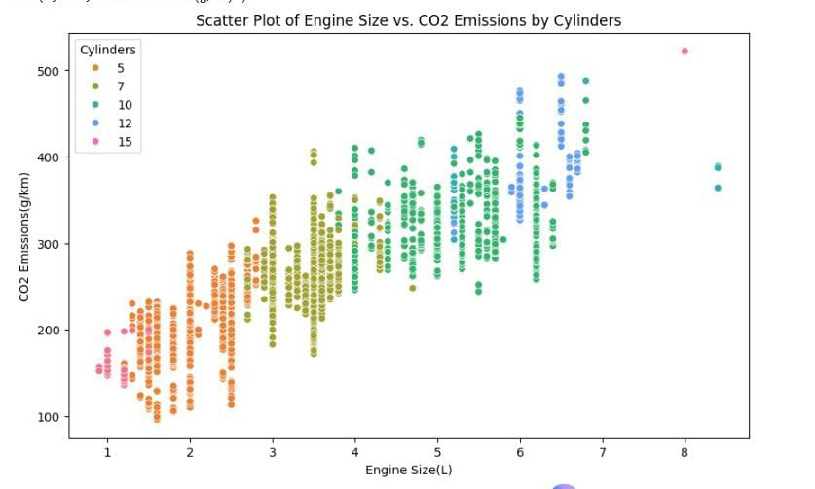
Scatter Plot
CO₂ Emission Rating by Vehicles

Slide 13
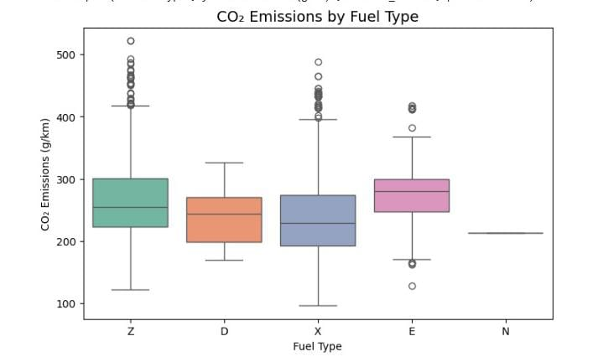
Box Plot
CO₂ Emission Rating by Vehicles

Slide 14
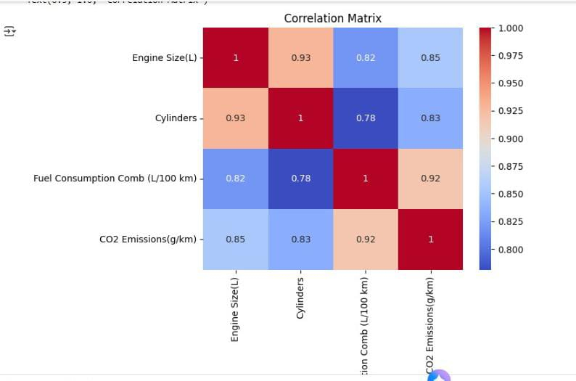
Correlation Matrix
CO₂ Emission Rating by Vehicles

Slide 15
Results: Evaluation Metrics
Table : Results of our Dataset
Model | Accuracy | Precision | Recall | F1-score
AdaBoost | 0.945 | 0.946 | 0.945 | 0.945
Random Forest | 0.977 | 0.977 | 0.977 | 0.977
XGBoost | 0.982 | 0.982 | 0.982 | 0.982
Voting Classifier | 0.979 | 0.979 | 0.979 | 0.979
CO₂ Emission Rating by Vehicles

Slide 16
XGBoost Classifier
The XGBoost model achieved 98% classification accuracy.
The model maintains consistent accuracy across all classes,
confirmed by the macro and weighted averages of 0.98.
This proves that XGBoost is the best-performing algorithm among those we tested.
CO₂ Emission Rating by Vehicles

Slide 17
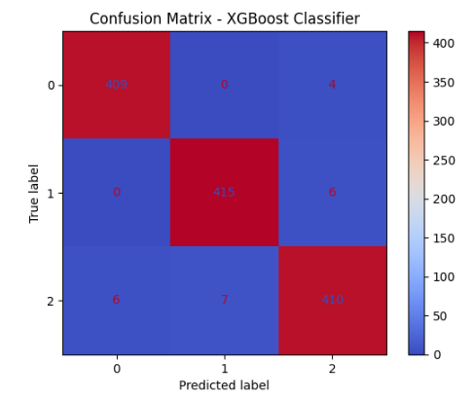
Confusion Matrix – XGBoost Classifier
CO₂ Emission Rating by Vehicles

Slide 18
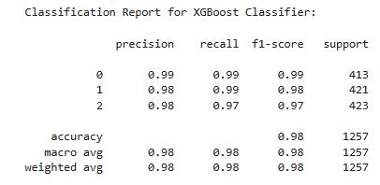
Confusion Matrix – XGBoost Classifier
CO₂ Emission Rating by Vehicles

Slide 19
References
Anitha Julian et al., “CO₂ Emission Rating by Vehicles Using Data Science,” IEEE INOCON 2023.
“CO2 Emissions Dataset (Canada) "- in kaggale
A Machine Learning Framework for Automobile Emission Classification.(2019)
Predicting CO2 Emission Levels Using ML Techniques.(2021)
CO₂ Emission Rating by Vehicles

