Slide 1

Python 3
These notes are CC BY 4.0
Notes:
See also https://web.stanford.edu/class/stats101/intro/intro-lecture01.pdf for inspiration
Useful: https://arxiv.org/pdf/1503.05570.pdf
A Data Science Course for Undergraduates: Thinking With Data by Ben Baumer, The American Statistician Vol. 69 , Issue. 4
Timing in Fall 2018:
Slide 35 at minute 45
Bowling demo started at minute 63
Finished in 2 hours, 25 minutes

Slide 2
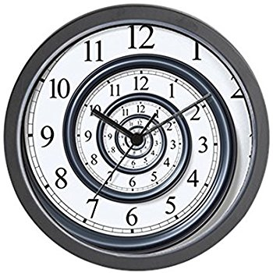
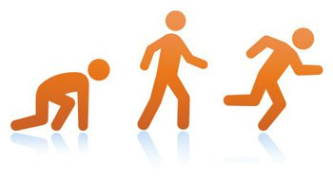
I won't be able to teach you all of Python
Notes:
http://www.padtinc.com/blog/the-focus/a-guide-to-crawling-walking-and-running-with-ansys-structural-analysis

Slide 3
Resources for learning Python
Online
Text – blue underscored text is hyperlinked in this presentation
https://nealcaren.github.io/python-tutorials/
Videos on Coursera
Books: see PDFs posted on Blackboard
Your instructor
Caveat: I'm not a programmer.
https://brohrer.github.io/imposter_syndrome.html
Linked from https://www.kdnuggets.com/2017/09/data-science-imposter-syndrome.html

Slide 4

Diversity of Software in Data Science
Diversity of Software in Data Science
Use of Python
EDA using Jupyter + Pandas
Visualization of data
Tips from the Trenches
Homework

Slide 5
Survey of "standard" software for Data Science
(not comprehensive)
Hive
MapReduce
Pig
JavaScript
Java
Orange
Rapid Miner
SAS
Enterprise Miner
JMP
Online services, ie from Azure, AWS, Google Compute
Matlab
Python
R
bash
Tensor Flow
Jupyter
Julia
Spark
SQL
Excel
PowerBI and other plugins
Tableau

Slide 6

Simplify by focusing on just Python
Since 1991
Python 3 is 10 years old!
Notes:
https://tinybuddha.com/blog/4-tiny-powerful-tips-reduce-stress-anxiety/

Slide 7
Survey of "standard" Python packages for Data Science
(not comprehensive)
Dask
Scikit-learn
Numpy
Scipy
Pandas
Matplotlib
Python Imaging Library (PIL)
NLTK
Beautifulsoup
Statsmodels
Seaborn
PyTorch
Keras
Theano
Gensim
Plotly
Bokeh
PySpark
Scrapy
Optional challenge: How many Python packages are there total?
Yes, this question is ill-defined. I'm happy to iterate with you after class
Notes:
The page https://pypi.org/ has a counter of projects – currently 166,000

Slide 8
Jargon alert!
Script = a file with extension .py containing Python code.
Application, aka Analytic, aka program = recipe of instructions
Library = generic term for code that was designed with the aim of being usable by many applications.
Module = a file with extension .py containing function definitions which can be referenced by other scripts. Use import to load these functions.
Package = a collection of modules.
All packages are modules, but not all modules are packages.
Overloading terms is common.
If you are confused during the semester, raise your hand during class or see me after class or submit an anonymous question
Notes:
https://docs.python.org/3/tutorial/modules.html
https://stackoverflow.com/questions/19198166/whats-the-difference-between-a-module-and-a-library-in-python
https://knowpapa.com/modpaclib-py/
https://www.aceable.com/blog/traffic-lights/

Slide 9
Python package management
Two package managers: conda and pip
Conda is equivalent to pip+virtualenv in terms of capability.
Difference: conda is used for package management outside Python;
pip is only for Python
For this class I'll advocate for using the simplicity of conda
Notes:
https://stackoverflow.com/questions/20994716/what-is-the-difference-between-pip-and-conda

Slide 10

Virtues of a Data Scientist
Using libraries
enables laziness.
see http://blog.teamtreehouse.com/the-programmers-virtues
Notes:
https://www.infoworld.com/article/3122803/application-development/the-power-of-lazy-programming.html

Slide 11
Use of Python
Building up from basics: the terminal
Diversity of Software in Data Science
Use of Python
EDA using Jupyter + Pandas
Tips from the Trenches
Homework

Slide 12

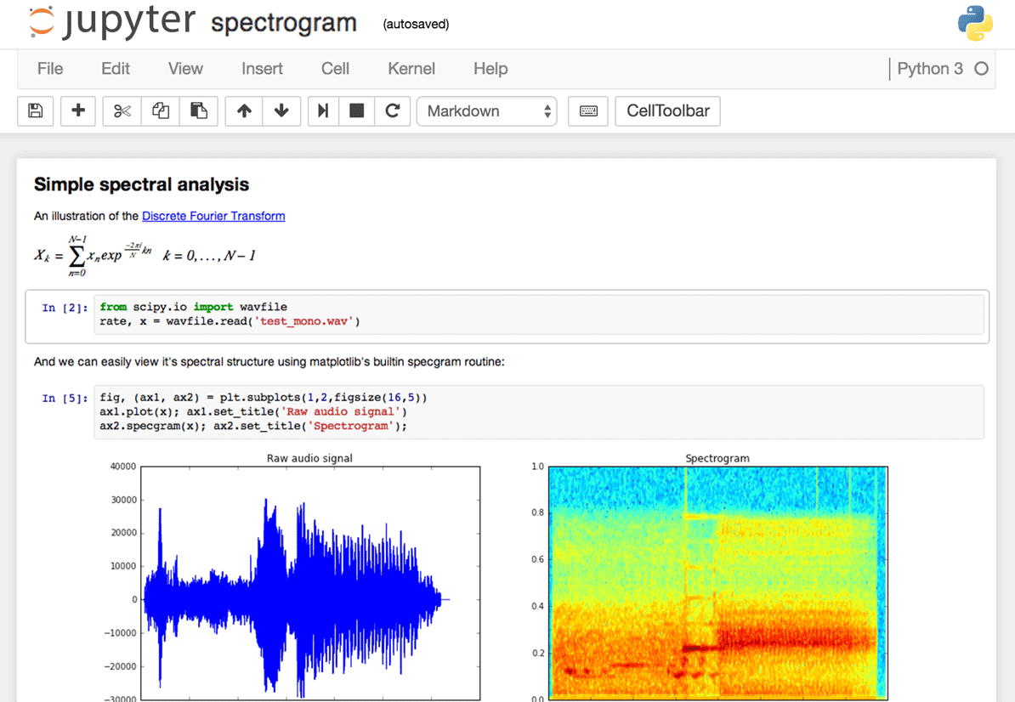
How to interact with Python
REPL: interactive command prompt
Scripts: files with .py extension
Text editors with syntax highlighting
IDEs like PyCharm with autocompletion
Jupyter Notebook (via web browser)

Slide 13
Shown in Python3
Returns expected results, ie 5, 5+4, x = 5+4, x == 9, x == 10, 'hello'
Lists:
mylist = [4, 5, 6, 'hello', 5, 2]
Accessing an element: mylist[0]
len(mylist)
mylist[12]
No warning when over-writing: mylist[0] = [3, 5, 9]

Slide 14
Shown in Python3
Dictionaries:
mydict = {'four':'three'}
mydict['four']
mydict = {'k': 'v'}
mydict['four']
mydict[0]
len(mydict)
mydict = {'this key': 'a value', 'another key': 'another value'};
mydict = {4:3, 5:4, 4:2}
mydict = { 'a': 5, 'b':[3,5]}
mydict = {[3, 4]:2, 4:3}
mydict = { 'a':{4:2, 'b':9}, 6: 3}

Slide 15
Generic Computing Language Essentials
Variable assignment
Control statements (if, else)
Loops (while, for)
Sets
Functions

Slide 16
Python functions bundle code
def myfunc(input):
# transform input to value
return value
If a line of code is a sentence,
then a function is a paragraph
Demo: show Python3

Slide 17
Shown in Python3
a = 5
def my_func(input):
a = 6
print(a)
return
my_func('hello')
print(a)

Slide 18
Activity: Pair programming exercise
Find a partner who you have not yet collaborated with

Slide 19
Activity: Pair programming exercise
Find a partner who you have not yet collaborated with
Determine who is the less experienced programmer
The less experienced person creates a .py file that prints "hello"
Or, if both of you are not challenged by this,
create a .py file that prints all palindromic numbers with 7 digits (see this page)
Run the script using the Python in Jupyter
Notes:
https://en.wiktionary.org/wiki/aibohphobia

Slide 20
Quiz on Python data structures
Given a list,
my_list = ['a', 'b', 'c', 'd']
What would the command
len(my_list)
return?

Slide 21
Quiz on Python data structures
Given a list,
my_list = ['a', 'b', 'c', 'd']
What would the command
len(my_list)
return?
1 2 3 4
4
Len = length of list

Slide 22
Quiz on Python data structures
Given a list,
my_list = ['a', 'b', 'c', 'd']
What would the command
my_list[1]
return?

Slide 23
Quiz on Python data structures
Given a list,
my_list = ['a', 'b', 'c', 'd']
What would the command
my_list[1]
return?
0 1 2 3
b
Python indexes from 0

Slide 24
EDA using Jupyter + Pandas
Diversity of Software in Data Science
Use of Python
EDA using Jupyter + Pandas
Visualization of data
Tips from the Trenches
Homework

Slide 25
Jupyter for more than just learning and small scale analysis
Analyze video to detect 60 million faces
http://willcrichton.net/notes/rapid-prototyping-data-science-jupyter/
How Netflix uses Jupyter notebooks
https://medium.com/netflix-techblog/notebook-innovation-591ee3221233

Slide 26


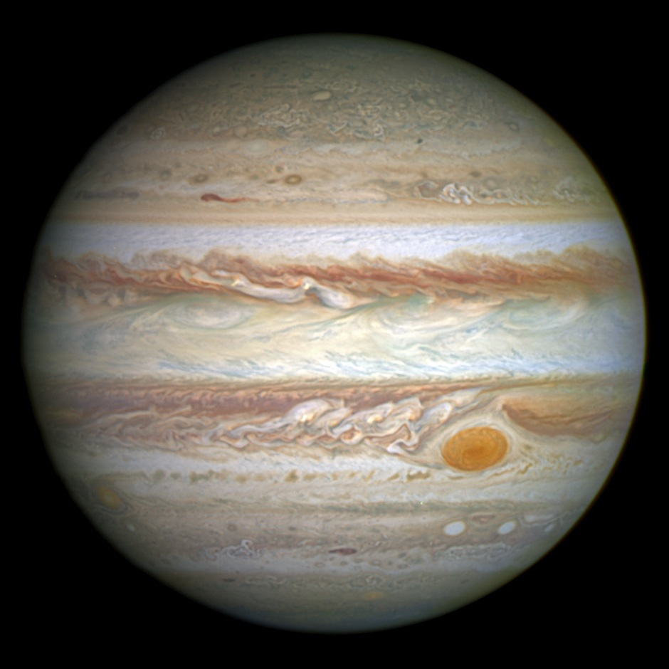
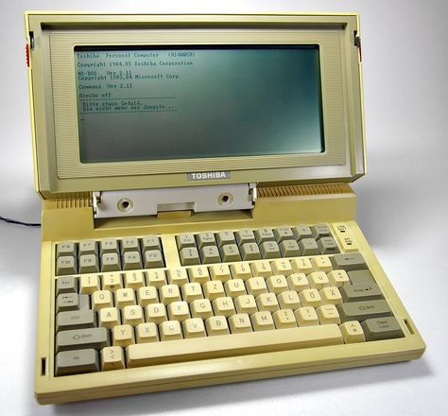
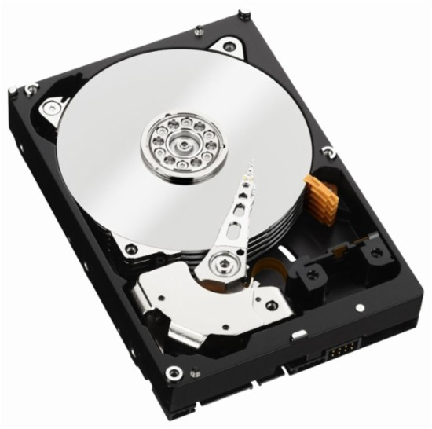
Pandas
A module for Python
Widely used in Data Science
Series
DataFrames for tables
Similar to data.frame in R
Uses NumPy
Many tutorials and documentation
Fancy operations like
Map, apply
Notes:
https://pandas.pydata.org/pandas-docs/stable/
https://upload.wikimedia.org/wikipedia/commons/2/2b/Jupiter_and_its_shrunken_Great_Red_Spot.jpg

Slide 27
Visualization of data
Diversity of Software in Data Science
Use of Python
EDA using Jupyter + Pandas
Visualization of data
Tips from the Trenches
Homework

Slide 28
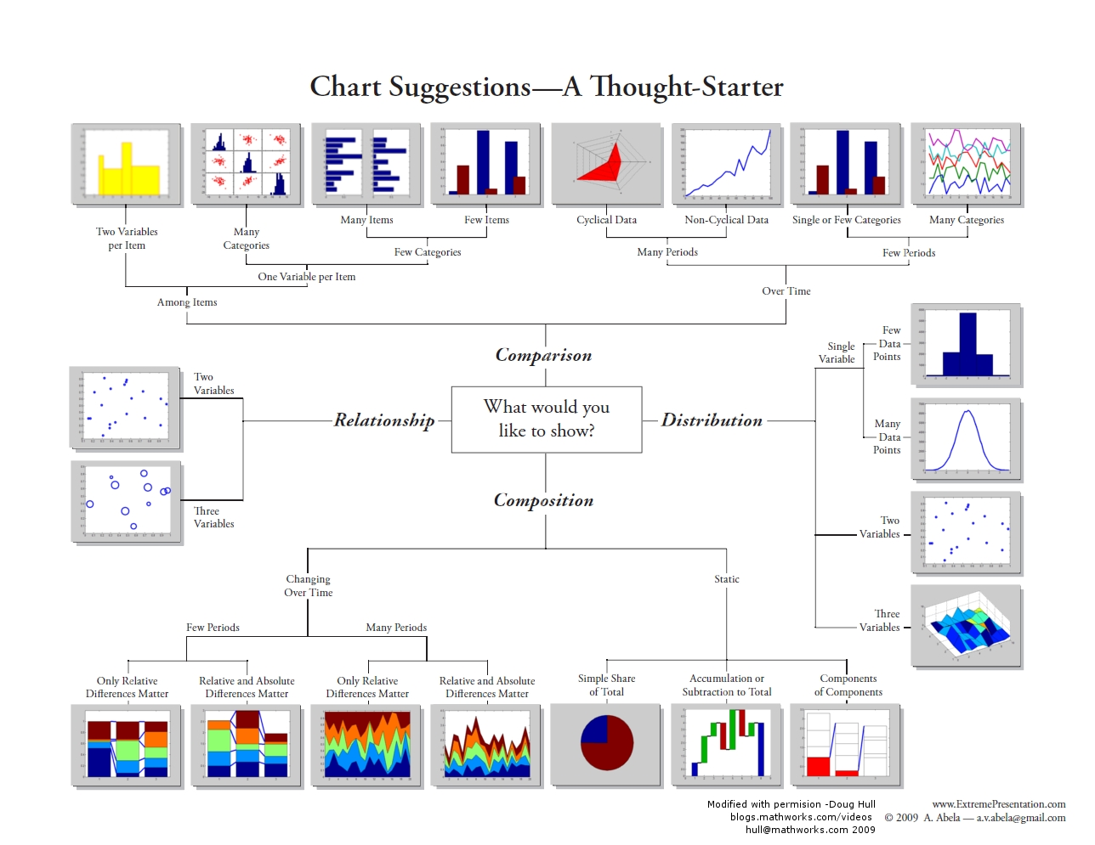
https://blogs.mathworks.com/videos/2012/04/26/choosing-a-visualization-in-matlab/

Slide 29
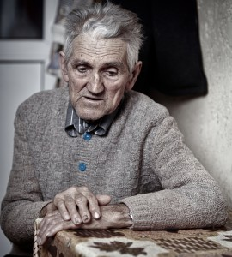
Data visualization may be useful, but it's old and no longer evolving

Slide 30
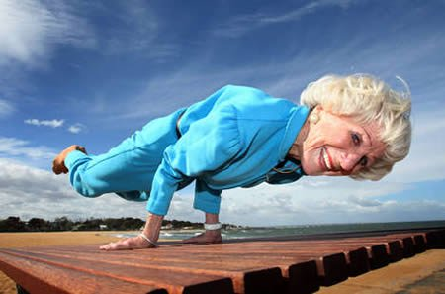
Data visualization may be useful, but it's old and no longer evolving
WRONG

Slide 31
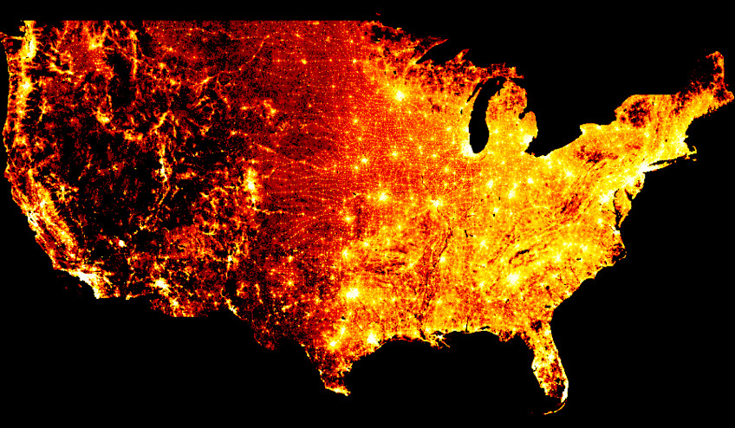
Visualization of data is advancing in multiple domains
Large-Scale data:
http://datashader.org/
Grammar of graphics
https://vega.github.io/vega/
https://altair-viz.github.io/
Interactivity
https://holoviews.org/
300 million points of data (one per person in the USA) from the 2010 census
See https://www.youtube.com/watch?v=ms29ZPUKxbU
See https://www.youtube.com/watch?v=0jhUivliNSo
Notes:
http://datashader.org/topics/strange_attractors.html
https://anaconda.org/jbednar/census/notebook

Slide 32
Visualization of data is advancing in multiple domains
Large-Scale data:
http://datashader.org/
Grammar of graphics
https://vega.github.io/vega/
https://altair-viz.github.io/
Interactivity enables EDA
https://holoviews.org/
See https://www.youtube.com/watch?v=ms29ZPUKxbU
See https://www.youtube.com/watch?v=0jhUivliNSo

Slide 33
Start with the basics
Matplotlib - open source Python visualization similar to Matlab
To get started, find what you're interested in the gallery
Seaborn - built on top of matplotlib and closely integrated with pandas data structures.
tutorial

Slide 34
Homework
Building up from basics: the terminal
Diversity of Software in Data Science
Use of Python
EDA using Jupyter + Pandas
Tips from the Trenches
Homework

Slide 35
Homework for Week 2, assignments 1 and 2
Assignment: Write a function that returns the count of characters and words in a string. The string is provided to the function as an argument. Submit a .ipynb file via Blackboard.
Assignment: Write a function that takes a list as the argument and returns a list with each element shifted right by one index.
For example, [3, 7, 4, 1] becomes [1, 3, 7, 4]
Submit a .ipynb file via Blackboard.
https://www.hackerrank.com/challenges/
Next week: code review

Slide 36
Homework for Week 2, assignment 3
Assignment: Download data in CSV format from one of the following sites: here or here. Load the data into a Pandas dataframe. Use Pandas to count the number of rows of data and number of columns. Your selection of a CSV should have at least 2 columns and at least 10 rows. Include a link to the data source in the Juptyer notebook you submit.
Next week: code review

Slide 37
Not enough homework?
Challenges abound:
https://www.hackerrank.com/challenges/
https://codesignal.com/interview-practice/
https://www.codewars.com/

Slide 38
For the first assignment,
Breakdown each Homework assignment, Part 1 of 2
"Write a function that returns the count of letters and words in a string. The string is provided to the function as an argument. Submit a .ipynb file via Blackboard."
Draw or write down what you're starting with
Draw or write down what the outcome should look like

Slide 39
For the first assignment,
Design your approach to solving problem
"Write a function that returns the count of letters and words in a string. The string is provided to the function as an argument. Submit a .ipynb file via Blackboard."
On a piece of paper, write down actions you'll need to take
Determine the dependencies among the actions you need to take
In what order should the steps be?
If you have time before leaving, take the listed actions using your computer

Slide 40
For the second assignment,
Breakdown each Homework assignment, Part 1 of 2
"Write a function that takes a list as the argument and returns a list with each element shifted right by one index.
For example, [3, 7, 4, 1] becomes [1, 3, 7, 4]"
Draw or write down what you're starting with
Draw or write down what the outcome should look like

Slide 41
For the second assignment,
Design your approach to solving problem
"Write a function that takes a list as the argument and returns a list with each element shifted right by one index.
For example, [3, 7, 4, 1] becomes [1, 3, 7, 4]"
On a piece of paper, write down actions you'll need to take
Determine the dependencies among the actions you need to take
In what order should the steps be?
If you have time before leaving, take the listed actions using your computer

Slide 42
End of class
Questions?
Comments?

