Slide 1


PLEDGE TO PROGRESS Sustainability Hackathon
Sponsored By
Project Title : AGRICULTURAL RTC (Reaping-Taking-Collecting)
Your Team Name : BLOOMING BUDS
Your Team Bio : K. Sushanth, II B.Tech ECE
Pitla Vikas , II B.Tech ECE
S. Sowmya , II B.Tech ECE
Safoora Begam , II B.Tech ECE
S. Sai Shiva , II B.Tech ECE
College Name: B V RAJU INSTITUTE OF TECHNOLOGY, TELANGANA
Date : 24/04/2023

Slide 2
Introduction
Agriculture is backbone of our country. India is currently the world’s third largest producer of agricultural raw materials.[1]
Annual production of onions in India ranked #2, 22.83% of total world onion production. Cultivated over 1,220,000 hectares.[2]
Harvesting underground crops such as onion, turmeric, carrot and so on it is time consuming and it completely needs a lot of manpower
As technology developed different machines were invented. Farmers are currently using separate machines for reaping and removing the crop from the ground
Now we have come up with a new idea to cut the leaves and pick the onion from the ground

Slide 3
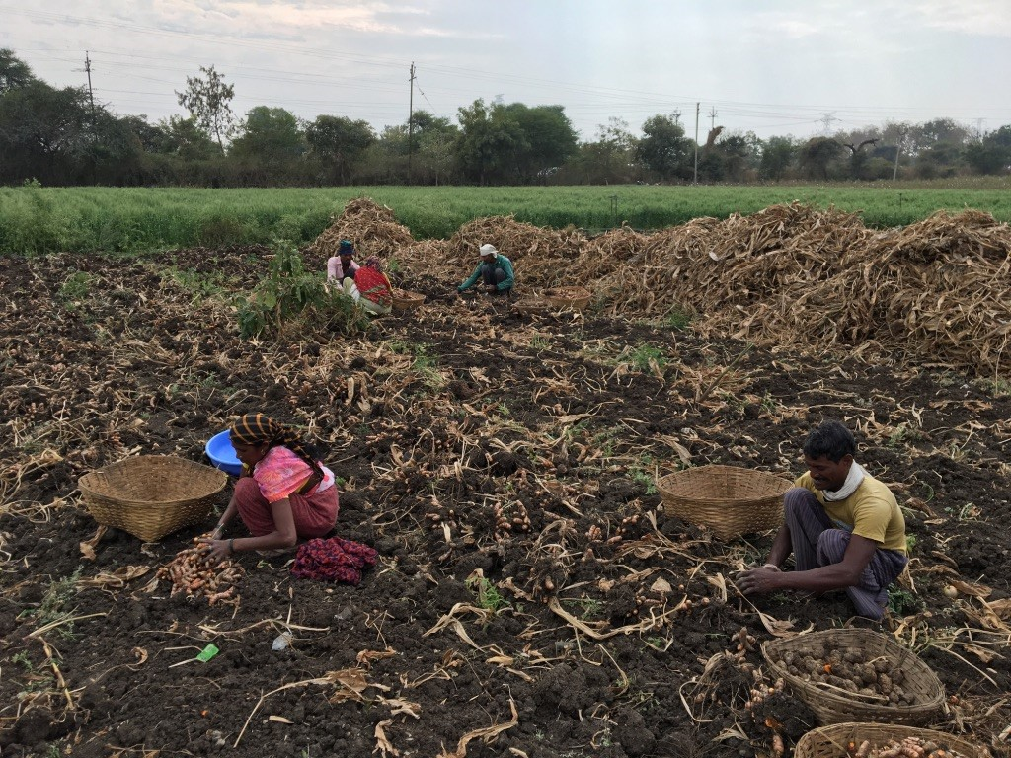
Problem Statement?
Lack of labor in Farming
Collecting picked crops requires
○More time
○ Huge manpower
To address this issue, a robotic system is
needed to efficiently harvest crops like onions
while minimizing crop waste

Slide 4
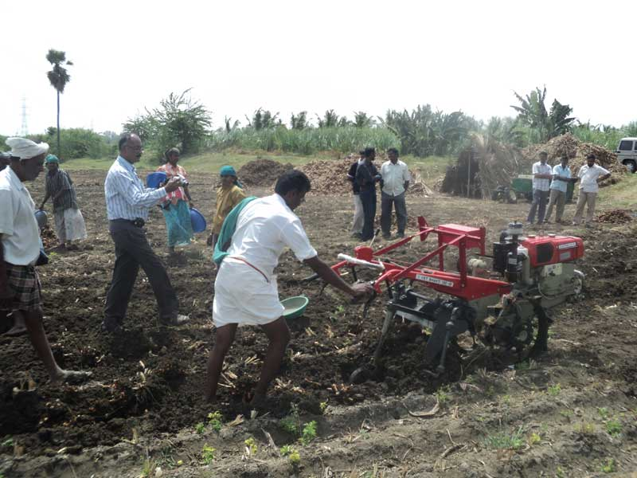
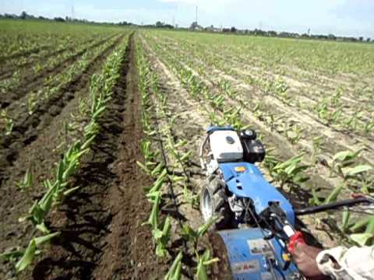
Wastage of crops when the harvesting is done manually
Using separate machines
Takes more time
Expensive
Consumes more fuel
Notes:
There is a lack of labor in farming.

Slide 5
User Segment & Pain Points
User Segments
Farmers who cultivate onions in medium and large-scale production
Agricultural companies which provide solutions in onion farming
Food processing companies that use onions as a raw material in their products
Geographic segments in onion cultivation in India :
• Maharashtra ( 507.0 Hectare)
• Madhya Pradesh( 150.87 Hectare)
• Gujarat (22.49 Hectare) [3]

Slide 6
Pain Points:
Labour shortage and high labor costs
Crop damage during harvesting
Operational efficiency
Time complexity
Supply chain disruptions

Slide 7
Competitors
There are many competitive machine available in the market such as
Onion Harvester
Onion Loader
Pull Type Onion Harvester
Self Propelled Green Topping Onion Harvester
Keulmac onion harvester
The limitations of competitive machinery :
High Cost of running, environmental pollution.
Our designed prototype can overcome the limitations of competitive machines .

Slide 8
SOLUTION
To Design an Robotic System to cut the leaves and pick the onion from the ground, so that
There is no wastage of crop since it picks deep from the ground
Fuel Free Machine
Cost can be reduced by the use of a single machine
Mud can be detached from the crop by sieving process using the same machine
Cloud technology is used to estimate the yield of crop

Slide 9

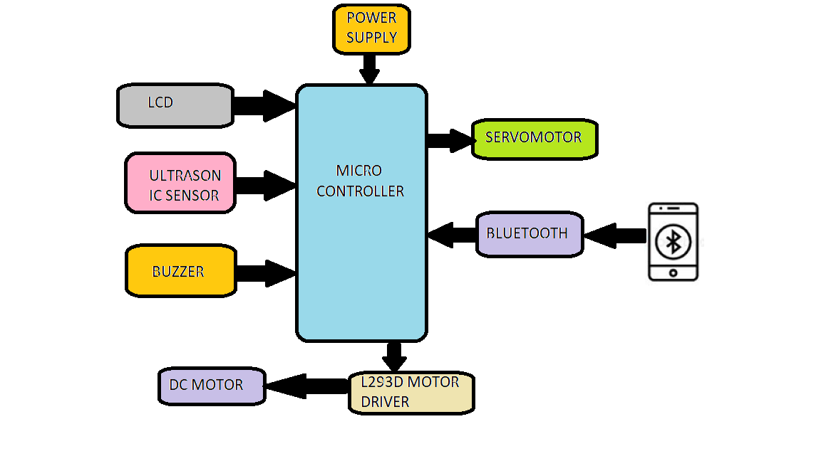
BLOCK DIAGRAM
.

Slide 10
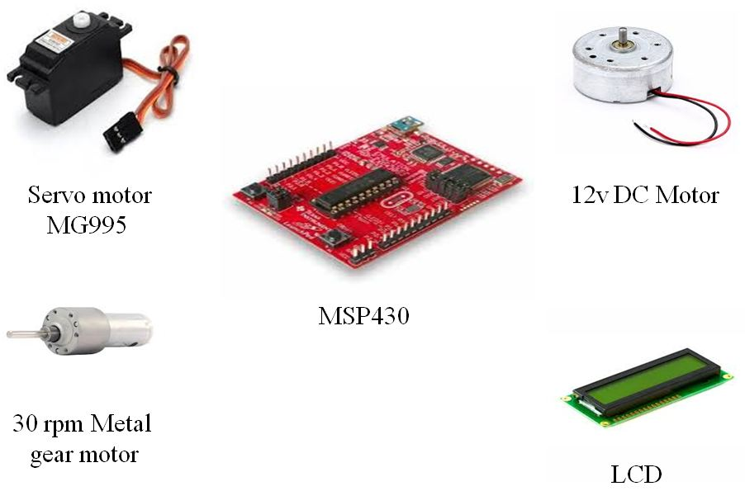
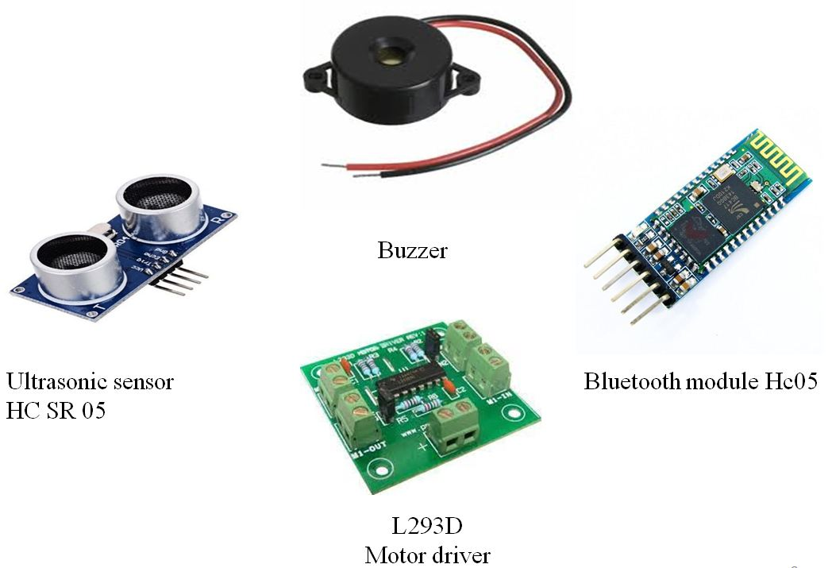
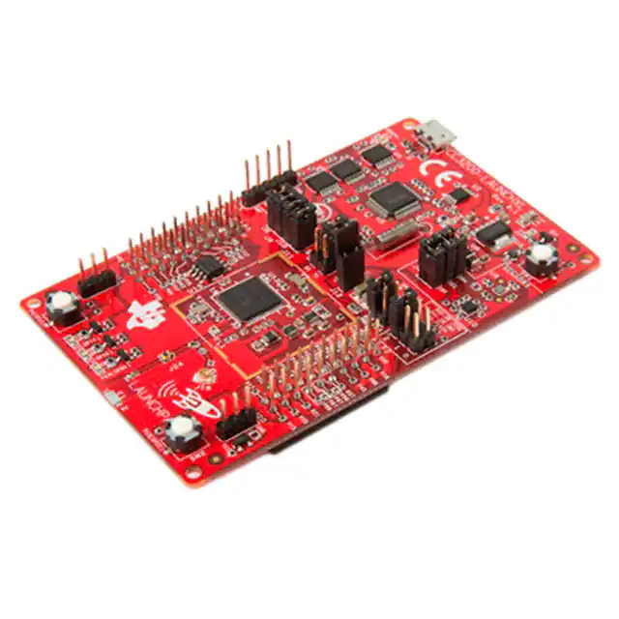
Tools or resources
TI CC 3200

Slide 11
METHODOLOGY
Our prototype consists of a DC motor with two crossed blades, which are used for reaping the leaves.
we use a stepper motor along with spokes for taking out the crop from the ground
The picked crop is moved onto the conveyor belt which is in vibrating mode. Due to the continuous vibration, most of the mud gets detached from the crop
From the conveyor belt the crop gets collected in the bin and the ultrasonic sensor monitors the status of the bin and gives a buzzer.

Slide 12
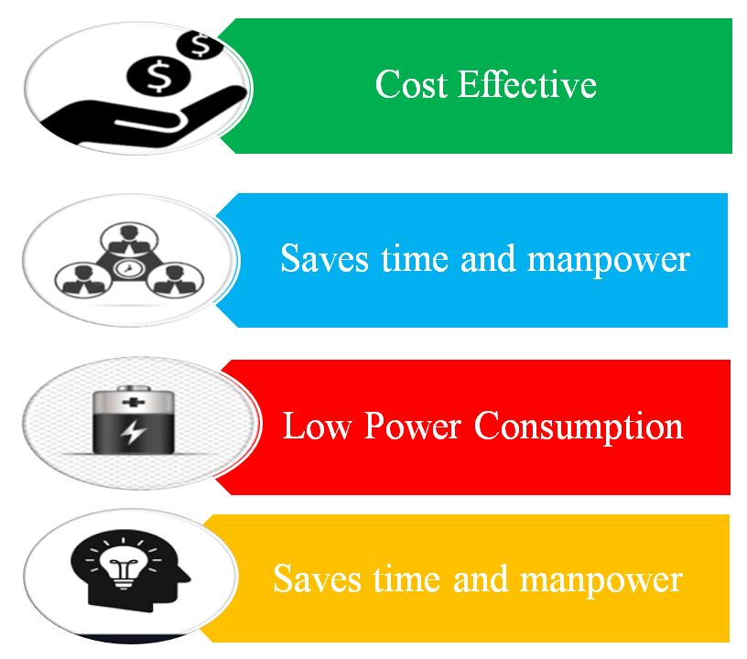
Key Differentiators & Adoption Plan
Adoption Plan
By conducting awareness programs in
villages
Promotions are also made through social
media, newspapers, radio, television,
catalogs, leaflets, etc
By telemarketing and conducting
campaigns.
By email marketing

Slide 13
GitHub Repository Link & supporting diagrams, screenshots, if any
How far it can go?

Slide 14
Reference
[1 ] https://dhanrajnathwani.com/agriculture-the-backbone-of-india/
[2]https://apeda.gov.in/apedawebsite/SubHead_Products/Onions.htm#:~:text=3%2C432.14%20crores%2F%20460.52%20USD%20Millions,MRLs)%20for%20the%20identified%20pesticides
[3] https://www.mapsofindia.com/top-ten/india-crops/onion.html

Slide 15
Thank You
Team member names

