Slide 1

Department of Computer Science and Engineering
(Cyber Security)
PROJECT DOMAIN: Web Development (HTML, CSS, JavaScript + SQLite Backend)
PROJECT TITLE: Downtown Plaza Parking Management System
SUBMISSION: Web Programming Project - 2026
NAME: Sushanth Reddy P V
REG NO: 241901115

Slide 2
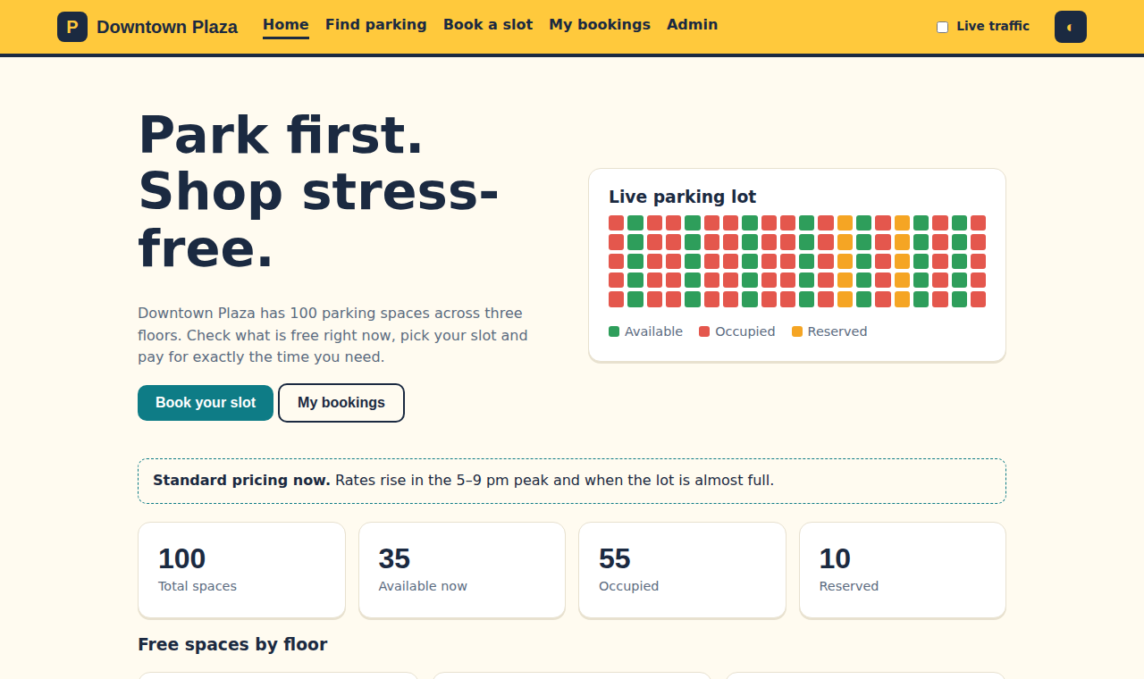
ABOUT THE PROJECT
Abstract: Downtown Plaza is a browser-based parking management system built with HTML5, CSS3 and JavaScript, with five pages for drivers and the admin.
Problem: Finding a free space in a busy mall is slow, and paper tickets or manual registers make bookings, fees and occupancy hard to track.
Solution: Live colour-coded slots across floors A, B and C (green available, red occupied, amber reserved or yours) with booking, fee and ticket in seconds.
Pricing: Rates by vehicle type (Bike Rs 15, Car Rs 40, EV Rs 60 per hour) with evening-peak and almost-full surge, long-stay and promo discounts.
Data Storage: Bookings, theme and traffic state are saved in browser LocalStorage as JSON, so they survive a page reload; no server or database is needed.
Admin: A PIN-protected dashboard (demo PIN 1234) shows six KPI cards, three charts and a CSV export of all bookings.
Key Takeaway: The project is fully front-end and zero-cost; only the admin charts and fonts need internet for Chart.js and Google Fonts.
Home page: live stats and traffic
5
pages
100
parking slots
3
floors

Slide 3
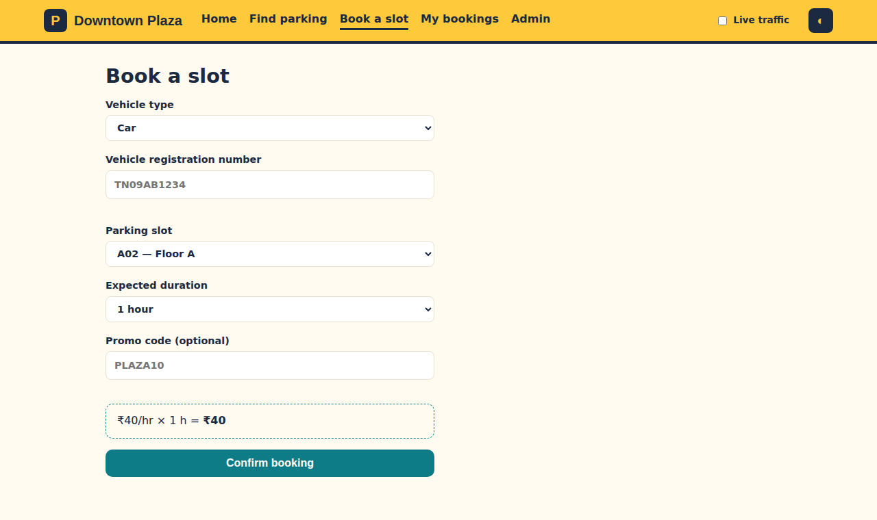
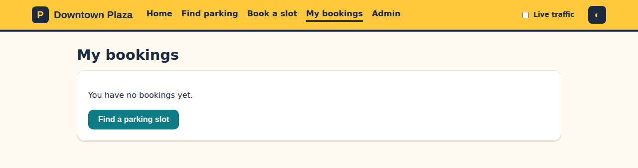
PROBLEM STATEMENT / OBJECTIVE
Problem: Finding a free space in a busy mall is slow, and paper tickets or manual registers make bookings, fees and occupancy hard to track.
Defect:
Drivers have no live view of which slots are free, so they hunt floor by floor.
Paper tickets and manual registers cannot show real-time occupancy.
Fees are hard to calculate without clear peak, long-stay and promo rules.
Staff have no single place to see revenue, status counts and bookings.
Objective:
Show live availability: colour-coded slots across floors A, B and C.
Book in seconds: pick a slot, hours and vehicle, then get a ticket.
Price fairly: rates by vehicle type with peak surge and discounts.
Help the admin: revenue, occupancy charts and CSV export.
Book a Slot: validated form, live fee, ticket
My Bookings: countdown, extend, cancel

Slide 4
TOOLS, TECHNOLOGIES AND IMPLEMENTATION
Frontend: HTML5 semantic pages, forms and tables for five screens; CSS3 with Grid, Flexbox, CSS variables and a dark theme in one stylesheet.
Logic: Plain JavaScript in js/app.js handles slots, booking rules, pricing and simulation; it runs only the code for the current page.
Data and Libraries: LocalStorage keeps dpp_bookings, dpp_sim and dpp_theme; Chart.js draws the admin charts and Google Fonts loads from a CDN.
Implementation Workflow:
Step 1: The Find page draws 100 slots with grid(); filters narrow by floor and type.
Step 2: The booking form checks the plate (TN09AB1234) and blocks a duplicate booking.
Step 3: The fee is recalculated on every change using rate, hours, surge and promo.
Step 4: A ticket is issued and the booking is saved to LocalStorage as JSON.
Step 5: Finished bookings auto-expire; extend adds 1 hour, up to 12 hours.
Step 6: Admin reads saved data for KPIs, charts and CSV; traffic ticks every 2.5 s.
+25%
Evening peak, 5-9 pm
+20%
Lot almost full (80+)
-10%
Long stay (4 h or more)
-10%
Promo code PLAZA10
fee = rate × hours × surge × long-stay × promo

Slide 5
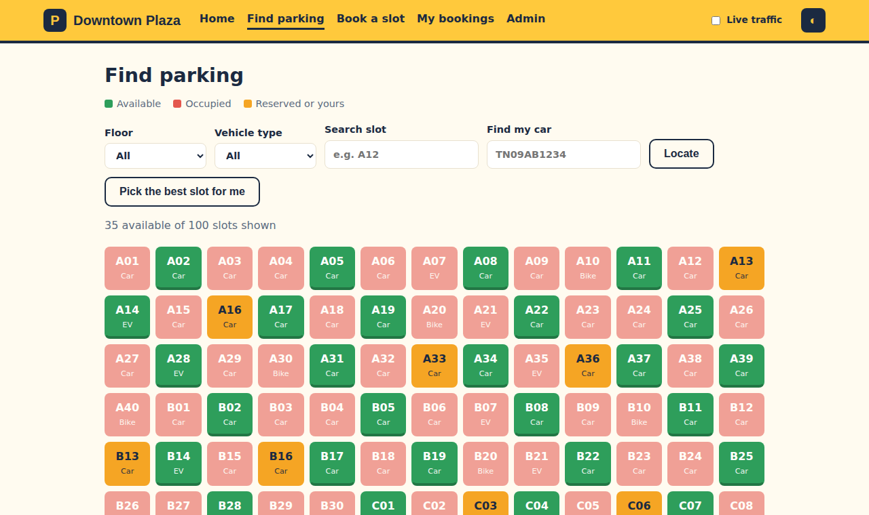
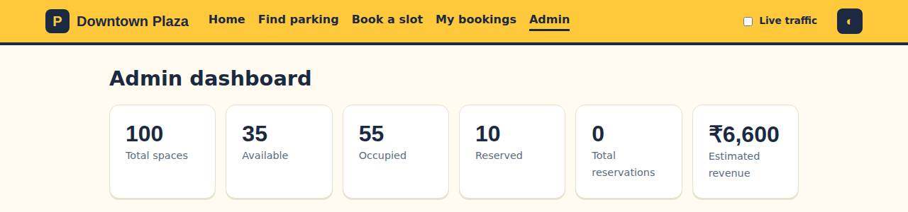
PROJECT OUTCOME
Live Slot Grid: 100 colour-coded slots on floors A, B and C with filters, search, a best-slot picker and find-my-car by plate number.
Booking and Pricing: Validated form, live fee preview, promo code PLAZA10, surge pricing and a printable ticket with a barcode.
My Bookings: Countdown on every active booking, +1 hour extension (maximum stay 12 hours), ticket view and cancel with confirmation.
Admin Dashboard: PIN login (demo PIN 1234), six KPI cards, three Chart.js charts and a bookings.csv export.
Verified:
Five working pages in one responsive web app with light and dark themes.
Bookings survive a reload via LocalStorage; finished ones auto-expire.
Live traffic runs every 2.5 s and warns if your chosen slot is taken.
Find Parking: live slot grid
Admin dashboard: six KPI cards

Slide 6
THANK YOU
Downtown Plaza Parking Management System
Web Programming Project - 2026
PROJECT DEMO
Open the project folder in any browser - five static pages, no server needed
Admin dashboard demo PIN: 1234
Header switch starts live traffic; dark mode is saved in LocalStorage
Tech Stack: HTML5 | CSS3 | JavaScript | LocalStorage | Chart.js
Submitted by: Sushanth Reddy P V (241901115), B.E. CSE (Cyber Security)

