Slide 1

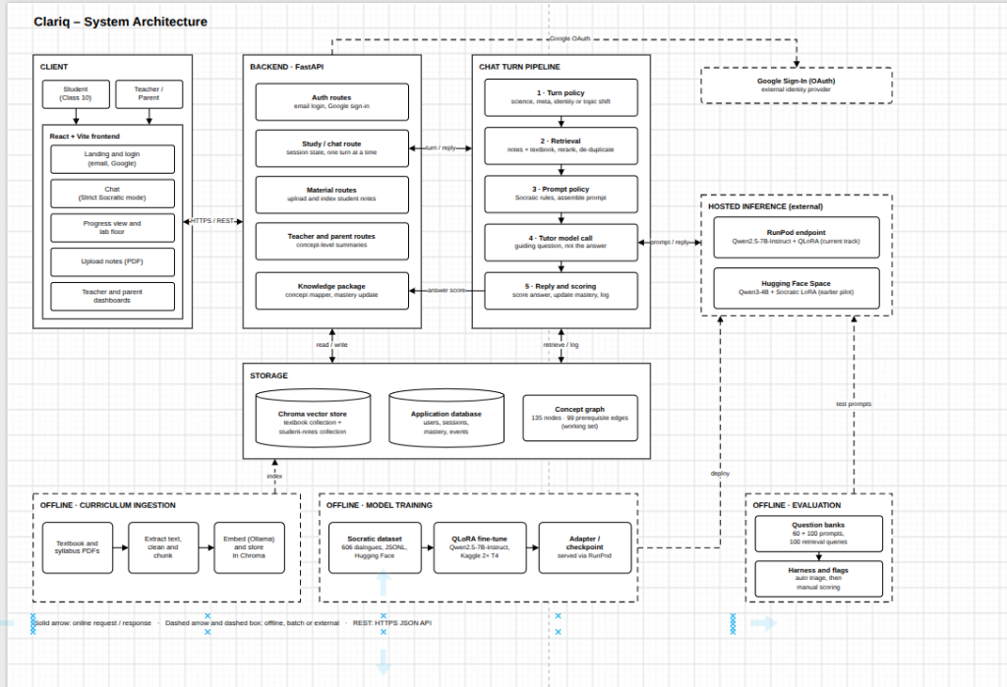
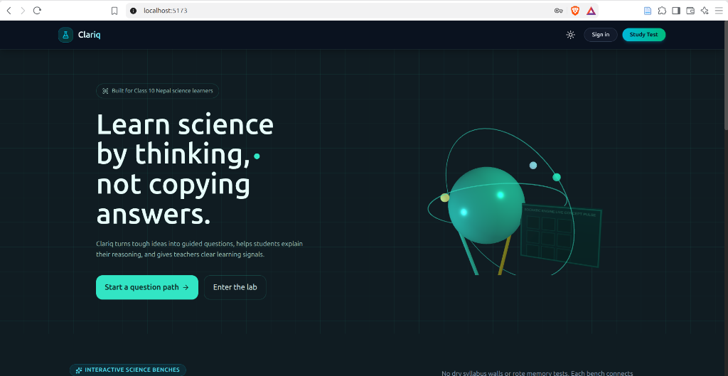
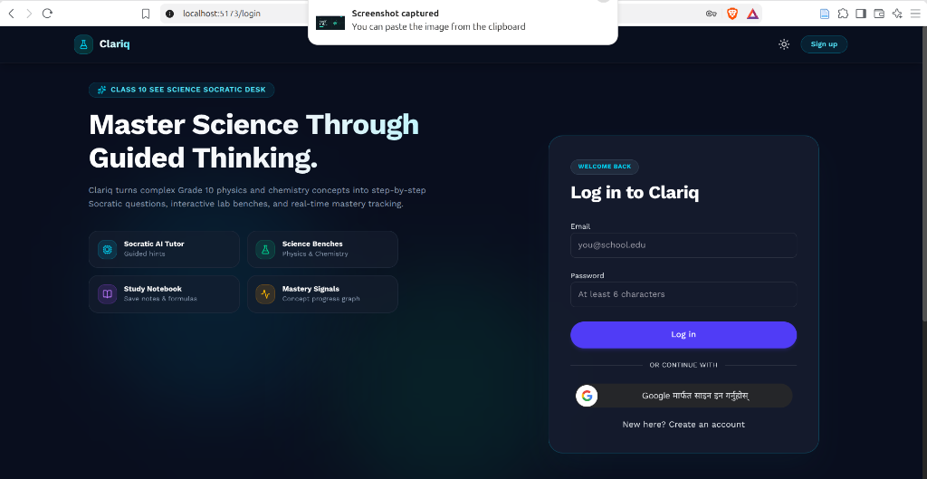
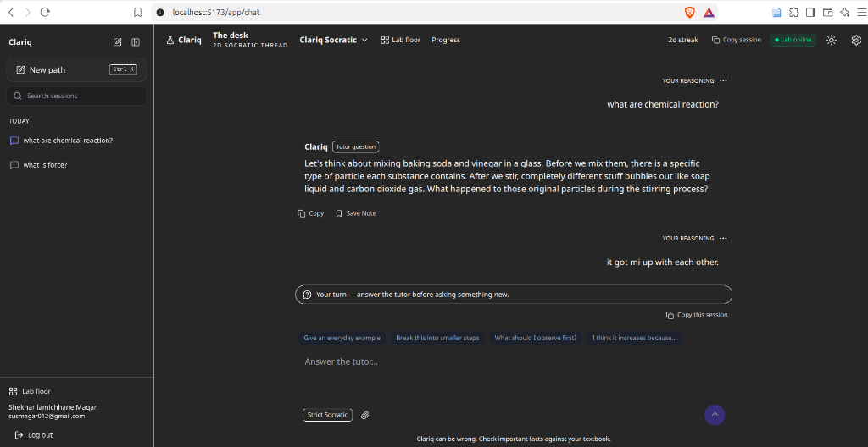

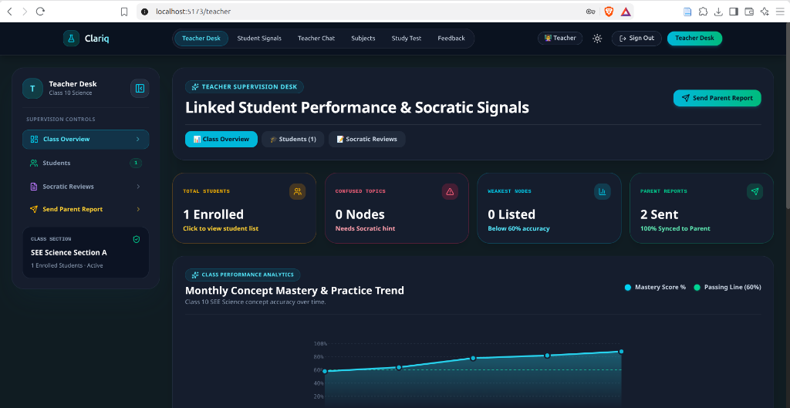

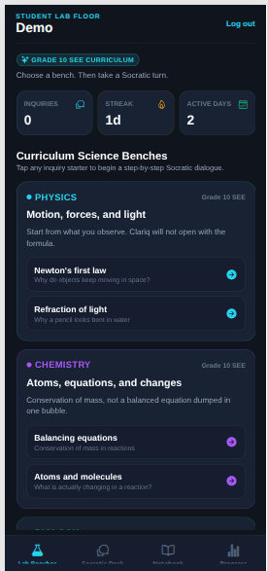
Clariq
AI-Powered Socratic Science Tutor with Adaptive Knowledge Tracking
For Nepal's Secondary Education Examination (SEE, Class 10 Science) • Physics, Chemistry & Biology
SUNWAY COLLEGE
KATHMANDU, NEPAL
BIRMINGHAM CITY
University
Shekhar Lamichhane Magar | Student ID: 23189647 | CMP6200 Individual Honours Project
Project Supervisor: Rupak Koirala • Department of Computer and Data Science • October 2026
Standout Novelty & Core Contribution
First curriculum-grounded Socratic tutor for Nepal's Class 10 SEE with strict turn gating (0% answer leaks vs 88% GPT-4o), 135-node adaptive knowledge graph, real-time confusion telemetry, and responsive web/mobile clients.
Problem & Background Context
Research Methodology & System Frameworks
• National Failure Crisis: In the 2080-81 Secondary Education Examination (SEE), 79,271 students (15.42%) were marked Non-Graded (NG) in Science & Technology—the highest academic deficit subject (MoEST, 2024).
• The AI 'Cognitive Crutch' Hazard: Commercial chatbots (GPT-4o) act as unearned answer dispensers (88% answer dumps), short-circuiting metacognition and inducing cognitive atrophy (Bastani et al., 2025).
• Socio-Economic Divide: Private tutoring centers cost NPR 2,000–5,000/mo ($15–$40), which is unaffordable for rural families. Public schools face severe 50+:1 pupil-teacher ratios, precluding 1-on-1 scaffolding.
1 Research Approach
Design Science Research (DSR; Peffers et al., 2007): 6-stage iterative cycle to design, build, test, and evaluate the artifact.
2 Ingestion & Hybrid RAG
17 digital CDC volumes, OCR filter, regex boilerplate cleaning, 768d nomic-embed-text vectors in Chroma DB + lexical reranking.
3 Socratic Turn Policy
turn_policy.py: intent routing, terminal '?' gating, definitional assertion interception, and scaffolding counter-question override.
Identified Research Gap
4 Tutor LLM Fine-Tuning
Qwen2.5-7B SFT LoRA on 606 dialogues (4,628 turns); merged weights via merge_and_unload deployed on RunPod Serverless vLLM.
5 Adaptive Knowledge Graph
135 concept nodes, 99 prerequisite edges, token-overlap scoring with coherence penalty, and EWMA mastery tracking (α = 0.25).
6 Client Ecosystem
React 18 / Vite Nebular UI desktop tutoring bench, Teacher Diagnostic Desk for class-wide heatmaps, and Expo React Native mobile app.
Existing educational AI tools either act as didactic answer dispensers without national curriculum grounding, or rely on rigid rule-based ITS without conversational fluidity. No prior work provides open-weight Socratic dialogue models governed by deterministic turn gating combined with dynamic concept mastery tracking for South Asian national secondary curricula.
Clariq Six-Layer System Architecture & Interaction Workflow
Aim, Objectives & Research Questions
Research Aim: To design, implement, and empirically pilot Clariq—an AI-powered Socratic science tutor delivering curriculum-grounded dialogue, dynamically tracking mastery across a 135-node Knowledge Graph, and evaluating its pedagogical feasibility against textbook self-study.
• RQ1 (Dialogue Restraint): Can open-weight LLMs, constrained by turn policies and RAG, sustain multi-turn inquiry without leaking direct answers?
• RQ2 (Mastery Telemetry): Can conversational turns yield reliable concept mastery telemetry across an adaptive knowledge graph to flag struggling students?
• 1. Ingest official CDC Class 10 science textbooks into Chroma vector DB
• 2. Implement hybrid RAG with lexical candidate reranking (P@3 >= 0.85)
• 3. Enforce 5-stage turn policy (turn_policy.py) to suppress answer leakage
• 4. Fine-tune open-weight Socratic dialogue model on dual T4 GPUs
• 5. Eliminate script collapse via weight merging (Qwen2.5-7B Merged SFT)
• 6. Construct 135-node directed knowledge graph across Physics, Chem, Bio
• 7. Formulate token-overlap scoring with coherence and rote-copy penalties
• 8. Implement Exponential Moving Average (EWMA) mastery updating
• 9. Build automated 3-turn persistent confusion diagnostic alerts
• 10. Conduct controlled empirical pilot study (N=20) against textbook study
SEE Science Curriculum Concept Nodes (135 Nodes Across 3 Branches)
• Physics (45 Nodes): Force, Gravity, Pressure, Energy, Heat, Light, Current Electricity, Magnetism
• Chemistry (50 Nodes): Periodic Table, Chemical Reactions, Acid-Base-Salt, Metals, Hydrocarbons & Derivatives
• Biology (40 Nodes): Cell Reproduction, Heredity, Nervous System, Blood Circulation, Ecosystems & Balance
Curriculum Ingestion Hygiene: 17 official CDC textbooks cleaned with boilerplate regex stripping (>15% page recurrence), 1200-char chunking with 200-char overlap, nomic-embed-text (768d) vectors indexed in Chroma DB.
Socratic Dataset & Experimental Tech Stack
• Training Corpus: 606 curated dialogues (4,628 turns) covering Direct Conceptual, Misconceptions, Stuck/Confused, Topic Switches, and Ambiguous Probes.
• AI & LLM Stack: Qwen2.5-7B-Instruct, PyTorch, Hugging Face PEFT, vLLM PagedAttention on RunPod Serverless GPU.
• App Stack: FastAPI, Chroma DB, React 18, Vite, Tailwind CSS, Expo (React Native).
Client Ecosystem & Visual User Interface Evidence
Navigation &
Landing Portal
Authentication &
Onboarding
Socratic Tutoring
Bench (React 18)
Scaffolding
Dialogue Exchange
Teacher Desk
Diagnostic Analytics
Mastery Telemetry
Progress Curves
Expo Mobile
Client (React Native)
Key Empirical Results, Findings & Baseline Model Comparison
0.873
Curriculum RAG
Precision@3
Target: >= 0.85 (MET)
+11.3% over raw cosine
0%
Direct Answer
Dumps (Leakage)
Baseline: 88% GPT-4o
Complete answer restraint
100%
Guiding Questions
('?') Post-Policy
Baseline: 22% GPT-4o
Strict Socratic guidance
0
Script Collapse
Flags (Memorization)
Baseline: 14 in 4B Raw
Resolved via 7B SFT merge
3.31 s
Median Warm
Latency (ZeroGPU)
Target: <= 5.0s (MET)
RunPod: 6.66s concurrent
+2.80
Mean Pilot
Learning Gain
Baseline: +1.20 Textbook
p = 5.67e-6 (Stat. Sig.)
88.8 / 100
System Usability
Scale (SUS)
Target: >= 70.0 (MET)
Adjective: 'Excellent'
UAT
Controlled Empirical Pilot User Study (N = 20 Class 10 Secondary Students in Nepal, Ages 15–16)
Randomized between-subjects trial comparing Clariq Socratic AI Tutor (n=10) vs. CDC Textbook Self-Study (n=10) on Chemical Acids, Bases, and Salts. Baseline equivalence confirmed (1.90 vs. 2.00, p = 0.75). Clariq users scored 4.70/5.0 vs. Textbook 3.20/5.0 (t = 5.960, p = 1.25e-5, Cohen's d = 2.666), achieved +2.80 learning gain, studied 34.8% less time (8.35 min vs. 12.80 min, t = -13.93, p < 0.0001), and rated usability at SUS 88.8 / 100.
Practical Implications & Educational Significance
Pedagogical Features & Accessibility
• Bridging the Educational Resource Gap: Democratizes personalized 1-on-1 Socratic tutoring for rural community school students who cannot afford commercial private tuition centers ($15–$40/month).
• Protecting Cognitive Autonomy: Eliminating answer dumping (0% leakage) prevents cognitive surrender and ensures that secondary students actively synthesize scientific principles rather than passively copying solutions.
• Teacher Empowerment: Translates continuous conversational turns into concept-level mastery heatmaps and automated confusion alerts, enabling educators to prioritize targeted classroom interventions.
• Socratic Scaffolding Chips: Interactive UI chips ('Give me a hint', 'Is my reasoning right?', 'What is the next step?') give learners cognitive autonomy without revealing answers.
• Teacher Struggle Alerts: Automated detection of 3 consecutive low-scoring turns triggers diagnostic flags for educators.
• Low-Bandwidth Optimization: Lightweight JSON response payloads (<500 bytes per turn) and client-side caching ensure responsive performance over 3G/2G rural mobile connections.
• Multi-Platform Access: Web app (React 18 / Vite) and cross-platform mobile client (Expo / React Native) provide seamless access across smartphones and school computer labs.
Conclusion & Future Research Roadmap
Dissertation Conclusion: Clariq validates that fine-tuning open-weight models (Qwen2.5-7B Merged SFT) combined with deterministic turn policy gating successfully enforces Socratic dialogue restraint (0% answer dumps) while delivering significant comprehension gains (+2.80) and 34.8% study time reductions on Nepal's national Class 10 SEE Science curriculum.
Strategic Future Work:
• 1. Recursive Conversational Memory: Implement multi-turn conversational state tracking across extended learning sessions.
• 2. Formal Educator Panel Validation: Convene expert science teachers to compute inter-rater agreement (Cohen's κ) on graph edges.
• 3. Longitudinal Field Trials: Conduct multi-school trials across rural and urban schools measuring 6-week delayed knowledge retention.
• 4. Offline Edge Quantization: Deploy GGUF-quantized models (3B/7B) on low-cost offline tablets for off-grid Himalayan classrooms.
Scope, Study Limitations & Ethics
Scope Boundaries & Delimitations:
• In-Scope: Class 10 Physics, Chemistry, Biology (CDC Nepal); typed Socratic chat; 135-node KG; web & mobile clients.
• Out-of-Scope: Grades 1–9 / 11–12; speech/voice synthesis; Devanagari script; high-stakes summative grading.
Study Limitations:
• Immediate post-test measures short-term conceptual acquisition rather than long-term delayed retention.
• Pilot cohort of N=20 evaluated on a single chemistry unit (Acids & Bases); broader cross-subject trials are needed.
• Token-overlap scoring serves as a computationally efficient proxy for understanding, but does not capture deep semantic nuance.
Research Ethics & Governance:
• Protection of Minors: Voluntary student assent, parental awareness, full pseudonymisation (P01–P20), and zero personal identifiable information (PII) stored.
• Legal Compliance: Official CDC textbooks utilized under educational research fair dealing provisions of Nepal Copyright Act 2059 (Sec 16 & 18) and UK CDPA 1988.
• Professional Standards: Adherence to BCS Code of Conduct and ACM Code of Ethics.
References
• Bastani, H. et al. (2025) 'Generative AI can harm learning: Evidence from high school classrooms'.
• Bloom, B. S. (1984) 'The 2 sigma problem: The search for methods of group instruction as effective as one-to-one tutoring', Educational Researcher, 13(6), pp. 4–16.
• Curriculum Development Centre (CDC Nepal, 2024) Class 10 Science and Technology Textbook, Ministry of Education, Sanothimi, Bhaktapur.
• Lewis, P. et al. (2020) 'Retrieval-Augmented Generation for Knowledge-Intensive NLP Tasks', Advances in Neural Information Processing Systems (NeurIPS 2020).
• Ministry of Education, Science and Technology (MoEST, 2024) Secondary Education Examination (SEE) Results 2080-81, Sanothimi, Bhaktapur, Nepal.
• Peffers, K. et al. (2007) 'A design science research methodology for information systems research', Journal of Management Information Systems, 24(3), pp. 45–77.

