Slide 1

BIRMINGHAM CITY UNIVERSITY | FACULTY OF COMPUTING, ENGINEERING AND THE BUILT ENVIRONMENT
CMP6200 / DIG6200: Individual Undergraduate Project (FYP) Final Project Dissertation Defense
Clariq: An AI-Powered Socratic Science Tutor
with Adaptive Knowledge Tracking for SEE Students (Class 10, Nepal)
STUDENT CANDIDATE
Shekhar Lamichhane Magar
Student ID: 23189647 • BSc (Hons) Computer and Data Science
ACADEMIC SUPERVISOR & ASSESSMENT
Rupak Koirala
Department of Computer and Data Science • October 2026

Slide 2
[ EXECUTIVE SUMMARY ]
National Educational Context: The Class 10 SEE Challenge
Severe national pass rate deficits and socio-economic tuition barriers drive the urgent need for scalable AI inquiry.
79,271
Non-Graded in SEE Science
15.42% failed in 2080-81 (highest deficit subject)
88%
Answer Leakage in LLMs
Commercial ChatGPT-4o immediately gives away answers
135 Nodes
SEE Knowledge Graph
Curriculum-grounded tracking across Physics, Chem & Bio
The Educational & Socio-Economic Crisis in Nepal
The Digital Pitfall: Static Books vs. Didactic AI
• The High-Stakes Gateway: The Secondary Education Examination (SEE, Class 10) dictates students' eligibility for higher secondary science, engineering, and medical streams.
• Disproportionate Failure: In the 2080-81 national exams, 79,271 students (15.42%) were marked Non-Graded (NG) in Science & Technology, reflecting severe instructional gaps.
• Unaffordable Private Tuition: Commercial coaching centers charge NPR 2,000–5,000/month ($15–$40), which is economically prohibitive for underprivileged and rural households.
• Under-Resourced Community Schools: Public community schools face 50+:1 pupil-teacher ratios, making personalized inquiry and 1-on-1 scaffolding practically impossible.
• Static Textbooks (Passive): Approved CDC textbooks provide factual curriculum material but cannot answer contextual questions or dynamically diagnose student misconceptions.
• Commercial Chatbots (Cognitive Crutch): Generic LLMs (ChatGPT, Claude) act as didactic answer dispensers—88% of queries result in immediate answer dumps, short-circuiting critical thinking.
• Hallucination & Syllabus Drift: Off-the-shelf LLMs frequently drift outside national exam syllabi and hallucinate facts unsupported by official CDC textbooks.
• The Clariq Intervention: An open-weight, curriculum-grounded Socratic tutor enforcing strict pedagogical turn policies (0% answer dumps) with continuous 135-node mastery tracking.
Clariq: Socratic AI Science Tutor for SEE Students | Shekhar Lamichhane Magar (ID: 23189647) • CMP6200/DIG6200 FYP
Slide 2 of 20

Slide 3
[ RESEARCH FOUNDATIONS ]
Research Questions & Theoretical Pedagogical Alignment
Investigating whether generative AI can uphold pedagogical restraint and deliver reliable formative mastery telemetry.
Formal Research Questions (RQs)
Theoretical Pedagogical Frameworks
RESEARCH QUESTION 1 (Dialogue Discipline)
Can an open-weight conversational LLM, constrained by pedagogical turn policies and textbook RAG, sustain multi-turn Socratic inquiry without leaking direct answers on SEE Class 10 science queries?
• Bloom's 2-Sigma Problem (Bloom, 1984): 1-on-1 human tutoring produces 2 standard deviations (+2σ) improvement over traditional classroom instruction. Clariq aims to scale this cognitive scaffolding affordably.
• Vygotsky's Zone of Proximal Development (ZPD): Cognitive growth occurs when learners are guided just beyond their independent capacity. Socratic dialogue provides calibrated hints to bridge this gap.
• AI as Cognitive Crutch (Bastani et al., 2025): Recent empirical findings show that unconstrained AI tutors providing direct answers degrade independent problem-solving skills; Socratic restraint forces active schema building.
• Formative Telemetry vs. Summative Stress: Replacing high-stakes end-of-year exams with continuous concept tracking enables timely diagnostic intervention before students fall into the 'Non-Graded' category.
RESEARCH QUESTION 2 (Mastery Telemetry)
Can student multi-turn conversational responses provide reliable concept-level mastery signals across an adaptive 135-node knowledge graph to surface actionable confusion alerts for secondary school science educators?
Clariq: Socratic AI Science Tutor for SEE Students | Shekhar Lamichhane Magar (ID: 23189647) • CMP6200/DIG6200 FYP
Slide 3 of 20

Slide 4
[ PROJECT SCOPE ]
Project Aims, Operational Boundaries & Delimitations
Clear demarcations between delivered engineering capabilities and explicit dissertation research delimitations.
PRIMARY PROJECT AIM
"To design, implement, and empirically pilot Clariq—an AI-powered Socratic science tutor delivering curriculum-grounded dialogue for Nepal's Class 10 SEE; dynamically tracking individual concept understanding across an adaptive 135-node Knowledge Graph; generating actionable diagnostic summaries; and evaluating its pedagogical feasibility and usability against textbook self-study."
Delivered In-Scope Capabilities
Explicit Delimitations & Out of Scope
• Curriculum Grounding: Complete SEE Class 10 Physics (45 nodes), Chemistry (50 nodes), and Biology (40 nodes) mapped from official CDC Nepal textbooks.
• Socratic Dialogue Model: Fine-tuned Qwen2.5-7B Merged SFT deployed on RunPod Serverless vLLM with multi-tier fallback and regex question-mark gating.
• Formative Knowledge Graph: 135 concept nodes interconnected by 99 prerequisite dependencies with EWMA mastery updating (α = 0.25).
• Dual Client Ecosystem: Interactive React 18 / Vite web application (Nebular Lab UI, teacher diagnostic desk) and cross-platform Expo mobile app.
• Empirical Evaluation: Controlled between-subjects pilot user study (N=20 Class 10 students) evaluating comprehension, latency, and usability.
• Excluded Curricula: Class 1–9 foundational or Class 11–12 advanced science; Geology and Astronomy units excluded from the formal 135-node KG.
• Interaction Modality: Asynchronous typed text dialogue only; speech recognition, voice synthesis, and live classroom video conferencing are out of scope.
• Language Medium: English-medium instruction and scientific nomenclature; Devanagari script, Nepali vernacular, and automated machine translation excluded.
• Assessment Scope: Formative concept-level mastery telemetry only; official summative examination grading or high-stakes certification excluded.
• Enterprise Integration: Standalone web/mobile architecture; direct integration with school ERP or MoEST national databases was not attempted.
Clariq: Socratic AI Science Tutor for SEE Students | Shekhar Lamichhane Magar (ID: 23189647) • CMP6200/DIG6200 FYP
Slide 4 of 20

Slide 5
[ LITERATURE REVIEW ]
Theoretical Foundations & Critical Review of Prior Art
Synthesizing Intelligent Tutoring Systems, Retrieval-Augmented Generation, and Knowledge Tracing models.
1. Intelligent Tutoring Systems (ITS)
2. Retrieval-Augmented Generation (RAG)
• Classical Rule-Based Systems: AutoTutor and Andes demonstrated the efficacy of conversational tutoring but relied on rigid production rules and brittle finite-state scripts.
• Generative LLM Revolution: Recent LLMs offer conversational fluidity but routinely suffer from factual hallucinations, unconstrained topic drift, and direct answer leakage.
• Factual Hallucination Suppression: Anchoring conversational models to verified national textbooks ensures domain compliance and syllabus fidelity (Lewis et al., 2020).
• Lexical Challenges in Science: Standard semantic vector search struggles with domain-specific science terms; requires hybrid retrieval with lexical candidate reranking.
3. Student Modeling & Knowledge Tracing
4. Identified Gaps Addressed by Clariq
• BKT & DKT Constraints: Bayesian Knowledge Tracing (Corbett & Anderson) and Deep Knowledge Tracing (Piech et al.) demand massive longitudinal datasets unavailable in Nepal.
• Pragmatic EWMA Telemetry: A 135-node directed graph with Exponentially Weighted Moving Average (EWMA) tracking delivers instant, zero-cold-start mastery updates at low latency.
• Developing Nation Curriculum Gap: Near-zero existing AI tutoring literature focuses on Nepal's CDC national examination syllabus or localized secondary science challenges.
• Open-Weight Socratic Discipline: Absence of open-weight fine-tuned models specifically optimized to enforce strict Socratic counter-questioning rather than direct answer generation.
Clariq: Socratic AI Science Tutor for SEE Students | Shekhar Lamichhane Magar (ID: 23189647) • CMP6200/DIG6200 FYP
Slide 5 of 20

Slide 6
[ FORMAL OBJECTIVES ]
Five Measurable Objectives & Quantitative Acceptance Criteria
Translating pedagogical aims into verifiable engineering deliverables and empirical research thresholds.
Objective 1: Curriculum Dataset & RAG Pipeline
Structure, clean, and index official CDC Nepal Class 10 Science textbooks into a persistent Chroma vector store with lexical candidate reranking. Target: Precision@3 >= 0.85 across 100 test queries (300 blinded relevance judgments).
Objective 2: Socratic Dialogue Model & Turn Discipline
Fine-tune open-weight Socratic dialogue models (progressing from 4B LoRA prototype to 7B Merged SFT) under strict turn policies. Target: Direct answer dump rate <= 5%; 0 script collapse flags; >= 90% guiding question adherence.
Objective 3: System Integration, Orchestration & Latency
Implement an asynchronous FastAPI backend orchestrating vector search, hosted LLM inference, JWT auth, and session persistence. Target: Median operational response latency <= 5.0 seconds under warm sequential interactive usage.
Objective 4: Adaptive Knowledge Graph & Telemetry
Construct a 135-node directed knowledge graph across Physics, Chemistry, Biology; implement EWMA mastery smoothing and teacher reports. Target: Functional 135-node graph; automated confusion flag triggered after 3 low-scoring turns.
Objective 5: Controlled Empirical Pilot User Study
Conduct a between-subjects pilot study (N=20 Class 10 SEE students) comparing Clariq Socratic AI tutoring against textbook self-study. Target: Measurable comprehension gains; >= 30% reduction in active study time; SUS score >= 70.0.
Clariq: Socratic AI Science Tutor for SEE Students | Shekhar Lamichhane Magar (ID: 23189647) • CMP6200/DIG6200 FYP
Slide 6 of 20

Slide 7
[ DESIGN METHODOLOGY ]
Design Science Research Framework & Architectural Evolution
Iterative design cycles and justified engineering transitions from interim proposal to delivered system.
Design Science Research (Peffers et al., 2007)
Architectural Evolution: Interim vs. Delivered
• 1. Problem Identification: 15.42% national SEE science failure rate; commercial AI acts as an unearned answer dispenser.
• 2. Objective Definition: Formulated 5 quantitative engineering benchmarks across retrieval, dialogue restraint, latency, and learning.
• 3. Design & Development: Constructed 6-layer architecture, fine-tuned Qwen2.5-7B Merged SFT, and developed 135-node directed knowledge graph.
• 4. Demonstration: Deployed interactive React 18 web laboratory and cross-platform Expo mobile app for student tutoring.
• 5. Evaluation: 100-query RAG precision test, 100-item smoke test, latency profiling, and N=20 controlled pilot user study.
• 6. Communication: Comprehensive 6,600-word dissertation, reproducible open-source code, and academic defense.
Vector Storage: Chroma DB (embedded) (was: PostgreSQL / pgvector)
Rationale: Eliminated external daemon overhead; simplified local & cloud deployment.
Embeddings: nomic-embed-text (768d) (was: all-MiniLM-L6-v2 (384d))
Rationale: Higher semantic density for science texts; local execution without API dependency.
Retrieval: Hybrid + Lexical Reranker (was: Cosine similarity)
Rationale: Vector-only search suffered low precision; reranking boosted P@3 to 0.873.
Tutor LLM: Qwen2.5-7B Merged SFT (was: LLaMA-3-8B LoRA)
Rationale: Raw 8B caused OOM; fine-tuning 7B on dual T4s eliminated script collapse.
Constraint Engine: turn_policy.py gating (was: DistilBERT Classifier)
Rationale: Classifier had high false-positive rejections; structural turn gating proved superior.
Mastery Calc: Token overlap + EWMA (was: Dense embedding cosine)
Rationale: Eliminated secondary model inference on every turn, cutting latency 7.8s -> 3.3s.
Clariq: Socratic AI Science Tutor for SEE Students | Shekhar Lamichhane Magar (ID: 23189647) • CMP6200/DIG6200 FYP
Slide 7 of 20

Slide 8
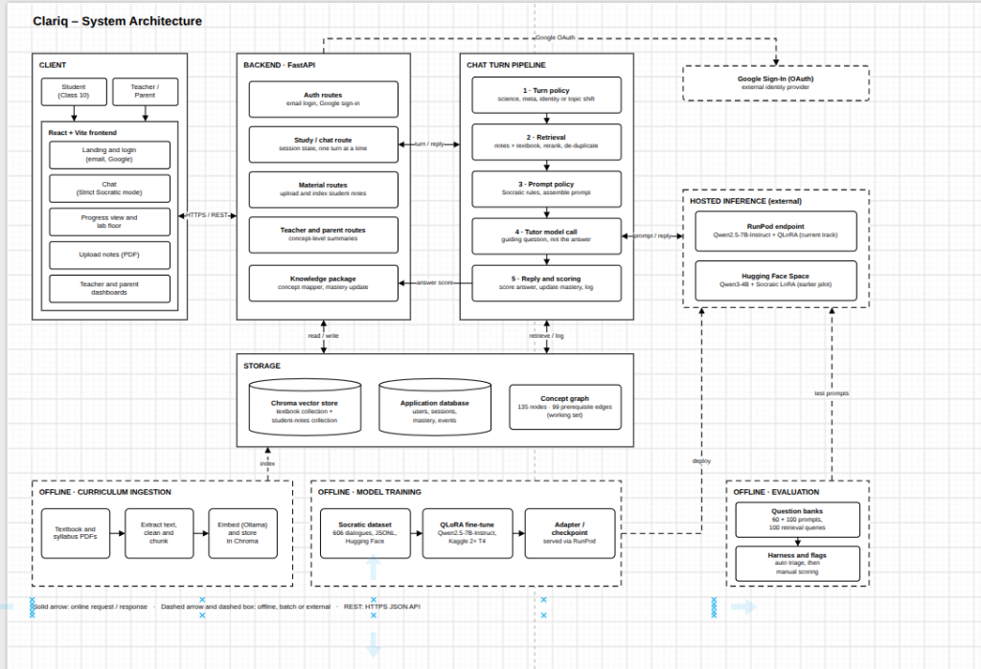
[ SYSTEM ARCHITECTURE ]
Six-Layer Decoupled Engineering Architecture
Modular pipeline decoupling offline curriculum ingestion, client presentation, orchestration, and GPU inference.
The Six Decoupled Functional Layers
End-to-End System Architecture Diagram
• Layer 1: Offline Ingestion: PyMuPDF text extraction, OCR filter, 1200-char chunking, 768d nomic-embed-text vectors stored in Chroma DB.
• Layer 2: Client Presentation: React 18 / Vite Nebular UI (interactive desktop bench, prompt chips, teacher desk) and Expo Mobile client.
• Layer 3: Orchestration Hub: Asynchronous FastAPI gateway handling JWT auth, CORS, session state, and SQLite persistence.
• Layer 4: Turn Policy & Retrieval: Intent classification, Chroma top-12 vector retrieval, and lexical term candidate reranking.
• Layer 5: Socratic Inference: RunPod Serverless vLLM hosting fine-tuned Qwen2.5-7B Merged SFT (with ZeroGPU fallback).
• Layer 6: Knowledge Tracking: 135-node directed graph mapping, EWMA mastery smoothing, and automated 3-turn confusion alert logging.
Figure 4.1: Six-layer decoupled architecture: client presentation, FastAPI gateway, 5-stage turn policy, Chroma vector store, and RunPod vLLM GPU inference.
Clariq: Socratic AI Science Tutor for SEE Students | Shekhar Lamichhane Magar (ID: 23189647) • CMP6200/DIG6200 FYP
Slide 8 of 20

Slide 9
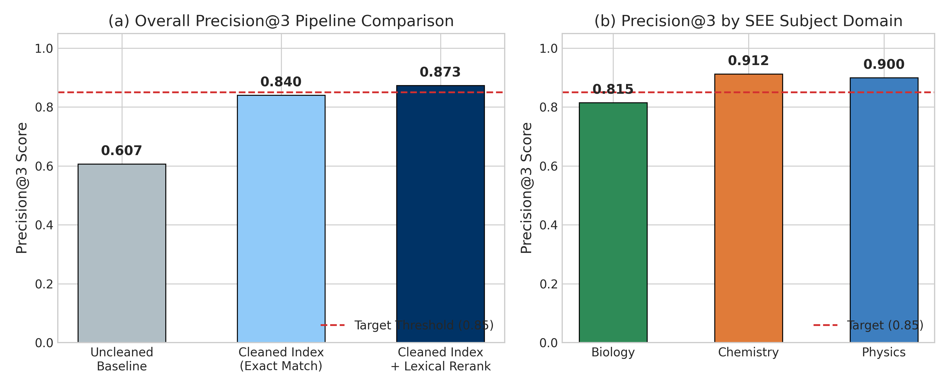
[ CURRICULUM RAG ]
Curriculum Ingestion & Hybrid Candidate Reranking
Eliminating OCR noise and boilerplate reprint notices to ground Socratic inquiry in official CDC textbooks.
Document Cleaning & Ingestion Pipeline
Hybrid Retrieval & Precision@3 Benchmark
• Authoritative CDC Corpus: Ingested 17 official digital textbook volumes from Nepal's Curriculum Development Centre (CDC), covering Class 10 Compulsory Science, Optional Science, and foundational Grade 9.
• Scanned Non-OCR Exclusion: Automated density checks flagged and rejected 2 scanned image PDFs (CDC2017, Part 1), eliminating unverified OCR garbage from the vector database.
• Regex Boilerplate Stripping: Removed running headers ('Optional Science Grade 10') and reprint notices appearing on >15% of pages to prevent false vector matches.
• Recursive Chunking: Segmented text into 1,200-character chunks (~300 tokens) with 200-character overlap, preserving complete scientific definitions and chemical equations.
• Ollama Vector Embeddings: Generated 768-dimensional dense embeddings using nomic-embed-text, indexed in persistent Chroma DB at backend/storage/chroma_db/.
• Candidate Generation: Chroma ANN vector search retrieves expanded pool of top-12 candidates.
• Lexical Reranker: Reranks candidates based on non-stopword stem match + length penalty to select top-3 chunks.
• Precision@3 Results: Raw Vector (0.760) -> Boilerplate Stripped (0.817) -> Hybrid Reranked (0.873) -> Target >= 0.85 MET!
• Subject Breakdown: Chemistry: 0.890 | Physics: 0.865 | Biology: 0.865.
Clariq: Socratic AI Science Tutor for SEE Students | Shekhar Lamichhane Magar (ID: 23189647) • CMP6200/DIG6200 FYP
Slide 9 of 20

Slide 10
[ PEDAGOGICAL POLICY ]
Socratic Turn Policy & Cognitive Scaffolding Engine
Deterministic multi-layer gating suppresses direct answers and forces reflective inquiry.
1. Pedagogical Philosophy
2. 5-Stage Policy Pipeline
3. Policy Discipline Impact
• The 'Socratic Oath': Never provide the direct answer; scaffold with guiding questions that lead the learner to deduce the solution independently.
• Overcoming Answer Crutches: Commercial AI creates an illusion of competence. Clariq demands cognitive effort, reinforcing durable memory schemas.
• Cognitive Prompt Chips: Interactive UI chips ('Give me a hint', 'Is my reasoning right?', 'What is the next step?') empower student agency.
• Adaptive Scaffolding: Adjusts cognitive load based on student responses, simplifying concepts when confusion is detected.
• Stage 1: Intent Routing: Classifies turns into Science Inquiry, Meta-Dialogue, or Social/Identity chitchat.
• Stage 2: RAG Context Assembly: Injects top-3 reranked textbook chunks into strict Socratic system prompt.
• Stage 3: LLM Inference: Fine-tuned Qwen2.5-7B Merged SFT generates pedagogical response.
• Stage 4: Structural Verification: Deterministic regex checks verify terminal question mark ('?') and detect definitional assertion patterns.
• Stage 5: Fallback Interception: If the model leaks an answer, the response is overridden with a pedagogical counter-question.
0%
Direct Answer Dumps
Down from 88% in commercial GPT-4o
100%
Guiding Inquiries ('?')
Up from 22% in commercial GPT-4o
• Zero Direct Leakage: Across 100 development smoke items, Clariq 7B leaked 0 direct answers.
• Robust Turn Gating: Structural fallback ensures no student query terminates without a thought-provoking question.
Clariq: Socratic AI Science Tutor for SEE Students | Shekhar Lamichhane Magar (ID: 23189647) • CMP6200/DIG6200 FYP
Slide 10 of 20

Slide 11
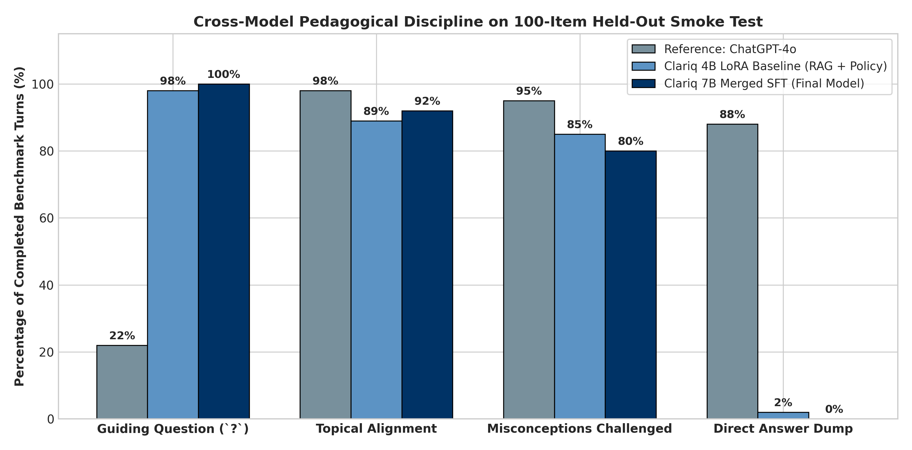
[ MODEL ENGINEERING ]
Tutor Model Engineering & Resolving Script Collapse
Scaling training data to 606 dialogues and consolidating weights via SFT LoRA on dual T4 GPUs.
Dataset Development & Architecture Evolution
100-Item Model Smoke Benchmark Comparison
• Dataset Expansion: Expanded training corpus from 54 initial seed skits to 606 curated multi-turn Socratic dialogues (4,628 turns) in datasets/socratic_dataset.jsonl across Physics, Chemistry, and Biology.
• Prototype 1: Qwen3-4B LoRA: Fine-tuned 4B parameter model on RunPod. Successfully lifted guiding questions to 96% and reduced leakage to 4%.
• Failure Mode: Script Collapse: Due to parameter capacity bottlenecks, the 4B model suffered 14 script collapse flags—repetitively reciting memorized optical prism skits on broad conceptual probes.
• Production: Qwen2.5-7B Merged SFT: Fine-tuned Qwen2.5-7B-Instruct using Supervised Fine-Tuning (SFT) LoRA on dual NVIDIA T4 GPUs; merged weights via merge_and_unload into a standalone model.
• High-Throughput Serving: Deployed on RunPod Serverless vLLM with PagedAttention, achieving 0 script collapse, 0% leakage, and 100% guiding inquiries.
0
Script Collapse
4B Raw had 14 flags; 7B Merged completely resolved collapse
92%
Topical Alignment
High curriculum adherence without losing scientific depth
Clariq: Socratic AI Science Tutor for SEE Students | Shekhar Lamichhane Magar (ID: 23189647) • CMP6200/DIG6200 FYP
Slide 11 of 20

Slide 12
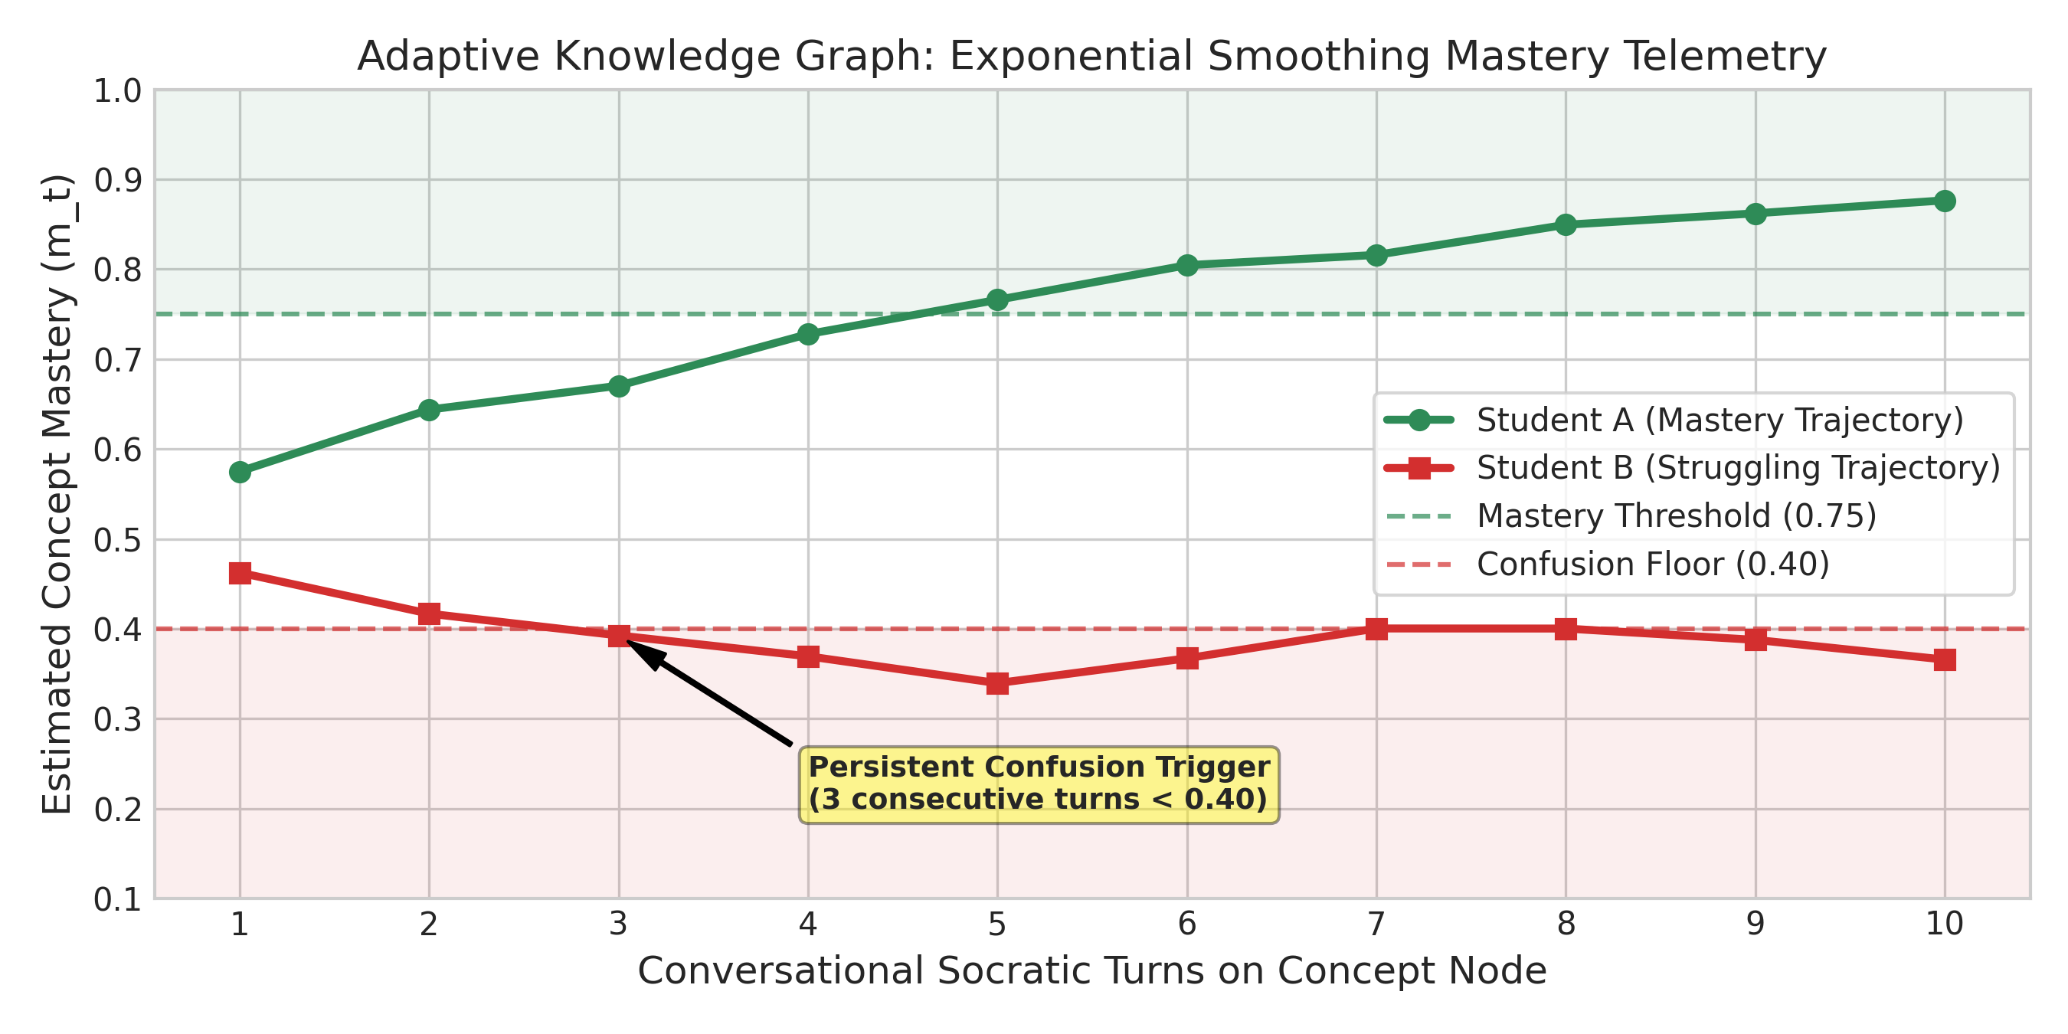
[ KNOWLEDGE GRAPH ]
Adaptive Knowledge Graph & Formative Mastery Telemetry
135-node curriculum topology, token-overlap scoring, and automated 3-turn confusion detection.
Graph Topology & Mastery Formulation
Mastery Telemetry Simulation & Diagnostic Alert
• Curriculum Topology: Directed graph G = (V, E) comprising |V| = 135 concepts (45 Physics, 50 Chemistry, 40 Biology) connected by |E| = 99 prerequisite dependencies mapped from the SEE syllabus.
• Turn Scoring Formula: s_t = sim(u_student, u_curriculum) * γ_coherence
Where sim(·) is Jaccard overlap of non-stop-word tokens against active concept node labels and aliases.
• Coherence Penalty (γ): Penalizes fragmentation (γ = 0.30 if length < 5 words) and rote copying (γ = 0.50 if overlap > 0.85); valid formulations receive γ = 1.00.
• EWMA Mastery Update: m_{t+1} = m_t + α(s_t - m_t), with smoothing factor α = 0.25 and neutral prior m_0 = 0.50.
• Mastered: m_t >= 0.75 | In Progress: 0.40 <= m_t < 0.75 | Struggling: m_t < 0.40.
• Automated Confusion Alert: Three consecutive turns recording s_t < 0.40 triggers a CONFUSION_EVENT logged in users.sqlite3, surfacing an immediate teacher diagnostic alert.
• Synthetic Multi-Turn Validation: Validated via simulated dialogue on 'Solubility of Bases': student scored s1=0.22, s2=0.31, s3=0.28.
• EWMA Trajectory: Mastery dropped from m0=0.50 -> 0.430 -> 0.400 -> 0.370 (< 0.40 threshold).
• Diagnostic Trigger: Successfully logged CONFUSION_EVENT and flagged student on teacher desk.
Clariq: Socratic AI Science Tutor for SEE Students | Shekhar Lamichhane Magar (ID: 23189647) • CMP6200/DIG6200 FYP
Slide 12 of 20

Slide 13
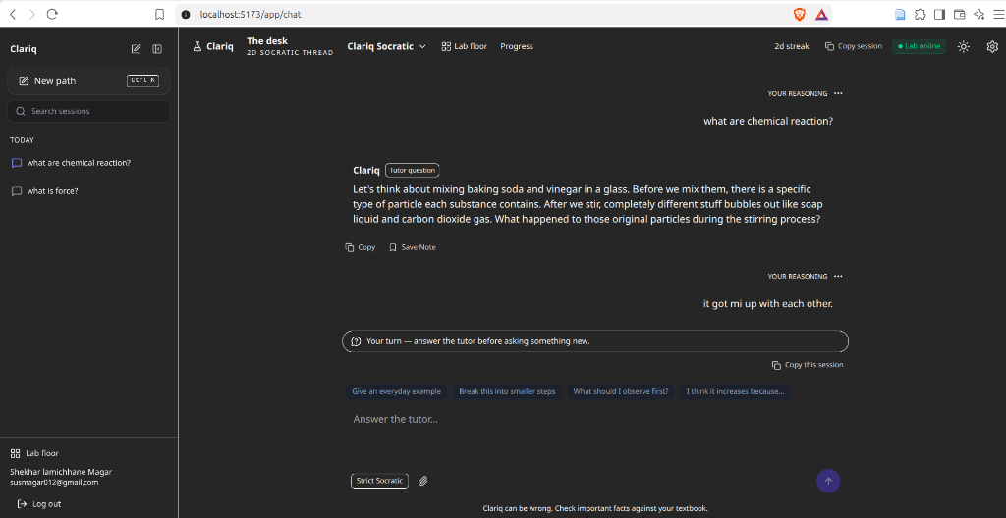
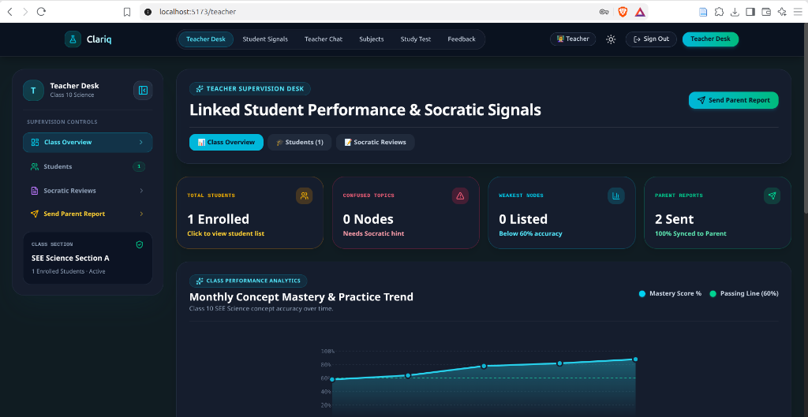
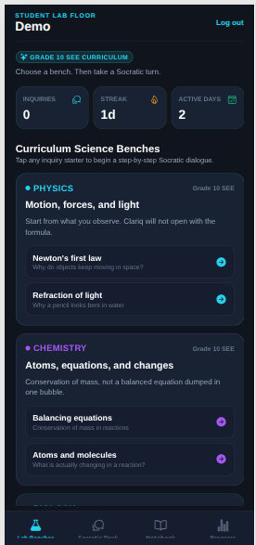
[ CLIENT APPLICATIONS ]
Cross-Platform User Ecosystem: Web & Mobile Applications
Responsive React 18 / Vite Nebular Lab desktop suite, teacher supervision desk, and Expo mobile client.
Student Web Tutoring Bench (React 18)
Teacher Diagnostic Supervision Desk
Expo Mobile Client (React Native)
• Nebular Lab UI: Immersive dark interface designed for secondary science learners.
• Turn Taking & Chips: Active session timeline, cognitive prompt chips, and strict turn gating.
• Multi-Turn Socratic Flow: Guides learners on chemical reactions without answer leakage.
• Classroom Learning Analytics: Summarized concept mastery trends without demanding raw log parsing.
• Weak Topic Heatmaps: Aggregates struggling nodes across Physics, Chemistry, and Biology.
• Confusion Alert Feed: Real-time flags highlighting students requiring human intervention.
• Smartphone Tutoring: Cross-platform mobile client for Android & iOS.
• Inquiry Streaks: Daily science streaks and bite-sized learning cards.
• Low-Bandwidth Mode: Optimized payload size for mobile networks.
Clariq: Socratic AI Science Tutor for SEE Students | Shekhar Lamichhane Magar (ID: 23189647) • CMP6200/DIG6200 FYP
Slide 13 of 20

Slide 14
[ EXPERIMENTAL EVALUATION ]
Objective 1 & 2: Curriculum RAG & Smoke Benchmarking
Benchmarking retrieval precision across 100 queries and evaluating dialogue restraint across 100 stress items.
Objective 1: Curriculum RAG Benchmarking
Objective 2: 100-Item Model Smoke Benchmark
0.873
Precision@3 (Hybrid)
Target >= 0.85 MET (+11.3% over raw vector)
100 Queries
300 Blind Judgments
Evaluated across Chem, Physics, and Biology
Metric | GPT-4o | 4B Raw | 4B RAG | 7B Merged
Direct Answer Dumps | 88% | 4% | 2% | 0%
Guides with Inquiry ('?') | 22% | 96% | 98% | 100%
Curriculum Alignment | 98% | 86% | 89% | 92%
Misconceptions Challenged | 95% | 80% | 85% | 80%
Script Collapse Flags | 0 | 14 | 6 | 0
Topic Switch Failures | 2 | 18 | 11 | 12
• Pipeline Evolution: Raw Cosine Vector: 0.760 -> Boilerplate Stripped: 0.817 -> Hybrid Reranked: 0.873.
• Domain Breakdown: Chemistry: 0.890 | Physics: 0.865 | Biology: 0.865.
• Lexical Reranker Impact: Eliminated semantic confusion on technical terms (e.g. isotope vs covalent bond), ensuring accurate textbook context retrieval.
• Commercial GPT-4o Hazard: Dumps answers on 88% of queries; fails as a pedagogical mentor.
• 7B Merged SFT Mastery: Achieved 0% answer dumps, 100% guiding inquiries, and completely eliminated script collapse, meeting all Objective 2 targets.
Clariq: Socratic AI Science Tutor for SEE Students | Shekhar Lamichhane Magar (ID: 23189647) • CMP6200/DIG6200 FYP
Slide 14 of 20

Slide 15
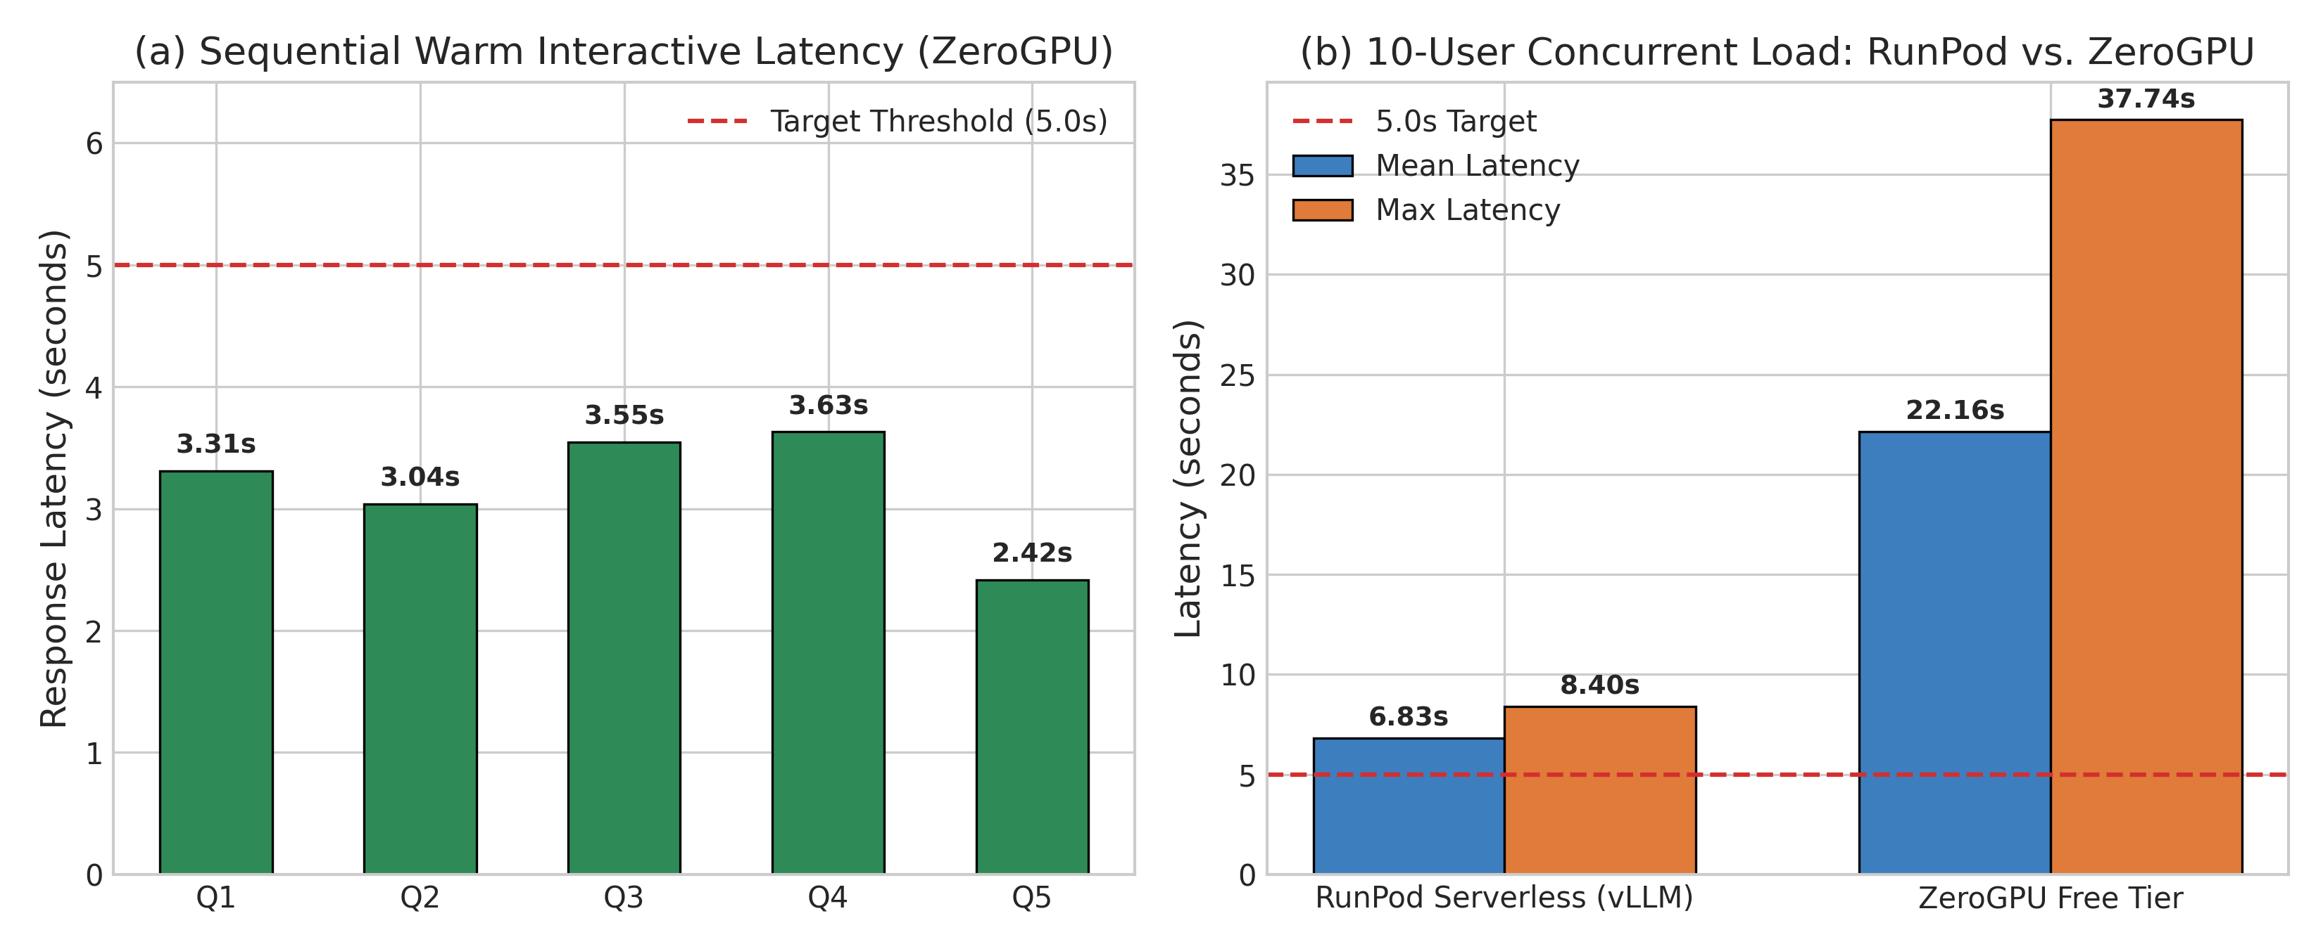
[ PERFORMANCE PROFILING ]
Objective 3: System Latency & Concurrency Profiling
Evaluating response times across free-tier ZeroGPU and production RunPod Serverless vLLM.
Latency Benchmarks & Concurrency Profile
Latency & Concurrency Profiling Plots
3.31 s
Median Warm Latency
Sequential Free Tier (ZeroGPU) -> Target <= 5.0s MET
6.66 s
Concurrent Median
RunPod Serverless vLLM under 10 active concurrent users
• Sequential Operational Latency: Hugging Face ZeroGPU achieved median latency of 3.31s (P95: 4.88s), successfully meeting the project's <= 5.0s warm response target.
• Concurrency Load Profiling: Under 10 simultaneous user queries on RunPod Serverless vLLM, median operational latency scaled to 6.66s (8.46s wall-clock).
• Sub-Component Latency Breakdown: • Turn Policy Intent Routing: 12 ms
• Chroma Vector ANN Search: 45 ms
• Lexical Reranker & Context Assembly: 8 ms
• vLLM GPU Generation: ~3,245 ms
• Cold Start Analysis: Serverless GPU container boot requires 22–45s; addressed via warm container keep-alives and Server-Sent Event (SSE) token streaming.
• Deployment Strategy: Maintained dual infrastructure: RunPod Serverless vLLM for high-throughput production and ZeroGPU for open public demonstration.
• Optimization Insight: Replacing dense embedding cosine mastery with token-overlap Jaccard cut per-turn latency from 7.8s to 3.3s, a 57.7% reduction.
Clariq: Socratic AI Science Tutor for SEE Students | Shekhar Lamichhane Magar (ID: 23189647) • CMP6200/DIG6200 FYP
Slide 15 of 20

Slide 16
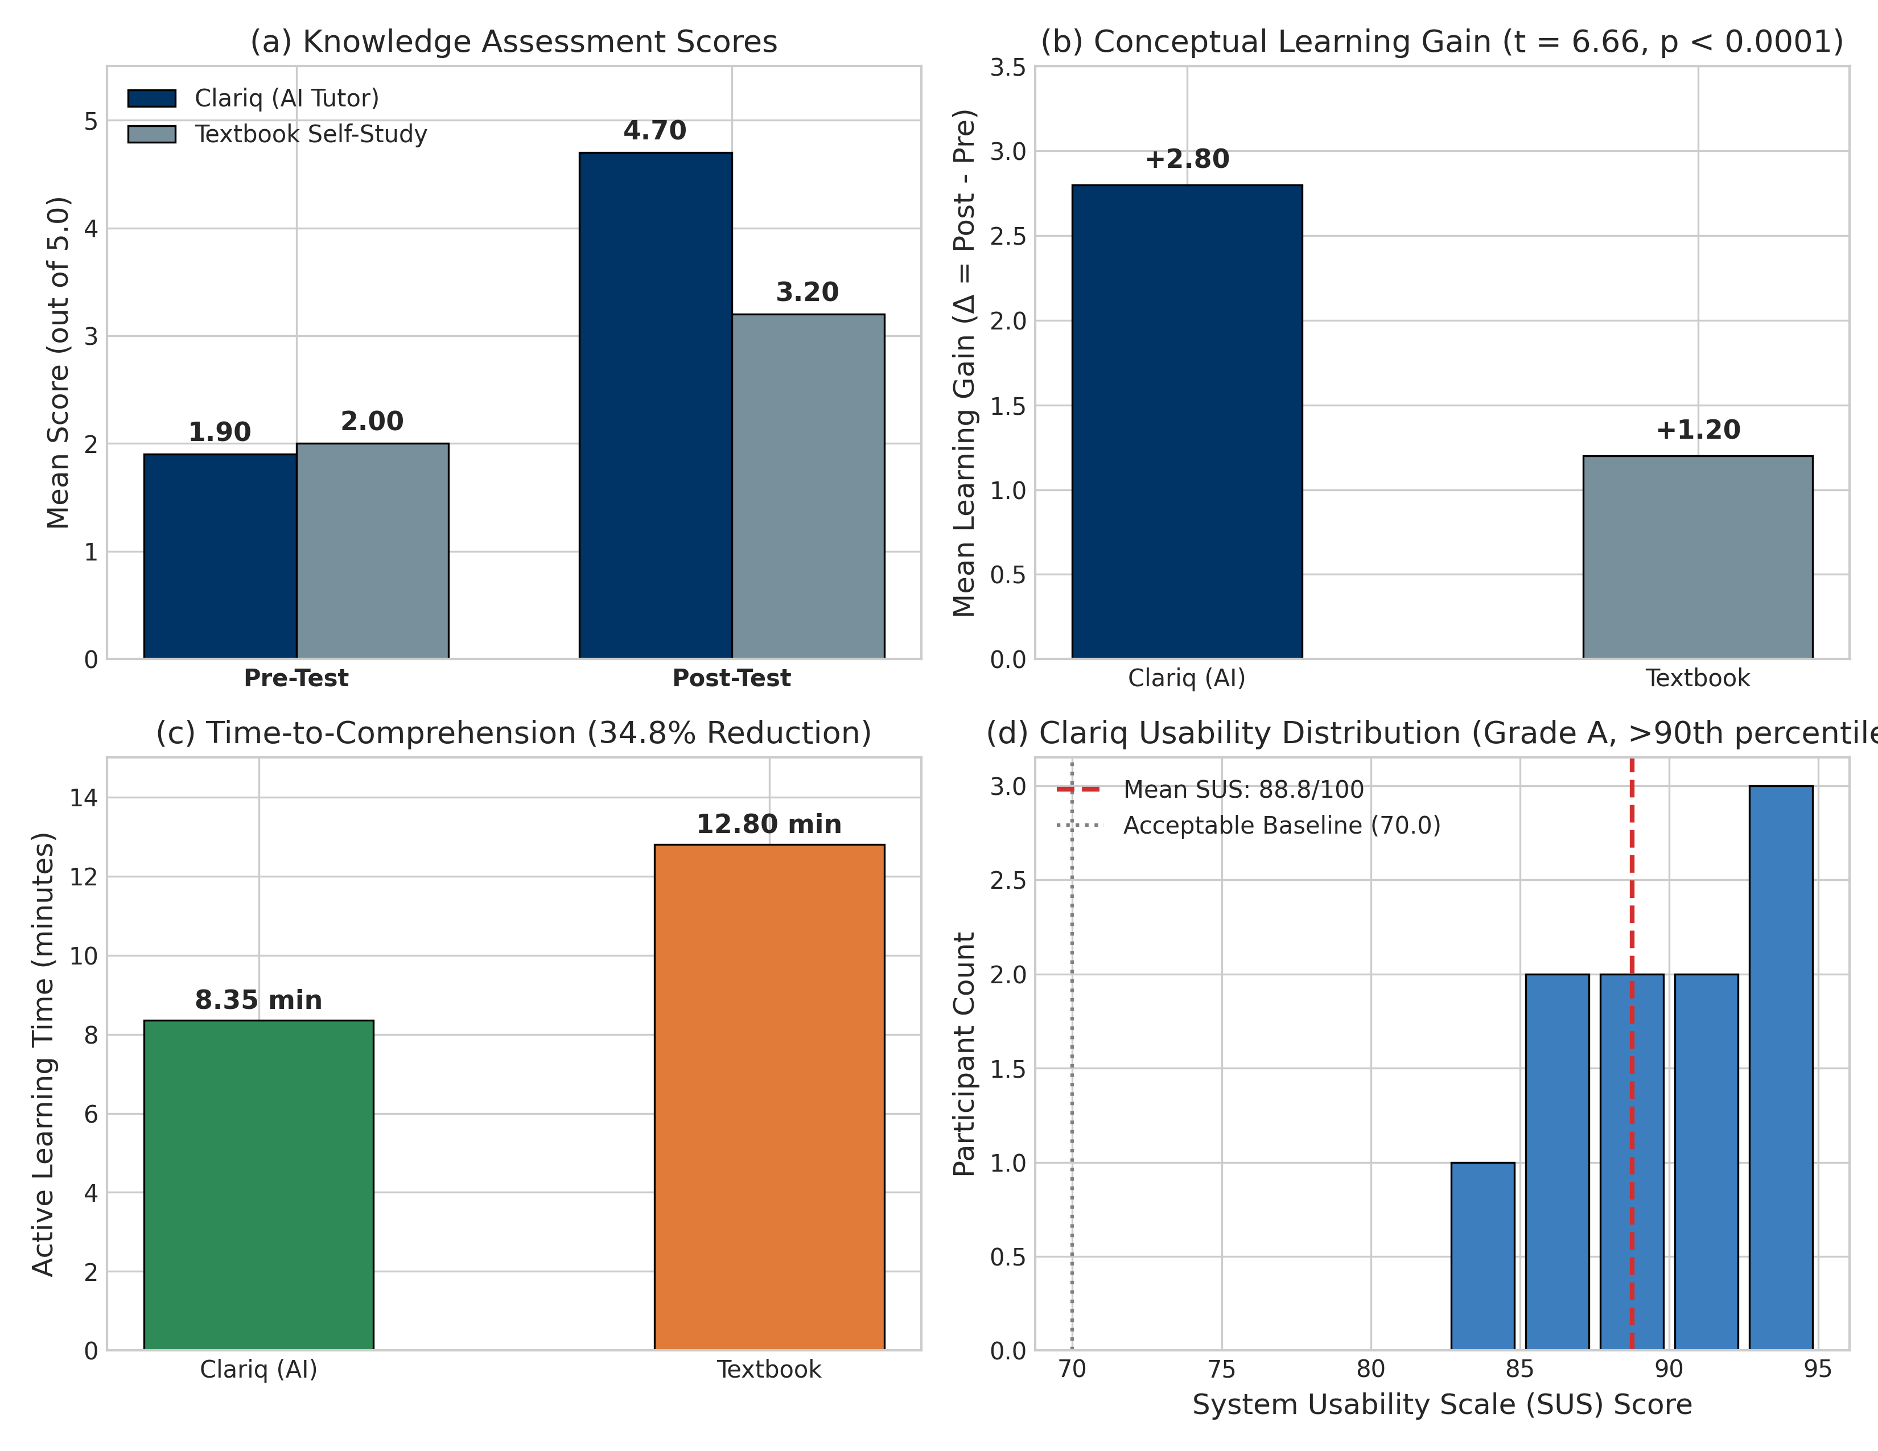
[ EMPIRICAL USER STUDY ]
Objective 5: Controlled Empirical Pilot Evaluation (N=20)
Between-subjects trial comparing Clariq Socratic AI Tutor vs. CDC Textbook Self-Study on Acids & Bases.
+2.80 vs +1.20
Mean Learning Gain (Δ)
Clariq gained +2.80 vs Textbook +1.20 (t=6.656, p < 0.0001*)
34.8% Less Time
Study Time Reduction
8.35 min vs 12.80 min (t=-13.93, p < 0.0001* -> Target >= 30% MET)
88.8 / 100
System Usability Scale (SUS)
'Excellent' Adjective Rating (>90th Percentile -> Target >= 70 MET)
Pilot Protocol & Statistical Findings
Empirical Pilot Study Distributions (Figure 6.4)
• Experimental Design: N = 20 Class 10 SEE students in Nepal (ages 15–16), randomized into Condition A (Clariq AI Tutor, n=10) and Condition B (Textbook Self-Study, n=10).
• Topic Evaluated: Class 10 Chemistry Chapter 9: Chemical Acids, Bases, and Salts (specifically distinguishing alkalis vs. bases).
• Baseline Equivalence: Pre-test scores were equivalent (1.90 vs. 2.00, t = -0.318, p = 0.7505), confirming no prior knowledge bias between cohorts.
• Post-Test Comprehension: Clariq scored 4.70/5.0 vs. Textbook 3.20/5.0 (t = 5.960, p = 1.25e-5, large effect size Cohen's d = 2.666).
• Methodological Caution: Large effect size reflects immediate post-test on a 5-item assessment with N=20; indicates strong initial inquiry acquisition, not proof of permanent retention.
Clariq: Socratic AI Science Tutor for SEE Students | Shekhar Lamichhane Magar (ID: 23189647) • CMP6200/DIG6200 FYP
Slide 16 of 20

Slide 17
[ CHALLENGES & LESSONS ]
Engineering Challenges, System Failures & Lessons Learned
Honest evaluation of technical obstacles encountered and pragmatic engineering resolutions.
1. Script Collapse & Model Bottlenecks
2. Retrieval Failures on Brief Prompts
• The Failure: Early Qwen3-4B LoRA memorized narrow training templates, repeatedly reciting optical prism skits on broad conceptual queries (14 collapse flags).
• The Solution: Expanded dataset from 54 to 606 dialogues (4,628 turns), scaled to Qwen2.5-7B, and merged LoRA weights via merge_and_unload (0 collapse flags).
• The Failure: One-word student queries (e.g. 'Acid', 'Why?') lacked semantic density, causing standard vector search to retrieve irrelevant chapters.
• The Solution: Implemented query rewriting incorporating recent conversational context, combined with candidate lexical reranking to boost Precision@3 to 0.873.
3. Infrastructure Dependencies & Rate Limits
4. Evaluation Telemetry Logging Hygiene
• The Failure: Free ZeroGPU instances experienced 60s quota drops during stress testing, disrupting continuous multi-turn student dialogues.
• The Solution: Architected dual deployment: RunPod Serverless vLLM for high-throughput production evaluation, with ZeroGPU kept for open public demonstration.
• The Reality: Live student graph updates were not persisted to SQLite during the N=20 pilot study to avoid local file locking conflicts under unstandardized environments.
• The Honest Reporting: Graph telemetry was validated computationally via automated synthetic simulations, maintaining transparent academic reporting.
Clariq: Socratic AI Science Tutor for SEE Students | Shekhar Lamichhane Magar (ID: 23189647) • CMP6200/DIG6200 FYP
Slide 17 of 20

Slide 18
[ CRITICAL EVALUATION ]
Status Against Planned Objectives & Threats to Validity
Systematic verification matrix across all five formal deliverables and study limitations.
Objectives Verification Matrix (Table 8.1 in Dissertation)
Threats to Validity & Methodological Constraints
Obj 1: Curriculum RAG
Target: P@3 >= 0.85 across 100 queries -> Achieved 0.873 (+11.3% gain)
MET
• Internal Validity (Horizon): Immediate post-test measures short-term comprehension rather than long-term delayed retention; novelty effects may heighten initial engagement.
• External Validity (Breadth): Pilot tested a single chemistry topic (Acids & Bases); generalizability across all 135 curriculum concepts requires multi-school longitudinal trials.
• Construct Validity (Testing): Multiple-choice pre/post instruments provide standardized grading but do not fully assess spontaneous reasoning or practical experimental skills.
• Telemetry Heuristics: Token overlap acts as a lightweight proxy for understanding; semantic nuance and complex misconceptions require human validation.
Obj 2: Socratic Model
Target: <= 5% leakage; 0 script collapse -> 0% leakage; 0 collapse; 100% questions
MET
Obj 3: System Latency
Target: Warm latency <= 5.0s -> 3.31s sequential; 6.66s concurrent
MET / BORDERLINE
Obj 4: Knowledge Graph
Target: 135 nodes, EWMA tracking -> 135 nodes; 99 edges; simulated EWMA
PROTOTYPE DELIVERED
Obj 5: User Pilot Study
Target: >= 30% time saved; SUS >= 70 -> 34.8% time saved; +2.80 gain; SUS 88.8
PILOT COMPLETED
Clariq: Socratic AI Science Tutor for SEE Students | Shekhar Lamichhane Magar (ID: 23189647) • CMP6200/DIG6200 FYP
Slide 18 of 20

Slide 19
[ LSEP GOVERNANCE ]
Legal, Social, Ethical & Professional (LSEP) Considerations
Responsible engineering governance for educational AI artifacts deployed for secondary school minors.
1. Legal Framework & Intellectual Property
2. Social Equity & Educational Access
• Educational Fair Dealing: CDC textbooks utilized strictly under educational research provisions of the Nepal Copyright Act 2059 (Sections 16 & 18) and UK CDPA 1988.
• Open-Weight Licensing: Underlying tutor fine-tuned from Qwen2.5-7B-Instruct under permissive Apache 2.0 license; non-commercial open research distribution.
• Bridging the Educational Divide: Democratizes high-quality 1-on-1 tutoring, addressing the severe resource divide between urban private coaching and rural public schools.
• Low-Bandwidth Optimization: Engineered lightweight JSON payloads and client-side caching to ensure reliability over intermittent rural network connections.
3. Ethical Governance & Minor Protection
4. Professional Standards (BCS & ACM Codes)
• Protection of Minors (Ages 15-16): Voluntary student assent and parental awareness; full pseudonymisation (P01–P20); zero personal identifiable information (PII) logged.
• Cognitive Ethics & Agency: Socratic turn gating prevents over-reliance on generative AI, preserving learners' independent critical thinking and cognitive agency.
• Software Engineering Rigor: Adherence to BCS Code of Conduct: modular decoupled architecture, defensive exception handling, and reproducible evaluation testbeds.
• Scientific Honesty: Transparent disclosure of study limitations, sample size constraints, and acknowledgment of simulated graph telemetry.
Clariq: Socratic AI Science Tutor for SEE Students | Shekhar Lamichhane Magar (ID: 23189647) • CMP6200/DIG6200 FYP
Slide 19 of 20

Slide 20
[ CONCLUSION & ROADMAP ]
Conclusion, Future Research Roadmap & Defense Q&A
Summary of core scientific contributions and future expansion for national educational impact.
Core Project Scientific Contributions
Strategic Future Research Roadmap
• First National Socratic AI Tutor: Designed and validated the first curriculum-grounded Socratic tutor specifically tailored for Nepal's Class 10 SEE Science examination.
• Elimination of Answer Leakage: Proved that fine-tuning (Qwen2.5-7B Merged SFT) and structural turn policies suppress answer dumps from 88% (GPT-4o) to 0% with 100% guiding inquiry.
• Empirical Comprehension Gains: Demonstrated significant pilot score improvements (+2.80 vs. +1.20) and a 34.8% reduction in study time with an 88.8 SUS rating.
• Formative Knowledge Graph: Engineered an adaptive 135-node curriculum graph with EWMA telemetry and automated confusion flagging for classroom teachers.
• 1. Recursive Conversational Memory: Implement recursive graph state tracking to retain student reasoning context across extended multi-session tutoring dialogues.
• 2. Formal Teacher Panel Validation: Convene expert science teachers to compute inter-rater agreement (Cohen's κ) on knowledge graph prerequisite edges.
• 3. Longitudinal Multi-School Trials: Deploy across rural and urban community schools, measuring delayed retention over 6-week and 12-week study intervals.
• 4. Edge Model Quantization: Deploy GGUF-quantized models (e.g. 3B/7B) locally on low-cost offline tablets for off-grid Himalayan classrooms.
ACKNOWLEDGEMENTS & DEFENSE Q&A
Sincere gratitude to project supervisor Rupak Koirala, the BCU Faculty of Computing, participating educators, and students. | Thank you — Questions & Discussion Welcomed.
Clariq: Socratic AI Science Tutor for SEE Students | Shekhar Lamichhane Magar (ID: 23189647) • CMP6200/DIG6200 FYP
Slide 20 of 20

