Slide 1

CAP615 PROGRAMMING IN JAVA
Unit-5

Slide 2
Topics Covered….
Managing data using JDBC:
introduction to JDBC,
connectivity with database,
CRUD operations,
Connection interface,
Statement interface, ResultSet interface, PreparedStatement,
ResultSetMetaData,
DatabaseMetaData

Slide 3
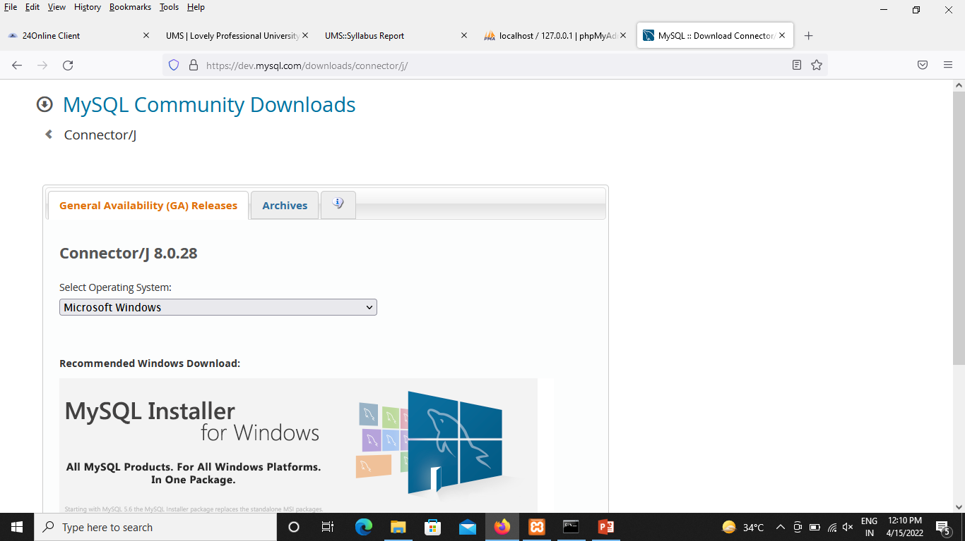
Steps to use MySQL Database
Go the link:
https://dev.mysql.com/downloads/connector/j/
Download MySQL Connector/J 8.0.28

Slide 4
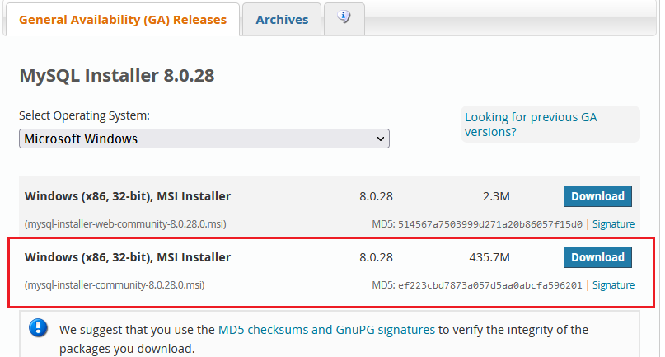

Slide 5
Now set path for MySQL Connector Jar file:
Copy path from location:
C:\Program Files (x86)\MySQL\Connector J 8.0\mysql-connector-java-8.0.28
Paste in Environment Variable:
Define Variable Name: classpath and paste this jar file location and put semicolon dot again semicolon:
C:\Program Files (x86)\MySQL\Connector J 8.0\mysql-connector-java-8.0.28;.;

Slide 6
If the CLASSPATH already exists in System Variables, click on the Edit button then put a semicolon (;) at the end. Paste the Path of MySQL-Connector Java.jar file.
If the CLASSPATH doesn't exist in System Variables, then click on the New button and type Variable name as CLASSPATH and Variable value as C:\Program Files (x86)\MySQL\Connector J 8.0\mysql-connector-java-8.0.28;.;
Note: Put ;.; at the end of the CLASSPATH.

Slide 7
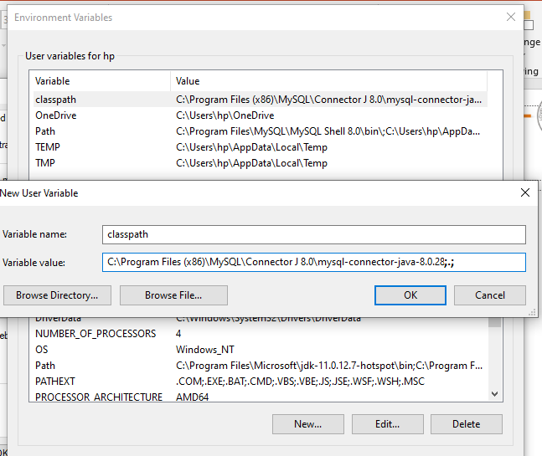

Slide 8
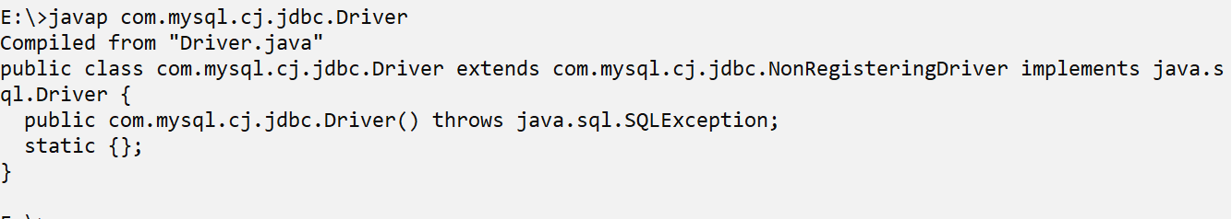
Now check connector jar file has been configured or not
Go to the command line:
E:\> javap com.mysql.cj.jdbc.Driver

Slide 9
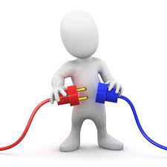
Introduction to JDBC
Java Database Connectivity
JDBC is a software tool and also known as an application programming interface(API) that is used to interact with the database.
JDBC
Java App
Databases

Slide 10
Need for Java JDBC
For establishing stable database connectivity with the application API.
To execute SQL(Structured Query Language) queries and DDL/DML commands.
For viewing and modify data records

Slide 11
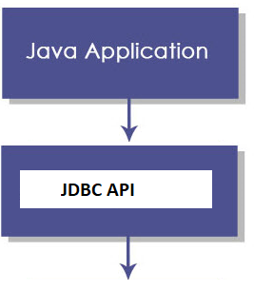
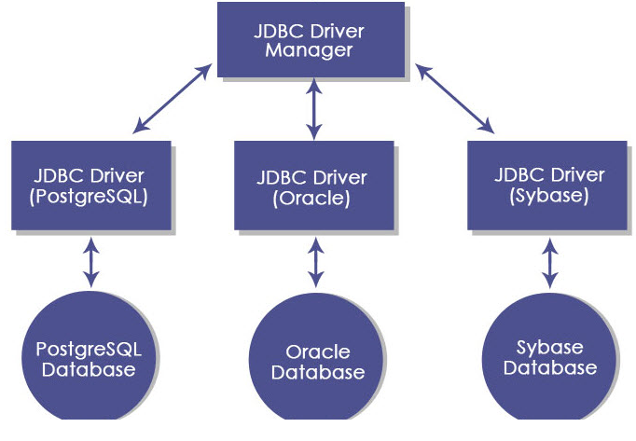
JDBC Architecture

Slide 12
JDBC API: It provides various methods and interfaces for easy communication with the database.
Interfaces of JDBC API
Driver interface
Connection interface
Statement interface
PreparedStatement interface
CallableStatement interface
ResultSet interface
ResultSetMetaData interface
DatabaseMetaData interface
RowSet interface
Classes of JDBC API
DriverManager class
Blob class
Clob class
Types class

Slide 13
JDBC Driver manager : It loads a database-specific driver in an application to establish a connection with a database.

Slide 14
JDBC Drivers
JDBC drivers are client-side adapters (installed on the client machine, not on the server) that convert requests from Java programs to a protocol that the DBMS can understand.
There are 4 types of JDBC drivers:
Type-1 driver or JDBC-ODBC bridge driver
Type-2 driver or Native-API driver
Type-3 driver or Network Protocol driver
Type-4 driver or Thin driver

Slide 15
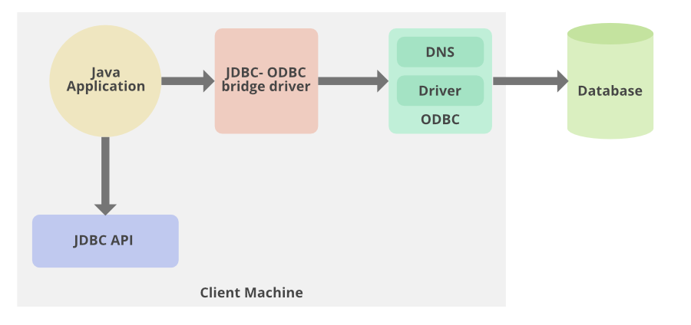
Type 1 − JDBC-ODBC Bridge Driver:
it provides a bridge to access the ODBC driver installed on each client. Using ODBC, requires configuring on your system a Data Source Name (DSN) that represents the target database.

Slide 16
Using the JDBC-ODBC bridge driver we can access the databases which support only ODBC. Java application sends a request to the JDBC-ODBC bridge driver the request internally calls the ODBC equivalent function and the ODBC driver retrieves the result from the underlying database and sends it back to the JDBC-ODBC bridge driver.

Slide 17
Oracle does not support the JDBC-ODBC Bridge from Java 8. Oracle recommends that you use JDBC drivers provided by the vendor of your database instead of the JDBC-ODBC Bridge.

Slide 18
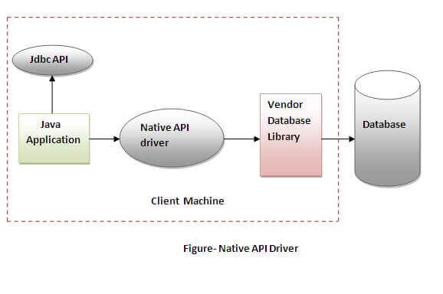
Native-API driver
The Native API driver uses the client-side libraries of the database. The driver converts JDBC method calls into native calls of the database API. It is not written entirely in java.

Slide 19
Advantage:
performance upgraded than JDBC-ODBC bridge driver.
Disadvantage:
The Native driver needs to be installed on the each client machine.
The Vendor client library needs to be installed on client machine.

Slide 20
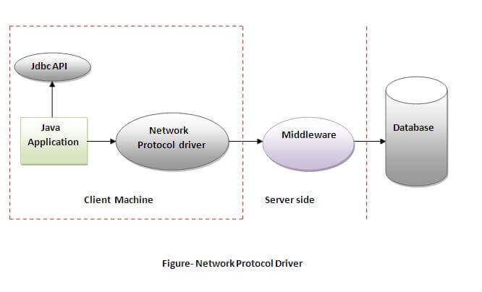
Network Protocol driver
The Network Protocol driver uses middleware (application server) that converts JDBC calls directly or indirectly into the vendor-specific database protocol. It is fully written in java.

Slide 21
Advantage:
No client side library is required because of application server that can perform many tasks like auditing, load balancing, logging etc.
Disadvantages:
Network support is required on client machine.
Requires database-specific coding to be done in the middle tier.
Maintenance of Network Protocol driver becomes costly because it requires database-specific coding to be done in the middle tier.

Slide 22
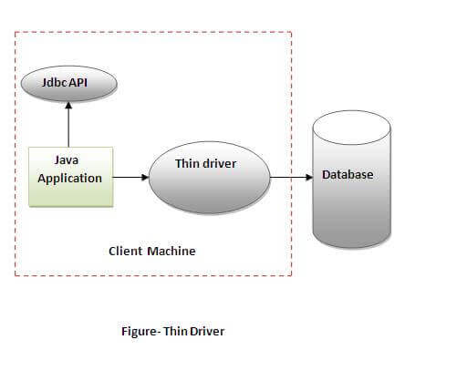
Thin driver
The thin driver converts JDBC calls directly into the vendor-specific database protocol. That is why it is known as thin driver. It is fully written in Java language.

Slide 23
Advantage:
Better performance than all other drivers.
No software is required at client side or server side.
Disadvantage:
Drivers depend on the Database.

Slide 24
The name of the class that implements java.sql.Driver in MySQL Connector/J is
com.mysql.cj.jdbc.Driver

Slide 25
Difference between DDL and DML:
DDL | DML
It stands for Data Definition Language. | It stands for Data Manipulation Language.
It is used to create database schema and can be used to define some constraints as well. | It is used to add, retrieve or update the data.
It basically defines the column (Attributes) of the table. | It add or update the row of the table. These rows are called as tuple.
Basic command present in DDL are CREATE, DROP, RENAME, ALTER etc. | BASIC command present in DML are UPDATE, INSERT, MERGE etc.
DDL does not use WHERE clause in its statement. | While DML uses WHERE clause in its statement.

Slide 26
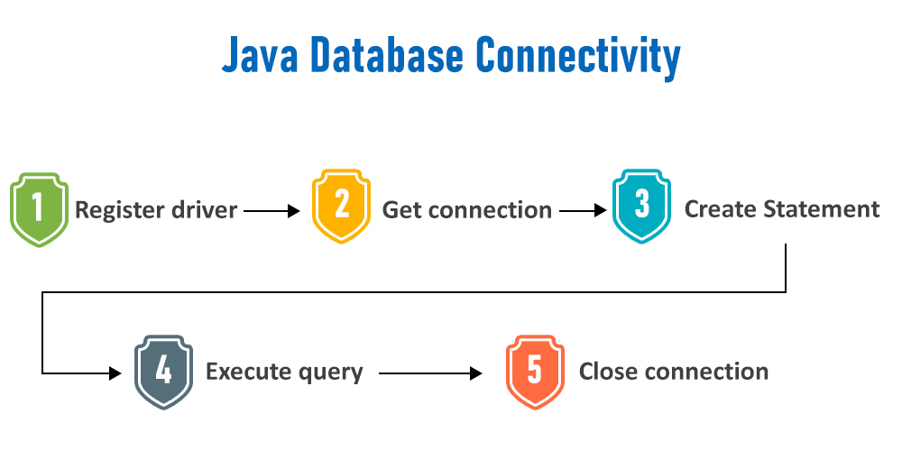
Steps to Connect Java JDBC

Slide 27
Import-Packages
: import java.sql*;
Load and Register the Driver:
DriverManager.registerDriver(driverClassName);
Or,
Class.forName(driverClassName);
Since JDBC 4.0, explicitly registering the driver is optional. We just need to put vender's Jar in the classpath, and then JDBC driver manager can detect and load the driver automatically.

Slide 28
Get connection or Connect to the Database:
DriverManager. getConnecttion(url,username,password);
String url = "jdbc:mysql://localhost:3306/;
String username = "root";
String passwd = "admin";
The getConnection() method of DriverManager class is used to establish connection with the database.
Syntax of getConnection() method:
public static Connection getConnection(String url)throws SQLException
public static Connection getConnection(String url,String name,String password) throws SQLException

Slide 29
https://docs.oracle.com/javase/7/docs/api/java/sql/Connection.html
https://docs.oracle.com/javase/7/docs/api/java/sql/DriverManager.html

Slide 30
Create Statement:
The createStatement() method of Connection interface is used to create statement. The object of statement is responsible to execute queries with the database.
Syntax of createStatement() method
public Statement createStatement()throws SQLException

Slide 31
Example to create the statement object
Statement stmt=con.createStatement();

Slide 32
Execute the query
The executeQuery() method of Statement interface is used to execute queries to the database. This method returns the object of ResultSet that can be used to get all the records of a table.
Syntax of executeQuery() method
public ResultSet executeQuery(String sql)throws SQLException

Slide 33
Example to execute query
ResultSet rs=stmt.executeQuery("select * from emp");
while(rs.next())
{
System.out.println(rs.getInt(1)+" "+rs.getString(2));
}

Slide 34
Close the connection object
By closing connection object statement and ResultSet will be closed automatically. The close() method of Connection interface is used to close the connection.
Syntax of close() method
public void close()throws SQLException

Slide 35
Example to close connection
con.close();
It avoids explicit connection closing step.
Since Java 7, JDBC has ability to use try-with-resources statement to automatically close resources of type Connection, ResultSet, and Statement.

Slide 36
Steps to use mysql in netbeans
Go to : https://search.maven.org/
Search:
<dependency>
<groupId>mysql</groupId>
<artifactId>mysql-connector-java</artifactId>
<version>8.0.28</version>
</dependency>

Slide 37
Connection Interface
Connection interface represents a session between java application and database. All SQL statements are executed and results are returned with in the context of a Connection object.
You can also use it to retrieve the metadata of a database like name of the database product, name of the JDBC driver, major and minor version of the database etc.

Slide 38
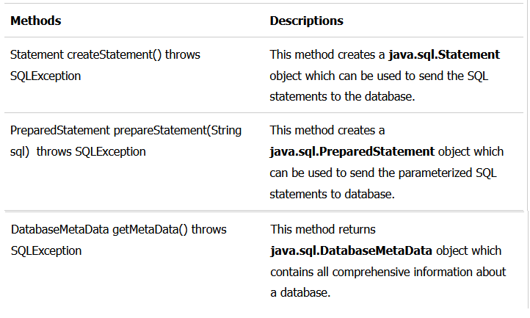
useful methods of Connection interface:

Slide 39
Statement interface
The statement interface is used to create SQL statements. It provides methods to execute queries with the database.
There are different types of statements that are used in JDBC as follows:
Create a Statement: Statement
PreparedStatement
CallableStatement

Slide 40
Create a Statement: It is generally used for general–purpose access to databases and is useful while using static SQL statements at runtime.
Syntax:
Statement statement = connection.createStatement();
Once the Statement object is created, there are three ways to execute it:
boolean execute(String SQL)
int executeUpdate(String SQL)
ResultSet executeQuery(String SQL)

Slide 41
PrepareStatement:
Prepared Statement represents a recompiled SQL statement, that can be executed many times. This accepts parameterized SQL queries. In this, “?” is used instead of the parameter, one can pass the parameter dynamically by using the methods of PREPARED STATEMENT at run time.
Once the PreparedStatement object is created, there are three ways to execute it:
boolean execute(String SQL)
int executeUpdate(String SQL)
ResultSet executeQuery(String SQL)

Slide 42
Callable Statement :
The CallableStatement interface is used to execute the SQL stored procedure in a database. The JDBC API provides stored procedures to be called in a standard way for all RDBMS.
Syntax: To prepare a CallableStatement
CallableStatement cstmt =
con.prepareCall("{call Procedure_name(?, ?}");

Slide 43
ResultSet interface
It is used to store the data which are returned from the database table after the execution of the SQL statements. The object of ResultSet maintains cursor point at the result data. In default, the cursor positions before the first row of the result data.
The next() method is used to move the cursor to the next position in a forward direction. It will return FALSE if there are no more records. It retrieves data by calling the executeQuery() method using any of the statement objects.

Slide 44
How to use ResultSet?
Statement statemnt1 = conn.createStatement();
ResultSet rs1 = statemnt1.executeQuery(“Select * from EMPLOYEE_DETAILS”);
PreparedStatement pstatemnt1 = conn.prepareStatement(insert_query);
ResultSet rs1 = pstatemnt1.executeQuery(“Select * from EMPLOYEE_DETAILS”);

Slide 45
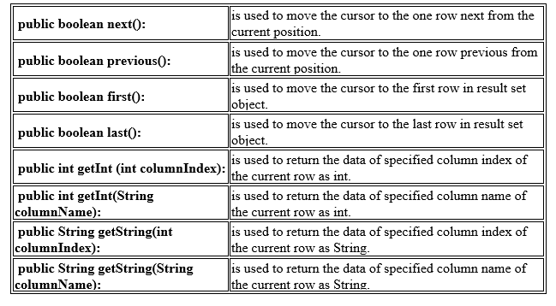
Methods in ResultSet

Slide 46
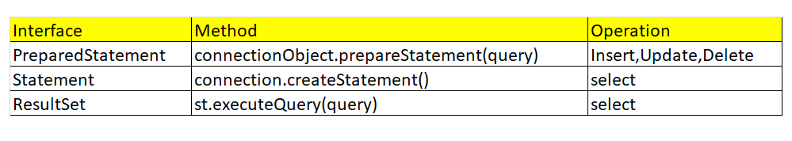
Note:

Slide 47
ResultSetMetaData Interface
The metadata means data about data i.e. we can get further information from the data.
If you have to get metadata of a table like total number of column, column name, column type etc. , ResultSetMetaData interface is useful because it provides methods to get metadata from the ResultSet object.

Slide 48
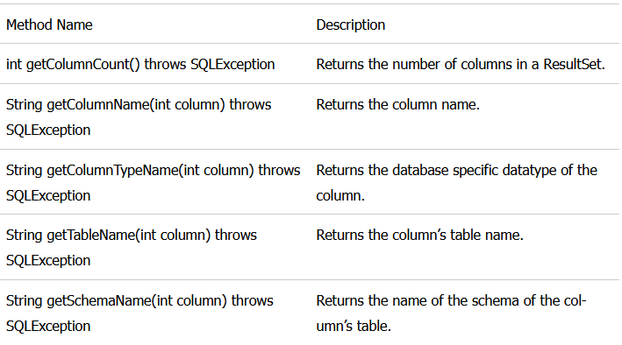
ResultSetMetaData Methods

Slide 49
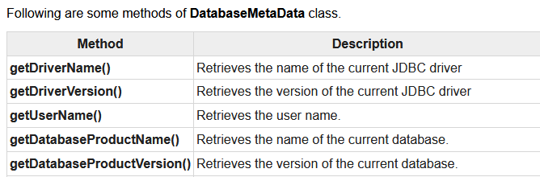
DatabaseMetaData interface
DatabaseMetaData interface provides methods to get meta data of a database such as database product name, database product version, driver name, name of total number of tables, name of total number of views etc.

Slide 50


