Slide 1
CAP615 PROGRAMMING IN JAVA
Presented by
Kumar Vishal

Slide 2
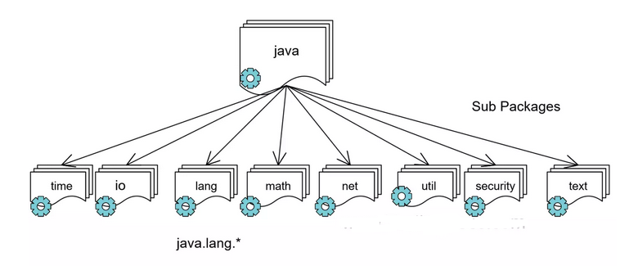
Java Packages

Slide 3
lang package in Java
It is a built-in package provided by the JDK (Java Development Kit).
java.lang package is a default package in Java, which means that it is automatically imported into all Java programs.

Slide 4
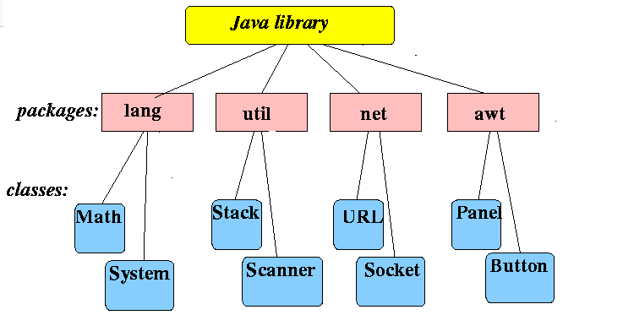

Slide 5
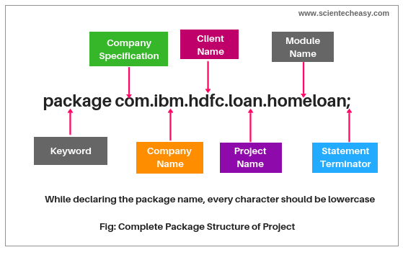
Naming Convention to declare User-defined Package in Real-time Project

Slide 6
Creating package in Java
Java supports a keyword called “package” which is used to create user-defined packages in java programming. It has the following general form:
package packageName;
For example:
package myPackage;
public class A {
// class body
}

Slide 7
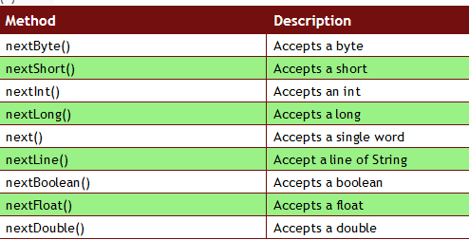
Scanner class in Java
Scanner is a class in java.util package used for reading input from console. It is the easiest way to read input in a Java program.

Slide 8
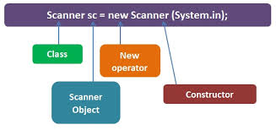

Slide 9
Java provides the following three standard streams:
Standard Input: This is used to feed the data to user's program and usually a keyboard is used as a standard input stream and represented as System.in.
Standard Output: This is used to output the data produced by the user's program and usually a computer screen is used for standard output stream and represented as System.out.
Standard Error: This is used to output the error data produced by the user's program and usually a computer screen is used for standard error stream and represented as System.err.

Slide 10
Any Query??

