Slide 1

CAP615 PROGRAMMING IN JAVA
Lecture #3

Slide 2
inner and nested classes
Define a class within another class, such classes are known as nested classes
Nested classes are divided into two categories:
static nested class :
Nested classes that are declared static are called static nested classes.
inner class :
An inner class is a non-static nested class.

Slide 3
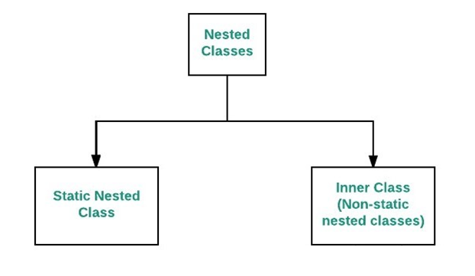

Slide 4
Example static nested class
class University
{
static class Department
{
public static void getDepartment()
{
System.out.println("SCA");
}
}
public void getUniversity()
{
System.out.println("LPU");
}
}

Slide 5
What will be output?
static class University
{
class Department
{
public void getDepartment()
{
System.out.print("SCA");
}
}
public void getUniversity()
{
System.out.print("LPU");
}
}
SCA
LPU
SCALPU
Error

Slide 6
Difference between Normal inner class and Static nested class
In normal inner class, we cannot declare any static members but in the static nested class, we can declare a static member including the main method.
Since we cannot declare the main method in the normal inner class, therefore, we cannot run inner class directly from the command prompt. But we can declare the main method and can also run the static nested class directly from the command prompt.

Slide 8


