Slide 1

CAP615 PROGRAMMING IN JAVA
Unit- 1

Slide 2
Unit-1
Introduction to Java :
basic java concepts,
JDK, JRE and JVM,
wrapper classes,
inner and nested classes,
working with arrays and strings,
String, String Buffer and StringBuilder classes,
access specifiers,
inheritance

Slide 3
Introduction about the java programming development tools
What is development tools in Java?
JDK (Java Development Kit)
JDK
JDK is Java Development Kit. The Java Development Kit (JDK) is a software development environment which is used to develop Java applications.

Slide 4
JRE (Java Runtime Environment) is an installation package that provides an environment to only run(not develop) the java program(or application)onto your machine. JRE is only used by those who only want to run Java programs.

Slide 5
JVM (Java Virtual Machine) is a very important part of both JDK and JRE because it is contained or inbuilt in both. Whatever Java program you run using JRE or JDK goes into JVM and JVM is responsible for executing the java program line by line, hence it is also known as an interpreter.

Slide 6
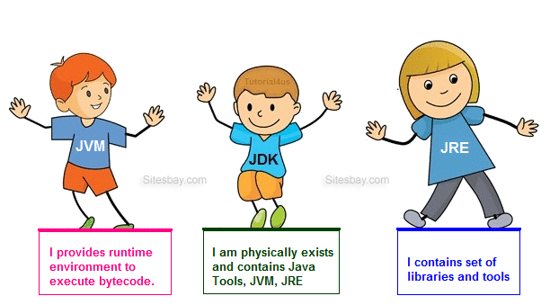
Working of JVM, JDK and JRE

Slide 7
There are different types of Java editions are available to develop applications:
Java Standard Edition (JSE)
Java Enterprise Edition(JEE)
Java Micro Edition(JME)

Slide 8
Java Standard Edition (JSE)
JSE can be used to develop client-side standalone (independant) applications or applets.
Java Enterprise Edition (JEE)
JEE can be used to develop server-side applications such as Java servlets and Java ServerPages.
Java Micro Edition (JME).
JME can be used to develop applications for mobile devices such as cell phones.

Slide 9
Basic java concepts:
Introduction about the java programming development tools,
Java keywords,
variables,
data types,
operators and
control statements

Slide 10
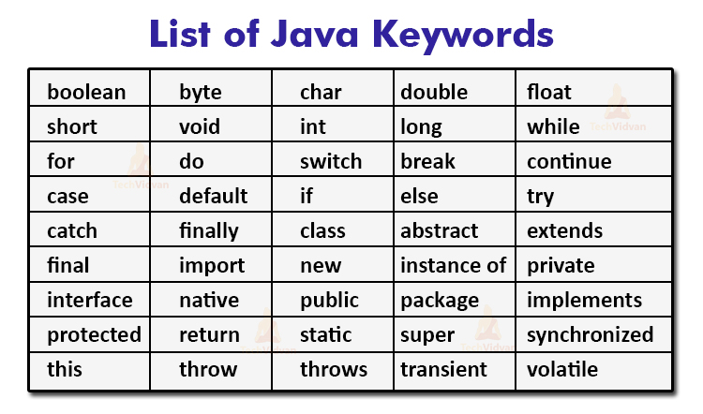
Java keywords: reserve words

Slide 11
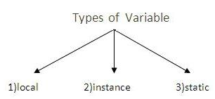
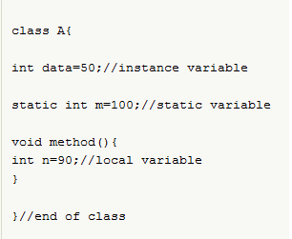
Variables:

Slide 12
Instance vs static
Instance variables gets the memory at the time of object creation, each object will have the copy of instance variable, if it is incremented, it won’t reflect to other objects.
Static variable will get the memory only once, if any object changes the value of the static variable , it will retain its value.

Slide 13
Data types in Java
Primitive
Non primitive
boolean
byte
short
int
long
char
float
double
String
Array
Class
Interface

Slide 14
To find size of datatypes
class MainClass
{
public static void main(String []args)
{
System.out.println("Size of int: " + (Integer.SIZE/8) + " bytes.");
System.out.println("Size of long: " + (Long.SIZE/8) + " bytes.");
System.out.println("Size of char: " + (Character.SIZE/8) + " bytes.");
System.out.println("Size of float: " + (Float.SIZE/8) + " bytes.");
System.out.println("Size of double: " + (Double.SIZE/8) + " bytes.");
}
}

Slide 15
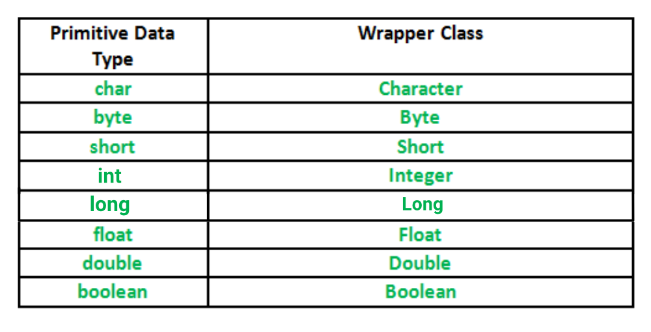
A Wrapper class is a class whose object wraps or contains
primitive data types.

Slide 16
When we create an object to a wrapper class, we can store primitive data types.
Example:
char ch = 'a';
Character a = ch;
In which case we can use:
Data structures in the Collection framework, such as ArrayList and Vector, store only objects (reference types) and not primitive types.

Slide 17
Important :what is autoboxing and unboxing?
The wrapper class in Java provides the mechanism to convert primitive into object and object into primitive.
The automatic conversion of primitive into an object is known as autoboxing and vice-versa unboxing.

Slide 18
In both which one is correct and why?
float a=10.123456789
double b=10.123456789

Slide 19
Float can store 6 digit after decimal points
Double can store 15 digit after decimal points
By default decimal will store double means
If we write Pi=3.14
It will store double datatype

Slide 20
public class Main
{
public static void main(String[] args)
{
float a=10.123456789f;
double b=10.123456789;
System.out.println(a);
System.out.println(b);
}
}

Slide 21

Operators

Slide 22
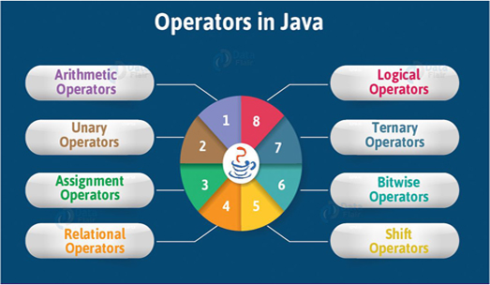

Slide 23
Arithmetic operators
Operator | Name | Example
+ | Addition | x + y
- | Subtraction | x - y
* | Multiplication | x * y
/ | Division | x / y
% | Modulus | x % y

Slide 24
Assignment Operators
Operator | Example | Same As
= | x = 5 | x = 5
+= | x += 3 | x = x + 3
-= | x -= 3 | x = x - 3
*= | x *= 3 | x = x * 3
/= | x /= 3 | x = x / 3
%= | x %= 3 | x = x % 3
&= | x &= 3 | x = x & 3
|= | x |= 3 | x = x | 3
^= | x ^= 3 | x = x ^ 3
>>= | x >>= 3 | x = x >> 3
<<= | x <<= 3 | x = x << 3

Slide 25
Comparison operators
Operator | Name | Example
== | Equal to | x == y
!= | Not equal | x != y
> | Greater than | x > y
< | Less than | x < y
>= | Greater than or equal to | x >= y
<= | Less than or equal to | x <= y

Slide 26
Logical operators
Operator | Name | Description | Example
&& | Logical and | Returns true if both statements are true | x < 5 && x < 10
|| | Logical or | Returns true if one of the statements is true | x < 5 || x < 4
! | Logical not | Reverse the result, returns false if the result is true | !(x < 5 && x < 10)

Slide 27
Bitwise operators
Operator | Description
& | AND Operator
| | OR Operator
^ | XOR Operator
~ | Ones Complement Operator
<< | Left Shift Operator
>> | Right Shift Operator

Slide 28
AND Operator (&)
If both side bit is on result will be On
a | b | a & b
0 | 0 | 0
0 | 1 | 0
1 | 0 | 0
1 | 1 | 1

Slide 29
Steps to solve:-
a = 12 (find binary form:1100 )
b = 25 (find binary form:11001)
How to find Binary:
64 32 16 8 4 2 1
0 1 1 0 0
12
25
8
1 1 0 0 1
1 0 0 0

Slide 30
a & b=
01100 (12)
11001 (25)
01000 (8) Ans.

Slide 31
OR Operator (|)
If any side bit is on result will be On
a | b | a | b
0 | 0 | 0
0 | 1 | 1
1 | 0 | 1
1 | 1 | 1

Slide 32
Steps to solve:-
a = 12 (find binary form:1100 )
b = 25 (find binary form:11001)
How to find Binary:
64 32 16 8 4 2 1
0 1 1 0 0
12
25
29
1 1 0 0 1
1 1 1 0 1

Slide 33
a | b=
01100 (12)
11001 (25)
11101 (29) Ans.

Slide 34
XOR Operator (^)
If both side bit is opposite result will be On
a | b | a ^ b
0 | 0 | 0
0 | 1 | 1
1 | 0 | 1
1 | 1 | 0

Slide 35
Steps to solve:-
a = 12 (find binary form:1100 )
b = 25 (find binary form:11001)
How to find Binary:
64 32 16 8 4 2 1
0 1 1 0 0
12
25
21
1 1 0 0 1
1 0 1 0 1

Slide 36
a ^ b=
01100 (12)
11001 (25)
10101 (21) Ans.

Slide 37
Left Shift Operator(<<)
a=10 (1010)
a<<1
1010.0
10100(20) Ans.
a<<2
1010.00
101000(40) Ans.

Slide 38
Right Shift Operator(>>)
a=10 (1010)
a>>1
1010.
101(5) Ans.
a>>2
1010.
10(2) Ans.

Slide 39
Unary Operators in Java
Java unary operators are the types that need only one operand to perform any operation like increment, decrement, negation, etc. It consists of various arithmetic, logical and other operators that operate on a single operand.

Slide 40
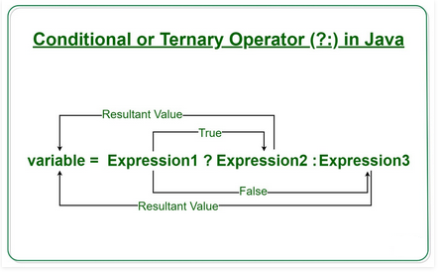
Ternary Operator
Java ternary operator is the only conditional operator that takes three operands. It’s a one-liner replacement for if-then-else statement and used a lot in Java programming.

Slide 41
Control Statements:
???

Slide 42
if/else constructs
If(condition)
{
// statement execute when condition true
}
else
{
// statement execute when condition false
}

Slide 43
switch statement
To select choices/options from user it used:
Switch with choice (integer value like: 1,2,..)
Switch with choice (character value like: A,B,..)
Switch with choice (String value like: “ADD”,”SUB”,..)

Slide 44
looping controls, nested loops
While loop
Do while loop
For loop
Enhanced or advanced for loop
Nested loops means one loop inside another loop.

Slide 45
Enhanced For loop
for(data_type variable : array | collection)
{
//body of for-each loop
}

Slide 46
Example:
int myArray[]=new int[]{11,12,13,14,15};
for(int num : myArray)
{
System.out.println(num);
}

Slide 47
Does Java support goto?
No but keyword is there

Slide 48
inner and nested classes
Define a class within another class, such classes are known as nested classes
Nested classes are divided into two categories:
static nested class :
Nested classes that are declared static are called static nested classes.
inner class :
An inner class is a non-static nested class.

Slide 49
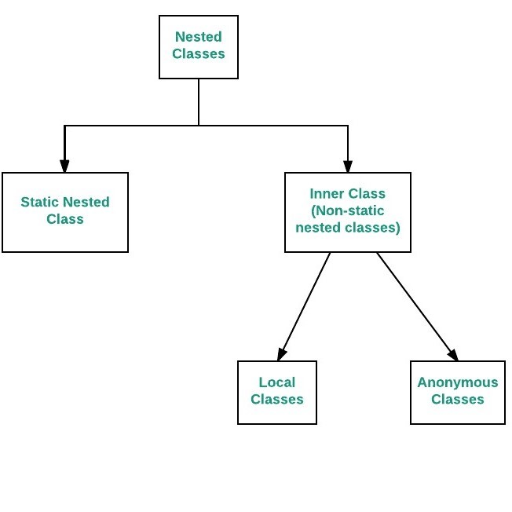

Slide 50
Difference between Normal inner class and Static nested class
In normal inner class, we cannot declare any static members but in the static nested class, we can declare a static member including the main method.
Since we cannot declare the main method in the normal inner class, therefore, we cannot run inner class directly from the command prompt. But we can declare the main method and can also run the static nested class directly from the command prompt.
A normal inner class can access both static and non-static members of the outer class directly but from the static nested class, we can access only static members.

Slide 51
Array
Array is a collection of similar type of elements that have contiguous memory location.
In java, array is an object the contains elements of similar data type.
It is a data structure where we store similar elements. We can store only fixed elements in an array.
Array is index based, first element of the array is stored at 0 index.

Slide 52
Advantage of Array
Code Optimization: It makes the code optimized, we can retrieve or sort the data easily.
Random access: We can get any data located at any index position.
Disadvantage of Array
Size Limit: We can store only fixed size of elements in the array. It doesn't grow its size at runtime. To solve this problem, collection framework is used in java.

Slide 53
Types of Array: There are two types of array.
Single Dimensional Array
Multidimensional Array-
2D array
3D array
Jagged array

Slide 54
Single Dimensional Array
The syntax for declaring and instantiating an array:
There are two ways to declare an array,
type[] arrayName;
type arrayName[];

Slide 55
How to instantiate an array
arrayName = new type[length];
How to declare and instantiate an array in one statement
type[] arrayName = new type[length];

Slide 56
Examples
Array of integers
int[] num = new int[5];
Array of Strings
String[] nameList = new String[5];
nameList[0] = "Amanda Green";
nameList[1] = "Vijay Arora";
nameList[2] = "Sheila Mann";
nameList[3] = "Rohit Sharma";
nameList[4] = "Mandy Johnson";

Slide 57
Enhanced For loop
for(data_type variable : array | collection)
{
//body of for-each loop
}

Slide 58
Example:
int []myArray=new int[]{11,12,13,14,15};
for(int num : myArray)
{
System.out.println(num);
}

Slide 59
Array length
The syntax for getting the length of an array
arrayName.length
e.g-
int[] values = new int[10];
for (int i = 0; i < values.length; i++)
{
values[i] = i;
}

Slide 60
Two-dimensional arrays
The syntax for creating a rectangular array-
type[][] arrayName = new type[rowCount][columnCount];
A statement that creates a 3x2 array
int[][] numbers = new int[3][2];
3x2 array and initializes it in one statement
int[][] numbers =new int[][] { { 1, 2 }, { 3, 4 }, { 5, 6 } };

Slide 61
Enhanced for loop for 2D array
for (int[] num: arr)
{
for(int data: num)
{
System.out.println(data);
}
}

Slide 62
Jagged array
type[][] arrayName = new type[rowCount][];
e.g:-int num[][]=new int[4][];
num[0]=new int[1];
num[1]=new int[2];
num[2]=new int[3];
num[3]=new int[4];

Slide 63
Enhanced for loop for 2D array
for (int[] num: arr)
{
for(int data: num)
{
System.out.println(data);
}
}

Slide 64
3 d array:
Syntax:
array_type[][][] array_name = new array_type[x][y][z];
Ex:
int[][][] num=new int[2][3][4];
Here, num[i][j][k] where ‘i’ is the array number, ‘j’ is the row number and ‘k’ is the column number.

Slide 65
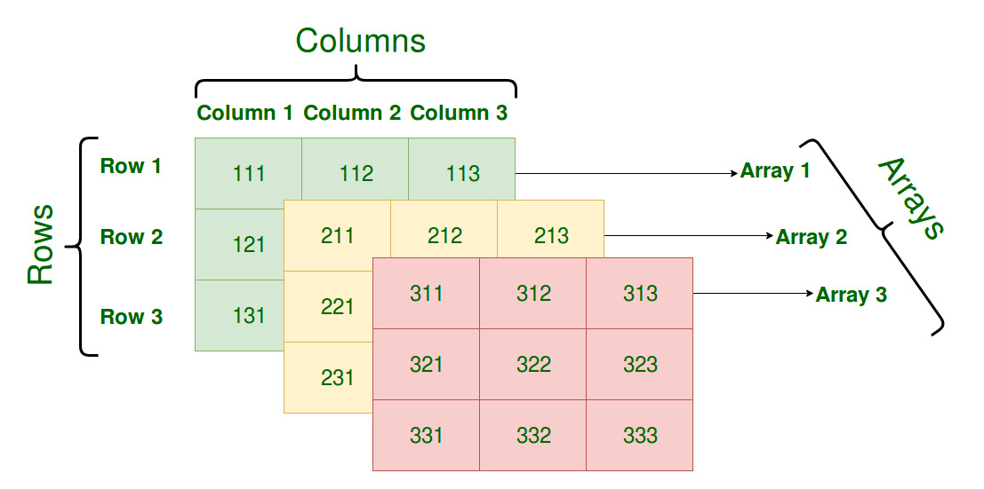
int[][][] num=new int[3][3][3];

Slide 66
For example find exam scores obtained by three students of each department in 3 different subjects.

Slide 67
Electronics department:
student1 scores: 75, 87, 69
student2 scores: 90, 87, 85
student3 scores: 56, 67, 76
Computer Science department:
student1 scores: 78, 67, 75
student2 scores: 87, 98, 76
student3 scores: 67, 56, 65
Information Technology department:
student1 scores: 72, 63, 72
student2 scores: 82, 91, 71
student3 scores: 64, 56, 66
To store all these exam scores, department-wise,
we will need to use three-dimensional array
int[ ][ ][ ] scores = new int[3][3][3];

Slide 68
4 D Array
Array of 3 D Array
int [][][][] num=new int[2][2][2][2];
Multi dimensional array means array of arrays.

Slide 69
String Class
String is a sequence of characters. But in Java, string is an object that represents a sequence of characters.
The java.lang.String class is used to create a string object.
In java, String objects are immutable which means a constant and cannot be changed once created.

Slide 70
string is immutable in java:
public static void main(String args[]){
String s=“Kumar";
s.concat(" Vishal");
System.out.println(s);
}
Output: Kumar

Slide 71
Here value not changed new object
Kumar Vishal has created
S
Kumar
s1
Kumar Vishal

Slide 72
Why string objects are immutable in java?
Because java uses the concept of string literal. Suppose there are 5 reference variables,all referes to one object “kumar".If one reference variable changes the value of the object, it will be affected to all the reference variables. That is why string objects are immutable in java.

Slide 73
There are two ways to create String object:
By string literal
By new keyword

Slide 74
string literal:
kumar
s
string constant pool
String s=“kumar";
Each time you create a string literal, the JVM checks the "string pool" first. If the string already exists in the pool, a reference to the pooled object is returned. If the string doesn't exist in the pool, a new string object is created and placed in the pool.
String s1=“kumar";
String s2=“kumar";
//It doesn't create a new string object
s1
kumar
s2
string constant pool

Slide 75
By new keyword:
String s=new String(“kumar")
In this case, JVM will create a new string object in normal (non-pool) heap memory, and the literal “kumar" will be placed in the string constant pool. The variable s will refer to the object in a heap (non-pool).

Slide 76
Concept:---
S
String s1=“kumar”
String s2=“kumar”
String s3= “Rahul”
s1
kumar
Rahul
s2
s3
String s4=new String(“kumar”)
string pool
s1==s2 // true
s1==s3//false
s1==s4//false
s4
kumar
Heap
Note:- Here s1,s2,s3 and s4 are references of string object kumar, Rahul, kumar

Slide 77
Methods in String class:
length(),
charAt()
Substring()
concat
indexOf()
equals()
compareTo()
trim()
replace()
toUpperCase()
toLowerCase();

Slide 78
length(), charAt()
int length();
char charAt(i);
Returns the number of characters in the string
Returns the char at position i.
Character positions in strings are numbered starting from 0 – just like arrays.
Returns:
”Problem".length();
”Window".charAt (2);
7
’n'

Slide 79
Substring()
Returns a new String by finding characters from an existing String.
String subs = word.substring (i, k);
returns the substring of chars in positions from i to k-1
String subs = word.substring (i);
returns the substring from the i-th char to the end
television
i k
television
i
Returns:
”television".substring (2,5);
“immutable".substring (2);
“lev"
“mutable"

Slide 80
Concatenation()
String word1 = “re”, word2 = “think”; word3 = “ing”;
int num = 2;
String result = word1.concat (word2);
//the same as word1 + word2 “rethink“

Slide 81
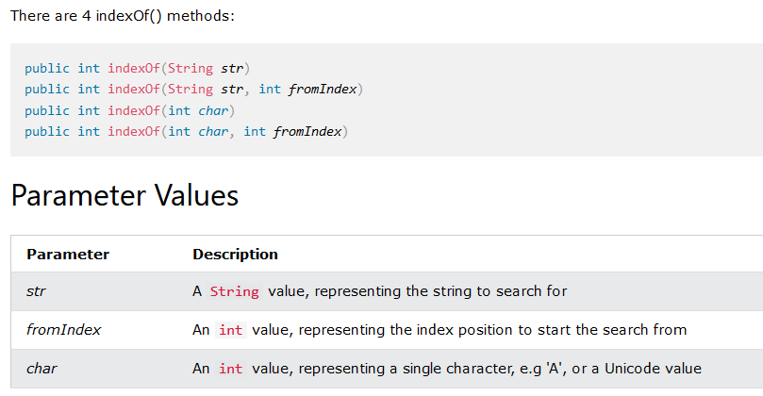
indexOf():The indexOf() method returns the position of the first occurrence of specified character(s) in a string.

Slide 82
indexOf()
index positions
String name =“President George Washington";
name.indexOf (‘P'); 0
name.indexOf (‘e'); 2
name.indexOf (“George"); 10
name.indexOf (‘e', 3); 6
name.indexOf (“Bob"); -1
Returns:
(starts searching at position 3)
(not found)
Notes:
String has four overloaded versions of indexOf and four versions of lastIndexOf.
lastIndexOf(ch, fromPos) starts looking at fromPos and goes backward towards the beginning of the string.

Slide 83
equals()/equalsIgnoreCase()
boolean b = word1.equals(word2);
returns true if the string word1 is equal to word2
boolean b = word1.equalsIgnoreCase(word2);
returns true if the string word1 matches word2, case-blind
b = “Raiders”.equals(“Raiders”);//true
b = “Raiders”.equals(“raiders”);//false b = “Raiders”.equalsIgnoreCase(“raiders”);//true
Notes:
You cannot use relational operators for comparing the contents of strings.
word1.compareTo(word2) returns an int. Basically if word1 is “smaller” than word2, the result is negative, and if word1 is “larger” the result is positive. compareTo returns 0 whenever equals returns true.
Here is how Java docs describe compareTo:
Compares two strings lexicographically. The comparison is based on the Unicode value of each character in the strings. The character sequence represented by this String object is compared lexicographically to the character sequence represented by the argument string. The result is a negative integer if this String object lexicographically precedes the argument string. The result is a positive integer if this String object lexicographically follows the argument string. The result is zero if the strings are equal; compareTo returns 0 exactly when the equals(Object) method would return true.
This is the definition of lexicographic ordering. If two strings are different, then either they have different characters at some index that is a valid index for both strings, or their lengths are different, or both. If they have different characters at one or more index positions, let k be the smallest such index; then the string whose character at position k has the smaller value, as determined by using the < operator, lexicographically precedes the other string. In this case, compareTo returns the difference of the two character values at position k in the two string — that is, the value:
this.charAt(k)-anotherString.charAt(k)
If there is no index position at which they differ, then the shorter string lexicographically precedes the longer string. In this case, compareTo returns the difference of the lengths of the strings — that is, the value:
this.length()-anotherString.length()

Slide 84
Difference between == and .equals() method in Java
equals() is a method and == is a operator
use == operators for reference comparison (address comparison) and .equals() method for content comparison.
In simple words, == checks if both objects point to the same memory location whereas .equals() evaluates to the comparison of values in the objects

Slide 85
compareTo()
int diff = word1.compareTo(word2);
returns the “difference” word1 - word2
if string1 > string2, it returns positive number
if string1 < string2, it returns negative number
if string1 == string2, it returns 0
The java string compareTo() method compares the given string with current string . It returns positive number, negative number or 0.
It compares strings on the basis of Unicode value of each character in the strings.
Notes:
You cannot use relational operators for comparing the contents of strings.
word1.compareTo(word2) returns an int. Basically if word1 is “smaller” than word2, the result is negative, and if word1 is “larger” the result is positive. compareTo returns 0 whenever equals returns true.
Here is how Java docs describe compareTo:
Compares two strings lexicographically. The comparison is based on the Unicode value of each character in the strings. The character sequence represented by this String object is compared lexicographically to the character sequence represented by the argument string. The result is a negative integer if this String object lexicographically precedes the argument string. The result is a positive integer if this String object lexicographically follows the argument string. The result is zero if the strings are equal; compareTo returns 0 exactly when the equals(Object) method would return true.
This is the definition of lexicographic ordering. If two strings are different, then either they have different characters at some index that is a valid index for both strings, or their lengths are different, or both. If they have different characters at one or more index positions, let k be the smallest such index; then the string whose character at position k has the smaller value, as determined by using the < operator, lexicographically precedes the other string. In this case, compareTo returns the difference of the two character values at position k in the two string — that is, the value:
this.charAt(k)-anotherString.charAt(k)
If there is no index position at which they differ, then the shorter string lexicographically precedes the longer string. In this case, compareTo returns the difference of the lengths of the strings — that is, the value:
this.length()-anotherString.length()

Slide 86
Comparison Examples
//negative differences
diff = “apple”.compareTo(“berry”);//a before b
diff = “Zebra”.compareTo(“apple”);//Z before a
diff = “dig”.compareTo(“dug”);//i before u
diff = “dig”.compareTo(“digs”);//dig is shorter
//zero differences
diff = “apple”.compareTo(“apple”);//equal
diff = “dig”.compareToIgnoreCase(“DIG”);//equal
//positive differences
diff = “berry”.compareTo(“apple”);//b after a
diff = “apple”.compareTo(“Apple”);//a after A
diff = “BIT”.compareTo(“BIG”);//T after G
diff = “huge”.compareTo(“hug”);//huge is longer

Slide 87
Methods — Changing Case
String word2 = word1.toUpperCase();
String word3 = word1.toLowerCase();
returns a new string formed from word1 by converting its characters to upper (lower) case
String word1 = “HeLLo“;
String word2 = word1.toUpperCase();//”HELLO”
String word3 = word1.toLowerCase();//”hello”
//word1 is still “HeLLo“
Notes:
Note that these methods do not change the string word1 but create and return a new string.
trim() only removes whitespace at the ends of the string, not in the middle.

Slide 88
trim()
removing white space at both ends does not affect whites space in the middle
Example:
String word1 = “ Hi Kumar “;
String word2 = word1.trim();
//word2 is “Hi Kumar” – no spaces on either end
//word1 is still “ Hi Kumar “ – with middle spaces
Notes:
Note that these methods do not change the string word1 but create and return a new string.
trim() only removes whitespace at the ends of the string, not in the middle.

Slide 89
replace()
method returns a string replacing all the old char or CharSequence to new char or CharSequence.
Syntax:
String replace(char oldChar, char newChar)
String replace(CharSequence target, CharSequence replacement)
Example:
String str1="hello hello hello";
String str2="hello hello hello";
str1=str1.replace('h', 'H');
str2=str2.replace("hello", "hi");
System.out.println(str1);
System.out.println(str2);
Notes:
Note that these methods do not change the string word1 but create and return a new string.
trim() only removes whitespace at the ends of the string, not in the middle.

Slide 90
replaceAll()
The java string replaceAll() method returns a string replacing all the sequence of characters matching regular expression and replacement string.
Syntax: String replaceAll(String regex, String replacement)

Slide 91
Example:
replace all occurrences of white spaces in a string:
String str = "how to do in java provides java reading materials";
String newStr = str.replaceAll(“\\s", "");
System.out.println(newStr);

Slide 92
StringBuffer class
StringBuffer is mutable means one can change the value of the object .
The object created through StringBuffer is stored in the heap .
each method in StringBuffer is synchronized that is StringBuffer is thread safe due to this it does not allow two threads to simultaneously access the same method . Each method can be accessed by one thread at a time .

Slide 93
Differences between StringBuffer and StringBuilder
StringBuffer | StringBuilder
StringBuffer is synchronized i.e. thread safe. It means two threads can't call the methods of StringBuffer simultaneously. | StringBuilder is non-synchronized i.e. not thread safe. It means two threads can call the methods of StringBuilder simultaneously.
StringBuffer is less efficient than StringBuilder. | StringBuilder is more efficient than StringBuffer.

Slide 94
methods of StringBuffer/StringBuilder class
append()
capacity()
ensureCapacity()
insert()
reverse()
replace()
length()
delete()
deleteCharAt()
substring()

Slide 95
append()
is used to append the string from one string to another string like concat.
Syntax:
StringBufferClassReference.append(any type)
Any type:-
append(char), append(boolean), append(int), append(float), append(double) etc.

Slide 96
capacity()
is used to return the current capacity of buffer.
The default capacity of the buffer is 16.
If the number of character increases from its current capacity, it increases the capacity by (oldcapacity*2)+2.
For example if your current capacity is 16, it will be (16*2)+2=34.

Slide 97
Condition1:
StringBuffer sb=new StringBuffer();
System.out.println("Current Capacity:"+sb.capacity());
// Current Capacity:16
Condition2:
StringBuffer sb=new StringBuffer(“hello”);
System.out.println("Current Capacity:"+sb.capacity());
// Current Capacity:21

Slide 98
ensureCapacity()
It ensures that the given capacity is the minimum to the current capacity. If it is greater than the current capacity, it increases the capacity by (oldcapacity*2)+2.
Ex:
If current capacity is:70
sb.ensureCapacity(70); // no change
But
sb.ensureCapacity(71); // cahnge now 142

Slide 99
insert()
It is used to inserts the string at the specified position.
Syntax:
StringBufferClassReference.insert(pos,string)
It is used to reverses the current string
Syntax:
StringBufferClassReference.reverse()
reverse()

Slide 100
replace():
replaces the string from the specified startingIndex and endingIndex.
Syntax:
StringBufferClassReference.replace(startingIndex, endingIndex, newstring)
e.g:
StringBuffer sb=new StringBuffer("Hello");
sb.replace(1,3,“kumar");
System.out.println(sb);//Hkumarlo

Slide 101
length() : to find the length of current string
Syntax:
StringBufferClassReference.length()
delete(): deletes the string from the specified startingIndex to endingIndex.
Syntax:StringBufferClassReference.delete(startingIndex,endingIndex)
e.g:
StringBuffer sb=new StringBuffer("Hello");
sb.delete(1,3);
System.out.println(sb);//Hlo

Slide 102
deleteCharAt():
deletes the character at the index specified by loc.
Syntax:
StringBufferClassReference.deleteCharAt(int loc)
e.g:
StringBuffer sb=new StringBuffer("Hello");
sb.deleteCharAt(3);
System.out.println(sb);//Helo

Slide 103
substring()
is used to return the substring from the specified startingIndex and endingIndex.
Syntax:
substring(int startingIndex, int endingIndex)

Slide 104
How to define class?
Class is a collection of data members and member methods.
Class is a collection of similar type of objects.

Slide 105
Syntax to declare a class:
class <class_name>
{
data_member;
member_method;
}
Defining scope of
The class
Class Name:
Data Member:
Member Methods:
Class Diagram(UML)

Slide 106
access control in Java
Access Modifier | within class | within package | outside package by subclass only | outside package
Private | Y | N | N | N
Default | Y | Y | N | N
Protected | Y | Y | Y | N
Public | Y | Y | Y | Y

Slide 107
A Java constructor name must exactly match with the class name (including case).
A Java constructor must not have a return type.
If a class doesn't have a constructor, Java compiler automatically creates a default constructor during run-time. The default constructor initialize instance variables with default values. For example: int variable will be initialized to 0
Constructors cannot be abstract or static or final.
Constructor can be overloaded but can not be overridden.

Slide 108
Constructor
Types:
No-Arg Constructor - a constructor that does not accept any arguments
Default Constructor - a constructor that is automatically created by the Java compiler if it is not explicitly defined.
Parameterized constructor - used to specify specific values of variables in object

Slide 109
overview of inheritance
One class is hiring properties from another class is called inheritance.
Advantages: Reusability
Class ClassA
{
}
Class ClassB extends ClassA
{
}

Slide 110
How to achieve encapsulation in JAVA?
Ans:
Using data member as a private and setter, getter accessor methods as a public to access these private data members.

Slide 111
Inheritance Types:
Single
Multilevel
Hierarchical
Using interface it is possible:
Hybrid
Multiple

Slide 112
Single inheritance:
One base class and one derived class
One-to-one relationship
Base Class
Derived Class
Bank
protected BankName
Customer
customerName
getDetails()

Slide 113
Multilevel inheritance:
One class is going to become base class for other derived class
Faculty
double salary,totalSalary=0;
Faculty(){ salary=25000}
Base Class for class Science
Science
private bonus=2000
void disp1(){}
Derived Class from Faculty and
Base Class for Computer
Computer
private bonus=3000
void disp2(){}
Derived Class from Science

Slide 114
Hierarchical inheritance:
One base class and multiple derived class, one –to-many relationship
Bank
rateofInterest
Bank(){rateofInterest=0}
SBI
Private IFSCCode
Bank(){rateofInterest=4.5}
PNB
Private IFSCCode
Bank(){rateofInterest=5.5}

Slide 115
Important Notes:-
Default parent class constructor automatically called by child class but for calling parameterized constructor of base class we need to use super keyword.

Slide 116
Super keyword
super keyword can be used to access the immediate parent class constructor.
super keyword can be used to invoke immediate parent class members and methods.
In some scenario when a derived class and base class has same data members or methods, in that case super keyword also used.

Slide 117
interface
Collection of abstract methods.
Use keyword interface
Achieve multiple inheritance
Use implements keyword for calling in derive class
Syntax:
interfcae Bank
{
int rateOfInterest();
}
class SBI implements Bank {
int rateOfInterest()
{
retutn 5;
}
}

Slide 118
Abstract Class
Abstraction is a process of hiding the implementation details and showing only functionality to the user.
A class which is declared with the abstract keyword is known as an abstract class in Java.
It holds both abstract and non-abstract methods.
It can have constructor also
We can achieve abstraction by using either abstract class or interface.
It can’t be instantiated
The abstract class can also be used to provide some implementation of the interface.

Slide 119
Q: Difference between abstract class and interface
Ans:---????

Slide 120


