Slide 1
CAP615 PROGRAMMING IN JAVA
Lecture #0
The kick start session

Slide 2
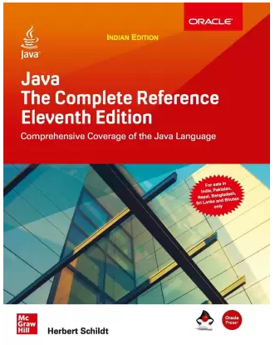
Course details
LTP – 3 0 0 [Three lectures/week]
Text Book
JAVA: THE COMPLETE REFERENCE by HERBERT SCHILDT, Tata McGraw Hill, India
Reference Books:
1.INTRO TO JAVA PROGRAMMING
(COMPREHENSIVE VERSION) by Y. DANIEL LIANG,
Pearson Education India
2. PROGRAMMING WITH JAVA by
E BALAGURUSAMY, Tata McGraw Hill, India

Slide 3
Course Assessment Model
Marks break up
Attendance 5
Continuous Assessment(2 out of 3) 25
MTT 20
ETT 50
Total 100

Slide 4

The hitch…
The three BURNING questions in mind…
Why are we learning JAVA language?
What would we do with it?
What will be the course outcome?

Slide 5
Course Outcomes:
understand the handling of strings and collection frameworks
apply multithreading for inter-process communication
analyze the use of swings and layouts for graphical design
develop applications using database connectivity and socket programming

Slide 6
Programme Outcomes
1. Computational Knowledge: Apply knowledge of computing fundamentals, computing specialization, mathematics, and domain knowledge appropriate for the computing specialization to the abstraction and conceptualization of computing models from defined problems and requirements.
2. Problem Analysis: Identify, formulate, research literature, and solve complex computing problems reaching substantiated conclusions using fundamental principles of mathematics, computing sciences, and relevant domain disciplines.
3. Design /Development of Solutions: Design and evaluate solutions for complex computing problems, and design and evaluate systems, components, or processes that meet specified needs with appropriate consideration for public health and safety, cultural, societal, and environmental considerations.

Slide 7
Programme Outcomes
4. Conduct investigations of complex Computing problems: Use research-based knowledge and research methods including design of experiments, analysis and interpretation of data, and synthesis of the information to provide valid conclusions.
5. Modern Tool Usage: Create, select, adapt and apply appropriate techniques, resources, and modern computing tools to complex computing activities, with an understanding of the limitations.
6. Professional Ethics: Understand and commit to professional ethics and cyber regulations, responsibilities, and norms of professional computing practices.
7. Life-long Learning: Recognize the need, and have the ability, to engage in independent learning for continual development as a computing professional.

Slide 8
Programme Outcomes
8. Project management and finance: Demonstrate knowledge and understanding of the computing and management principles and apply these to one ’s own work, as a member and leader in a team, to manage projects and in multidisciplinary environments.
9. Communication Efficiency: Communicate effectively with the computing community, and with society at large, about complex computing activities by being able to comprehend and write effective reports, design documentation, make effective presentations, and give and understand clear instructions. 10. Societal and Environmental Concern: Understand and assess societal, environmental, health, safety, legal, and cultural issues within local and global contexts, and the consequential responsibilities relevant to professional computing practices.
11. Individual and Team Work: Function effectively as an individual and as a member or leader in diverse teams and in multidisciplinary environments. 12. Innovation and Entrepreneurship Identify a timely opportunity and using innovation to pursue that opportunity to create value and wealth for the betterment of the individual and society at large.

Slide 9
Mapping of POs with COs
 |  | CO1 | CO2 | CO3 | CO4
 | PO1 | 2 | 2 | 2 | 2
 | PO2
 | PO3 |  |  |  | 2
 | PO4
 | PO5 | 2 | 2 | 2 | 2
 | PO6
 | PO7
 | PO8
 | PO9
 | PO10
 | PO11
 | PO12

Slide 10
Learnings for you…
Desktop GUI Applications
Mobile Applications
Enterprise Applications
Scientific Applications
Web-based Applications
Embedded Systems
Big Data Technologies
Distributed Applications
Cloud-based Applications
Web servers and Application servers
Software Tools
Gaming Applications

Slide 11
Companies like:
Naukri,
Jabong,
Google,
Myntra,
Flipkart,
Trivago,
ibibo
TripAdvisor
Spotify,
Uber,
TCS,
Infosys,
HCL,
Wipro,
Pinterest,
eBay,
etc use Java.

Slide 12
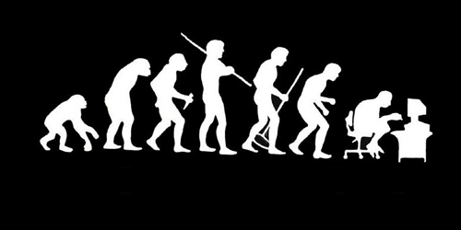
Let us re-invent ourselves
To begin with basics…
Let us go to basics.
Let us begin from toddling to learn to walk
Get ready to be childish….

Slide 13
Daily routine
Let us look around our daily routine…
Let us see where all we do programming everyday
Simple things we do to start the day

Slide 14

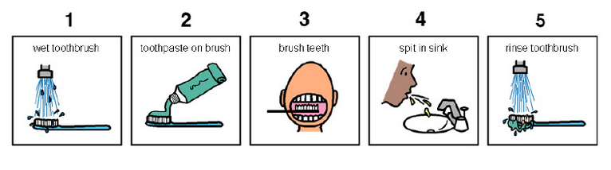
So there is ONE program you know which is there in you…

Slide 15
Daily routine
Start
There is a set procedure
Each step is defined
The occurrence is ordered
Jump is NOT permitted
A step cannot be skipped
Pick Brush
Rinse Brush
Apply Paste
Brush
Rinse Mouth
Rinse Brush
Stop

Slide 16


Daily routine
Let us explore more as the day goes by…
Going for a morning 0900 AM Class
Going for a movie at 0900 AM
It is all about WHICH program is loaded WHEN

Slide 17


Daily routine
The flow changes
Start
Go!!!
Where
To
Go?
Class
Movie
Stop
Stop

Slide 18

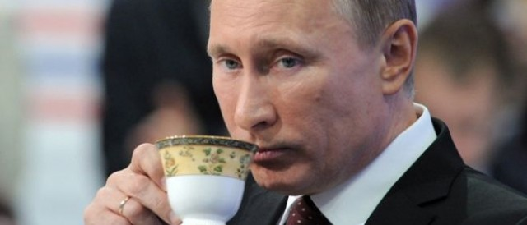




Daily routine
Yet another example but more complex
Vision
Sensor
Sipping TEA
Smell
Sensor
Radiation
Sensor
If all sensors
SIP
If even one is
Touch
Sensor
WAIT!!!

Slide 19




So what does this mean?
Take ANY activity of the day…
It will have a set procedure
It has to be done in a designated way
If not done the specified way will yield wrong results.
Success in doing it depends on how closer one is to the prescribed method.
This clearly shows that everything has a
Logic

Slide 20



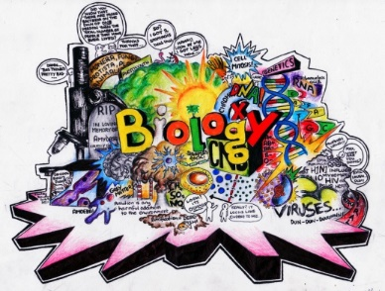





Logic, logic and logic
Logic

Slide 21
What next?
If there is logic in anything and everything
There has to be ways to represent logic
There has to be modes to modify and re-represent logic.
There should be methodology to implement and re-design logic.
And for all this…

Slide 22


What next?
There has to be logic machine to assimilate, understand, solve, store, retrieve and represent logic
There has to be a LANGUAGE to communicate with the logic machine
Otherwise….

Slide 23



Diving deeper…
How do I get A+ grade in CAP615?

Slide 24


Diving deeper…
How do I get A+ grade in CAP615?
If marks are greater than or equal to 85.
A program written in Java language with LOGIC

Slide 25
The course contents
Introduction to Java
Collection Framework
Multithreading
Swings and Layouts
Managing data using JDBC
Network Programming
Syllbus.pdf

Slide 26
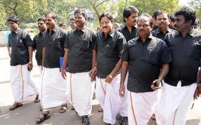


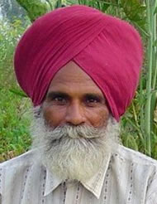

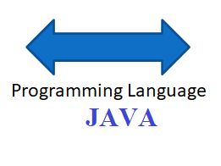
What do we need to know?
Unit 1
Tamil
Punjabi
Need of Language :: Introduction to Java

Slide 27
What do we need to know?
Unit 1
Principles of OOP's and Java Basics
How to do calculations
Area = Length * Breadth
Area = 12 * 5
Area = 10 * 4
Area = 7.6 * 3.7
3.7
4
7.6
5
10
12
Performing Calculations in JAVA:: Variables and operators

Slide 28

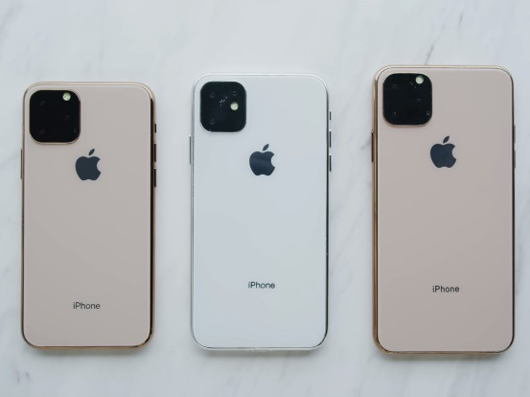
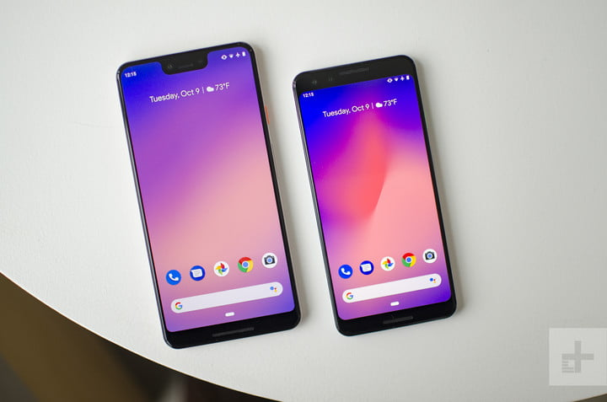
What do we need to know?
Unit 1
Classes and Objects
Mobile
Symbian
(Keypad
Phone)
Android
phone
i-phone

Slide 29



What do we need to know?
Inheritance: reusability
Unit 1
mother
father
child

Slide 30
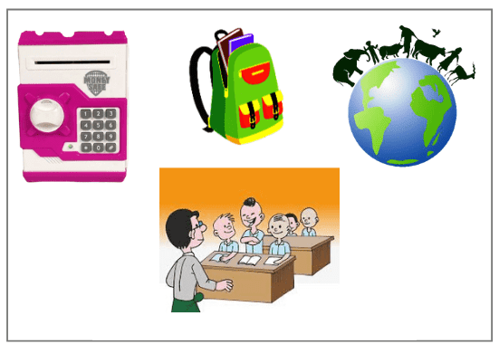
What do we need to know?
Collection Framework
Unit 2

Slide 31
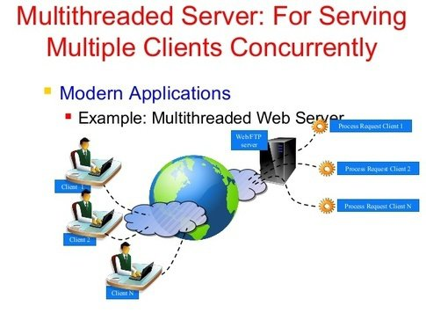
What do we need to know?
Multithreading
Unit 3

Slide 32
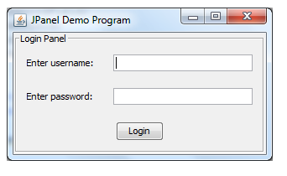
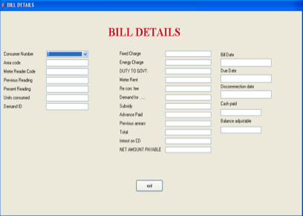
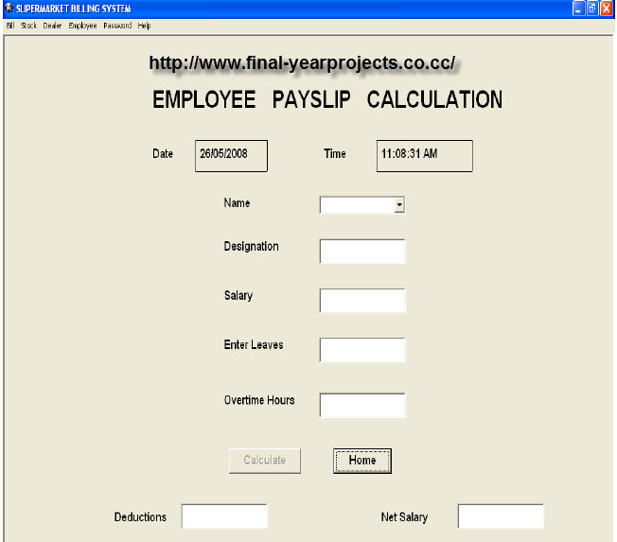
What do we need to know?
Swings and Layouts
Unit 4

Slide 33
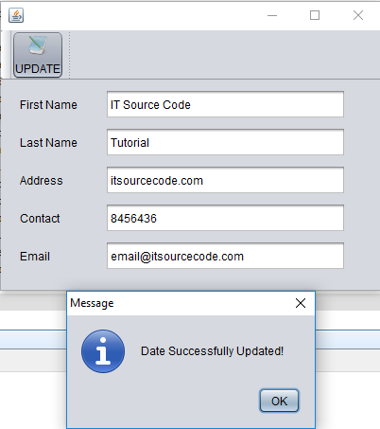
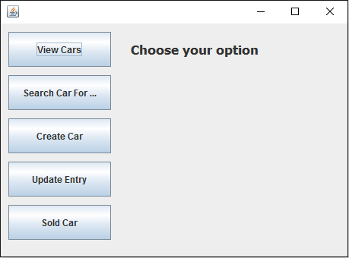
What do we need to know?
Managing data using JDBC
Unit 5

Slide 34
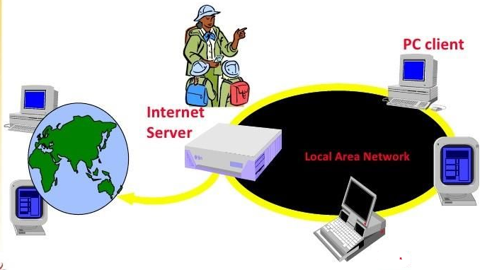

What do we need to know?
Network Programming
Unit 6

Slide 35
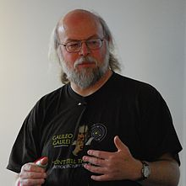
Recognize?
A. Dennis Ritchie
B. Bjarne Stroustrup
C. James Gosling
D. None

Slide 36
Which is OOPs feature?
Encapsulation
Polymorphism
Inheritance
Above All

Slide 37
Acknowledgements
NPTEL(National Programme on Technology Enhanced Learning)
Simplilearn
Coursera
edureka
Common Sense

Slide 38
Next :Introduction to JAVA

