Slide 1

Modelling a DRL agent to play the game of Rock Paper and Scissors
Team – 08
Sathvik
Sushma
Panchami

Slide 2
Index
Problem Statement
DQN Architecture
RL Formulation
System Architecture
Implementation
Results
References

Slide 3
Problem Statement
To design and create a RL agent to play the game of rock, paper and scissor against a human in real time.
This RL agent tries to identify the pattern with which the opponent player is playing and tries to beat the opponent.

Slide 4
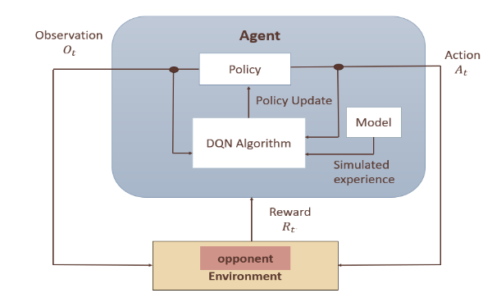
RL Formulation

Slide 5
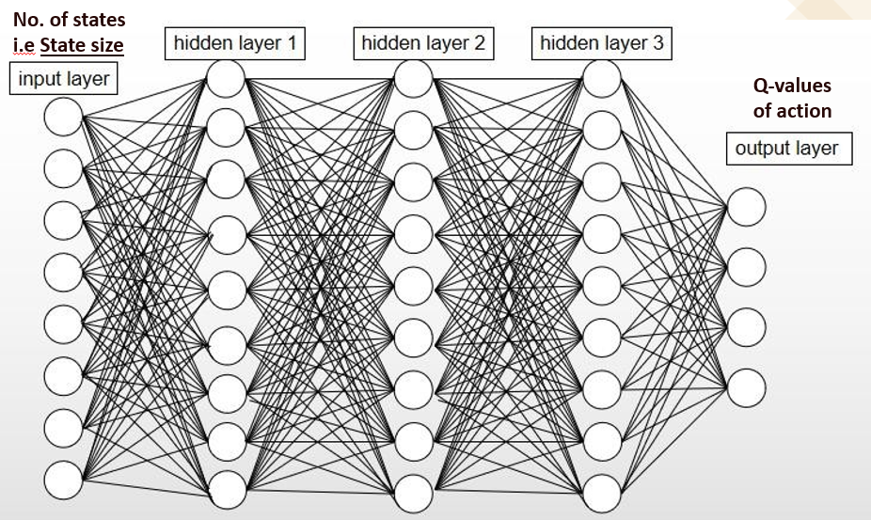
DQN Architecture

Slide 6
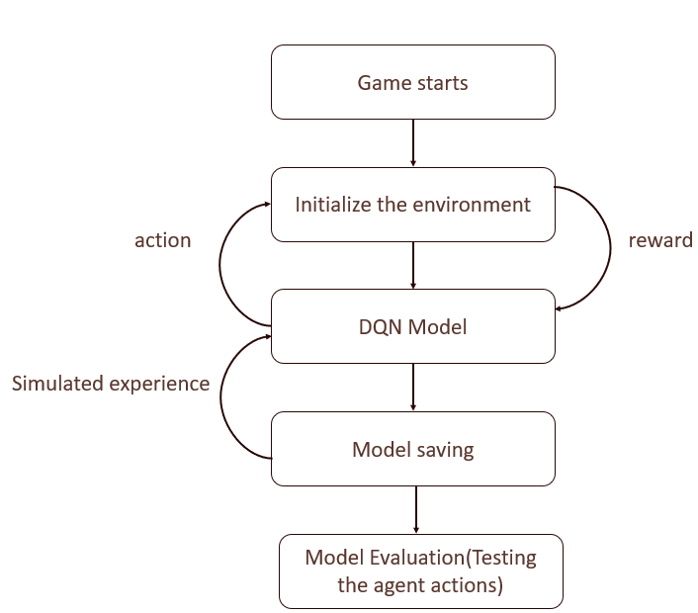
System Architecture

Slide 7
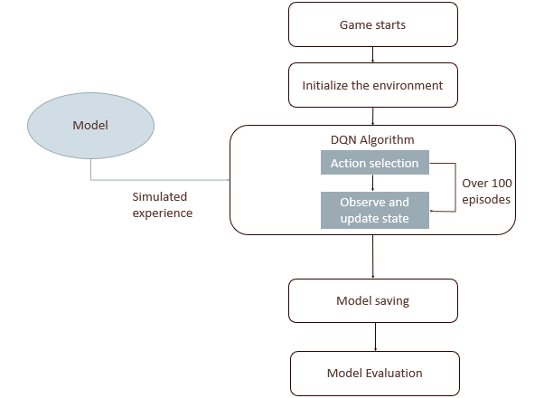
Implementation

Slide 8
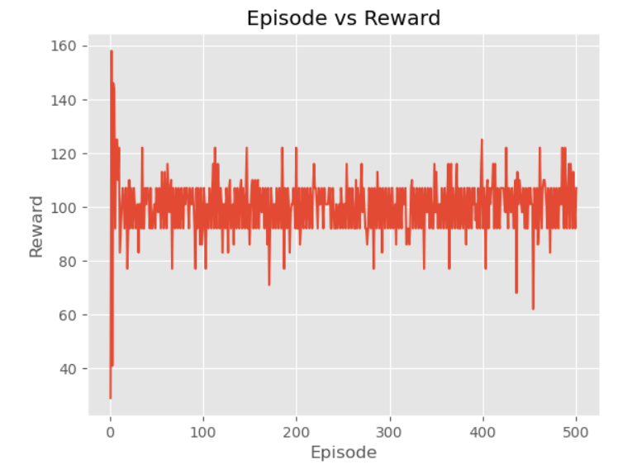
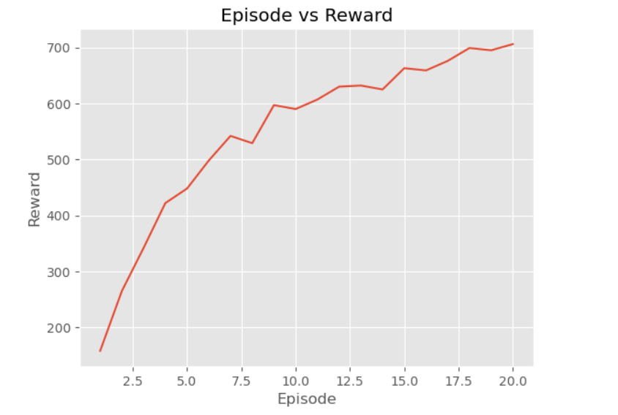
Results

Slide 9
References
Daeyol Lee, Benjamin P.McGreevy, Dominic J.Barraclough , “Learning and decision making in monkeys during a rock–paper–scissors game”, sciencedirect,2005.
Franco Salvetti,Paolo Patelli,Simone Nicolo, “ Chaotic time series prediction for the game, Rock-Paper-Scissors”,Sciencedirect,2006.
David S. Leslie,E.J.Collins, “CONVERGENT MULTIPLE-TIMESCALES REINFORCEMENT LEARNING ALGORITHMS IN NORMAL FORM GAMES”, 2003,Vol.13,No.4,1231-1251.
Gregory Chernov, “How to Learn to Defeat Noisy Robot in Rock-Paper-Scissors Game: An Exploratory Study”,2020 HSE Economic Journal.

