Slide 1

AVAZU CTR PREDICTION
INSY 5377 WEB AND SOCIAL ANALYTICS
TEAM: Not So Naive Bayes
TEAM MEMBERS
Prashanthi Chandrasekaran
Sandeep Ramesh
Sourabh Mahajan
Sushidhar Jayaraman
Vijaya vasavi Seenivasan

Slide 2

Objectives
Predict whether a mobile ad will be clicked or not
Business Insights
Model Selection and Validation

Slide 3
Dataset
SOURCE: https://www.kaggle.com/c/avazu-ctr-prediction/data
11 days of click-through and ads data with size of 5 GB and 40 million records
Random Sampling consists of 300,000 rows
Training Set - 240,000 records
Test Set - 60,000 records

Slide 4
Attributes
id: ad identifier
click: 0/1 for non-click/click (Class)
hour: format is YYMMDDHH
banner_pos
site_id
site_domain
site_category
app_id
app_domain
app_category
device_id
device_ip
device_model
device_type
device_conn_type
C1, C14-C21 -- anonymized categorical variables

Slide 5
Data Pre-Processing
Conversion of csv data to sqlite db using Odo package
DB browser for SQLite tool
Scaling using Standard Scalar
Feature Engineering
Recursive Feature elimination to select the optimal number of Features

Slide 6
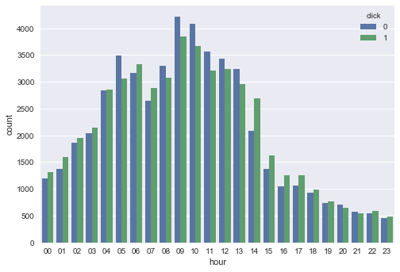
Data Pre-Processing

Slide 7
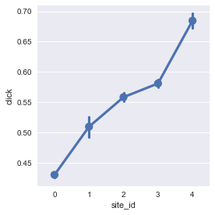
Data Pre-Processing

Slide 8
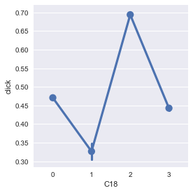
Data Pre-Processing

Slide 9
Classifiers
Family | Algorithms
Ensemble | Extra Trees
 | Random Forest
 | AdaBoost
Neighbors | KNeighbors
Linear model | Logistic
Naïve Bayes | Naive Bayes
Tree | Decision Tree

Slide 10
Classifier Results
Algorithms | Accuracy | F1 Score | ROC AUC Score
Extra Trees | 0.630966667 | 0.623550614 | 0.665670167
Random Forest | 0.640283333 | 0.643262095 | 0.688126876
KNeighbors | 0.625216667 | 0.627248164 | 0.665366359
Logistic | 0.6048 | 0.606008241 | 0.6487891
Naive Bayes | 0.597466667 | 0.598977186 | 0.634369743
Decision Tree | 0.620066667 | 0.610843661 | 0.63316261
AdaBoost | 0.647166667 | 0.656977121 | 0.696067633

Slide 11
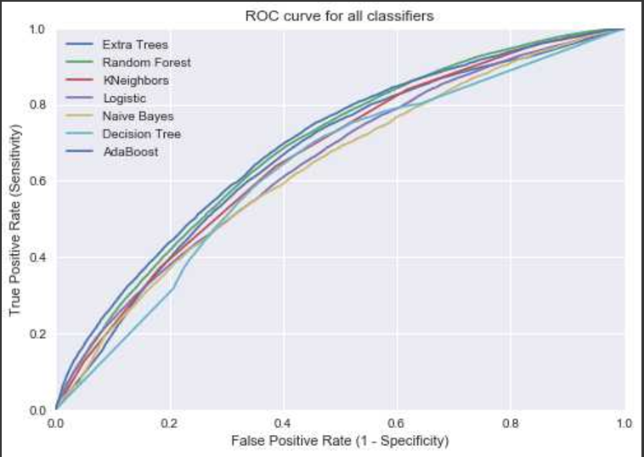
ROC

Slide 12
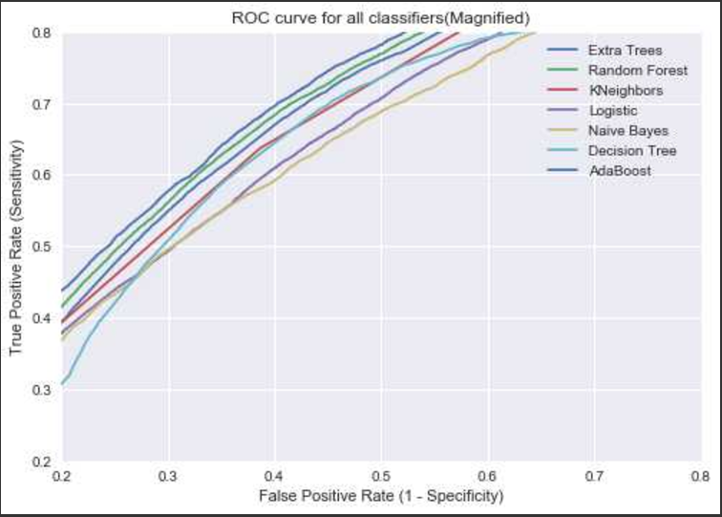
ROC

Slide 13
Conclusion
A major challenge of this project was the number of observations to load and analyze. But conversion of CSV to SQLiteDB data made the loading and analysis much easier.
Adaboost classifier performs the best based on AUC score
In future, we must come up with a way to deal with the entire data so that we have more accurate results.

Slide 14
References
https://www.kaggle.com/c/avazu-ctr-prediction/data

Slide 15


