Slide 1

Project 4- Diabetes Prediction
Presented by
Dashrath Bhandari
Sushil Baskota

Slide 2
Project Outline
Introduction
Importing Libraries
Importing Data
Missing Value Analysis
Exploratory Data Analysis
Modelling
Prediction
Conclusion

Slide 3
Introduction
A high blood sugar level in the body is called diabetes
It is the most prevalent chronic disease causing a massive economic burden around the globe
$467 million was spent in 2015 and is expected to rise to $807 million by 2030 to manage diabetes in Australia (Australian Institute of Health and Welfare)
Without ongoing and careful management, diabetes can lead to a buildup of sugars in the blood, which can increase the risk of dangerous complications, such as stroke and heart disease, Therefore we like to investigate …

Slide 4
Objectives
Predict if a person is a diabetes patient or not
1
Find the most indicative features of diabetes
2
Try different classification methods to find the highest accuracy
3

Slide 5
Data Source
Data set available on public space -Kaggle

Slide 6
Column descriptions
Sex: patient's gender (1: male; 0: female)
HighChol: 0 = no high cholesterol 1 = high cholesterol
CholCheck: 0 = no cholesterol check in 5 years 1 = yes cholesterol check in 5 years
Smoker: Have you smoked at least 100 cigarettes in your entire life? [Note: 5 packs = 100 cigarettes] 0 = no 1 = yes
HeartDiseaseorAttack: coronary heart disease (CHD) or myocardial infarction (MI) 0 = no 1 = yes
PhysActivity: physical activity in the past 30 days - not including job 0 = no 1 = yes
Fruits: Consume Fruit 1 or more times per day 0 = no 1 = yes
Veggies: Consume Vegetables 1 or more times per day 0 = no 1 = yes
HvyAlcoholConsump: (adult men >=14 drinks per week and adult women>=7 drinks per week) 0 = no 1 = yes
GenHlth: Would you say that in general, your health is: a scale 1-5 1 = excellent 2 = very good 3 = good 4 = fair 5 = poor
MentHlth: days of poor mental health scale 1-30 days
PhysHlth: physical illness or injury days in the past 30 days scale of 1-30
DiffWalk: Do you have serious difficulty walking or climbing stairs? 0 = no 1 = yes
Stroke: you ever had a stroke? 0 = no, 1 = yes
HighBP: 0 = no high, BP 1 = high BP

Slide 7
Describing column- Age
13-level age category
1 = 24 or younger
2 = 25-29
3 = 30-34
4 = 35-39
5 = 40-44
6 = 45-49
7 = 50-54
8 = 55-59
9 = 60-64
10 = 65-69
11 = 70-74
12 = 75-79
13 = 80 or older

Slide 8
Importing Libraries
Python Pandas
Matplotlib
Sklearn
Seaborn
Numpy

Slide 9
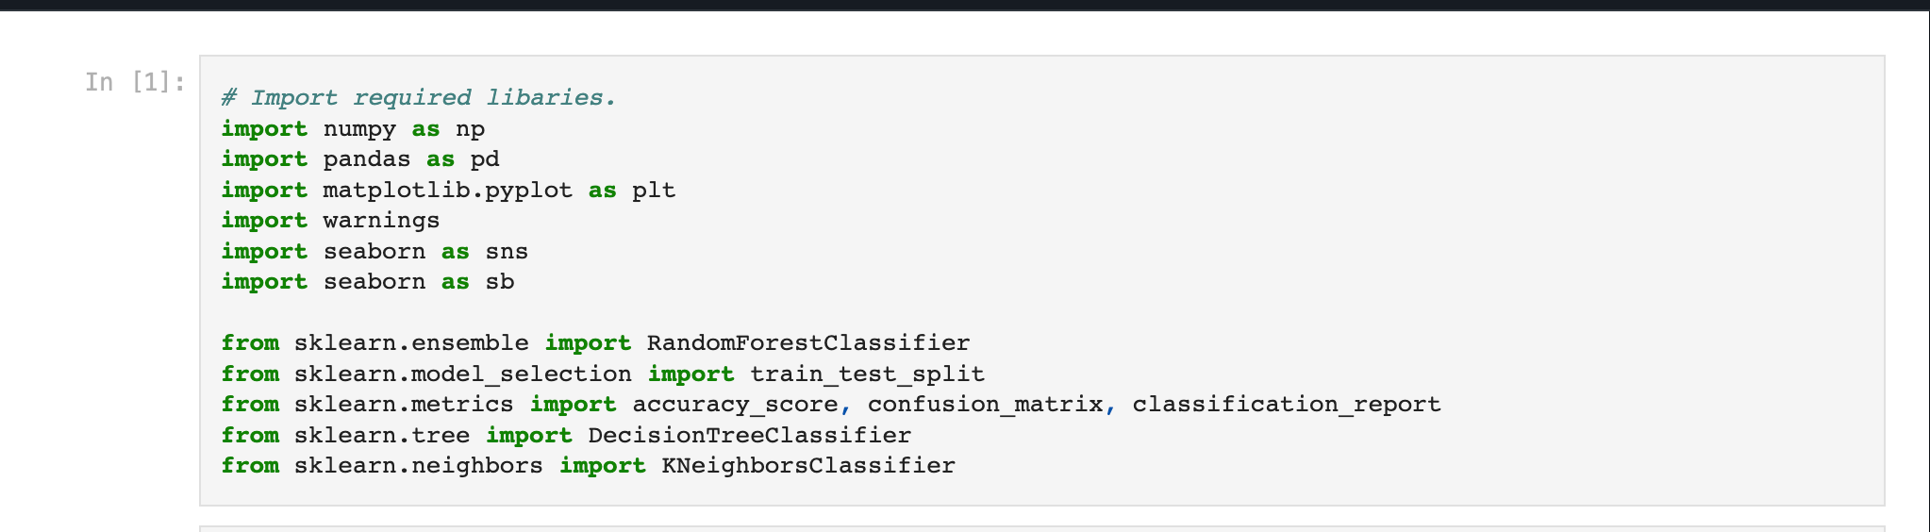

Slide 10
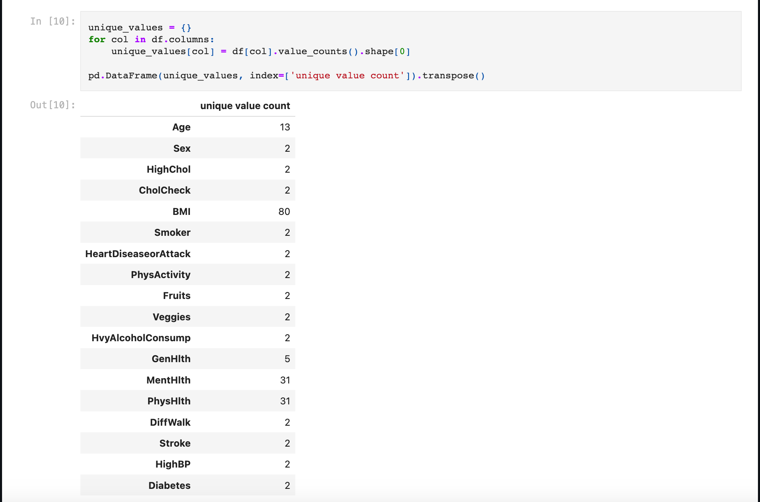
Checking unique value

Slide 11
Missing Value Analysis
Cleanup of the dataset is a very crucial part of the analysis as missing data can lead to wrong statistics during modeling and predictions.
In our dataset, there were no missing or null values

Slide 12
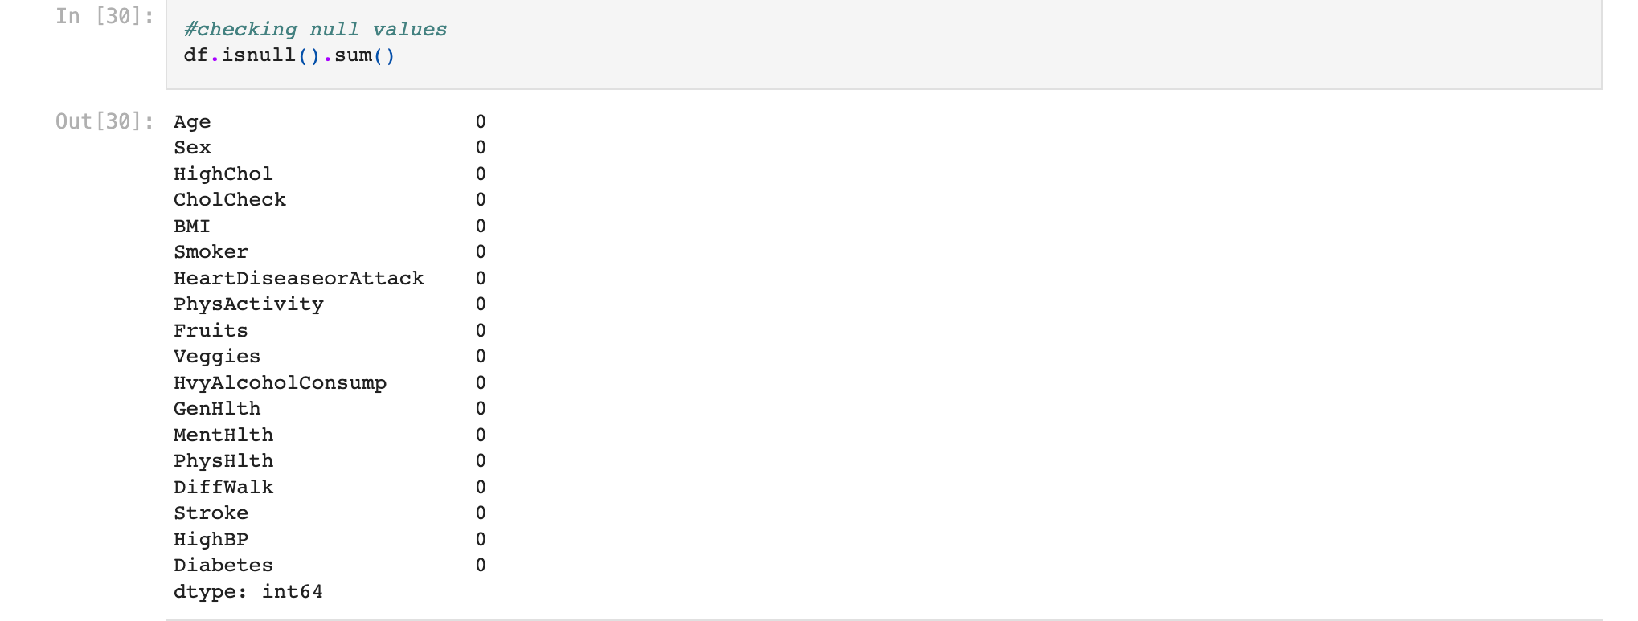

Slide 13
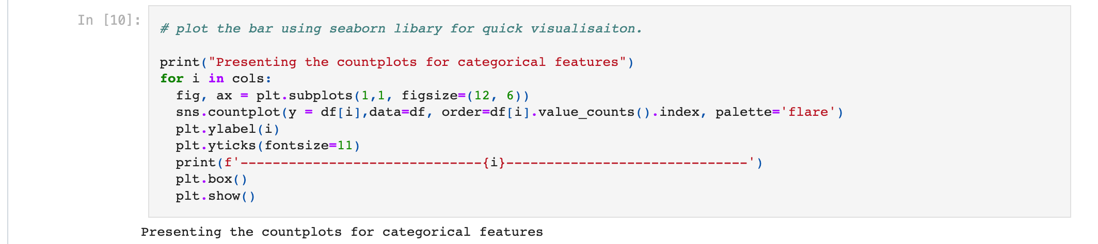
Presenting the countplots for categorical feature

Slide 14
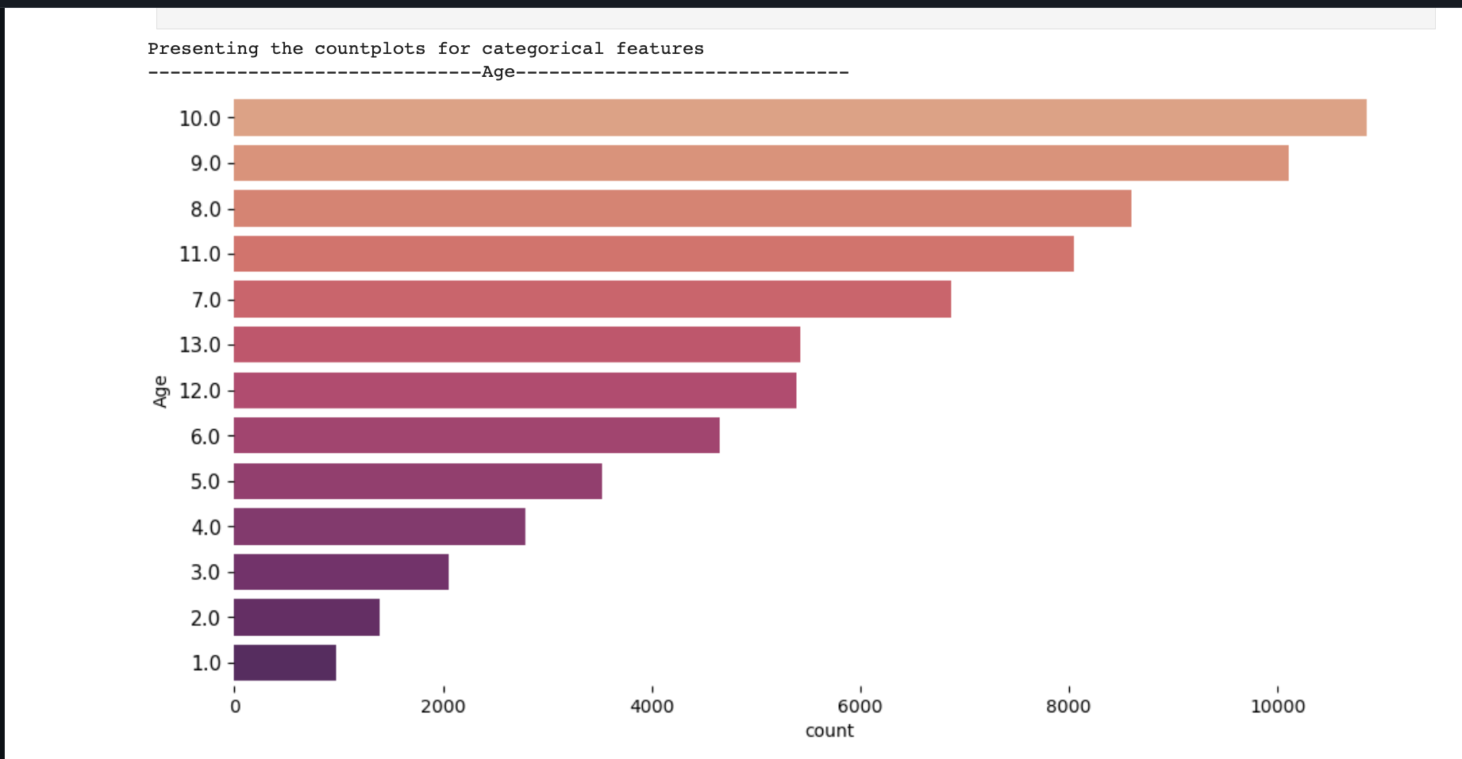

Slide 15
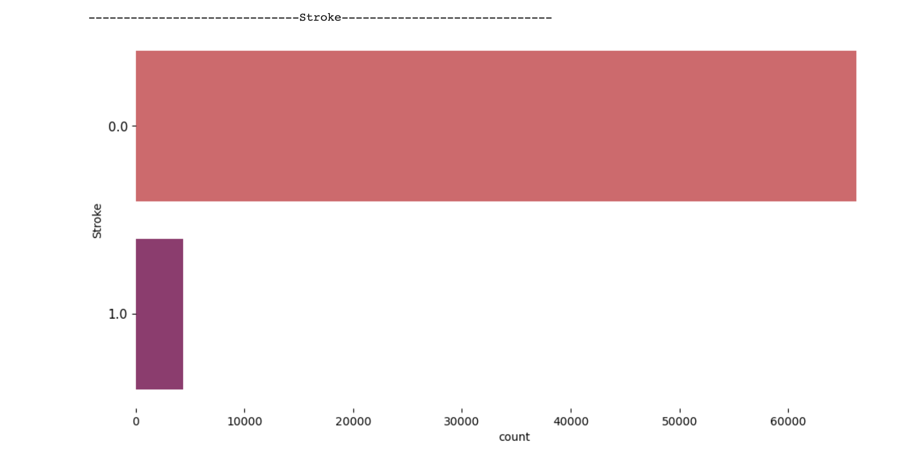

Slide 16
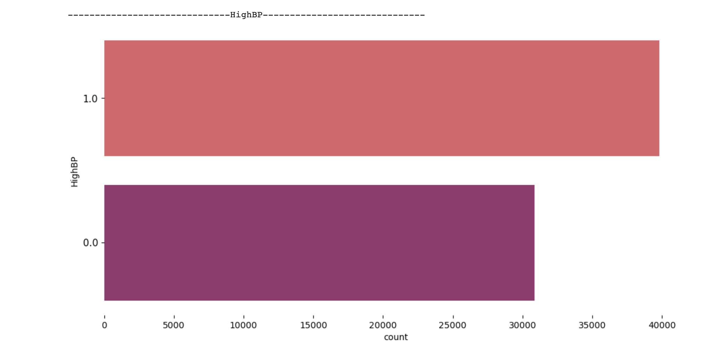

Slide 17
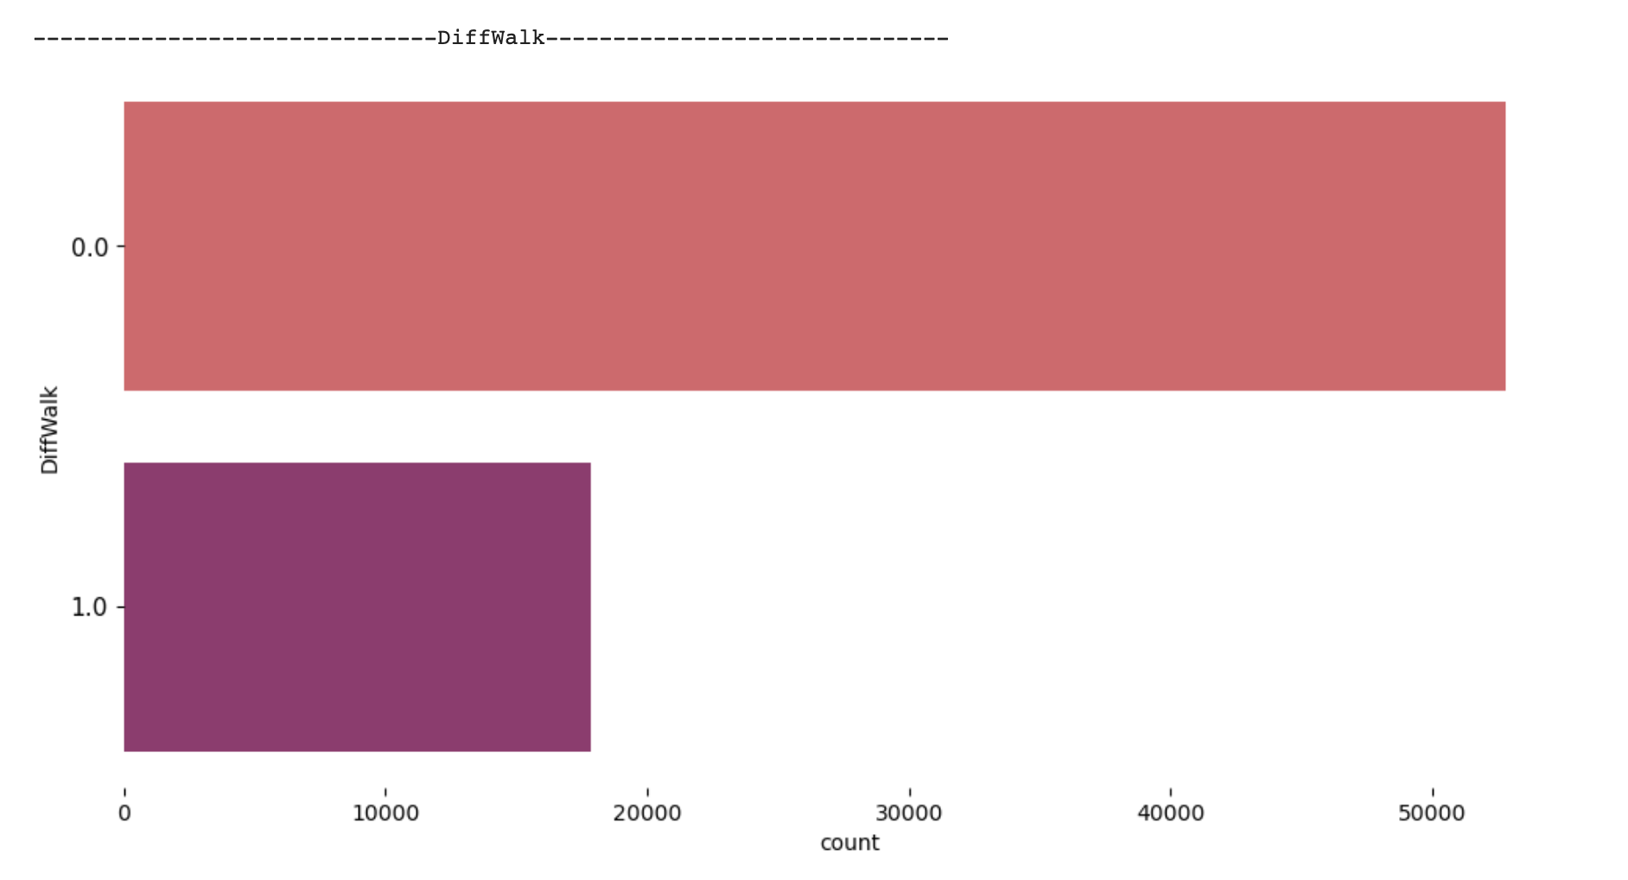

Slide 18
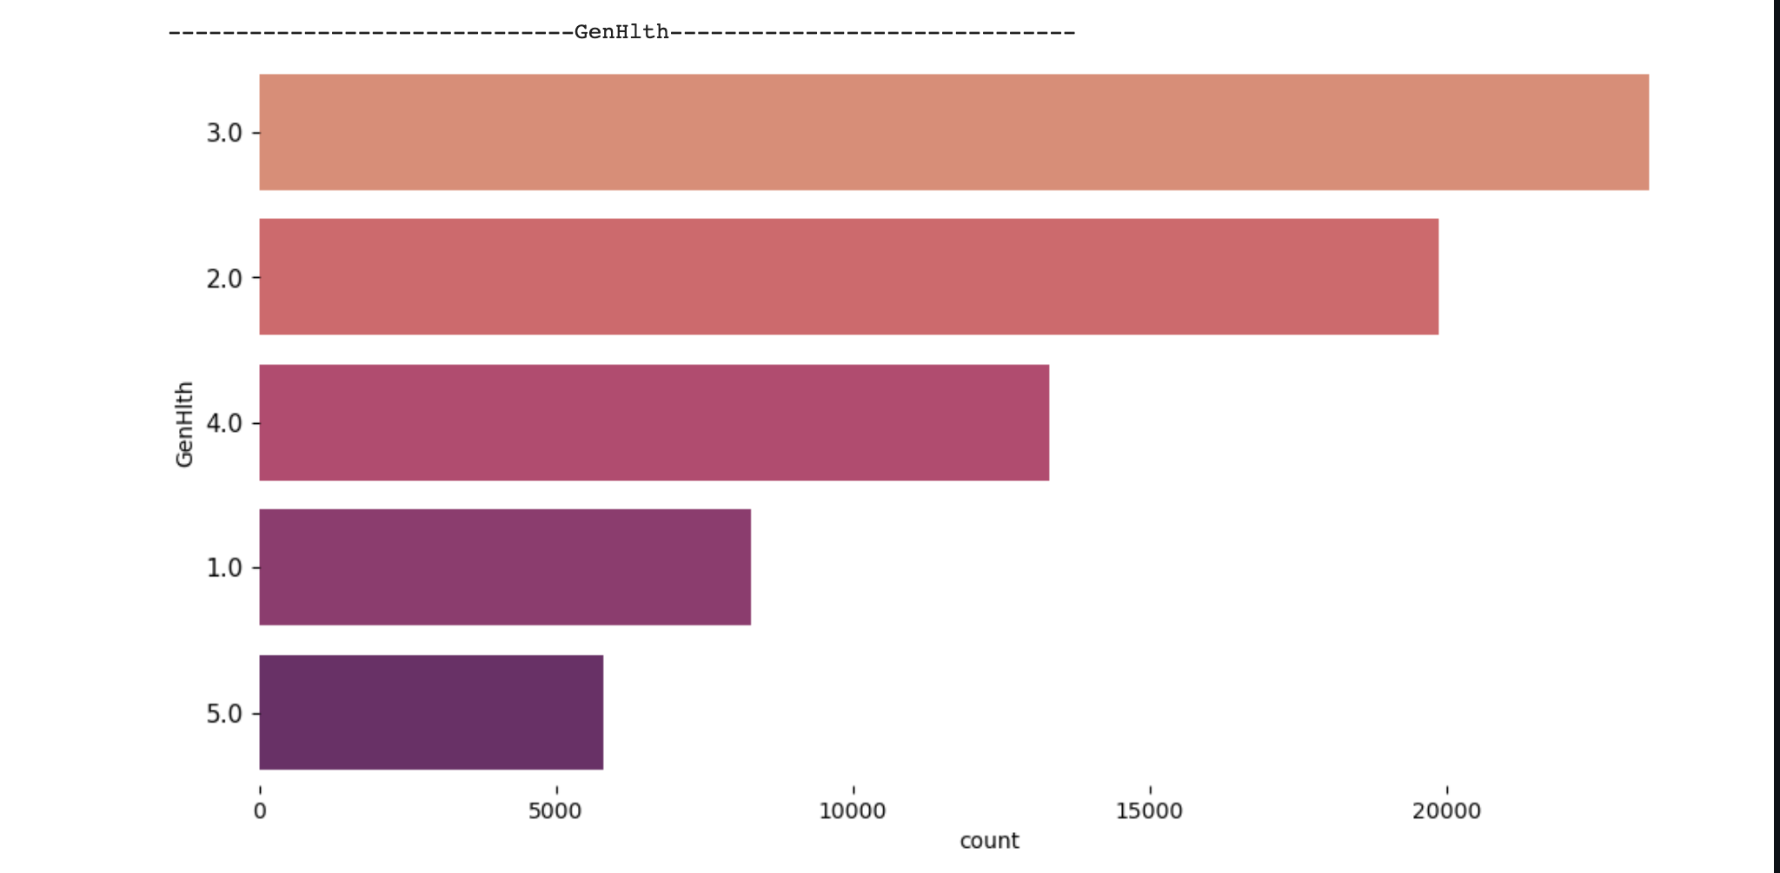

Slide 19
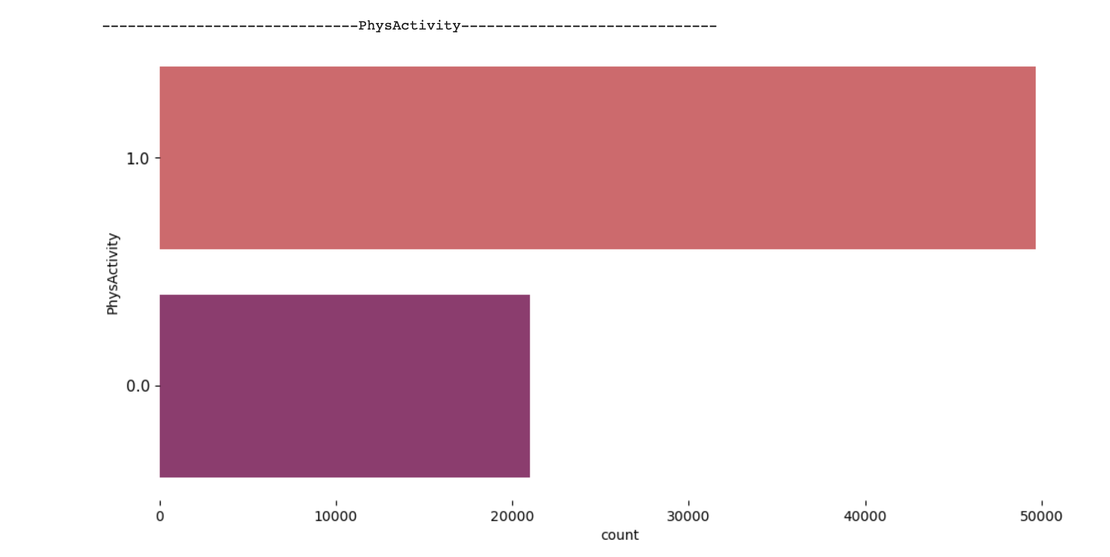

Slide 20
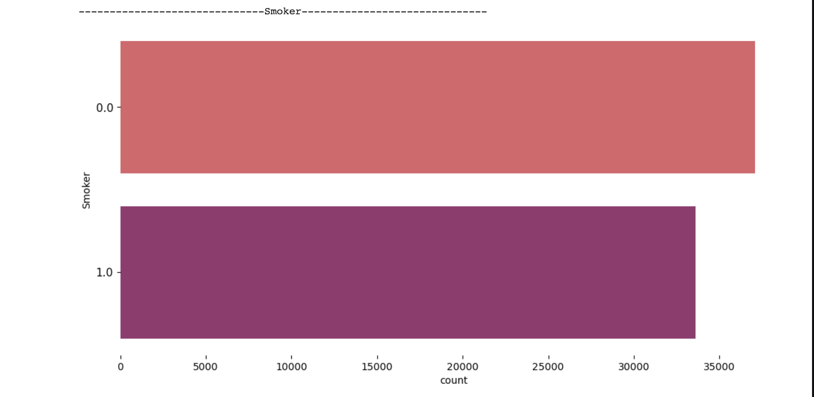

Slide 21
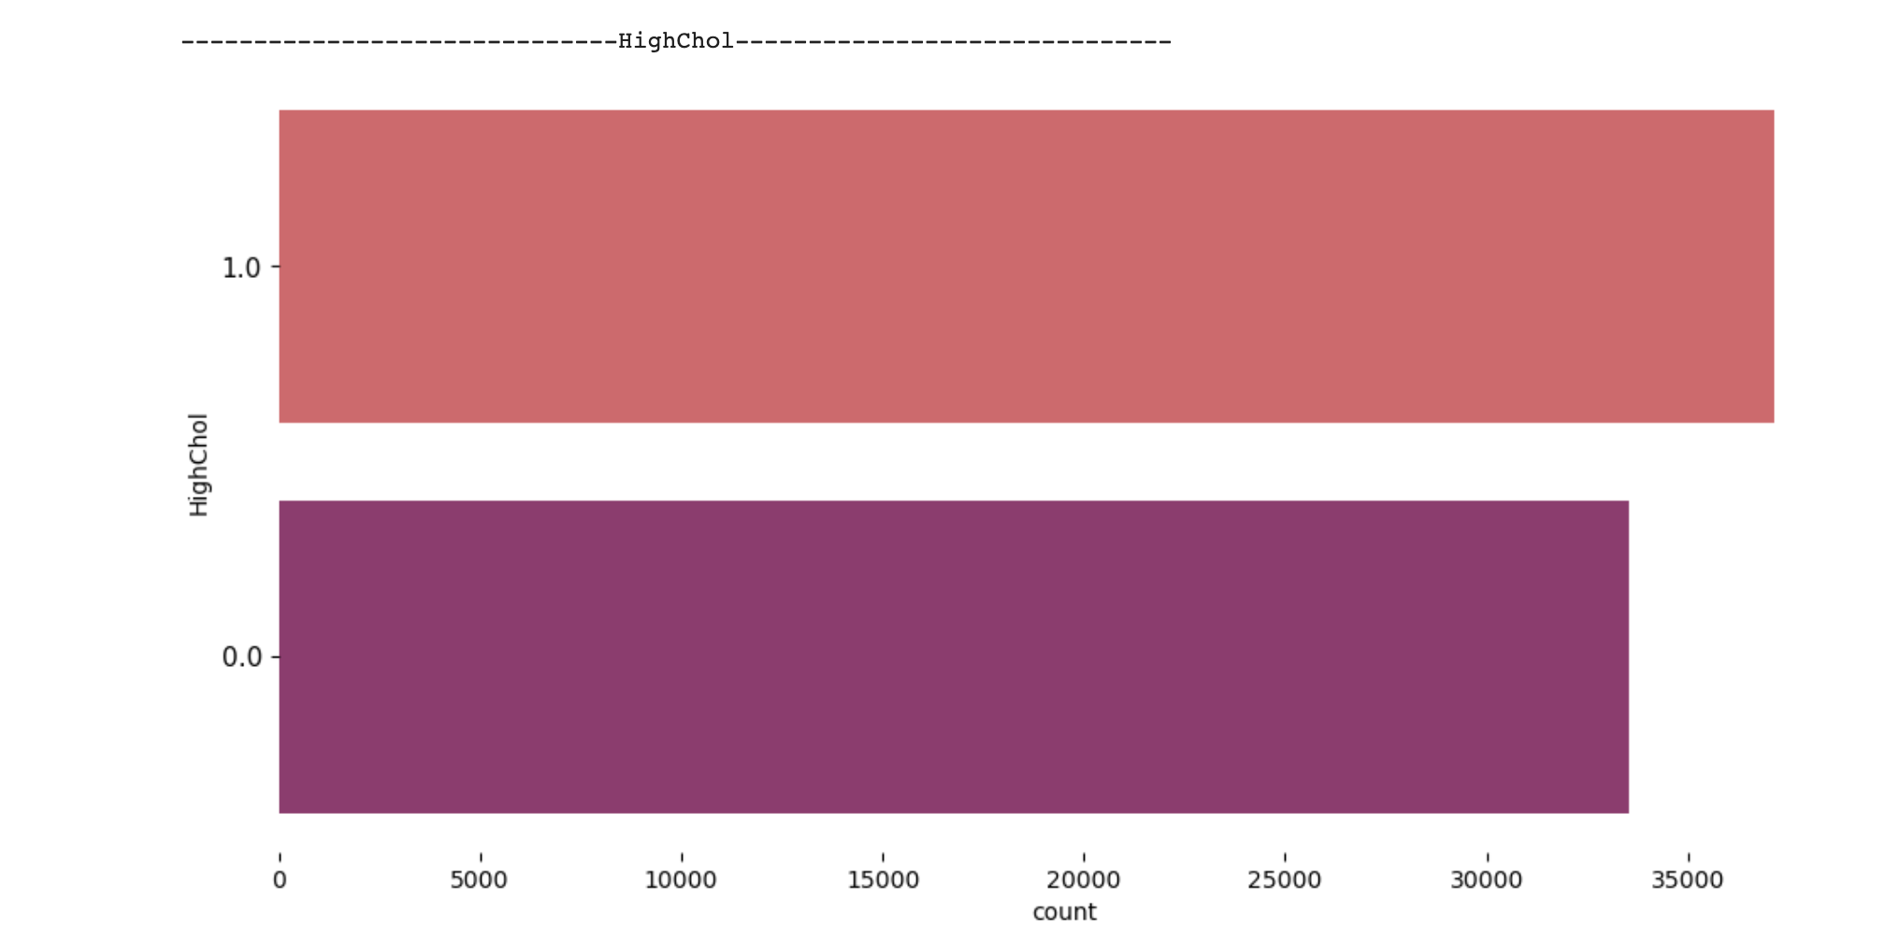

Slide 22
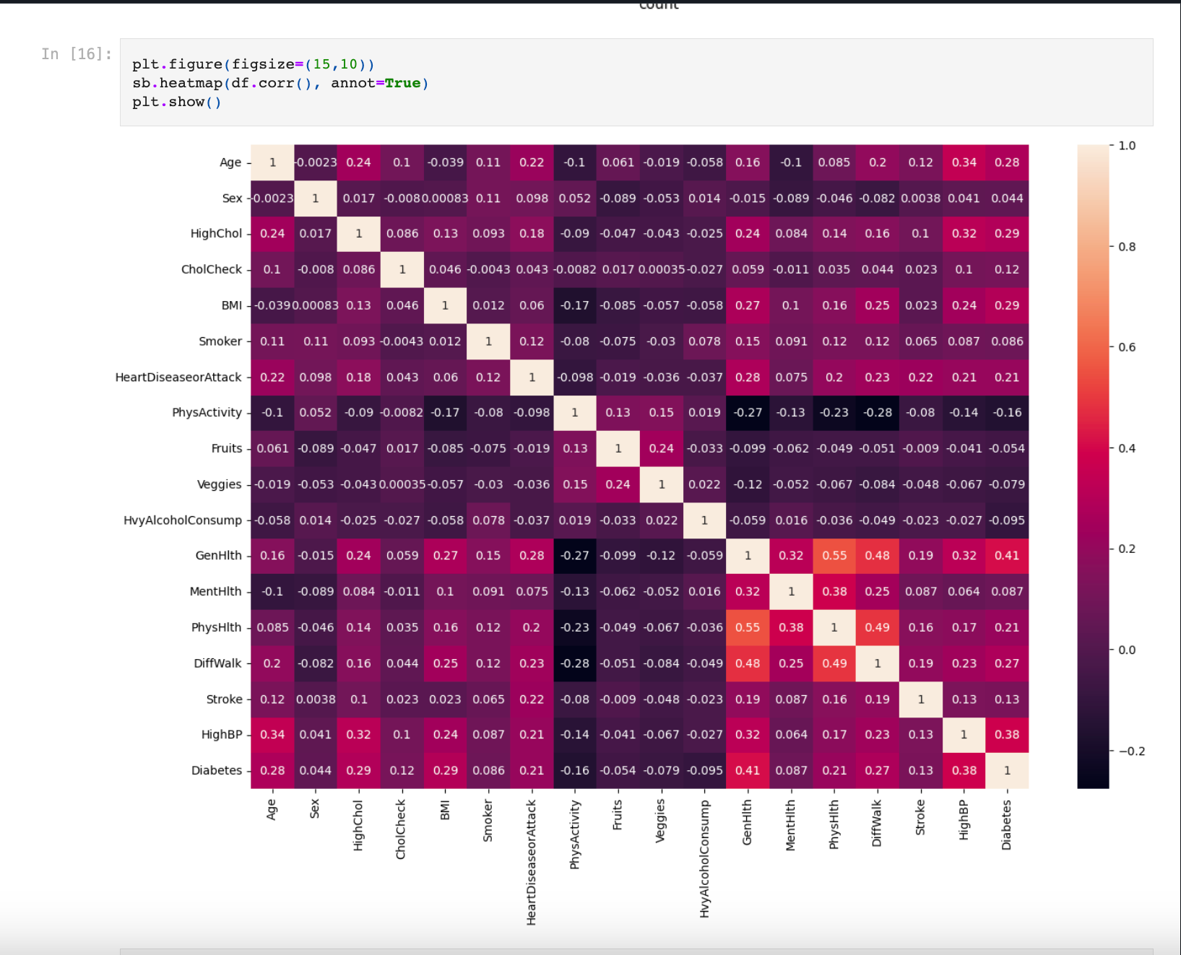
Exploring the correlation between dependences

Slide 23
Modelling
4 data modelling techniques have been used
Random Forest
Decision Tree
Kneighbors
Support Vector Machine (SVM)

Slide 24
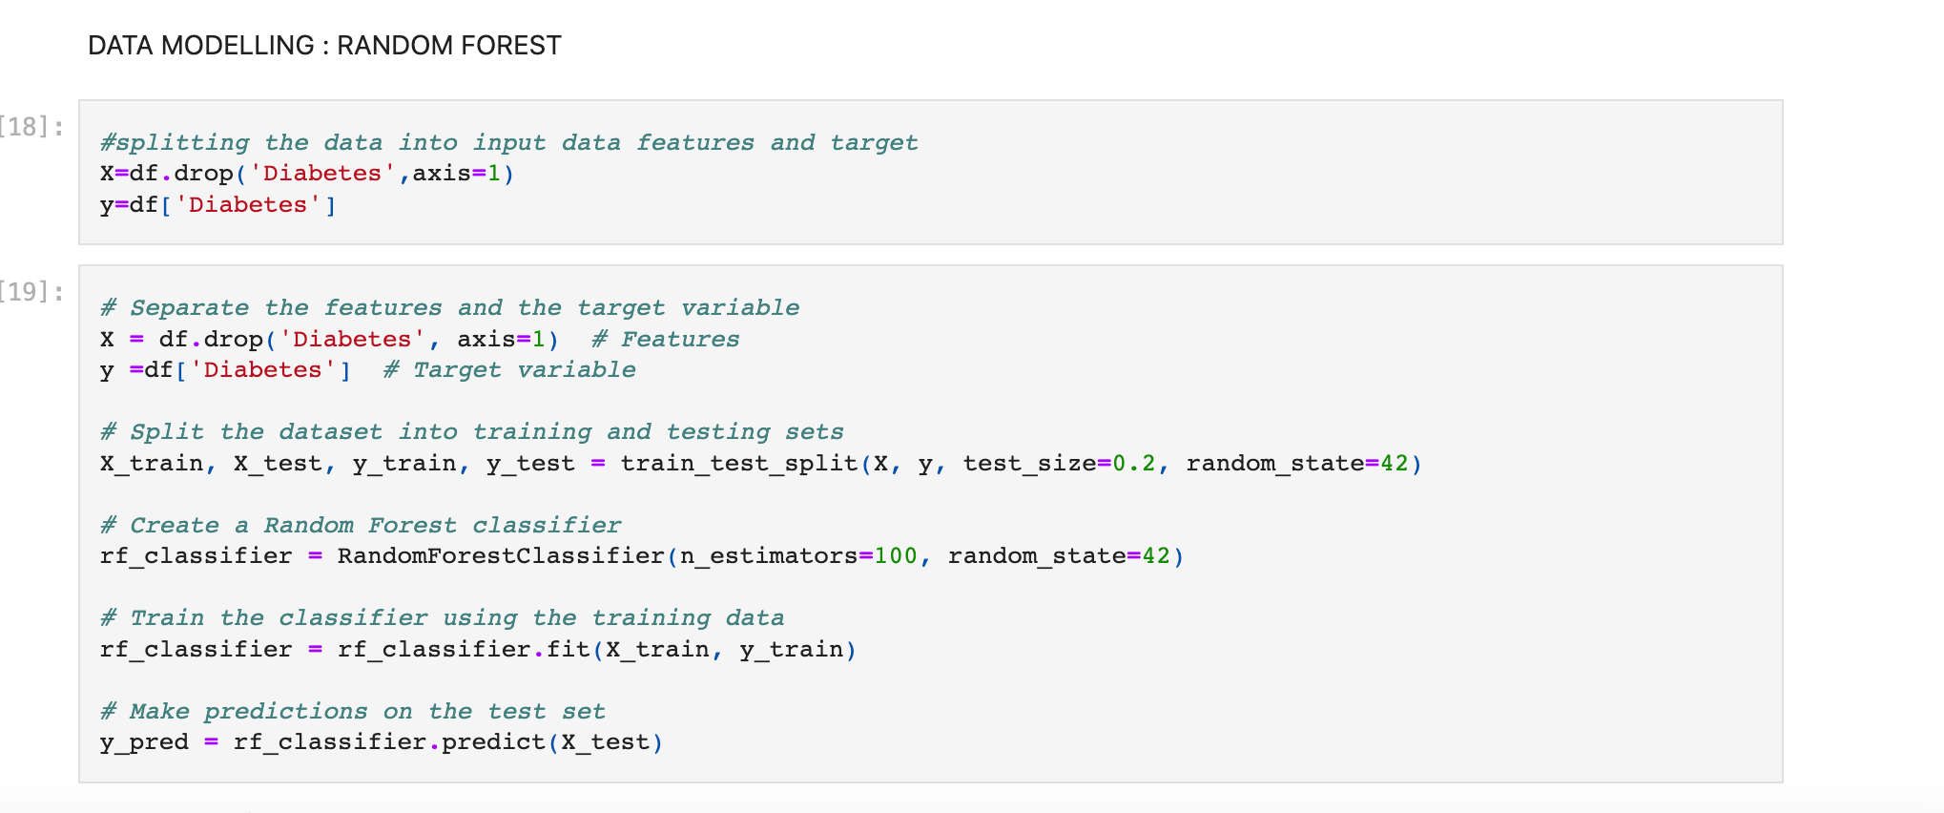

Slide 25
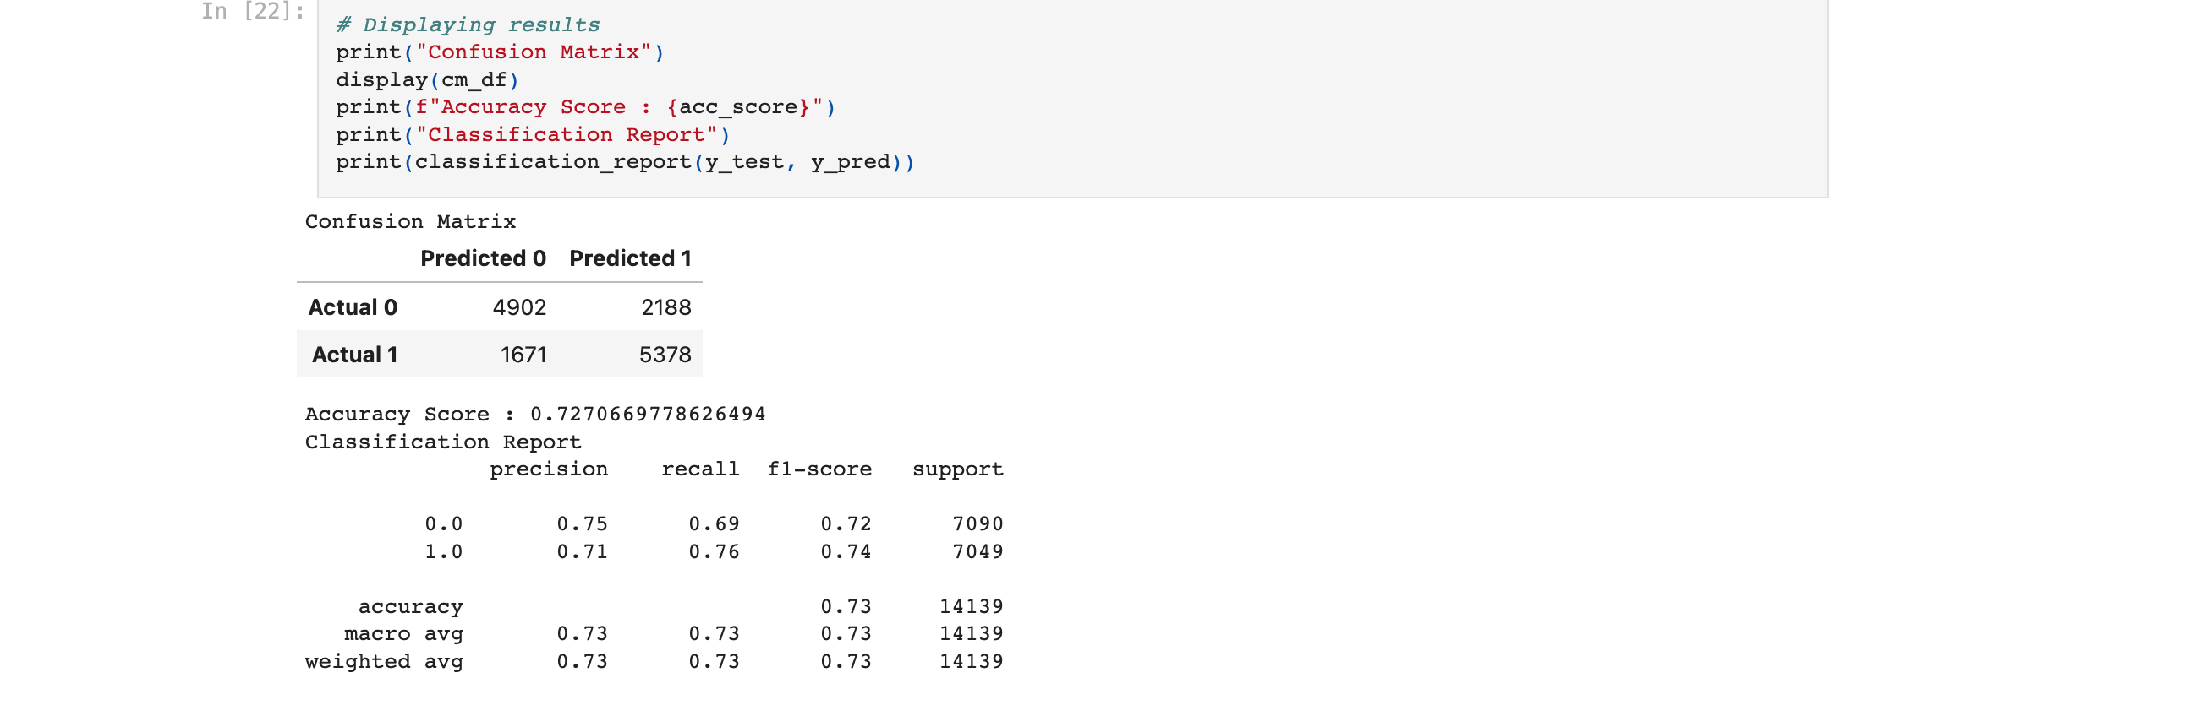
Confusion Matrix and Classification report- Random Forest

Slide 26
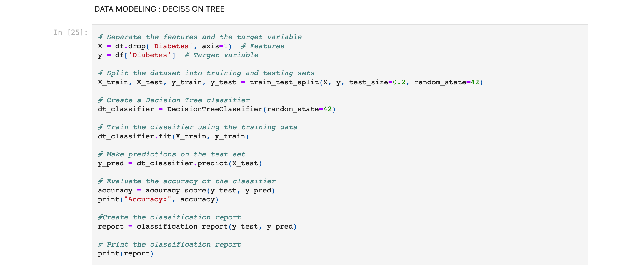

Slide 27
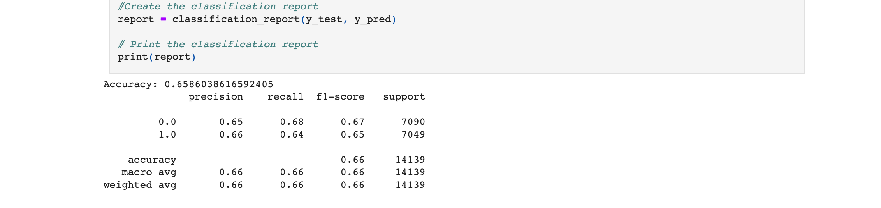
Confusion Matrix and Classification report-Decision Tree

Slide 28
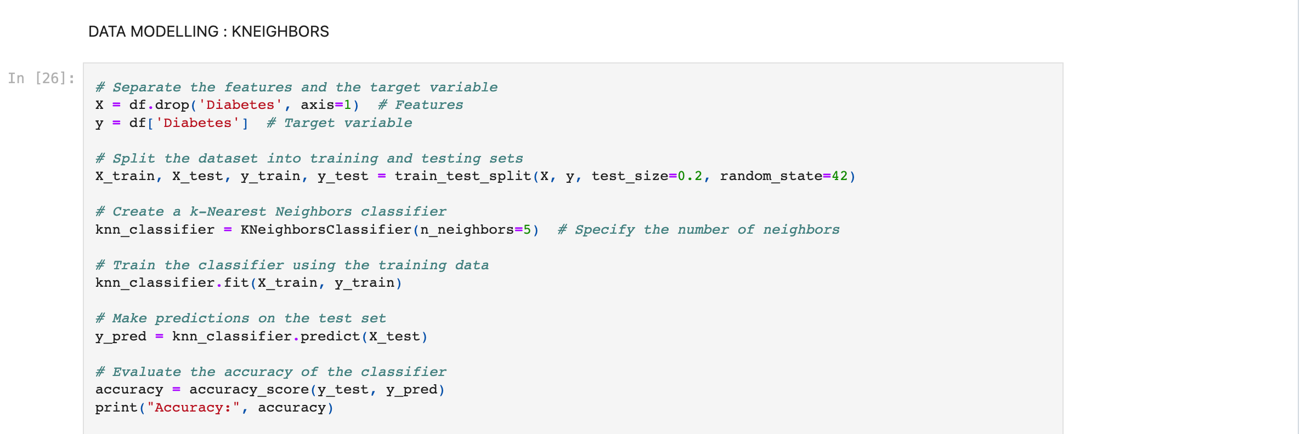

Slide 29
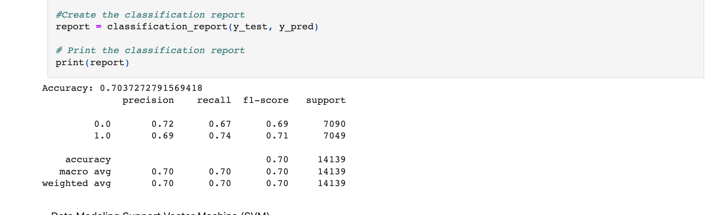
Confusion Matrix and Classification report- K Neighbors

Slide 30
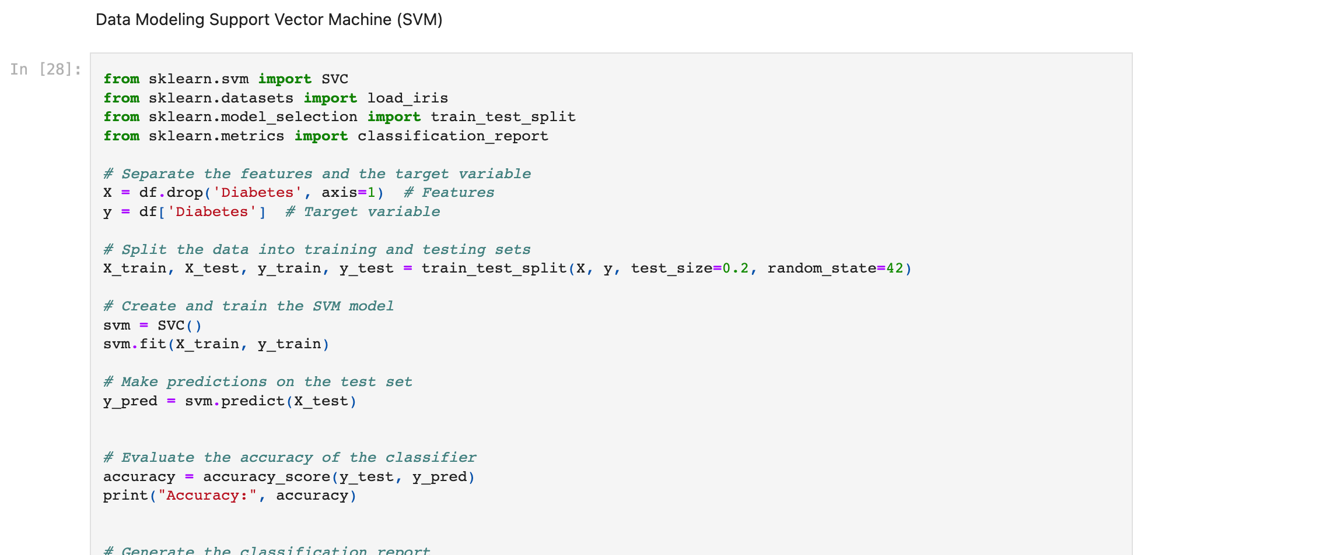

Slide 31
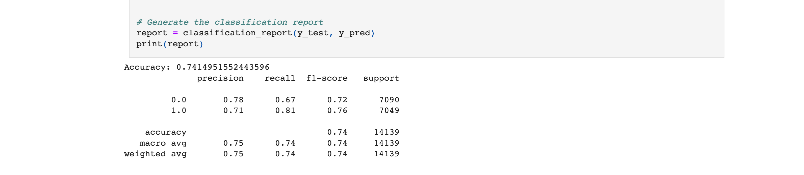
Confusion Matrix and Classification Report- Support Vector Machine

Slide 32
Discussion
What do we achieve from the above data modelling?
With the help of machine learning and different data modelling, the physician might be able to predict if a patient has diabetes or not
Can these models be useful for future prediction?
Since the accuracy of the above models does not meet the requirement (75%), especially in health-related decision-making, it is not recommended
The success of data modelling also depends on different factors such as data collection, data quality, and model performance, there can be limitations on the outcomes which can be improved by trying the latest model.

Slide 33
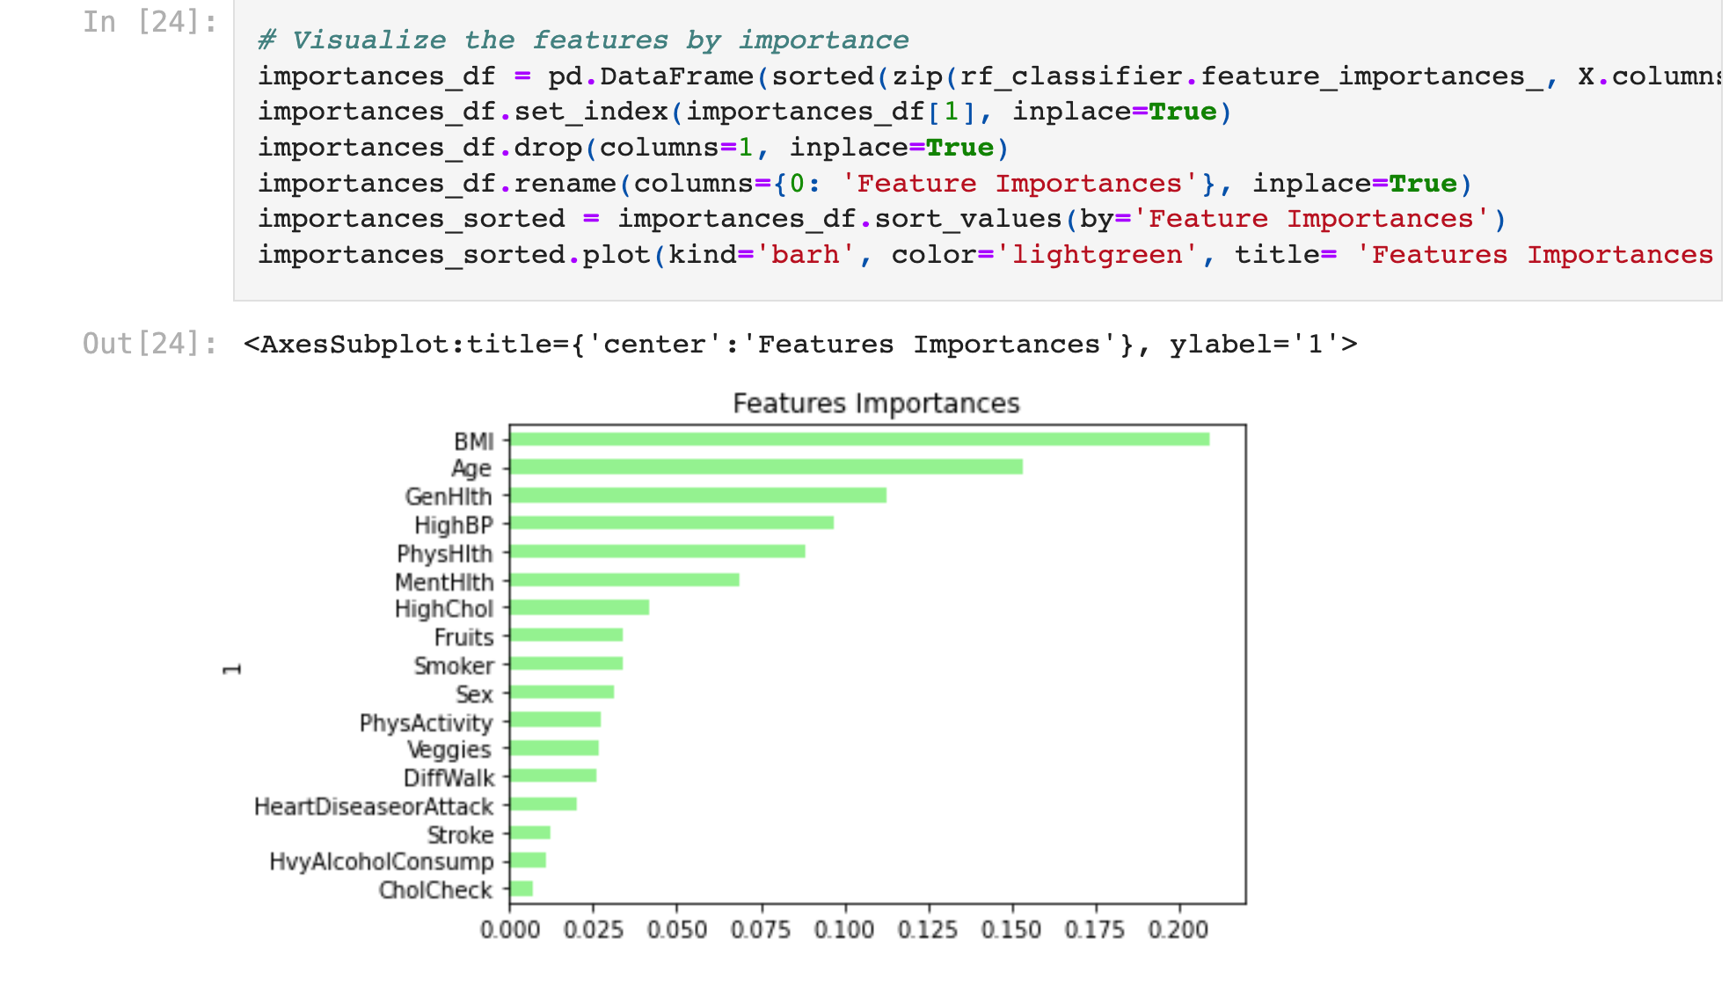

Slide 34
Conclusion
From the feature importance, we can conclude that BMI is the most influential factor contributing to diabetes which is followed by age, general health and high BP.
Similarly, Cholchek, high alcohol consumption comes as the least contributing factor for diabetes.
After analyzing the accuracy results and classification report, we can say the support vector machine is best than the other 3 models that we analyzed.

