Slide 1
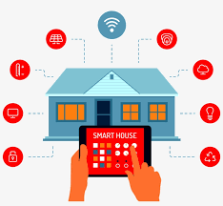
$mart Homes
Making Homes Smarter
BY
PRAVEEN SARASWAT
RAVI KUMAR

Slide 2
content….
A. INTRODUCTION
B. MILESTONES
C. WORKING
D. REPRESENTATION &IMPLEMENTATION
E. PROBLEMS & ADVANTAGAES

Slide 3
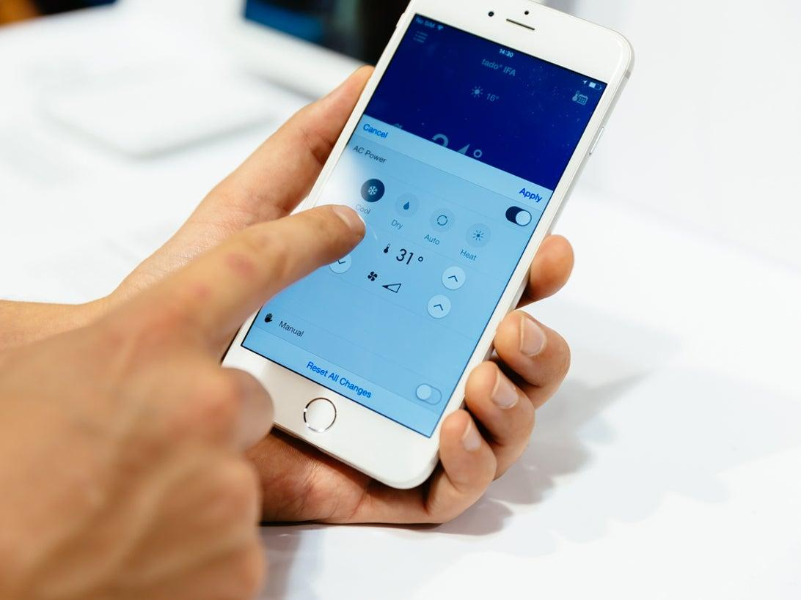
INDRODUCTION
Home automation is nothing but building automation for home ,
Which is smart enough to control its appliances from anywhere with help of internet.Generally it has many user control means access to trusted individual which leads to save Time and Energy also.

Slide 4
Milestones
1.Controlling and accessing home appliances using internet from anywhere in the world
2.Using voice/text/web based command for controlling the application
3.Forming the gateway to control all the appliances from a single point
.

Slide 5
WORKING
HOW OUR DEVICES ARE WORKING ON A PARTICULAR COMMANDS)
1)With the help of pythons speech recognising library we will be converting the voice command into text and when the text matches with any of the command a particular code is activated.
2)Now it will sends the information to firebase and make changes to the database.
3) As the database is connector to nodemcu the following command will be reflected on the nodeMCU and it will make change to the appliances

Slide 6
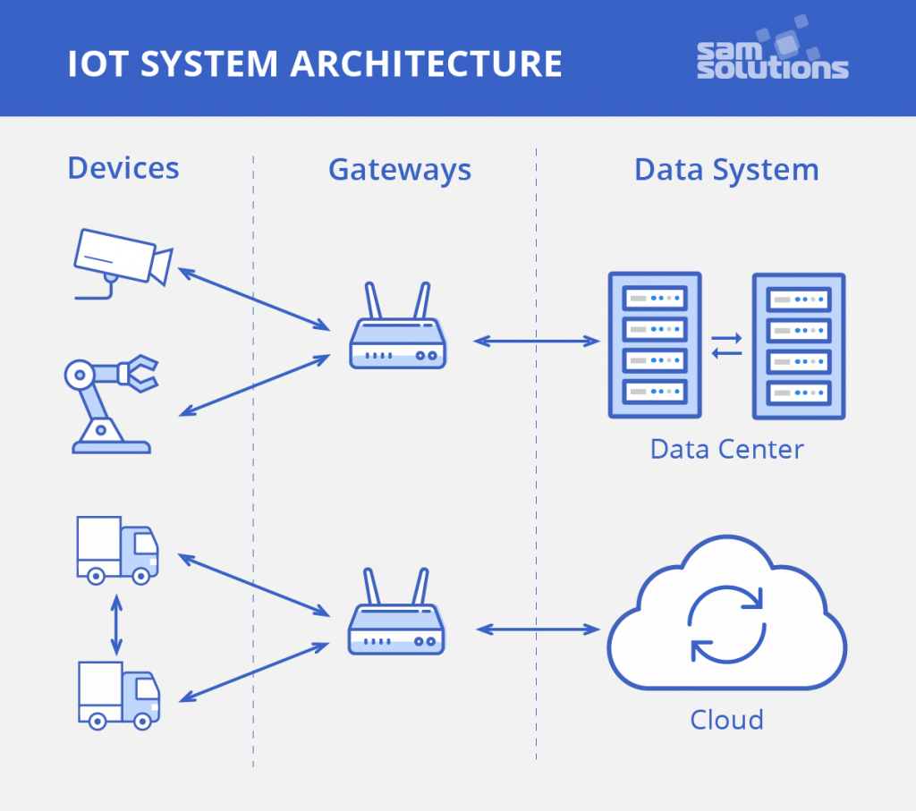
PICTORIAL REPRESENTATION OF WORKING

Slide 7
What more we have done
We have implemented the light automation using tinkerCad with the use of ir remote
TinkerCad link

Slide 8
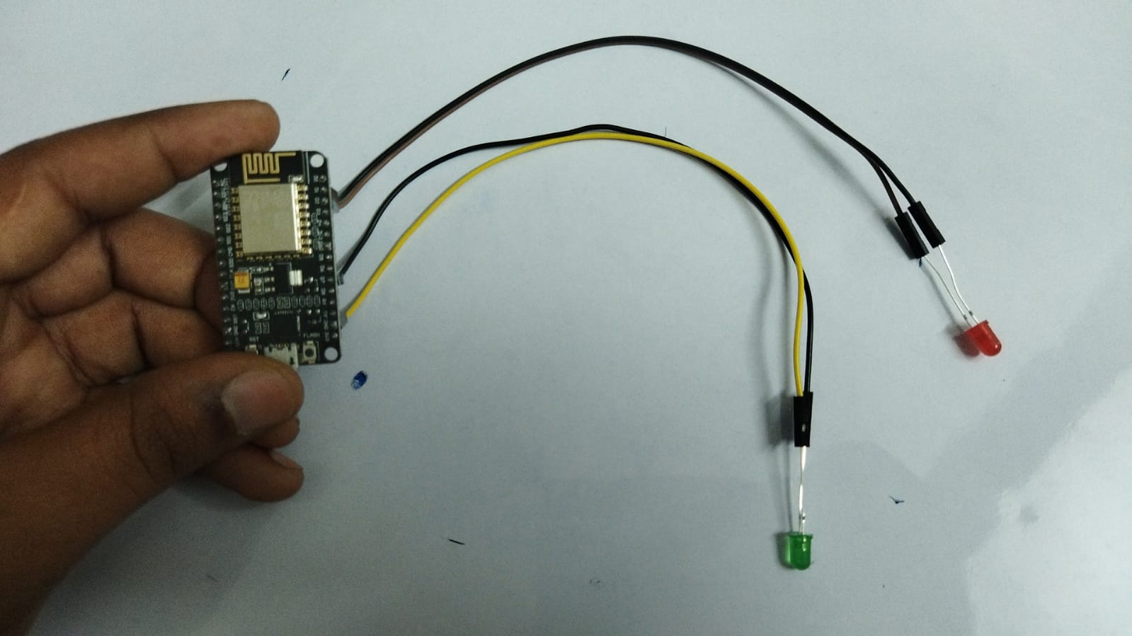
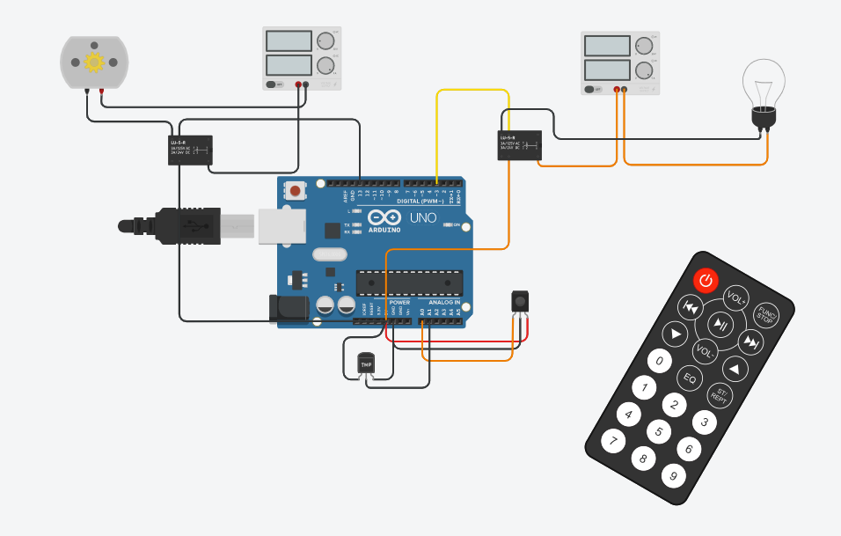
CIRCUIT REPRESENTATION
IMPLEMENTED circuit on thinkercard

Slide 9
PROBLEMS FACED DURING MAKING
1)Due to the lack of proper hardware we have demonstrated the appliances as led
2)The Red led represents the fan
3)And the green represents bulb
4)And also as the version of ariuno-firebase library should to compatible with AndroidJs library to run the code on arduino ide

Slide 10
Advantages
1)The primary and main advantage of IoT is monitoring. It helps us Know the precise quantity of supplies or the air quality in your home, it can also provide more data that could not have previously been possible to collect easily.
2)Right now, you can easily gain the required information in real-time, from (almost) any location you are at. It only takes a smart device and internet connection.
3)As we know it takes long time to cool a room when we ON an Air Conditioner. So by this before entering the house we give command to ac to switch on before entering the house

Slide 11
THANK YOU…….

