Slide 1
RED BULL BASEMENT CHERRY+ NETWORK IDEATHON FINTECH
Dhanify : Unlock Your Wealth Potential, One Step at a Time.
By: Lingo Linkers

Slide 2
INTRODUCTION
Empowering the Next Generation with Financial Literacy: Building a Nation of Financially Informed Individuals
"Did you know that 78% of young adults feel unprepared to manage their finances effectively?“
"Our mission is to make financial literacy accessible, engaging, and impactful for young individuals, empowering them to lead financially secure and prosperous lives.“ By educating the youth about finance, we aim to reduce the nation's financial literacy gap, leading to better money management, reduced debt, and a more prosperous economy.

Slide 3
Problem statement
The Financial Literacy Crisis: A Silent Barrier to Economic Prosperity
Problem Overview: Financial literacy is alarmingly low among young adults, who are often left to navigate the complexities of money management without adequate education or resources. Despite its critical importance, financial literacy is rarely a part of mainstream education, resulting in a generation of individuals who are ill-prepared to make informed financial decisions.
Lack of Financial Education: Schools and universities do not prioritize financial literacy, leaving students unprepared for real-world financial challenges such as budgeting, saving, and investing.
Poor Financial Decision-Making: The absence of financial knowledge leads to poor money management, increased debt, and a lack of investment in future financial security.
Widespread Consequences: This gap in financial literacy not only impacts individuals but also has far-reaching effects on the nation's economy, contributing to higher poverty rates, economic instability, and a less financially resilient population.
Impact: Without proper financial education, young adults struggle with basic financial concepts, resulting in negative outcomes such as high credit card debt, poor savings habits, and limited investment in their futures. This issue is not just personal but has national implications, as it contributes to a less stable and less prosperous economy.
A recent survey found that only 24% of millennials demonstrate basic financial knowledge, which has resulted in widespread issues such as high levels of debt and inadequate savings. This highlights the urgent need for accessible and engaging financial education for the youth.

Slide 4
Solution
Dhanify: The Gamified Path to Financial Literacy
In a world where financial literacy is often overlooked, especially among young people, Dhanify steps in as a transformative solution. Our platform reimagines financial education by making it engaging, accessible, and practical for everyone, regardless of their background or prior knowledge.
Dhanify is more than just an app; it’s a comprehensive financial literacy platform designed to empower users with the knowledge and tools they need to take control of their financial future. We leverage the power of gamification to make learning about finance not just a necessity, but an exciting and rewarding journey.
Gamified Learning Experience: Through interactive quizzes, challenges, and simulations, users can learn essential financial concepts in a fun and engaging way. Progress through levels, earn rewards, and unlock achievements as you master topics ranging from budgeting and saving to investing and wealth management.
Peer Learning & Community Engagement: What sets Dhanify apart is its focus on social investing and peer learning. Users can form or join investment groups where they can discuss strategies, share knowledge, and learn from each other’s experiences. This community-driven approach encourages collaboration and helps users learn through shared insights, making financial literacy a collective goal.

Slide 5
Real-World Financial Simulations: Dhanify offers simulations of real-world financial scenarios, such as managing a virtual stock portfolio or budgeting for life events like buying a car or planning a vacation. These simulations help users apply their knowledge in practical, risk-free environments, building confidence before making real-life financial decisions.
Interactive Learning Modules: Inspired by books like Rich Dad Poor Dad and The Psychology of Money, Think and Grow Rich, The Richest Man in Babylon. Dhanify breaks down complex financial concepts into easy-to-understand modules. Each module is designed to be interactive, using case studies, storytelling, and problem-solving exercises to teach users the principles of smart financial management.
Goal-Oriented Financial Planning: Dhanify allows users to set financial goals whether it’s saving for a major purchase, paying off debt, or building an emergency fund and provides tailored educational content and investment opportunities to help them reach these goals. Users can track their progress, adjust their plans, and celebrate milestones along the way.
Why It Matters: Financial literacy is the foundation of a secure and prosperous life. By making this education engaging and accessible, Dhanify aims to close the financial knowledge gap that has left so many young people unprepared for the real world. We believe that with the right tools and knowledge, everyone has the potential to achieve financial independence and contribute to a stronger, more economically stable society.
Exceptional Innovation: Dhanify's Peer Learning & Community Engagement feature is a unique approach that fosters collaboration and shared growth. By enabling users to learn from one another and apply their knowledge through group discussions and community challenges, we create a dynamic learning environment that is both supportive and motivating. This social aspect of learning, combined with real-world simulations, ensures that users are not just passive learners but active participants in their financial education journey.
Join us in creating a future where financial literacy is not just a privilege, but a universal right, empowering the next generation to thrive.

Slide 6
TECHNICAL APPROACH
1. System Architecture
Our solution comprises a mobile application built using Android Studio, which connects to Firebase for real-time data management and user authentication. The system architecture includes the following components:
Frontend (Mobile App):Developed in Android Studio using JAVA for the user interface and experience. The app provides a seamless experience for users to interact with financial educational content, take quizzes, set goals, and track their progress.
Backend (Firebase):Firebase Authentication for secure user login and management. Cloud Firestore for storing and retrieving user goals, quiz scores, and other personalized data. Firebase Realtime Database (if needed) for real-time synchronization of certain features like quiz leaderboards or peer interactions.
2. Core Features
Gamified Learning: Interactive quizzes and challenges that teach financial concepts in a fun and engaging way.
Goal Setting & Tracking: Users can set financial goals (e.g., saving for a trip) and track their progress using the app. These goals are stored and retrieved securely via Firebase.
Peer Learning & Social Investing: The app facilitates peer learning through forums and allows users to engage in social investing activities, enhancing community-driven learning.
3. Firebase Integration
Data Storage: User goals, progress, and quiz scores are stored in Cloud Firestore, which allows for real-time data synchronization and efficient querying.
Authentication: Firebase Authentication is used to manage user accounts securely, ensuring that only authorized users can access their personalized data.
Notifications: Firebase Cloud Messaging (FCM) is utilized to send push notifications for reminders and new content updates, keeping users engaged with the platform.

Slide 7
TARGET AUDIANCE
Our target audience primarily consists of students and young adults who are at the beginning stages of their financial journey. This demographic is particularly vulnerable to poor financial decision-making due to a lack of formal financial education. By focusing on this group, we aim to address the critical gap in financial literacy and empower them with the tools and knowledge needed to manage their finances effectively.
Why They Need Our Solution:
Bridging the Education Gap: Our platform provides essential financial knowledge that is often missing from traditional education systems.
Real-World Application: The app offers practical tools and scenarios that allow users to apply financial concepts in real life.
Community and Peer Learning: Encourages learning through community engagement, making financial education a shared and supportive experience.

Slide 8
FEASIBILITY AND SCALABILITY
Feasibility
Technical Viability: Built using Android Studio and Firebase, leveraging proven and scalable technologies. Firebase offers seamless integration for authentication, data storage, and real-time updates.
Team Expertise: Our team possesses strong skills in mobile development, UI/UX design, and backend integration, ensuring successful implementation.
Market Readiness: High demand for financial education among students and young adults, coupled with a user-friendly design, makes the app viable for immediate adoption.
Scalability
Backend Scalability: Firebase’s cloud infrastructure supports automatic scaling, allowing the app to handle growth in user base and data volume efficiently.
Feature Expansion: Modular architecture allows for easy addition of new features, such as cross-platform support.
Geographical Expansion: Initially targeting urban areas, with plans to expand to semi-urban and rural regions. Social and peer learning features promote organic user growth.

Slide 9
IMPACT
Empowering Youth: The app equips students and young adults with essential financial knowledge, fostering informed decision-making and financial independence.
Improved Financial Literacy: By addressing the education gap, we contribute to a generation better prepared to manage money, reduce debt, and invest in their future.
Economic Benefits: Enhanced financial literacy leads to a more financially resilient population, reducing poverty rates and contributing to national economic stability.
Community Growth: The app promotes peer learning and social investing, creating a supportive community focused on collective financial improvement.
Long-Term Change: Our platform not only addresses immediate educational needs but also drives long-term financial well-being and prosperity for individuals and society as a whole.
This focus on impact highlights the far-reaching benefits of our solution, from individual empowerment to broader economic improvement.

Slide 10


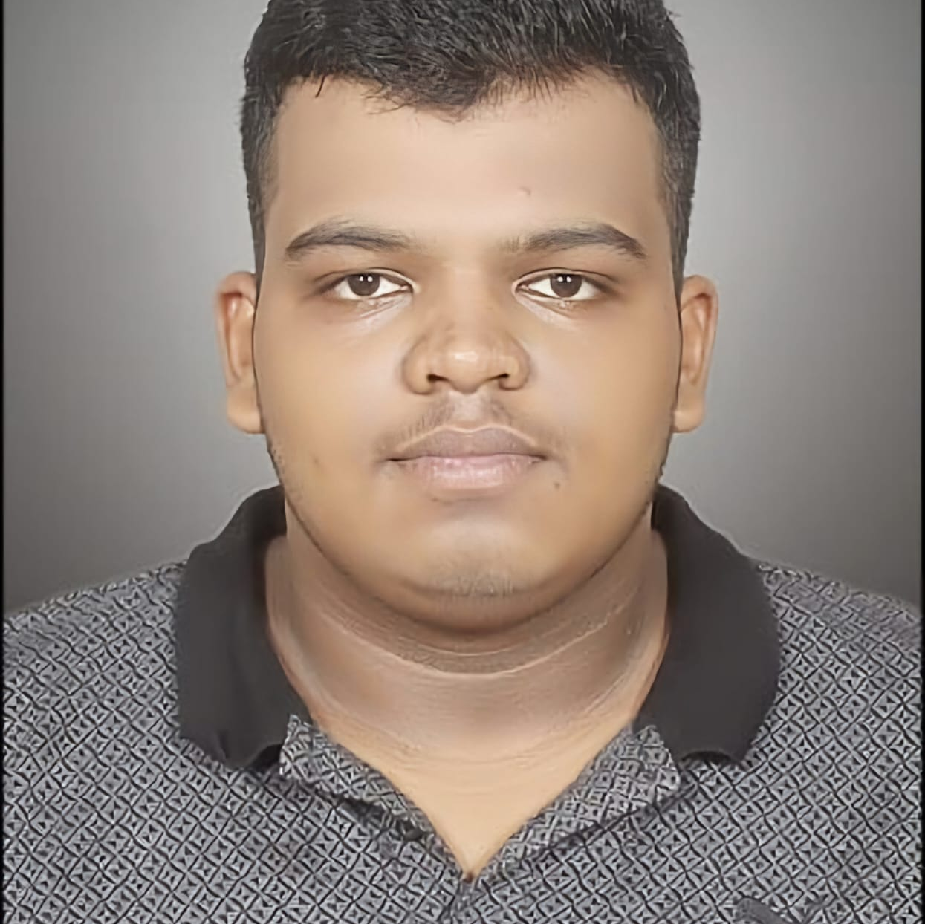

MEET OUR TEAM
Sushil Kumar Mishra
Arnav Prateek​
Divyansh Kumar Singh
Sarvesh R
Team Leader

Slide 11
THANK YOU

