Slide 1

Self-Introduction
Name: Deepak Moud
Qualification: BE, MTECH, PhD(Persuing)
Designation: Head of Department
Research Area: Image Processing, Machine Learning, Deep learning, data Mining
E-mail Id: deepakmoud@poornima.org
Phone Number: 07568748510

Slide 2
Books
Sr. No. | Title of the book | Author
1 | Machine Learning | Anuradha Srinivasaraghavan, Vincy Joseph
2 | Data Mining Concepts and Techniques | Jiawei Han University of Illinois at Urbana–Champaign Micheline Kamber Jian Pei Simon Fraser University

Slide 3
This document contains images obtained by routine Google Images searches. Some of these images may perhaps be under copyright. They are included here for educational and noncommercial purposes and are considered to be covered by the doctrine of Fair Use. In any event they are easily available from Google Images.
Public Notice regarding Use of Images
It's not feasible to give full scholarly credit to the creators of these images. We hope they can be satisfied with the positive role they are playing in the educational process.
2

Slide 4
Agenda
What is KNN?

Slide 5
Eager Learners vs Lazy Learners
Eager learners, when given a set of training tuples, will construct a generalization model before receiving new (e.g., test) tuples to classify.
Lazy learners simply stores data (or does only a little minor processing) and waits until it is given a test tuple.
Lazy learners store the training tuples or “instances,” they are also referred to as instance based learners,

Slide 6


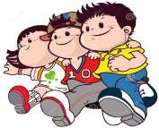
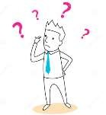
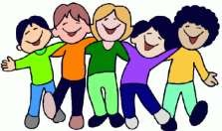
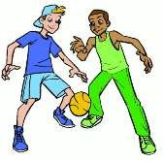
Simple Analogy..
•
Tell me about your
friends(who your
neighbors
are)
and
I
will
tell
you
who
you
are.
3

Slide 7

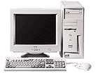

Instance-based
Learning
Its very similar to a
Desktop!!
4

Slide 8
k- Nearest Neighbor Classifier
➢ History
• It was first described in the early 1950s.
• The method is labor intensive when given large
training sets.
• Gained popularity, when increased computing
power became available.
• Used widely in area of pattern recognition and
statistical estimation.

Slide 9
What is k- NN??
 Nearest-neighbor
classifiers
are
based
on
learning by analogy, that is, by comparing a given
test tuple with training tuples that are similar to it.
 The training tuples are described by n attributes.
 When k = 1, the unknown tuple is assigned the
class of the training tuple that is closest to it in
pattern space.

Slide 10
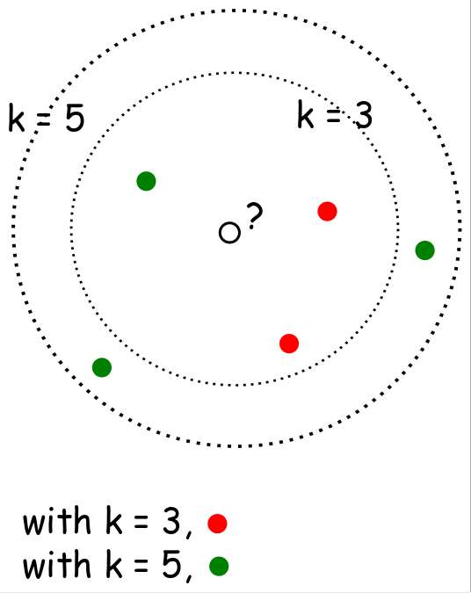
When k=3 or k=5??

Slide 11
Distance
Measure
Compute
Distance
Test
Record
Training
Records
Choose k of the
“nearest” records
9

Slide 12


Closeness
 The
Euclidean
distance
between
two
points
or
tuples, say,
X1 = (x11,x12,...,x1n)
and
X2 =(x21,x22,...,x2n),
is
 Min-max normalization
can be used to transform
a
value
v
of
a
numeric attribute
A to
v0
in
the
range [0,1] by computing

Slide 13
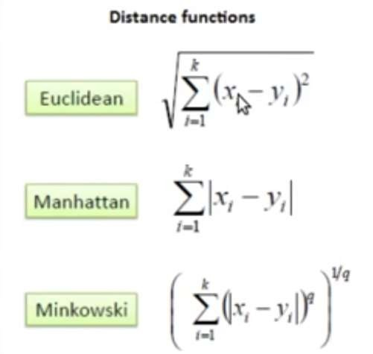
Distance
measure for
Variables
Continuous
10

Slide 14
How to determine a good
value for
k?
 Starting with k = 1, we use a test
the error rate of the classifier.
set to estimate
 The k
value
that
gives
the
minimum
error
rate
may be selected.

Slide 15
KNN Algorithm
and
Example

Slide 16
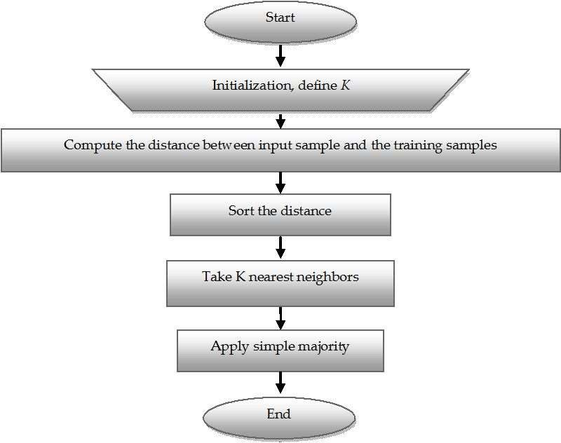
KNN Classifier Algorithm

Slide 17
Example
data from the questionnaires survey and testing with two attributes (acid durability and

We have
objective
strength)
to classify whether a special paper
tissue
is
good
or
not.
Here
are
four
training
samples
:
X1 = Acid Durability X2 = Strength Y = Classification
(seconds) (kg/square meter)
7 7 Bad
7 4 Bad
3 4 Good
1 4 Good
Now
the factory produces
a new paper tissue
that
passes the
laboratory test with X1 = 3 and X2 = 7. Guess the classification of
this new tissue.

Slide 18
 Step 1 : Initialize and Define k.
Lets say, k = 3
(Always choose k as an odd number if the number of
attributes is even
to avoid a tie in the class prediction)
 Step 2 : Compute the distance between input sample and
training
sample
- Co-ordinate of the input sample is (3,7).
- Instead of calculating the Euclidean distance, we
calculate the
Squared Euclidean distance.
X1 = Acid Durability X2 = Strength Squared Euclidean distance
(seconds) (kg/square meter)
7 7 (7-3)² + (7-7)² = 16
7 4 (7-3)² + (4-7)² = 25
3 4 (3-3)² + (4-7)² = 09
1 4 (1-3)² + (4-7)² = 13

Slide 19
 Step 3 : Sort the distance and determine the nearest
neighbours based of the
K^{th}
minimum distance :
X1 = Acid X2 = Strength Squared Rank Is it included Durability (kg/square Euclidean minimum in 3-Nearest (seconds) meter) distance distance Neighbour?
7 7 16 3 Yes
7 4 25 4 No
3 4 09 1 Yes
1 4 13 2 Yes

Slide 20
 Step 4 : Take 3-Nearest Neighbours:
 Gather the category Y of the nearest neighbours.
X1 = Acid X2 = Squared Rank Is it Y = Durability Strength Euclidean minimum included in Category of (seconds) (kg/square distance distance 3-Nearest the nearest
meter) Neighbour? neighbour
7 7 16 3 Yes Bad
7 4 25 4 No -
3 4 09 1 Yes Good
1 4 13 2 Yes Good

Slide 21
 Step 5 : Apply simple majority
 Use simple majority of the category of the nearest
neighbours as the prediction value of the query instance.
 We have 2 “good” and 1 “bad”. Thus we conclude that
the new paper tissue that passes the laboratory test with
X1 = 3 and X2 = 7 is included in the “good” category.

Slide 22


Advantages of KNN classifier :
Can be applied to the data from any distribution for example, data does not have to be separable with a linear boundary
Very simple and intuitive


Good classification if the number of samples
enough
is
large




Disadvantages of KNN classifier :
Choosing k may be tricky
Test stage is computationally expensive
No training stage, all the work is done during stage
the test

This is actually the opposite of what we want. Usually
we
can afford training step to take a long time, but we want
fast test step

Slide 23
Applications of KNN
Classifier
 Used
 Used
 Used
 Used
 Used
 Used
 Used
in
to
in
in
in
to
to
classification
get missing values
pattern recognition
gene expression
protein-protein prediction
get 3D structure of protein measure document similarity

