Slide 1
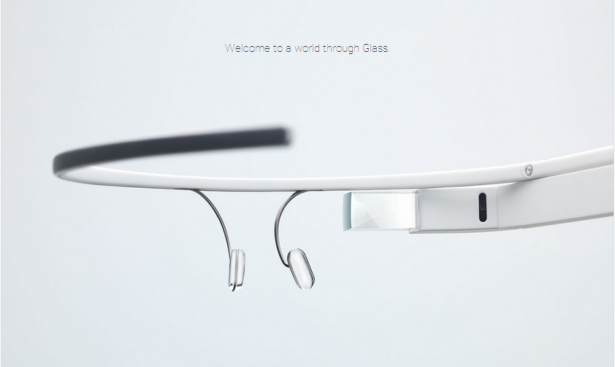
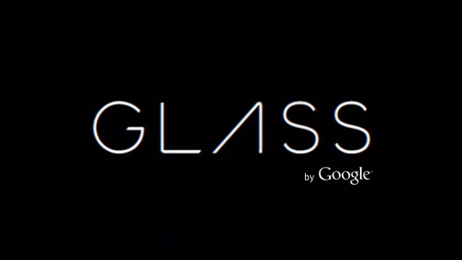
Google Glasses
SEMINAR 2
BY
AADITI SAOJI 3559
YASH SHAH 3560
SUSHIL KHAIRNAR 3668

Slide 2
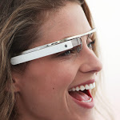
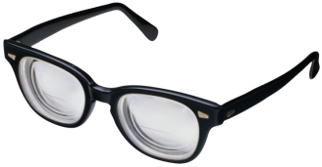
What is Google Glass?
Revolutionary new product made by Google.
Google Glass is a research and development program by Google to develop an augmented reality Head Mounted Display (HMD).

Slide 3
Literature Survey
Google Glass was developed by Google-X Lab in California intended to run on the Android Operating System.
In mid-2011,Google engineered prototype that weighed 8 pounds(3.6kg),by 2013 they were lighter than the average pair of sunglasses.
In may 2012,Google demonstrated for the first time how Google glass could be used to shoot videos.
In April 2013,the Explorer edition was made available to Google I/O developers in United States for $1500.
In June 2014,Nepal government adopted Google glass for tackling poachers of wild animals and herbs of Chitwan International Park.
The intended purpose of Google Glass was hands free displaying of information currently available to most of the smartphone users.
In July 2014,the startup company Surgery Academy in Milan, Italy, launched a remote training platform dedicated to medical students.
Gurkha Military currently uses Google glass to keep track of the ememies.

Slide 4
Introduction
Project Glass is a research and development program by Google to develop an augmented reality Head Mounted display (HMD).
The intended purpose of Google Glass would be the hands free displaying of information currently available to most smartphone users.

Slide 5
Overview
Google is expected to start selling eyeglasses that will project information onto the lenses. These glasses can use a 4G cell connection to pull in information from Google’s mountain of databases and display info about the real world in augmented reality on the lens in front of the eye.
The device will probably communicate with mobile phones through Wi-Fi and display contents on the video screen as well as respond to the voice commands of the user.

Slide 6
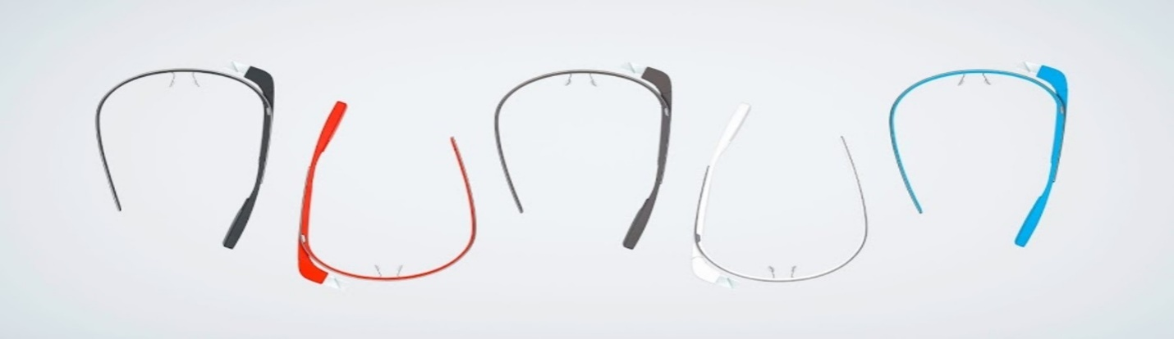
Technologies Used
Wearable Computing
Ambient Intelligence
Smart Clothing
Eye Tap Technology
4G Technology
Android Technology
Augmented Reality

Slide 7
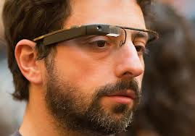
Wearable Computing
Worn by the bearer under , with or on top of clothing
Developed for general or special purpose information technologies and media development

Slide 8
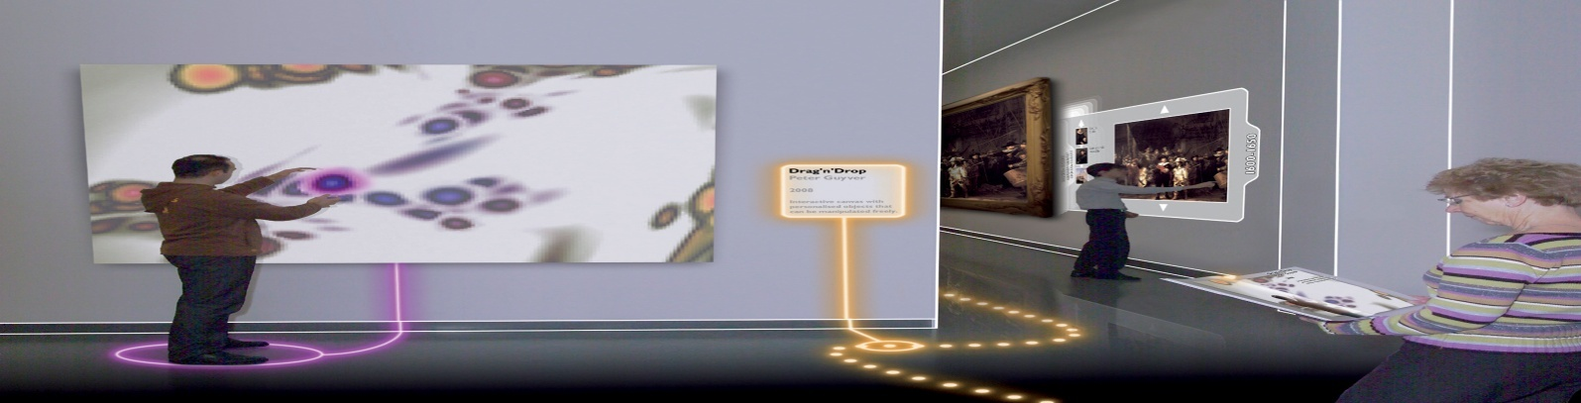
Ambient Intelligence
Electronic environments that are sensitive and responsive to the presence of people.
Devices work in concert to support people in carrying out their everyday life activities.

Slide 9
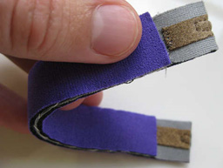
Smart Clothing
It is a combination of new fabric technology and digital technology.
The clothing is made with new signal-transfer fabric technology installed with digital devices.

Slide 10
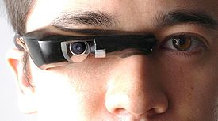
Eye Tap Technology
EyeTap is a device that is worn in front of the eye that acts as a
eye to record the scene available to the eye as well as a display.

Slide 11
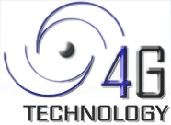
4G Technology
4G is the fourth generation of cell phone mobile communications.
4G Technology is basically the extension in the 3G technology with more bandwidth and services offers in the 3G.
This system provides higher data rates of 100 Mbps in mobility to 1 Gbps while stationary.

Slide 12
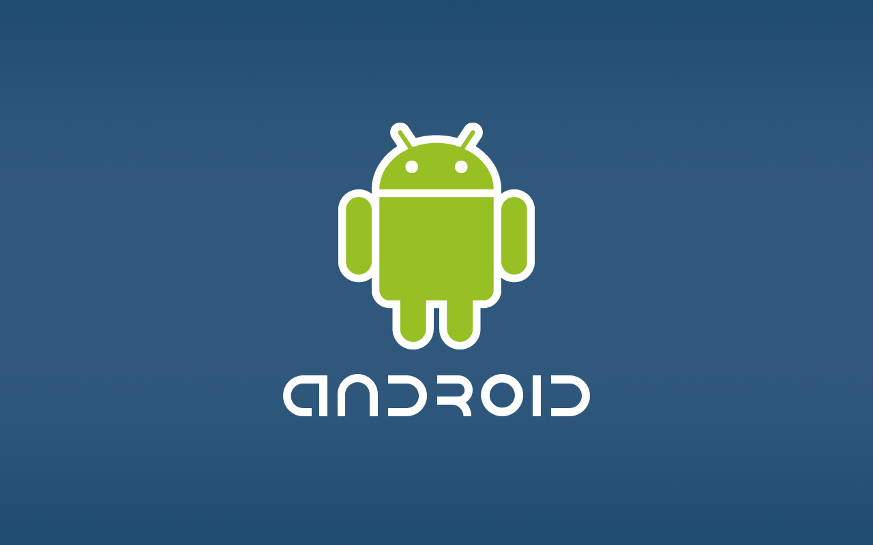
Android Technology
Android is a Linux-based operating for mobile devices such as smart phones and tablet computers, developed by Google in conjunction with the Open handset Alliance.

Slide 13
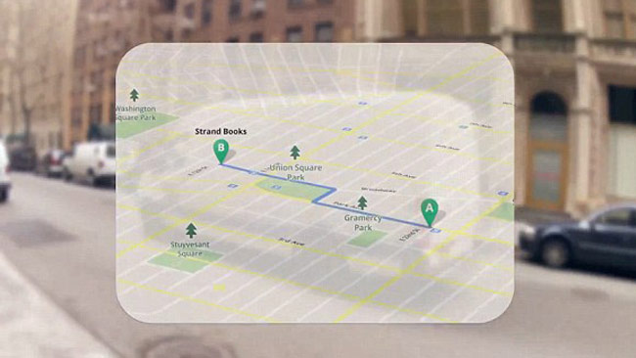
Augmented Reality
Augmented reality allow to see information about your surrounding on google glasses using mobile map tools.
Mobile map tools is a 3D mapping engine connected to wearable device through the camera using the sensors.
It uses standard GIS data to display on wearable device.

Slide 14
Features
Touchpad
5MB camera
Glass OS, dual core processor
2 GB RAM, 16GB flash memory
Built-in GPS, Gmail, Google+, Maps etc.
Voice Activation

Slide 15
Applications
Photography and Video
Message Sending
Google Search
Google Translate
Google Maps
Healthcare
Journalism
Military

Slide 16
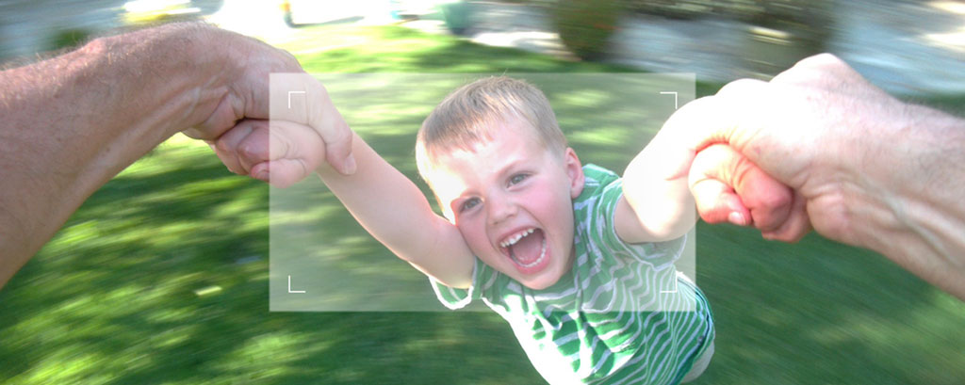
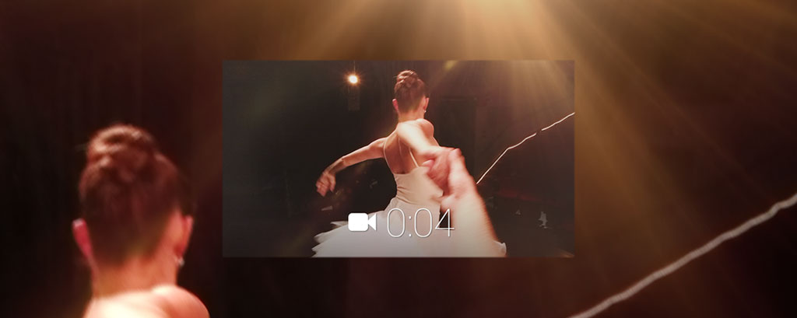
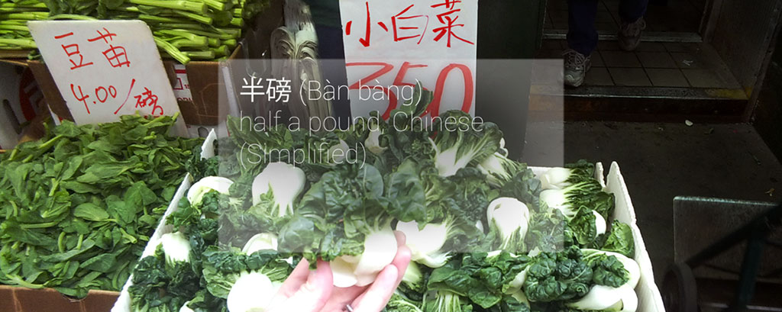
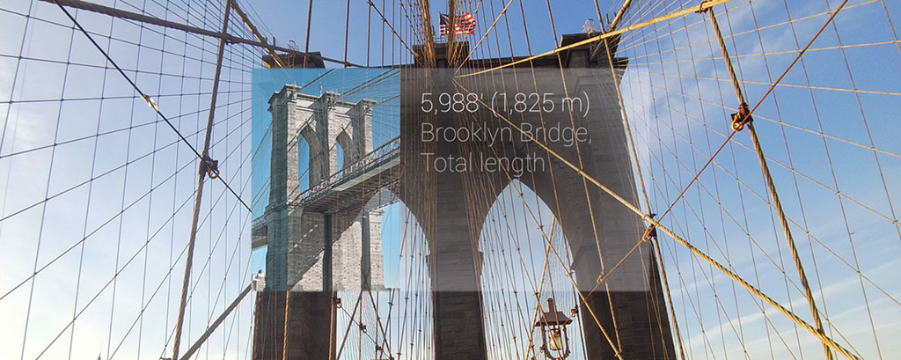

Slide 17
Send Message And Google Search
Google Glass will show you text messages you receive and allow you to reply to them via voice commands.
If you are in the habit of Googling things a lot. You simply need to ask a question and the device will pull the answer from the internet

Slide 18
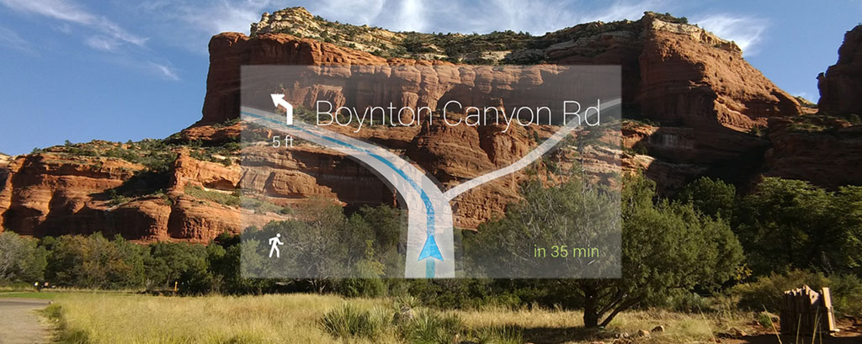
Google Translate And Google Maps
Google Glass translate a phrase or sentence from one language to another .
The widely used Google Maps are integrated into Glass, so that users will be able to chart the course of their journey or look up locations or establishments via voice commands.

Slide 19
Advantages
A true “hands-free” experience
Makes your life easier
Allow multi-task and stay always connected
Built-in camera(5MP)and video camera(720p)
Advanced voice recognition technology
A touch pad for scrolling and on/off functions.
Bluetooth tethering and Wi-Fi connectivity.
A rechargeable battery

Slide 20
Disadvantages
May take a toll on your vision
Could be a distraction
Not everyone is on board
The one size fits all design may be uncomfortable for some people
It may lead to accidents while driving
Privacy of people may breach with new glasses.

Slide 21
Google Glass 2
The next version of Google Glass is google glass 2 also called as Google Glass Enterprise Edition.
It featured a new hinge system for easy folding, a new LED for the headset to sow when the camera is in use and a new charging port along with display, camera and touchpad attached to small frame.

Slide 22
Google glass 2 is powered by an Intel CPU and also support 5GHz Wi-Fi.
The google glass 2 is specifically and exclusively aimed at businesses.

Slide 23
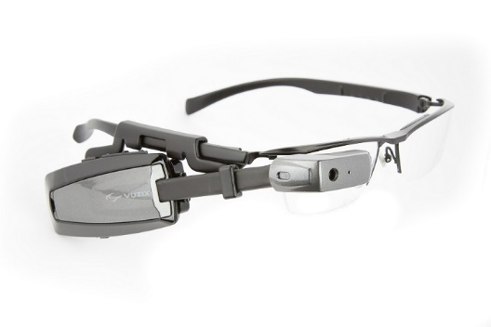
Improvements in Google Glass 2
Better battery life
Eye customization
Better price
Improved camera
Water Proofing

Slide 24
ADVANCEMENTS
Google Glass 2 let wearers take pictures with their hands
users could use gestures to crop and frame their images.
Using the side of your hands in a squeezing motion could indicate your desire to take portrait pictures, while using an “okay” sign with your index finger and thumb could tell Google Glass to take a smaller, more focused picture.

Slide 25
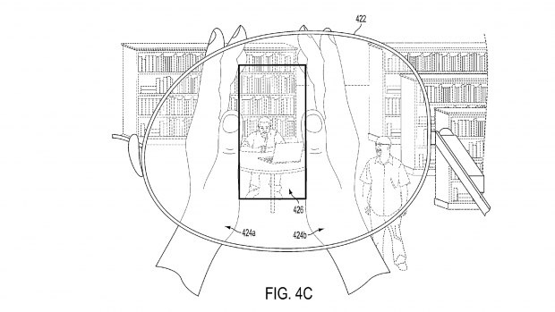
HH Google Glass 2 consist of head mountable device (HMD), to capture and process images with user placing their hands in the wearer’s field of view and withdrawing from frame to responsively capturing an image

Slide 26
Conclusion
Google glasses are basically wearable computers that use the evolving familiar technologies that brings the sophistication and ease of communication and information .
Hands free technology by Google.
Assistance to disabled individuals.
Google Glass is fashionable and frame colors are available in gray, orange, black, white and light blue.

Slide 27
References
International Journal of Application or Innovation in Engineering & Management (IJAIEM)
International Journal of Scientific & Engineering Research, Volume 4, Issue 12, December-2013
http://en.wikipedia.org/wiki/Project_Glass
http://www.smart-glasses.org/benefits-smart-glasses

Slide 28


