Slide 1
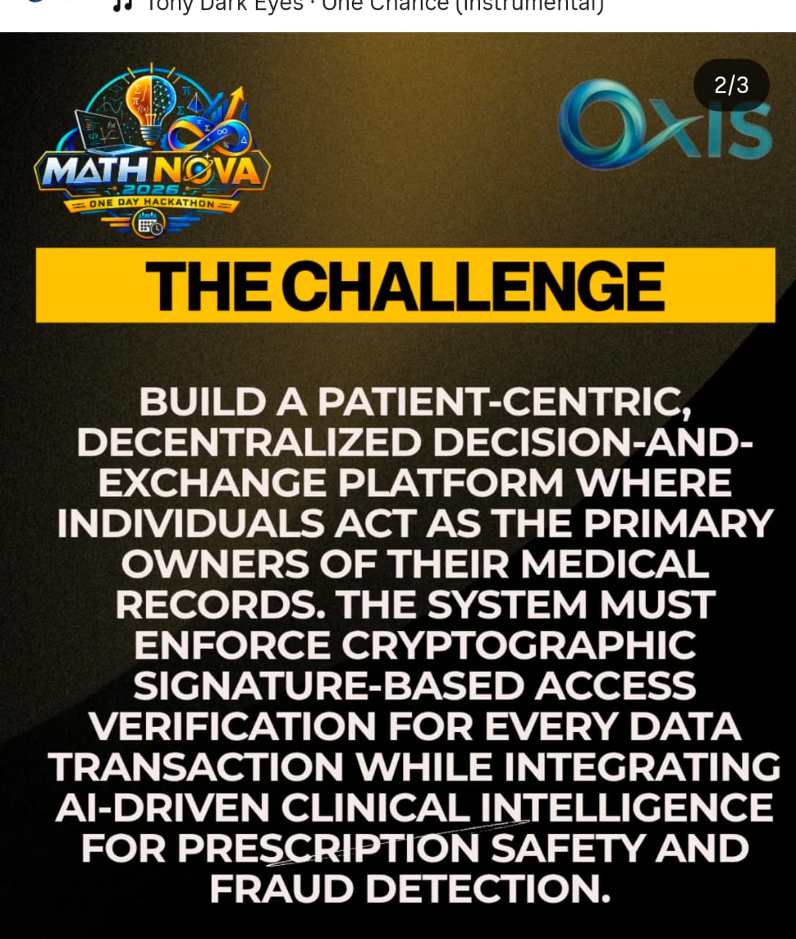
MEDIVAULT AI
Patient-Owned • Cryptographically Trusted • AI-Intelligent
Transforming fragmented healthcare records into a secure, consent-driven intelligence network.
PATIENT FIRST
ZERO-TRUST ACCESS
AI SAFETY
Your Health. Your Data. Your Consent.
MathNova 2026 • Hackathon Solution Presentation
MediVault AI | MathNova 2026 Hackathon

Slide 2
The Problem: Healthcare Data Has a Trust Gap
Fragmented records create privacy, safety and fraud challenges.
Fragmented Data
Weak Patient Control
Records are scattered across hospitals, pharmacies, labs and insurers.
Patients often cannot precisely control who accesses which records and why.
Prescription Risk
Fraud & Tampering
Allergy conflicts, interactions and duplicate medicines may be missed.
Modified prescriptions and suspicious billing/claims require stronger verification.
Core challenge: How do we enable secure health data exchange without sacrificing patient control?
MediVault AI | MathNova 2026 Hackathon

Slide 3
Our Big Idea
Move from organization-centric data control to patient-centric, verifiable consent.
TODAY
WITH MEDIVAULT AI
Fragmented Model
Patient-Sovereign Model
Hospital owns one record. Pharmacy sees another. Patient has limited visibility. Trust is assumed.
CONTROL + TRUST
Patient controls consent. Every request has a purpose. Access is scoped + temporary. Every transaction is verifiable.
We don't just digitize records — we digitize trustworthy consent.
MediVault AI | MathNova 2026 Hackathon

Slide 4
MediVault AI: The Solution
A secure patient-controlled health data exchange and intelligence platform.
1
2
3
4
Digital Health Vault
Consent Engine
Crypto Trust Layer
AI Intelligence
Prescriptions, medications, allergies, reports and records
Purpose-specific, scoped and temporary access
Digital signatures, integrity verification and auditability
Prescription safety and anomaly/fraud risk analysis
One platform. Four trust layers. One patient at the center.
MediVault AI | MathNova 2026 Hackathon

Slide 5
End-to-End Architecture
Designed as a modular MVP that can evolve toward enterprise deployment.
PATIENT
HOSPITAL
PHARMACY
LAB / INSURER
MediVault API + Policy Layer
Authentication • Access Requests • Consent • Scoped Authorization • Audit Logging
HEALTH VAULT
CRYPTO LAYER
AI ENGINE
Encrypted health records
Sign • Verify • Detect tampering
Safety checks • Risk scoring
Hackathon MVP: React UI → FastAPI → SQLite → Cryptography → AI Rule/Anomaly Engine
MediVault AI | MathNova 2026 Hackathon

Slide 6
The Trust Workflow: Request → Consent → Verify
Every data transaction answers: Who? What? Why? For how long?
1
2
3
4
5
REQUEST
REVIEW
SIGN
VERIFY
ACCESS
Hospital requests specific fields and states purpose.
Patient sees requester, purpose, fields and duration.
Patient approves and digitally signs the authorization.
System validates signature, scope and expiry.
Only authorized data is released; every event is logged.
Result: Minimum necessary data • Explicit consent • Time-bound access • Verifiable authorization
MediVault AI | MathNova 2026 Hackathon

Slide 7
Cryptographic Trust Layer 🔐
A signature proves authorization and protects data integrity.
1
Authorization Payload
Patient ID • Requester • Purpose • Allowed fields • Expiry
2
Hash
A fingerprint is created from the exact authorization or prescription data.
3
Digital Signature
The authorized signer cryptographically signs the data.
4
Verification
Any modification breaks verification and triggers an alert.
Example: 500mg → 1000mg after signing → integrity verification fails → TAMPERING ALERT
MediVault AI | MathNova 2026 Hackathon

Slide 8
AI Clinical Intelligence — Assist, Don't Replace
Human-in-the-loop decision support for safety and risk prioritization.
INPUT CONTEXT
INTELLIGENCE ENGINE
ACTIONABLE OUTPUT
• Documented allergies • Active/past medications • New prescription • Prescriber metadata • Billing/claims signals
Deterministic safety checks + Anomaly / risk scoring + Optional AI explanations
⚠ Allergy conflict ⚠ Drug interaction ⚠ Duplicate medication ⚠ Suspicious pattern → Clinical / human review
Safety-critical logic should rely on validated structured knowledge; AI explains and prioritizes.
MediVault AI | MathNova 2026 Hackathon

Slide 9
Live Demo Story: A Moment That Judges Can See
A complete narrative from consent to safety to verification.
👤 Patient Vault
🏥 Access Request
🔐 Patient Consent
👨‍⚕️ Prescription
Arun's allergy: Penicillin
Hospital asks for allergies + medications
Approves only selected fields for 24 hours
Doctor enters a new medicine
🤖 Safety Alert
💊 Verification
🚨 Tamper Test
Possible allergy/interaction conflict detected
Pharmacy verifies signed prescription QR
Change dosage → signature verification fails
This is not a slide-only concept — the MVP demonstrates the complete trust workflow.
MediVault AI | MathNova 2026 Hackathon

Slide 10
Fraud & Anomaly Intelligence 🕵️
Risk detection is explainable — anomaly ≠ proof of fraud.
Signature Failure
Abnormal Volume
Claim Outlier
Duplicate Pattern
Risk contribution: +50 Possible modification
Risk contribution: +25 Unusual prescriber pattern
Risk contribution: +20 Billing outside expected range
Risk contribution: +15 Repeated suspicious activity
EXPLAINABLE RISK SCORE
Key Principle
95 / 100 HIGH RISK → HUMAN REVIEW
The system flags suspicious patterns for investigation. It does not automatically accuse someone of fraud.
MediVault AI | MathNova 2026 Hackathon

Slide 11
We Anticipated the Hard Questions
A mature MVP knows its boundaries.
Is this really decentralized?
Control is distributed through patient-controlled authorization; blockchain is optional, not mandatory.
Where are private keys stored?
MVP is simplified; production uses secure enclaves, HSM/KMS and key rotation.
What if patient is unconscious?
A governed break-glass flow can expose only critical data with full auditing.
Can AI replace doctors?
No. It is clinical decision support; qualified professionals remain responsible.
Is this production ready?
No. Production needs compliance, clinical validation, security hardening and interoperability.
MediVault AI | MathNova 2026 Hackathon

Slide 12
Honest Engineering: MVP Today, Enterprise Tomorrow
We demonstrate the critical workflow now and a credible path forward.
HACKATHON MVP
PRODUCTION EVOLUTION
• React / Web UI • FastAPI APIs • SQLite demo database • Digital signatures • Scoped temporary consent • QR prescription verification • Safety rule engine • Explainable risk scoring
• PostgreSQL + encrypted storage • Enterprise IAM • HSM / KMS key management • Validated clinical data sources • FHIR/interoperability adapters • Monitoring + disaster recovery • Security testing + compliance • Clinical validation
Judges: evaluate the MVP for proof of concept, architecture quality and real-world extensibility.
MediVault AI | MathNova 2026 Hackathon

Slide 13
Why MediVault AI Should Win 🏆
A complete answer to the challenge — technically credible and demo-ready.
👤 Patient Sovereignty
🎯 Purpose-Based Access
⏳ Temporary Permissions
🔐 Cryptographic Verification
🤖 AI Safety Intelligence
🕵️ Explainable Fraud Risk
📜 Auditable Transactions
🏥 Healthcare-Ready Architecture
“We are not just digitizing medical records. We are building a trust layer for healthcare data exchange.”
MEDIVAULT AI — Your Health. Your Data. Your Consent.
MediVault AI | MathNova 2026 Hackathon

Slide 14
THANK YOU
Questions & Discussion
MEDIVAULT AI
Patient-Owned • Cryptographically Trusted • AI-Intelligent
BUILDING TRUST IN HEALTHCARE DATA
MediVault AI | MathNova 2026 Hackathon

