Slide 1
SPEECH EMOTION RECOGNITION
Project-I Presentation
B.Tech CSE Regular
IV year I semester
Section A
Team members:
1. Adithi Karre (18011A0501)
2. Pindiga Sushma Niveni (18011A0539)
3. Aishwarya Madishetty (18011A0564)

Slide 2
CONTENTS
WHY WE CHOSE THIS PROJECT?
BASIC ANALOGY OF THE PROJECT
IDEOLOGY BEHIND THE PROJECT
LIBRARIES USED
DATASET USED
FEATURE EXTRACTION
ANALYZING AUDIO SIGNALS
DEFINING EMOTIONAL DICTIONARY
TRAINING AND TESTING THE DATA

Slide 3
CONTENTS
BUILDING THE MODEL
PREDICTIONS
IMPLEMENTATION
APPLICATIONS
DRAWBACKS AND FUTURE SCOPE
CONCLUSIONS AND CHALLENGES
REFERENCES

Slide 4

WHY WE CHOSE THIS PROJECT
Emotion detection has become one of the biggest marketing strategies, in which mood of the consumer plays an important role. So to detect the current emotion of the person and suggest him the apt product and help him/her accordingly, will increase the demand of the product or the company.

Slide 5

Humans have the natural ability to use all their available senses for maximum awareness of the received message. The emotional detection is natural for humans but it is a very difficult task for machines.
Detecting emotions is one of the most important marketing strategies in today’s world.
For this reason, we decided to do a project where we could detect a person’s emotions just by their voice which will let us manage many AI related applications.
Some examples could be including call centres to play music when one is angry on the call. Another could be a smart car slowing down when one is angry or fearful.

Slide 6
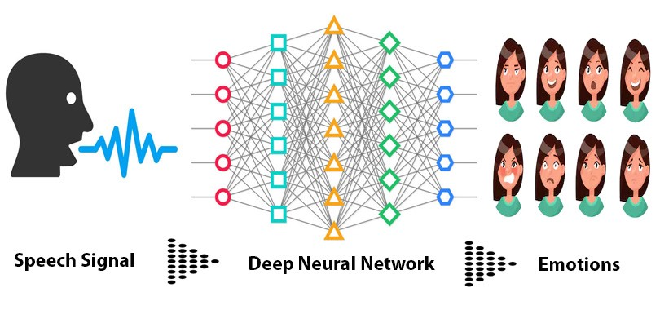
BASIC ANALOGY OF THE PROJECT

Slide 7
IDEOLOGY BEHIND THE PROJECT
The idea behind creating this project was to build a machine learning model that could detect emotions from the speech we have with each other all the time.
So why not have an emotion detector that will gauge your emotions and in the future recommend you different things based on your mood. This can be used by multiple industries to offer different services like marketing company suggesting you to buy products based on your emotions, automotive industry can detect the person's’ emotions and adjust the speed of autonomous cars as required to avoid any collisions, etc.

Slide 8





LIBRARIES USED

Slide 9
DATASET USED
For this Python mini project, we use the RAVDESS dataset; this is the Ryerson Audio-Visual Database of Emotional Speech and Song dataset. This dataset has 7356 files rated by 247 individuals 10 times on emotional validity, intensity, and genuineness. The entire dataset has 24 actors, (12 male and 12 female).
In our project, we have taken 60 voice sample for each actor.
The emotions in the RAVDESS data set are neutral, calm, happy, sad, angry, fearful, disgust and surprised.

Slide 10
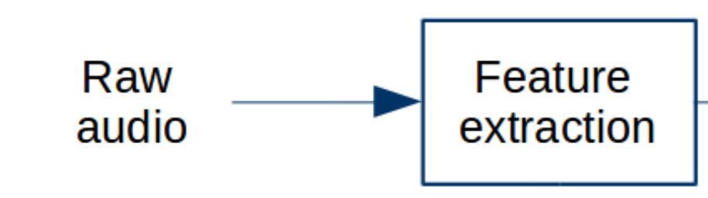
FEATURE EXTRACTION
The next step involves extracting the features from the audio files which help our model to learn between these audio files. For feature extraction we make use of the LibROSA library in python which is one of the libraries used for audio analysis.
We define a function extract_feature to extract the mfcc, chroma, and mel features from a sound file. This function takes 4 parameters- the file name and three Boolean parameters for the three features:
mfcc: Mel Frequency Cepstral Coefficient, represents the short-term power spectrum of a sound
chroma: Pertains to the 12 different pitch classes
mel: Mel Spectrogram Frequency

Slide 11
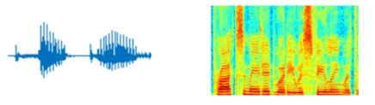
Open the sound file with soundfile. SoundFile using with-as so it’s automatically closed once we’re done. Read from it and call it X. Also, get the sample rate. If chroma is True, get the Short-Time Fourier Transform of X.
Let result be an empty numpy array. Now, for each feature of the three, if it exists, make a call to the corresponding function from librosa.feature (eg- librosa.feature.mfcc for mfcc), and get the mean value. Call the function hstack() from numpy with result and the feature value, and store this in result. hstack() stacks arrays in sequence horizontally (in a columnar fashion). Then, return the result.

Slide 12
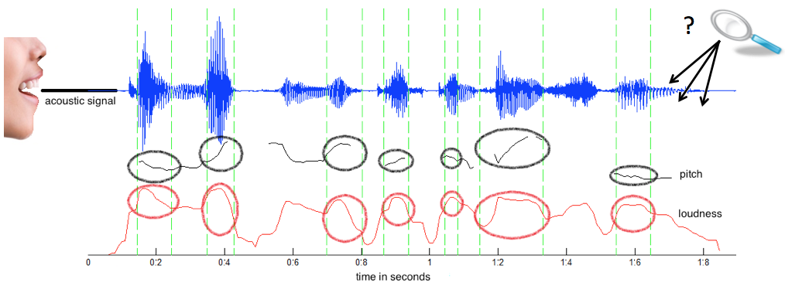
ANALYZING AUDIO SIGNALS
In this step we test out the audio files by plotting out the waveform and spectrogram to see the sample audio files.

Slide 13

DEFINING EMOTIONAL DICTIONARY
Now, let’s define a dictionary to hold numbers and the emotions available in the RAVDESS dataset, and a list to hold those we want- calm, happy, fearful, disgust.
Using our emotions dictionary, the assigned numbers are turned into emotions, and our function checks whether this emotion is in our list of observed_emotions; if not, it continues to the next file. It makes a call to extract_feature and stores what is returned in ‘feature’. Then, it appends the feature to x and the emotion to y. So, the list x holds the features and y holds the emotions. We call the function train_test_split with these, the test size, and a random state value, and return that.

Slide 14
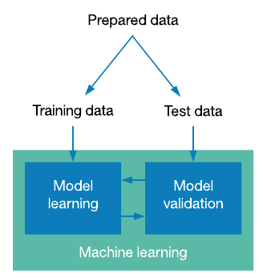
TRAINING AND TESTING THE DATA
We split our entire dataset into training and testing sets using the load_data function. We use 75% of our data for training and the other 25% for testing.
After splitting, we observe the shape of the training and testing data.

Slide 15
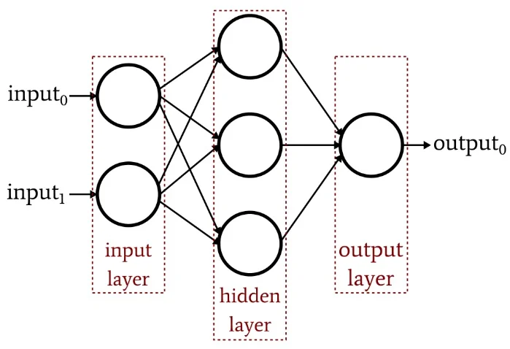
BUILDING THE MODEL
Since the project is a classification problem, Multilayer Perceptron seems like the obvious choice. We choose this model to predict the right emotions.
The classifier connects to Neural Network unlike other classification algorithms such as Support Vectors or Naive Bayes Classifier, MLPClassifier relies on an underlying Neural Network to perform the task of classification.

Slide 16
We initialize an MLPClassifier. This is a Multi-layer Perceptron Classifier; it optimizes the log-loss function using LBFGS or stochastic gradient descent. Unlike SVM or Naive Bayes, the MLPClassifier has an internal neural network for the purpose of classification. This is a feedforward ANN model.
Next, we will fit the model.
http://playground.tensorflow.org/

Slide 17
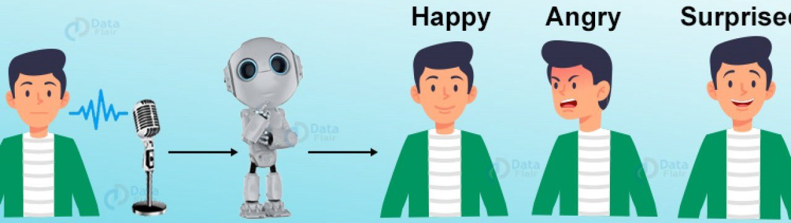
PREDICTIONS
After tuning the model, tested it out by prediction the emotions for the test data. Following which is the splitting of training and testing data to save the model. Model is loaded again to predict the test data and store its result in .csv file along with its labels for mapping individual result to its wav file name.

Slide 18
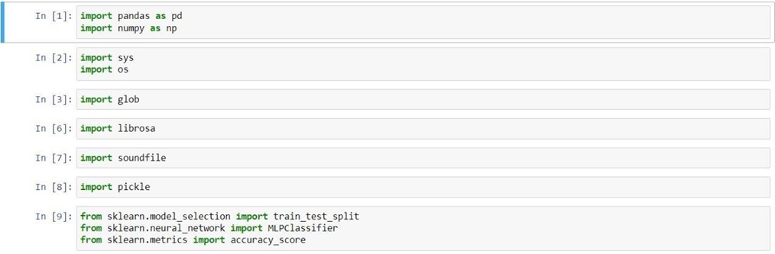
IMPLEMENTATION
1. Make the necessary imports

Slide 19
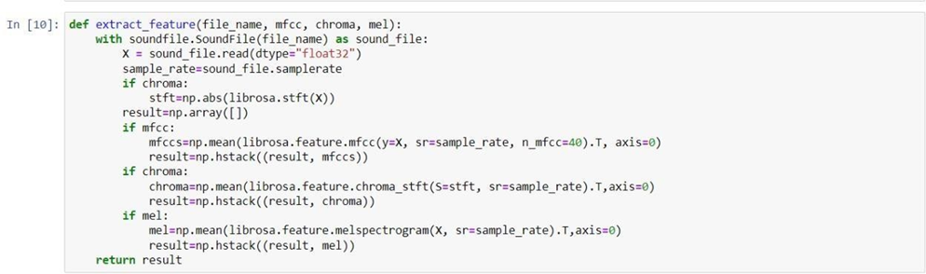
2. Define a function extract_feature to extract the mfcc, chroma, and mel features from a sound file. This function takes 4 parameters- the file name and three Boolean parameters for the three features: mfcc, chroma and mel.

Slide 20
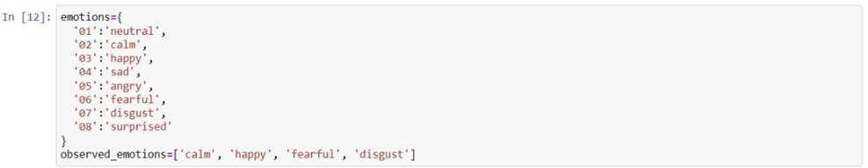
3. Let’s define a dictionary to hold numbers and the emotions available in the RAVDESS dataset, and a list to hold those we want- calm, happy, fearful, disgust.

Slide 21
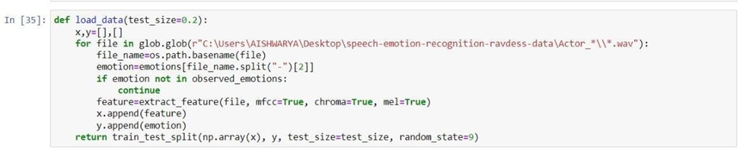
4. Let’s load the data with a function load_data() – this takes in the relative size of the test set as parameter. x and y are empty lists; we’ll use the glob() function from the glob module to get all the pathnames for the sound files in our dataset.

Slide 22
5. Split the dataset into training and testing sets, Let’s keep the test set 25% of everything and use the load_data function for this.
6. Observe the shape of the training and testing datasets
7. And get the number of features extracted.

Slide 23
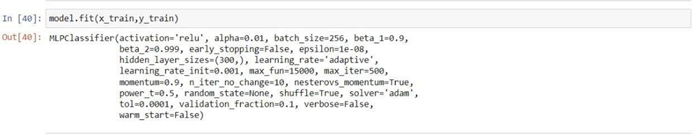
8. Now, let’s initialize an MLPClassifier. This is a Multi-layer Perceptron Classifier; it optimizes the log-loss function using LBFGS or stochastic gradient descent. Unlike SVM or Naive Bayes, the MLPClassifier has an internal neural network for the purpose of classification. This is a feedforward ANN model.
9. Fit/train the model.

Slide 24
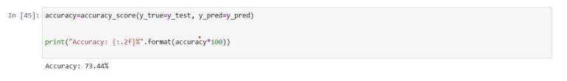
10. Let’s predict the values for the test set. This gives us y_pred (the predicted emotions for the features in the test set).
11. To calculate the accuracy of our model, we’ll call up the accuracy_score() function we imported from sklearn. Finally, we’ll round the accuracy to 2 decimal places and print it out.

Slide 25
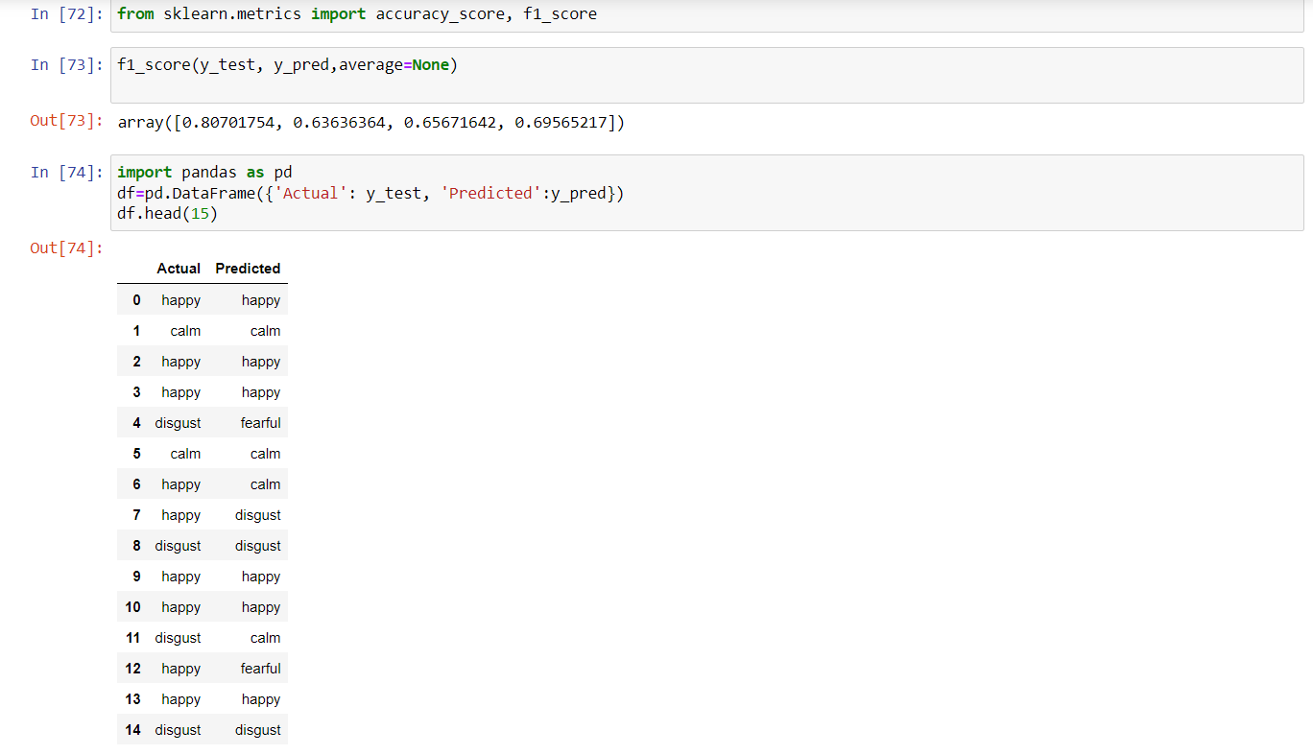
12. Actual vs Predicted

Slide 26

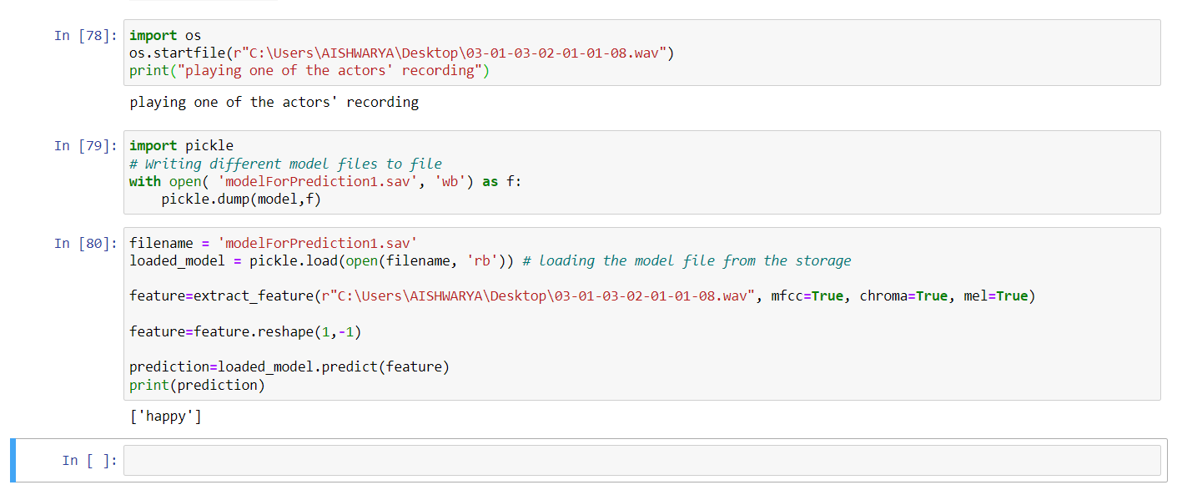
13. Implementing our model on a single audio file

Slide 27
APPLICATIONS
Lie Detection
Virtual Personal Assistant
Military operations

Slide 28
DRAWBACKS AND FUTURE SCOPE
You can try other different classifiers as well to predict the emotion behind the audio like CNN, SVM, etc.
Predicting the Live Audio takes a lot of process and it is sometimes difficult to process as it is unlike the binary data with some csv file associated with it.
In future, we can predict the random recorded audio as well.
We can also embed our UI with ML Model, and we can build web based application with ML using Flask in future, this point can be a great scope.
More advancements can be more variety of voices can be trained and dataset can be increased to deploy a more realistic model.

Slide 29
CONCLUSIONS AND CHALLENGES
The literature in speech emotion detection is not very rich and researchers are still debating what features influence the recognition of emotion in speech. There is also considerable uncertainty as to the best algorithm for classifying emotion, and which emotions to class together.
In the real problem, different individuals reveal their emotions in a diverse degree and manner. There are also many differences between acted and spontaneous speech.
As of now the systems are extensively trained in English and has not been very inclusive of other languages.

Slide 30
REFERENCES
1. HEAD FIRST PYTHON A BRAIN FRIENDLY GUIDE, PAUL BARRY.
2. MACHINE LEARNING, TOM M. MITCHELL, VMCGRAW-HILL.
3. HUMAN SPEECH EMOTION RECOGNITION – Maheshwari Selvaraj, Dr.R.Bhuvana, S.Padmaja.
4. SPEECH EMOTION RECOGNITION USING NEURAL NETWORK AND MLP CLASSIFIER
– Jerry Joy, Aparna Kannan, Shreya Ram, S.Rama.
5. Speech Emotion Recognition (SER) through Machine Learning (analyticsinsight.net)
6. Speech Emotion Recognition Using Deep Learning (dataiku.com)

Slide 31
THANK YOU

