Slide 1
Product Performance & Sales Drivers
Apex Planet Data Analytics Internship - Task 4
Data Storytelling & Statistical Validation
Presented by: Sushma Sakry

Slide 2
Business Objective
The objective of this analysis is to understand the major factors influencing sales performance across products, cities, and time.
The analysis combines:
Product performance analysis
Transaction volume analysis
Sales value analysis
City-level performance
Monthly sales trends
Statistical validation of a key business hypothesis
Key Business Questions
Which products generate the highest sales?
Is sales performance influenced more by transaction volume or transaction value?
Which products have the highest units sold?
Which products have the highest average transaction value?
How does product performance vary across cities?
Does the observed difference in average transaction value between selected products show statistical significance?

Slide 3
Dataset Overview
The analysis uses a cleaned retail sales transaction dataset.
Dataset Details
Transactions: 1,000
Original Columns: 12
Final Analysis Columns: 16
Products: 6
Categories: 5
Cities: 9 including Unknown
Date Range: January 2025 – January 2026
2025 Records: 995
January 2026 Records: 5
Key Variables
Order Date
Customer ID
Age
Gender
City
Product
Category
Quantity
Unit Price
Total Sales
Tools Used
Python
Pandas
NumPy
Matplotlib
Seaborn
Power BI

Slide 4
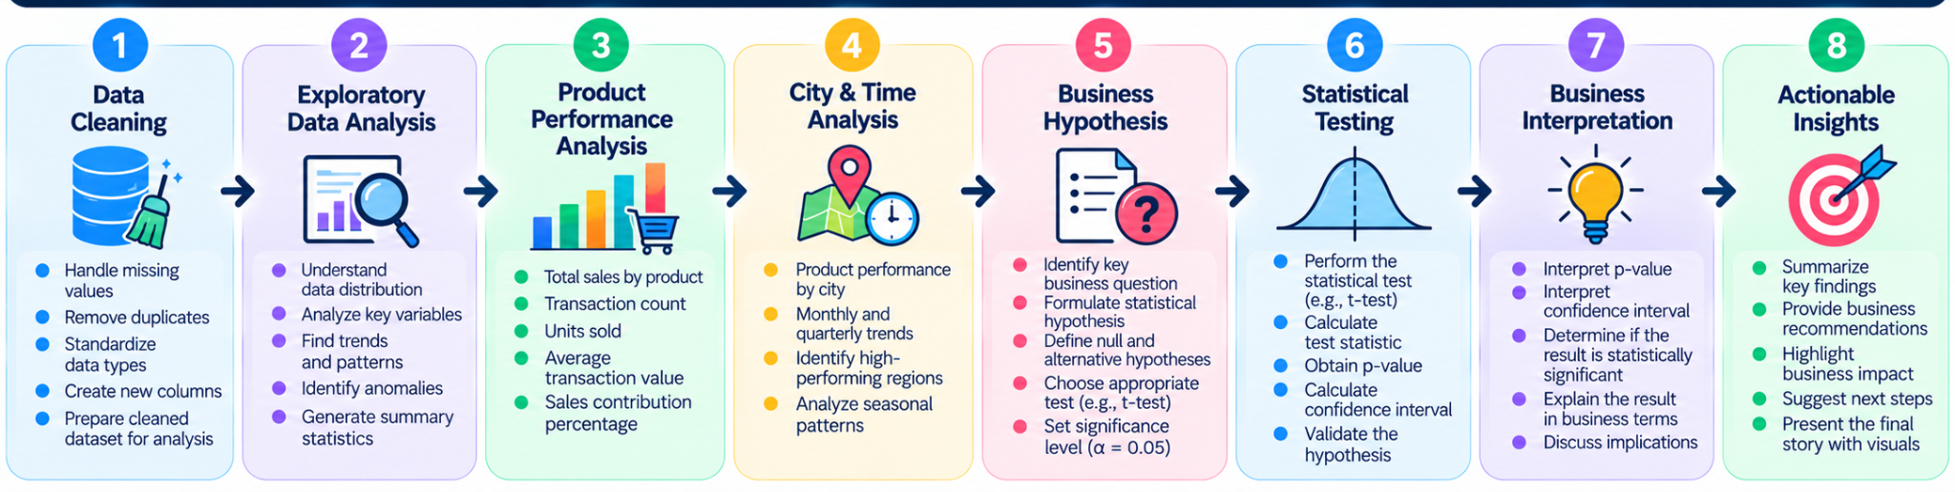
From Data to Business Insight
Approach: The analysis combines descriptive analytics, visualization, and statistical validation to move from raw transaction data to business insights.

Slide 5
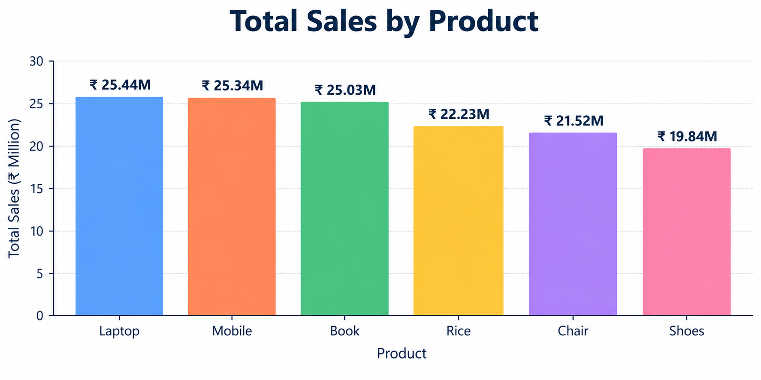
Overall Sales Performance
Key Metrics
Total Sales: ₹139.40M
Transactions: 1,000
Average Transaction Value: ₹139,399
Median Transaction Value: ₹108,594
Key Observation
The mean transaction value is higher than the median, indicating that relatively high-value transactions increase the overall average.

Slide 6
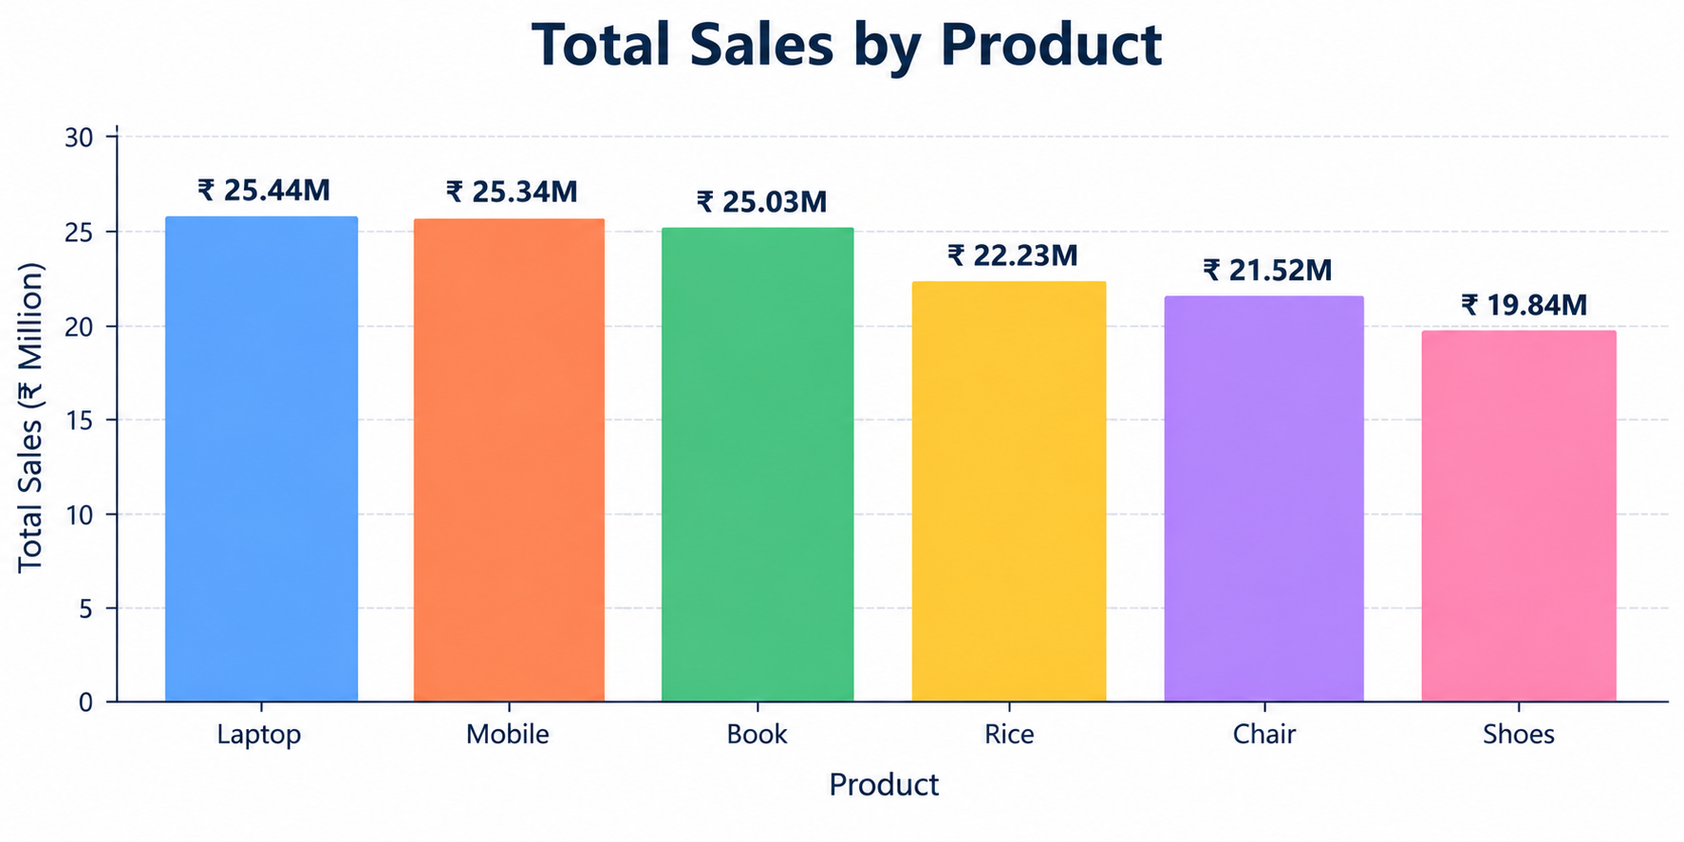
Product Sales Performance
Key Insights
Laptop recorded the highest total sales.
Mobile was very close to Laptop in total sales.
Book was the third-highest product by total sales.
Shoes recorded the lowest total sales among the six products.
Laptop, Mobile, and Book together contributed approximately 54.4% of overall sales.

Slide 7
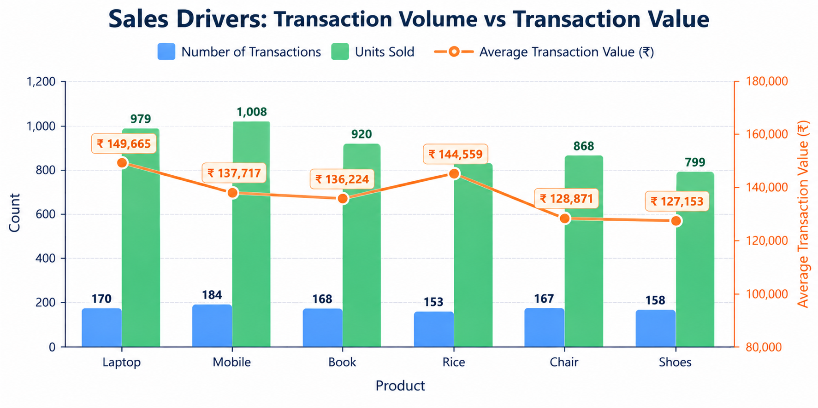
Sales Drivers: Volume vs Transaction Value
Product sales are influenced by both:
Transaction Volume
Number of transactions
Units sold
Transaction Value
Average transaction value
Unit price
Key Findings
Mobile recorded the highest transaction count: 184
Rice recorded the lowest transaction count: 153
Mobile sold the highest number of units: 1,008
Shoes sold the lowest number of units: 799
Laptop had the highest average transaction value: approximately ₹149,665
Shoes had the lowest average transaction value: approximately ₹127,153
Business Insight
Higher transaction volume does not always result in the highest total sales. Product sales reflect a combination of transaction frequency, quantity, and transaction value.

Slide 8
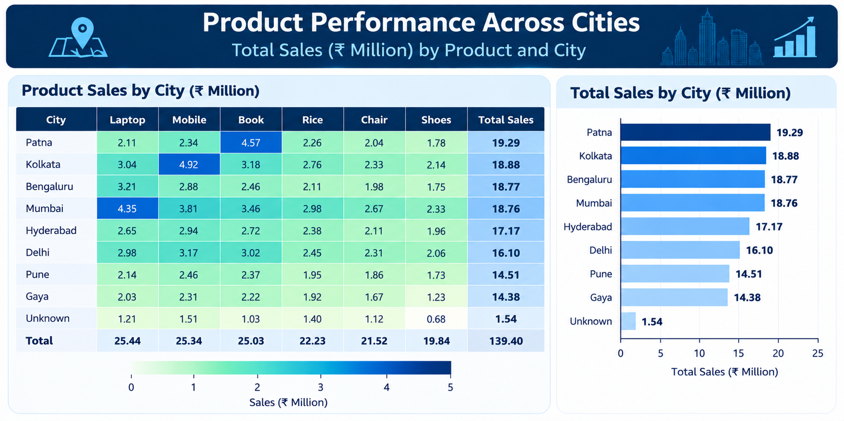
Product Performance Across Cities
The analysis shows that product performance varies across locations.
Key Findings
Mobile recorded its highest city-level sales in Kolkata, at approximately ₹4.92M.
Laptop showed strong sales in Mumbai, at approximately ₹4.35M.
Laptop also showed strong performance in Bengaluru, at approximately ₹3.21M.
Book recorded strong sales in Patna, at approximately ₹4.57M.
Business Insight
Product performance is not uniform across cities. Location-level differences can help identify markets where individual products perform particularly well.

Slide 9
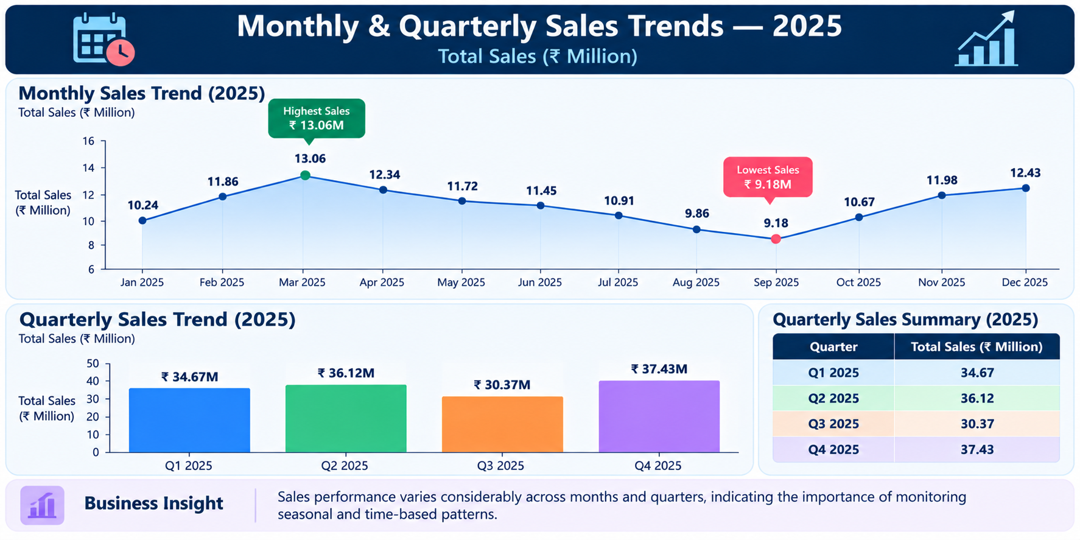
Monthly & Quarterly Sales Trends
Key Findings
March 2025 recorded the highest monthly sales at approximately ₹13.06M.
September 2025 recorded the lowest monthly sales at approximately ₹9.18M.
Q4 2025 recorded the highest quarterly sales at approximately ₹37.43M.
Q3 2025 recorded the lowest quarterly sales at approximately ₹30.37M.
Business Insight
Sales performance varies considerably across months and quarters, indicating the importance of monitoring seasonal and time-based patterns.

Slide 10
Business Hypothesis
Research Question
Is the average transaction value significantly different between Laptop and Mobile transactions?
Null Hypothesis (H₀) - There is no statistically significant difference in the average transaction value between Laptop and Mobile transactions.
Alternative Hypothesis (H₁) - There is a statistically significant difference in the average transaction value between Laptop and Mobile transactions.
Significance Level: α = 0.05
Statistical Test - Welch's Independent Two-Sample t-test
Why this test?
The test compares the mean transaction values of two independent product groups while not requiring equal population variances.

Slide 11
Hypothesis Testing Results
Metric | Result
Laptop Mean Transaction Value | ₹149,664.76
Mobile Mean Transaction Value | ₹137,693.33
Difference in Means | ₹11,971.42
t-statistic | 0.954
p-value | 0.341
95% Confidence Interval | ₹−12,717.22 to ₹36,660.07
Decision Rule
If p-value < 0.05, reject H₀.
If p-value ≥ 0.05, do not reject H₀.
Test Result
p-value = 0.341 ≥ 0.05
Business Interpretation
The test does not provide sufficient statistical evidence that the average transaction value differs significantly between Laptop and Mobile transactions.

Slide 12
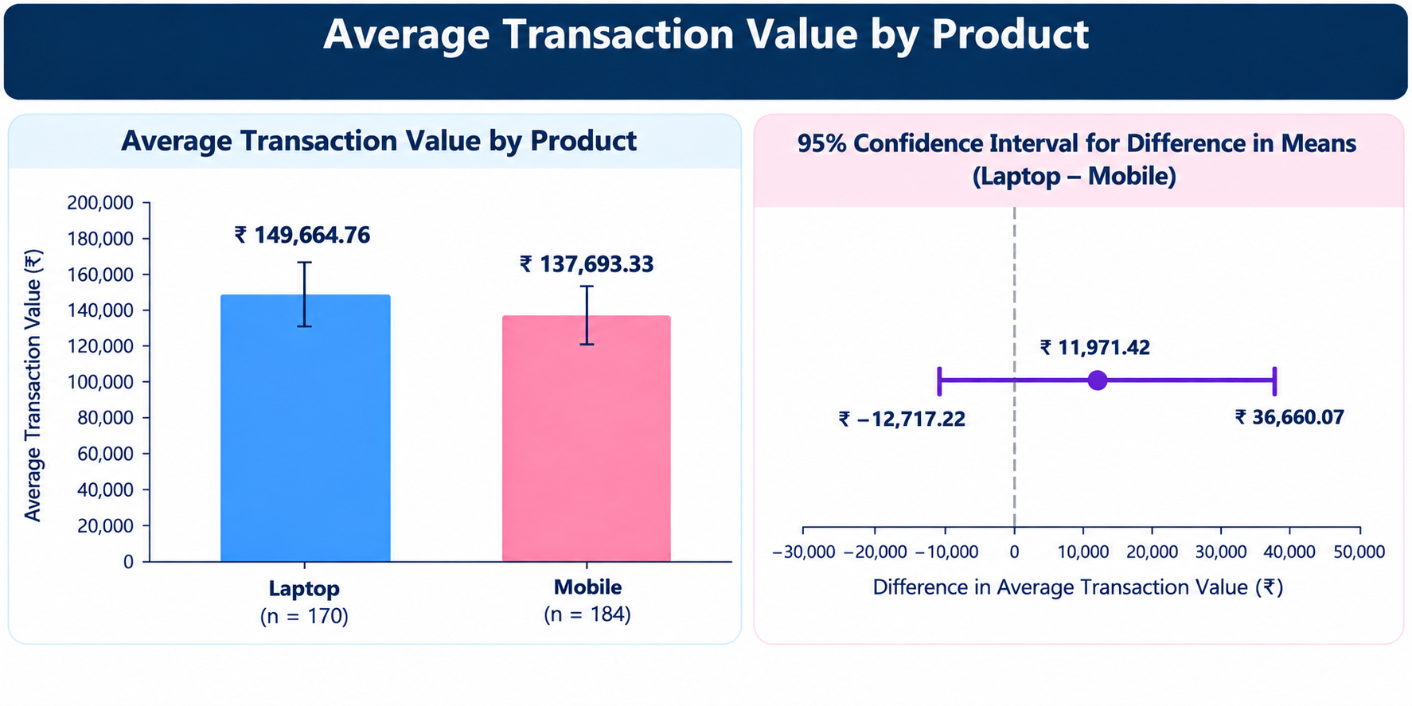
Statistical Interpretation
Interpretation of the Statistical Test
The p-value is 0.341, which is above the 0.05 significance level. Therefore, the null hypothesis is not rejected.
The analysis does not provide sufficient statistical evidence of a difference in average transaction value between Laptop and Mobile transactions.
Confidence Interval
The 95% confidence interval for the difference in average transaction value is:
₹−12,717.22 to ₹36,660.07
The confidence interval provides the estimated range for the difference in average transaction values between the two product groups.
Business Interpretation
Although Laptop transactions have a higher observed average transaction value than Mobile transactions, the statistical test does not provide sufficient evidence that this difference is statistically significant.

Slide 13
Key Business Insights
Laptop generated the highest total sales, while Mobile generated the highest transaction volume and units sold.
Transaction volume alone does not fully describe product sales performance; transaction value also contributes to differences in total sales.
Statistical testing adds rigor to descriptive findings by determining whether an observed difference between product groups is statistically supported.
Product performance varies across cities, with different products showing stronger sales in different locations.
Sales vary across time, with March recording the highest monthly sales and Q4 recording the highest quarterly sales.

Slide 14
Business Action Points
Based on the analysis, businesses can:
Monitor both transaction volume and transaction value when evaluating product performance.
Use monthly and quarterly trends to support sales planning.
Use statistical testing to validate important differences before making data-driven decisions.
Identify cities where specific products demonstrate stronger sales performance.
Investigate products with high transaction volume but comparatively different transaction values.
Continue monitoring product and location performance through interactive dashboards.

Slide 15
Conclusion
The analysis combined exploratory data analysis, product-level deep-dive analysis, interactive dashboarding, and statistical validation to understand retail sales performance.
The findings show that product performance is influenced by multiple factors, including transaction volume, quantity sold, transaction value, location, and time.
The statistical hypothesis test provides an additional level of evidence for evaluating differences between product groups.
Overall Outcome
The analysis transforms transaction data into actionable business insights and demonstrates how descriptive and statistical analysis can support data-driven decision-making.

Slide 16
THANK YOU

