Slide 1


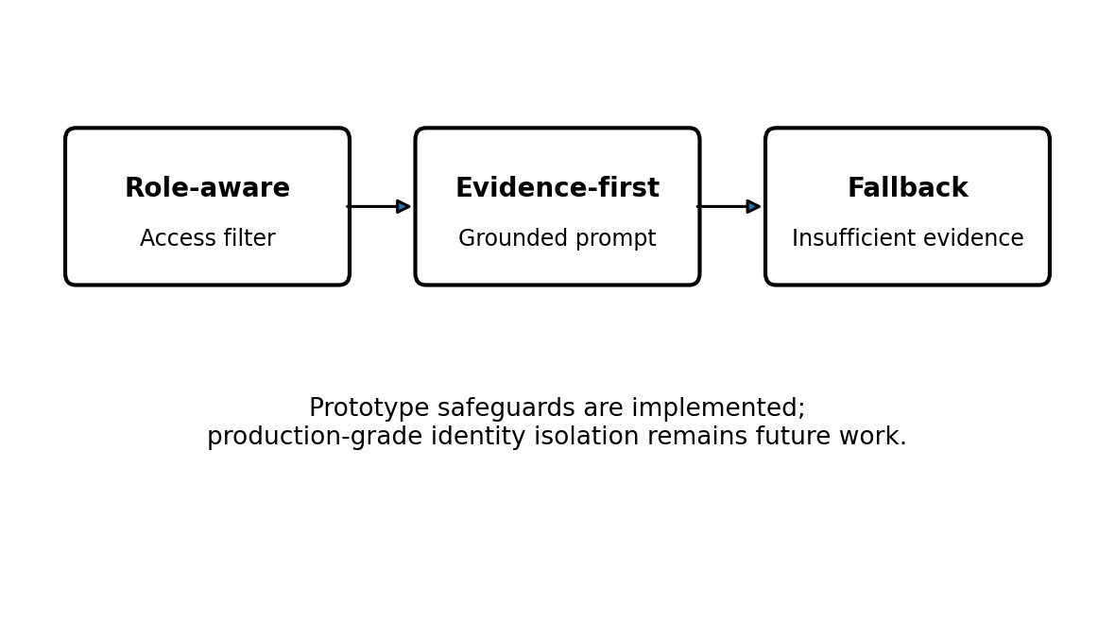
M.Tech/MCA Program
Advanced Industry Integrated Programs
Jointly offered by University and LTIMindTree
REVIEW III
Adaptive Enterprise
Knowledge Assistant
Hybrid RAG • Role-Aware Retrieval • Evidence-Based Hallucination Detection
Team Member: [Enter Name] | M.Tech AIML
HYBRID
RETRIEVAL
ROLE-AWARE
FILTER
LOCAL
LLM
EVIDENCE
CHECK
RETRIEVE → GENERATE → VERIFY
Knowledge partner | Implementation partner

Slide 2
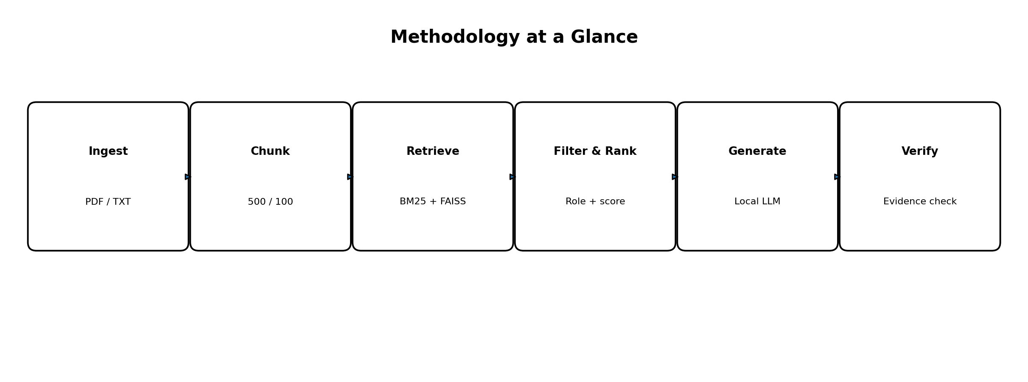
Adaptive Enterprise Knowledge Assistant
Introduction
Enterprise policies are distributed across many files.
Keyword-only search can miss semantically relevant passages.
LLM-only answers may sound confident without sufficient evidence.
This prototype combines hybrid retrieval, role-aware filtering and evidence checks.
WHY HYBRID RAG?
KEYWORD
VECTOR
EVIDENCE
Exact terms
Meaning
Grounded answer
Goal: relevant answers with visible evidence.

Slide 3
Adaptive Enterprise Knowledge Assistant
Objectives
Build a local document QA pipeline for PDF and TXT files.
Combine BM25 keyword retrieval with FAISS vector retrieval.
Filter retrieved context according to the selected user role.
Generate answers with Llama 3.2:3b through Ollama.
Check evidence support and use an insufficient-evidence fallback.
PROJECT GOALS
RETRIEVE
Combine BM25 + FAISS
PROTECT
Filter by user role
VERIFY
Check evidence support

Slide 4
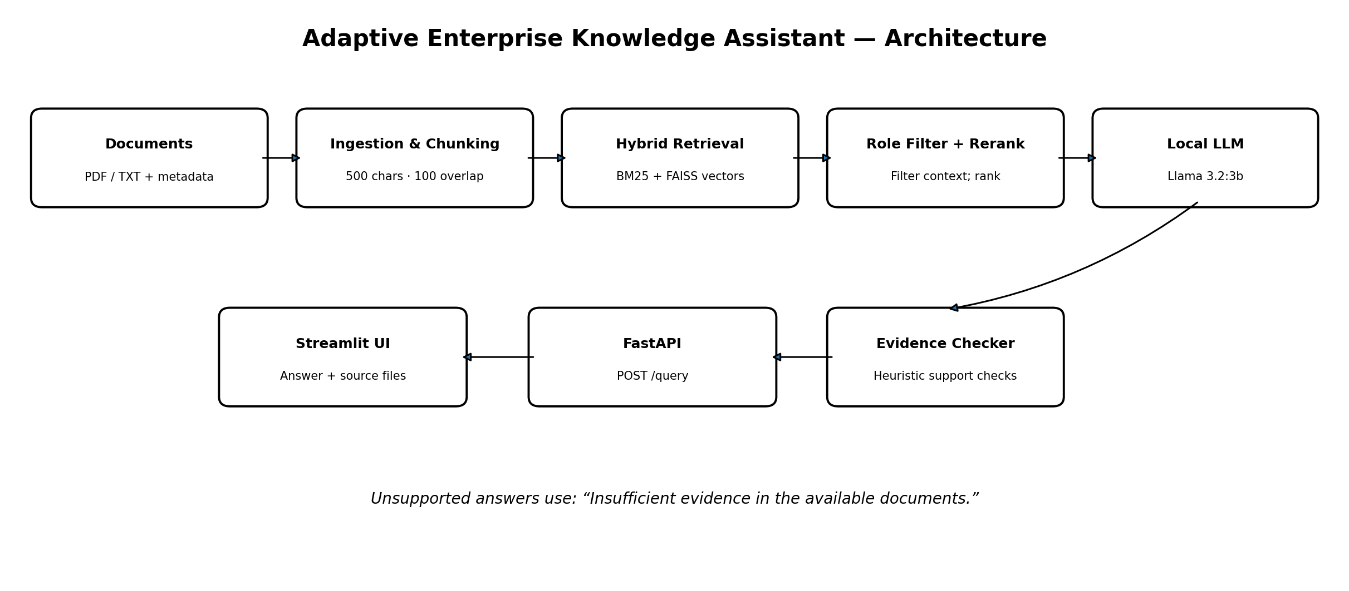
Adaptive Enterprise Knowledge Assistant
System Architecture
END-TO-END SYSTEM DESIGN
DOCUMENTS
INGEST + CHUNK
HYBRID SEARCH
ROLE FILTER
LOCAL LLM
PDF / TXT
metadata
500 chars
100 overlap
BM25 + FAISS
score fusion
Access rules
+ reranking
Llama 3.2:3b
Ollama
EVIDENCE CHECKER
FASTAPI BACKEND
STREAMLIT DASHBOARD
Heuristic support checks
Unsupported → fallback
POST /query
Health endpoint
Answer + filenames
Role selector
Retrieval and role filtering precede generation; the checker reviews the generated answer.

Slide 5
Adaptive Enterprise Knowledge Assistant
Problem Statement
Relevant knowledge is fragmented across policy documents.
Lexical and semantic retrieval can return complementary evidence.
Restricted content must not be passed to unauthorized users through context.
Generated answers need a transparent response when evidence is insufficient.
Goal: improve reliability while preserving role-aware access rules.
CHALLENGE → RESPONSE
FRAGMENTED FILES
Unified ingestion
MISSED MEANING
Hybrid retrieval
UNSUPPORTED ANSWERS
Evidence checks

Slide 6
Adaptive Enterprise Knowledge Assistant
Methodology
FROM RAW DOCUMENTS TO EVIDENCE-GROUNDED ANSWERS
Ingest PDF/TXT documents and metadata.
Split text into 500-character chunks with 100-character overlap.
Build BM25 and FAISS retrieval indexes.
Fuse normalized scores using α = 0.5; filter by role and rerank.
Generate an answer, then run heuristic evidence checks.
01 INGEST
02 CHUNK
03 RETRIEVE
04 FILTER
05 GENERATE
06 VERIFY
PDF / TXT
+ metadata
500 characters
100 overlap
BM25 + FAISS
hybrid search
Role-aware
context filtering
Llama 3.2:3b
via Ollama
Heuristic evidence
checks + fallback
If evidence is insufficient → “Insufficient evidence in the available documents.”
Local inference • Transparent evidence handling • Role-aware retrieval

Slide 7
Adaptive Enterprise Knowledge Assistant
Approach / Algorithms / Tools
Retrieval: BM25 keyword ranking + FAISS vector similarity.
Fusion: min–max score normalization; hybrid score = 0.5 × BM25 + 0.5 × vector.
Reranking: custom score-based ranking and deduplication; not a neural cross-encoder.
LLM & embeddings: Ollama, llama3.2:3b, nomic-embed-text.
Application: Python 3.11, PyPDF, FastAPI, Streamlit, PyTest and Docker.
CI/CD: GitHub Actions and container publishing are planned next steps.
RETRIEVAL
LLM
BACKEND
UI
DEPLOY
BM25 + FAISS
Ollama
FastAPI
Streamlit
Docker

Slide 8
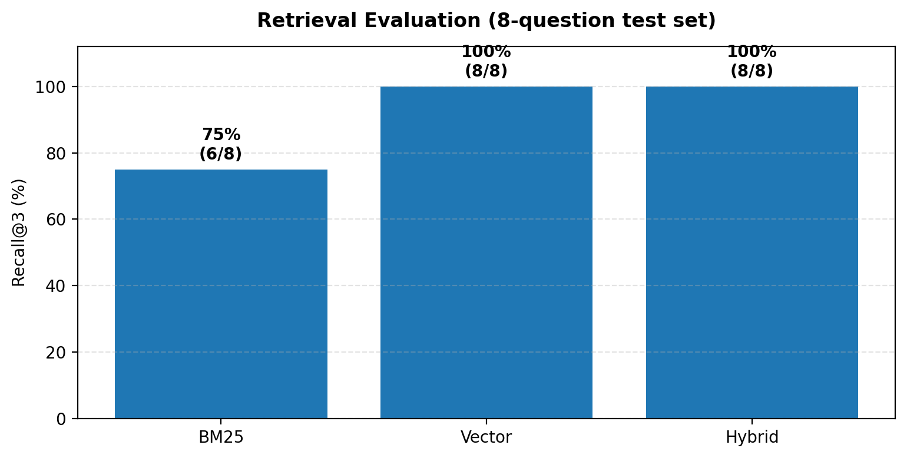
Adaptive Enterprise Knowledge Assistant
Findings and Results
RETRIEVAL QUALITY ON THE CURRENT 8-QUESTION SET
Corpus: 14 files and 404 chunks.
BM25 Recall@3: 75% (6/8 questions).
Vector Recall@3: 100% (8/8 questions).
Hybrid Recall@3: 100% (8/8 questions).
14 tests passed in the reported test run.
BM25
75% (6 / 8)
Vector
100% (8 / 8)
Hybrid
100% (8 / 8)
Hybrid retrieval matched the best observed Recall@3 in this small test set.
Small evaluation set; preliminary results, not a production guarantee.
Preliminary results only; larger, diverse evaluation is required.

Slide 9
Adaptive Enterprise Knowledge Assistant
Conclusion
A working local RAG prototype was built for enterprise policy Q&A.
Hybrid retrieval reached 100% Recall@3 on the current 8-question set.
Role filtering, grounded prompting and fallback support safer answers.
Evidence verification is heuristic and needs stronger semantic evaluation.
Next: expand the benchmark, strengthen access isolation and implement CI/CD.
TAKEAWAYS
WORKING PROTOTYPE
Local RAG pipeline
PROMISING RESULT
Hybrid Recall@3 = 100%
NEXT ITERATION
Bigger benchmark + CI/CD

Slide 10
Adaptive Enterprise Knowledge Assistant
Acknowledgement
VIT Vellore and LTIMindTree for the M.Tech Advanced Industry Integrated Program.
Faculty guide and project mentors for their guidance and review feedback.
Open-source communities behind Python, LangChain, FAISS, FastAPI, Streamlit and Ollama.
Publicly available university policy documents used to demonstrate ingestion.
Experiments used a prototype corpus and local inference setup.

Slide 11
Adaptive Enterprise Knowledge Assistant
References
1. Lewis et al., “Retrieval-Augmented Generation for Knowledge-Intensive NLP Tasks,” NeurIPS, 2020.
2. Robertson & Zaragoza, “The Probabilistic Relevance Framework: BM25 and Beyond,” Foundations and Trends in IR, 2009.
3. Johnson, Douze & Jégou, “Billion-scale similarity search with GPUs,” IEEE Transactions on Big Data, 2019 (FAISS).
4. Ollama documentation: https://ollama.com
5. FastAPI documentation: https://fastapi.tiangolo.com
6. Streamlit documentation: https://docs.streamlit.io
7. Project corpus: public KCL/UCL policy PDFs and synthetic HR/IT policy TXT files.

