Slide 1
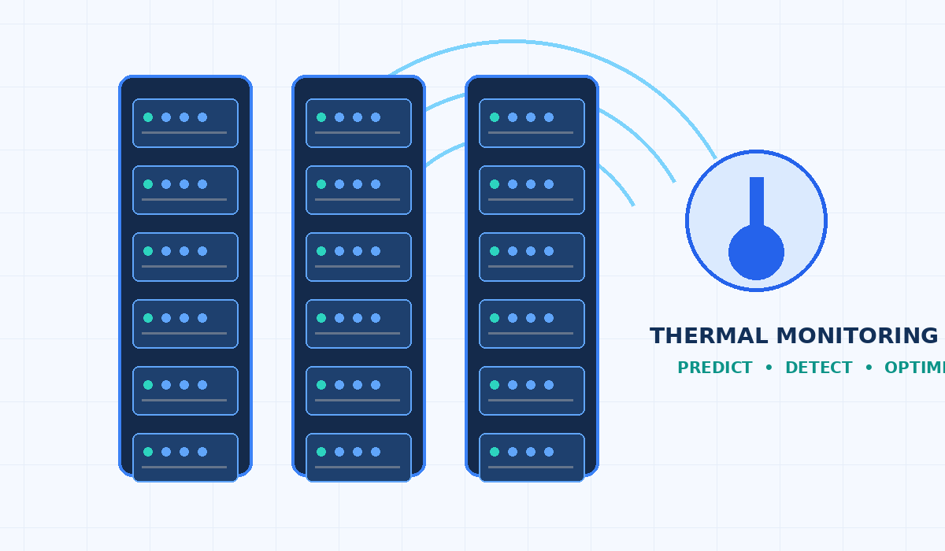


M.Tech/MCA Program
Advanced Industry Integrated Programs
Jointly offered by University and LTIMindTree
REVIEW III
Agentic AI-Based Data Center Cooling Optimization and Thermal Anomaly Management System
Team Member: Sushma P
M.Tech AIML | VIT Vellore | LTIMindTree
Knowledge partner | Implementation partner

Slide 2
Agentic AI-Based Data Center Cooling Optimization and Thermal Anomaly Management System
Introduction
Data centers generate heat as computing workloads change; poor thermal management can affect reliability and energy use.
This project combines telemetry, machine learning and a single Agentic AI decision-support layer.
The system predicts temperature, detects anomalies, diagnoses probable causes and recommends cooling actions.
Proof-of-concept uses synthetic rack-level telemetry; no physical cooling equipment is controlled.

Slide 3
Agentic AI-Based Data Center Cooling Optimization and Thermal Anomaly Management System
Objective
Predict future rack temperature to provide early warning.
Detect abnormal thermal behavior using Isolation Forest.
Identify probable root causes using transparent diagnostic rules.
Recommend cooling actions while considering thermal safety and energy impact.
Explain the recommendation to an operator and require human approval.

Slide 4
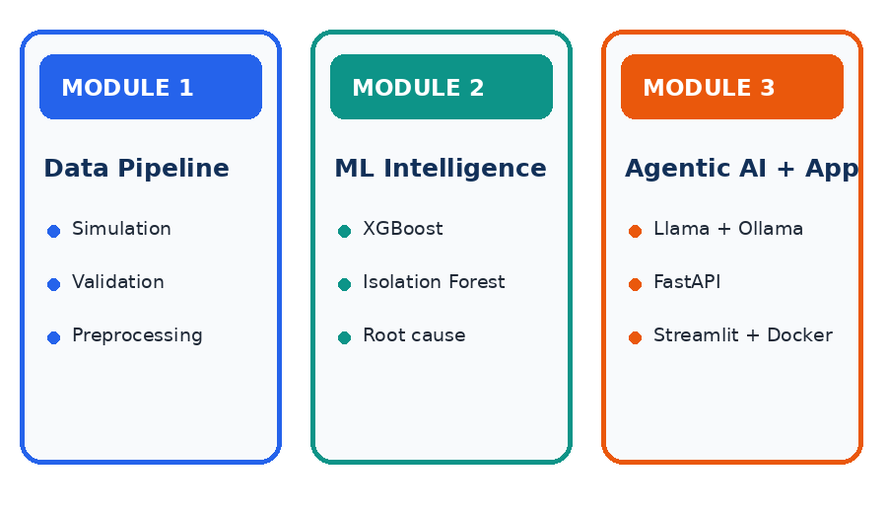
Module 1 — Data pipeline: telemetry simulator, validation, preprocessing and feature engineering.
Module 2 — Intelligence: XGBoost prediction, Isolation Forest detection, root-cause analysis and cooling optimization.
Module 3 — Agentic AI & application: local LLM explanation, FastAPI, Streamlit, Docker and CI.
Boundary: recommendations only; no direct control of real cooling infrastructure.
Agentic AI-Based Data Center Cooling Optimization and Thermal Anomaly Management System
Modules

Slide 5
Agentic AI-Based Data Center Cooling Optimization and Thermal Anomaly Management System
Problem Statement
Rack temperature changes with workload, power consumption, airflow, fan speed, ambient temperature and cooling load.
Fixed thresholds alone may miss interacting variables and emerging thermal trends.
Operators need early warning, probable-cause explanations and practical cooling recommendations.
Problem addressed: integrate prediction, anomaly detection, diagnosis and optimization into one explainable decision-support workflow.

Slide 6
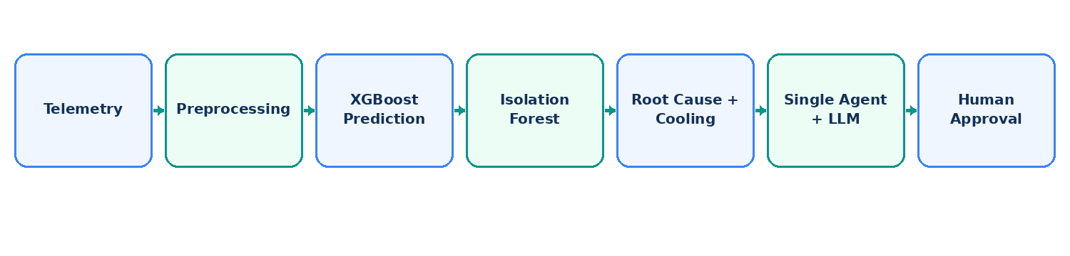
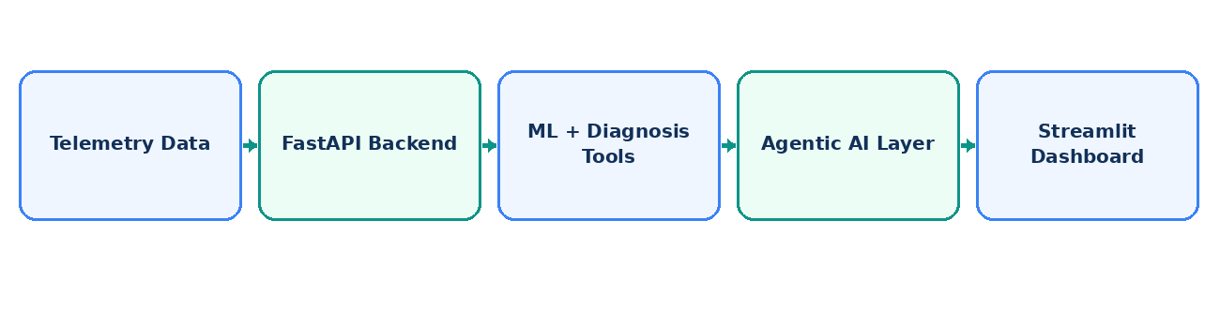
Agentic AI-Based Data Center Cooling Optimization and Thermal Anomaly Management System
Methodology
Generate synthetic telemetry for 5 racks × 500 records = 2,500 records.
Validate and preprocess timestamps, missing values, duplicates and numerical features.
Train XGBoost to predict future temperature; use Isolation Forest for anomalies.
Apply rule-based root-cause diagnosis and cooling optimization.
Single Agentic AI workflow coordinates tools; Llama 3.2:3b via Ollama explains the result.
Expose analysis through FastAPI and Streamlit; test and containerize with Docker.

Slide 7
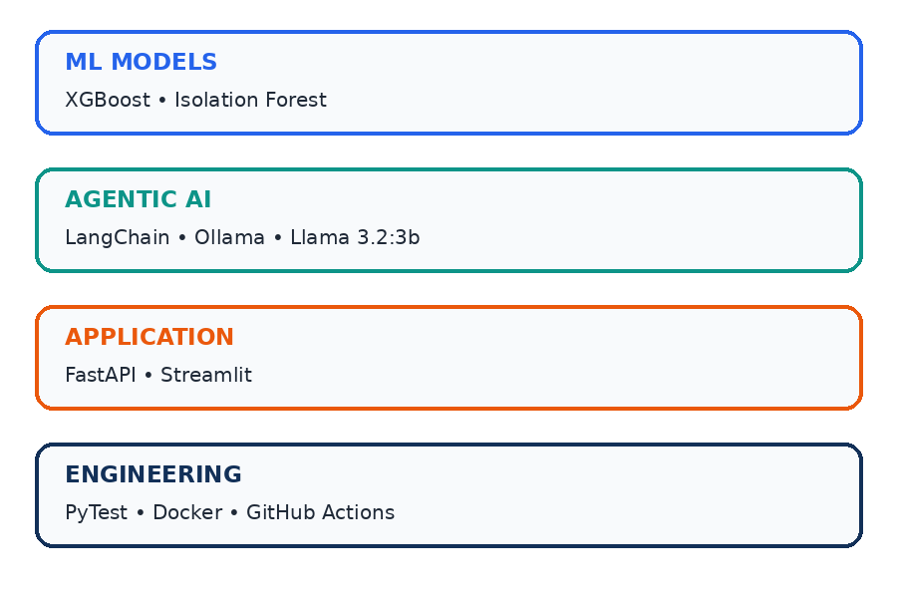
Agentic AI-Based Data Center Cooling Optimization and Thermal Anomaly Management System
Approach/Algorithms/Tools
Python 3.11, Pandas and NumPy — telemetry processing and feature engineering.
XGBoost Regressor — future temperature prediction.
Scikit-learn Isolation Forest + StandardScaler — unsupervised anomaly detection.
Python diagnostic rules + cooling optimizer — probable cause and recommended action.
LangChain + Ollama + Llama 3.2:3b — single-agent orchestration and natural-language explanation.
FastAPI/Uvicorn, Streamlit, Requests, PyTest, Docker Compose, GitHub and GitHub Actions.

Slide 8
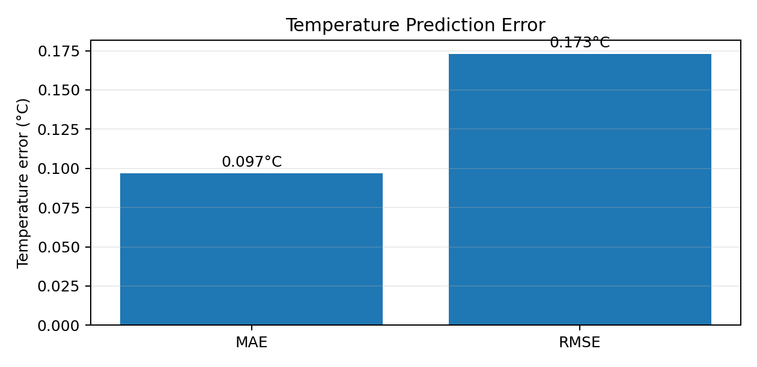
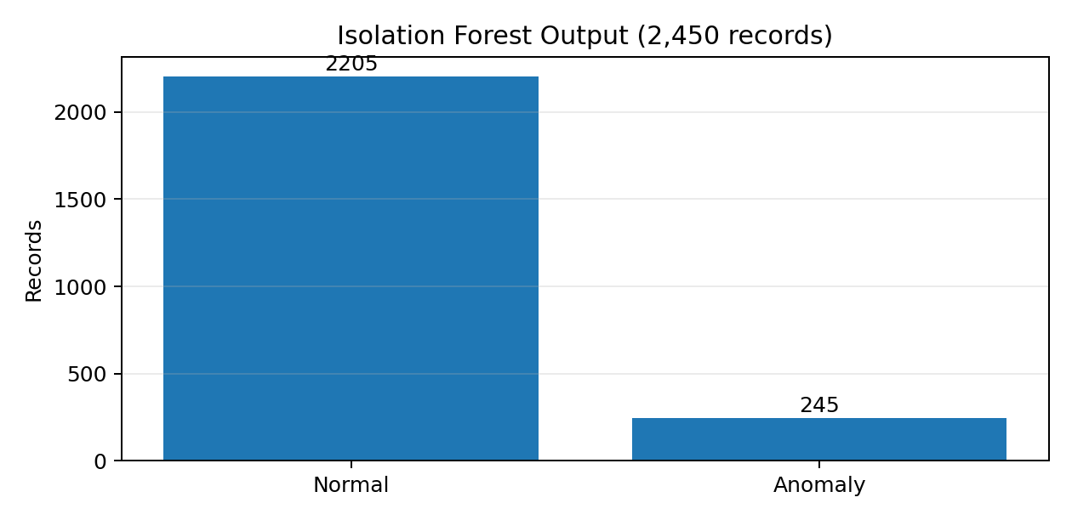
Agentic AI-Based Data Center Cooling Optimization and Thermal Anomaly Management System
Findings and Results
Temperature prediction on chronological test data: MAE ≈ 0.097°C; RMSE ≈ 0.173°C.
Isolation Forest evaluated 2,450 records: 2,205 normal and 245 flagged as anomalies.
Example tool run: current 30.5°C → predicted 33.51°C → high anomaly → reduced airflow → cooling +15% recommendation.
Automated tests: 7 passed; GitHub Actions CI and Docker build validation succeeded.
Results are PoC evidence using synthetic data; validate with real telemetry before operational deployment.

Slide 9
Agentic AI-Based Data Center Cooling Optimization and Thermal Anomaly Management System
Conclusion
Integrated a complete PoC from telemetry generation to operator-facing cooling recommendation.
Combines prediction, anomaly detection, rule-based diagnosis and cooling optimization under one Agentic AI decision-support layer.
FastAPI and Streamlit provide an accessible application; Docker improves reproducibility.
Completed: ML workflow, dashboard, tests, containerization and CI.
Next steps: persistent database, CD/deployment, final end-to-end validation and real-data evaluation.

Slide 10
Agentic AI-Based Data Center Cooling Optimization and Thermal Anomaly Management System
Acknowledgement
We thank LTIMindTree and VIT Vellore for the opportunity to work on this industry-integrated project.
We are grateful to our project guide, mentors and faculty for their guidance and feedback.
We acknowledge the open-source communities behind Python, XGBoost, scikit-learn, LangChain, Ollama, FastAPI, Streamlit and Docker.

Slide 11
Agentic AI-Based Data Center Cooling Optimization and Thermal Anomaly Management System
References
Chen, T. & Guestrin, C. (2016). XGBoost: A Scalable Tree Boosting System. KDD.
Liu, F. T., Ting, K. M., & Zhou, Z.-H. (2008). Isolation Forest. IEEE ICDM.
XGBoost documentation: https://xgboost.readthedocs.io/
Scikit-learn documentation: https://scikit-learn.org/
LangChain documentation: https://python.langchain.com/
Ollama documentation: https://ollama.com/
FastAPI: https://fastapi.tiangolo.com/ | Streamlit: https://docs.streamlit.io/
Docker: https://docs.docker.com/ | GitHub Actions: https://docs.github.com/actions

