Slide 1

Shelf

Slide 2
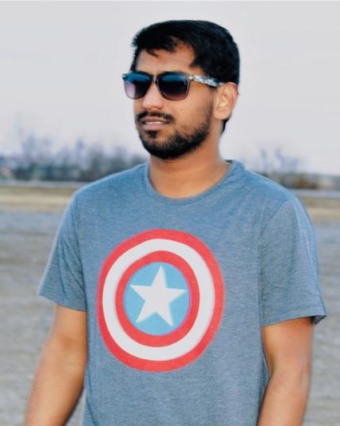


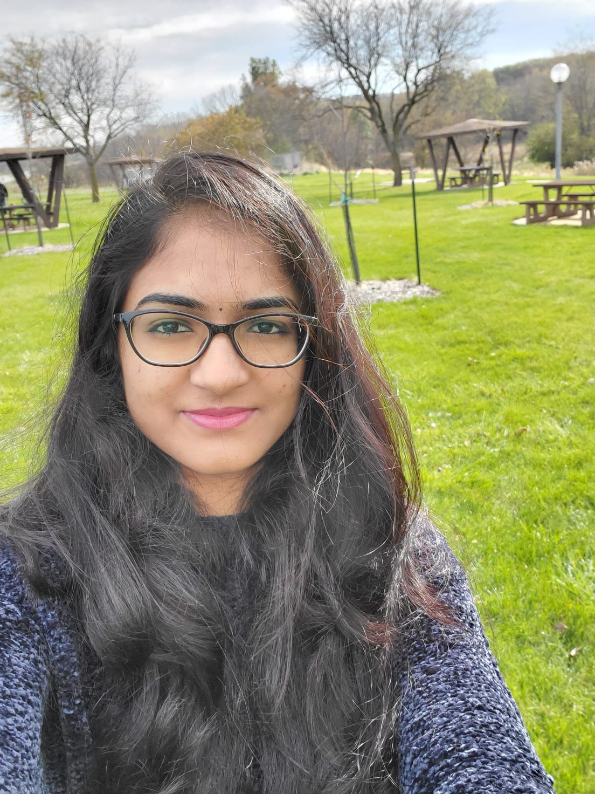
Anvesh Rokalanwar
Pavan Kumar Reddy Byreddy
Samanth Gourineni
Sushma Rani Reddy Aleti

Slide 3

Problem
3
Finding and sharing books for free
Pavan Kumar Reddy Byreddy

Slide 4
Proposed Solution
Android app that allows the people to share or request physical books with others.
Using our application a user can either share a book that he/she has or he/she can get a book that is available.
Pavan Kumar Reddy Byreddy

Slide 5
Features
We can add the book.
We can find the books available.
We can send request to the book owner.
We can view the location of the user in google maps.
Send notification to user through email when accepted/rejected.
Samanth Gourineni

Slide 6
Activities
Login
Signup
Forgot password
Home(Your books)
Add book
Find book
Send request
Book details
Book requests
Profile
Samanth Gourineni

Slide 7
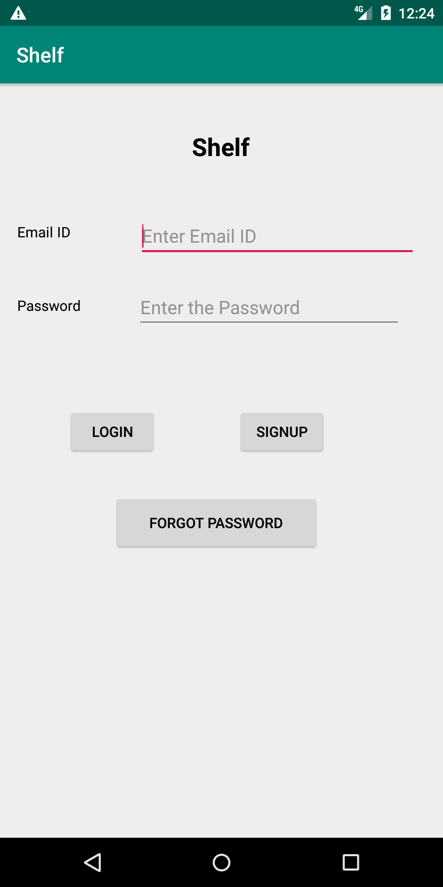
Login activity
Samanth Gourineni

Slide 8
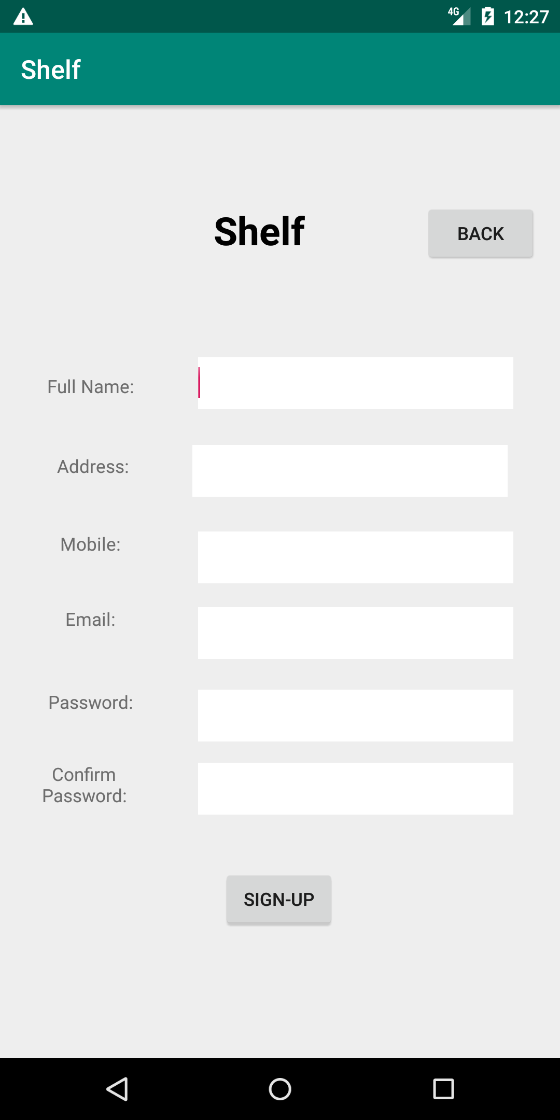
Sign up
Samanth Gourineni

Slide 9
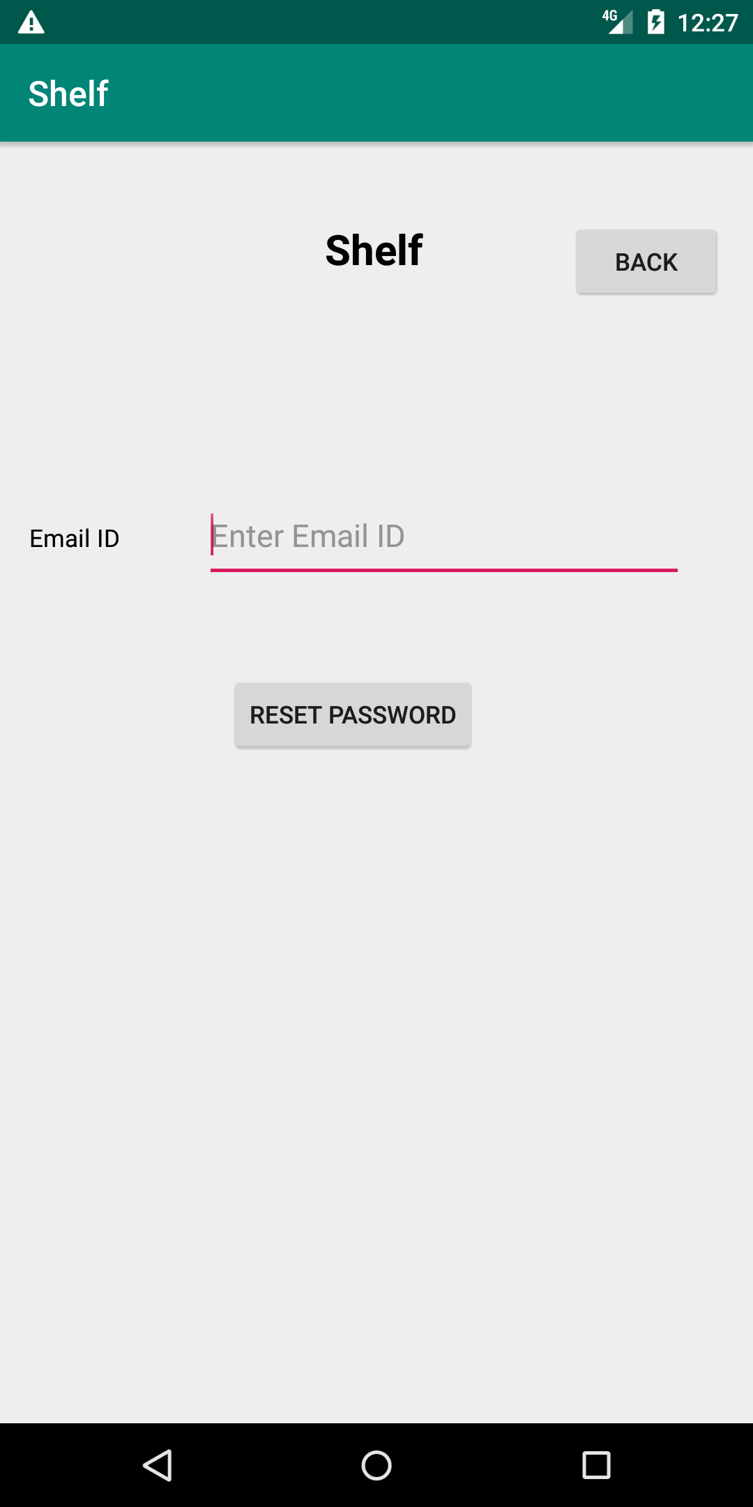
Forgot password
Samanth Gourineni

Slide 10
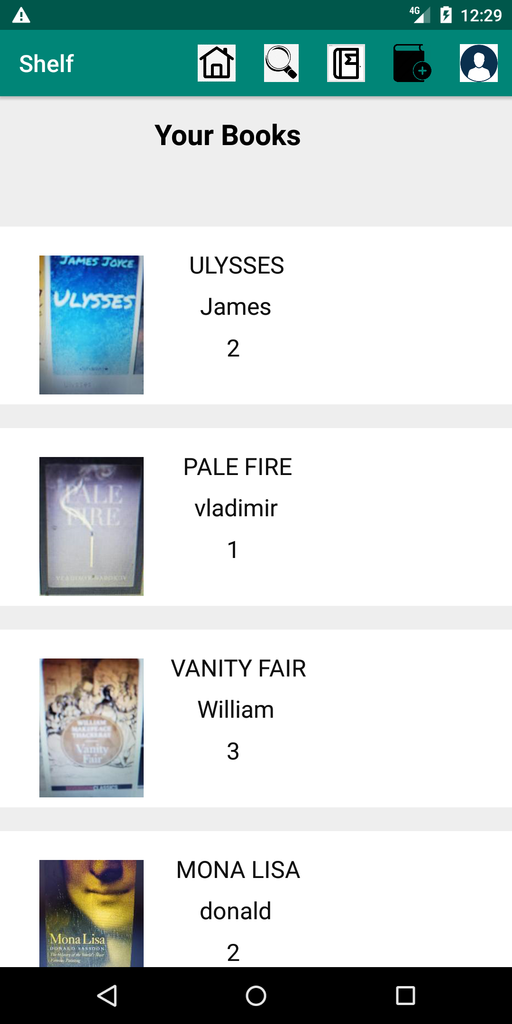
Home(Your books)
Sushma Rani Reddy Aleti

Slide 11
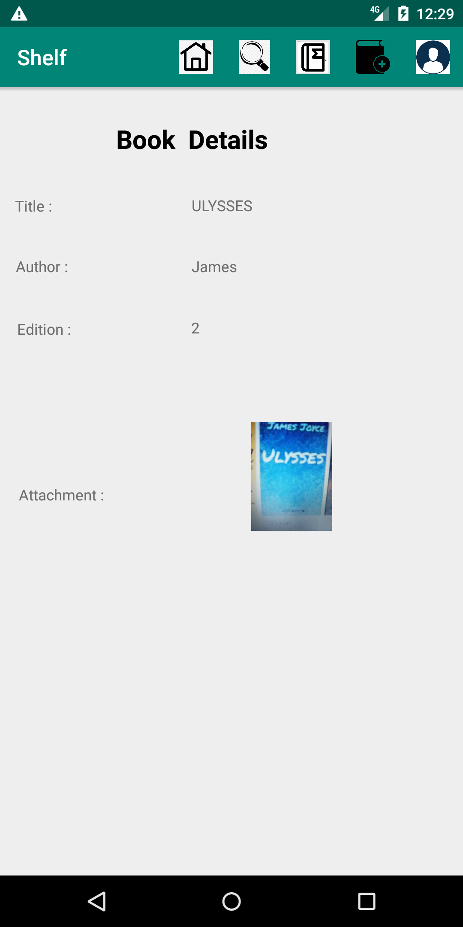
Book details
Sushma Rani Reddy Aleti

Slide 12
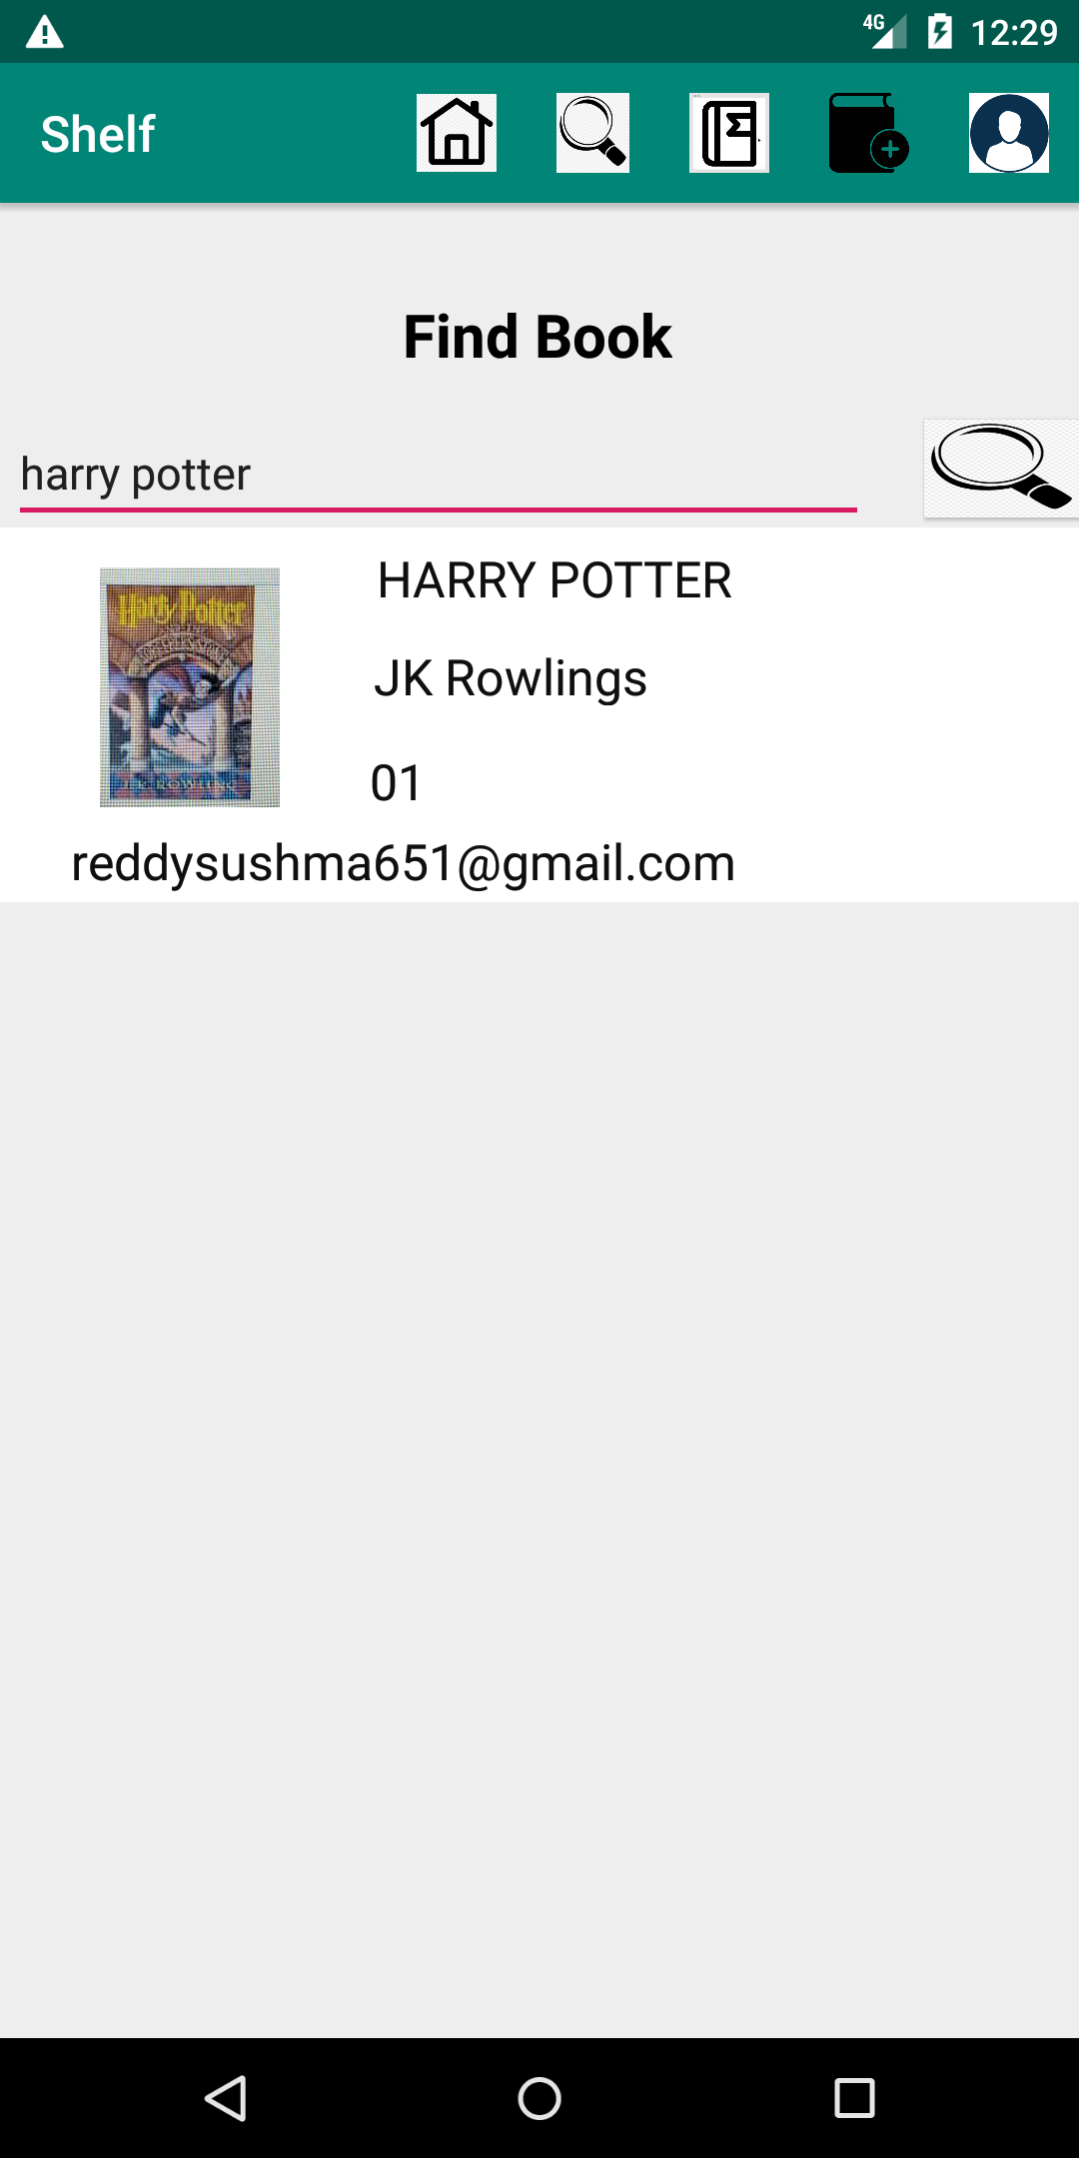
Find book
Sushma Rani Reddy Aleti

Slide 13
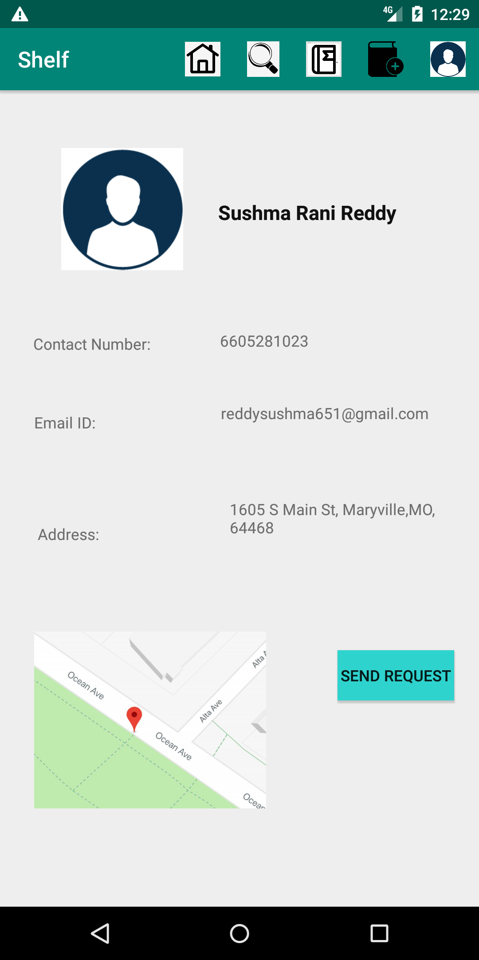
Send request
Sushma Rani Reddy Aleti

Slide 14
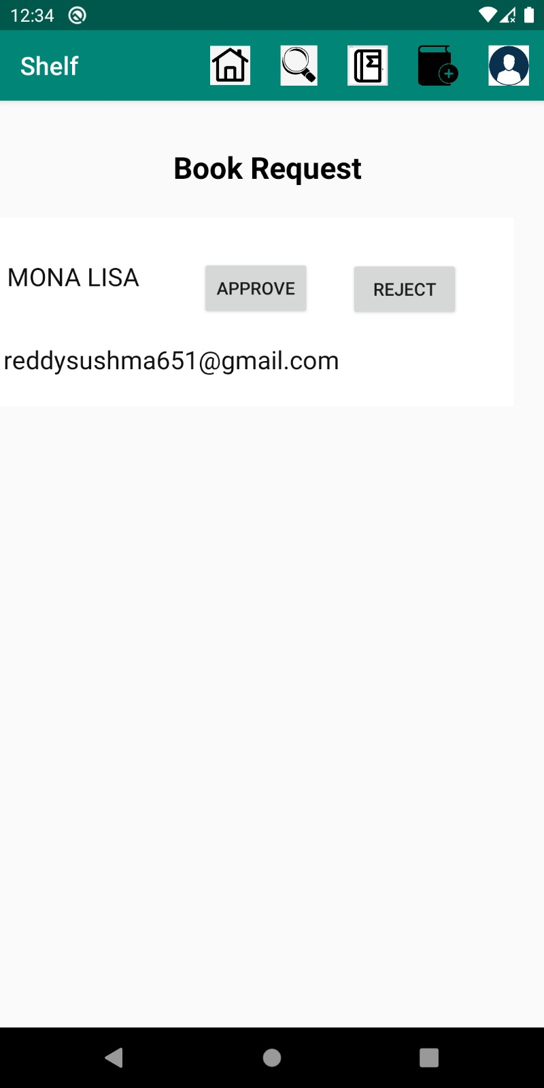
Requests
Sushma Rani Reddy Aleti

Slide 15
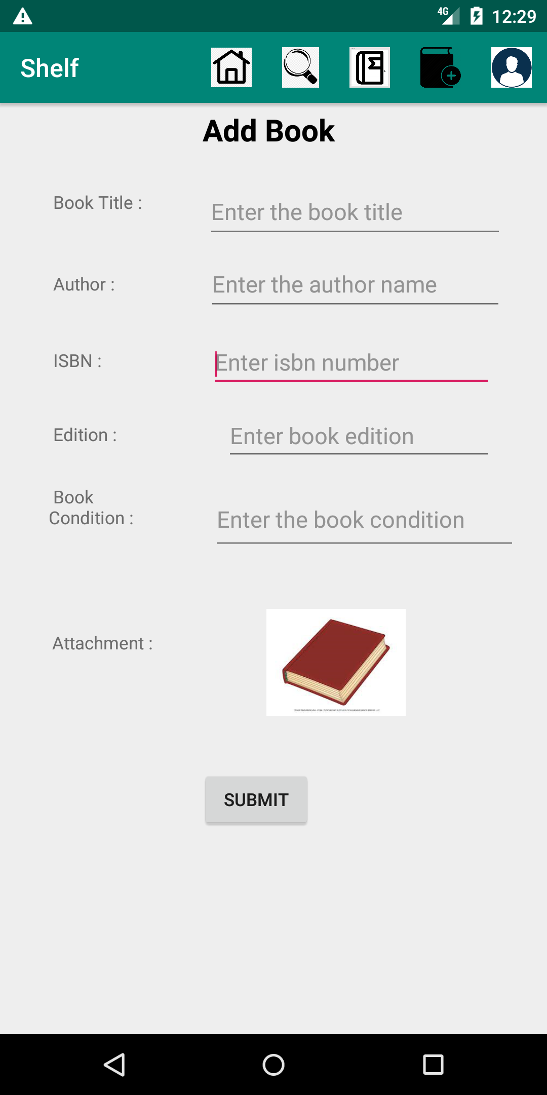
Add book
Sushma Rani Reddy Aleti

Slide 16
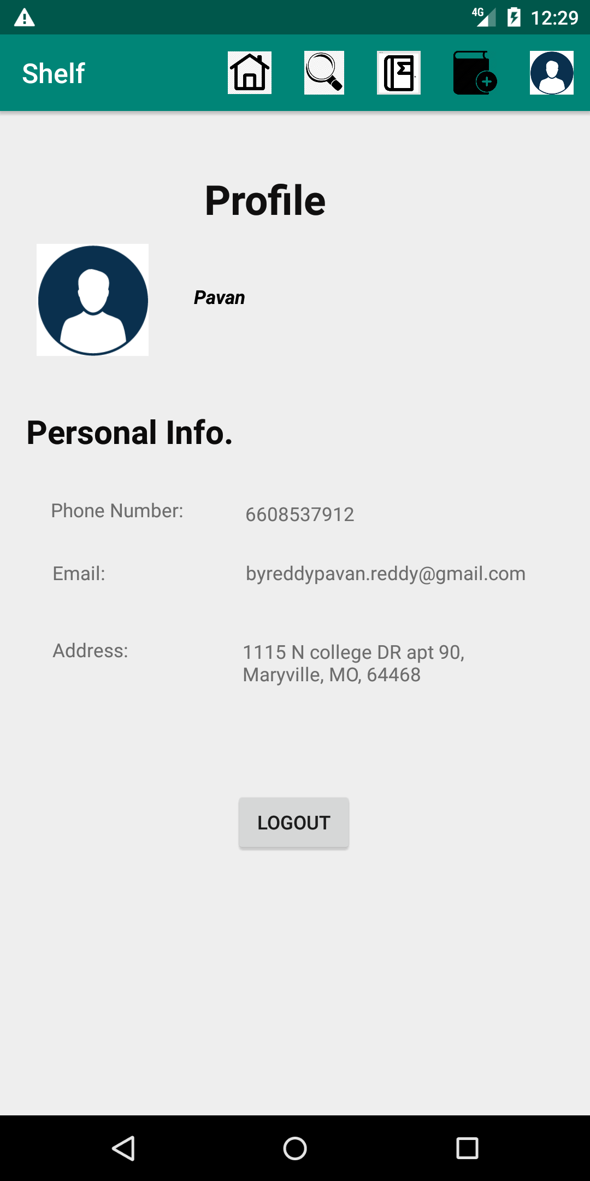
Profile
Sushma Rani Reddy Aleti

Slide 17
Persistent data
Email
Anvesh Rokalanwar

Slide 18
API not used in class
Google API
Anvesh Rokalanwar

Slide 19
Problems faced
Layout design
Image upload
Google maps
Anvesh Rokalanwar

Slide 20
Future improvements
Push notifications when user accepts/rejects
Directions in maps
Sent requests
Anvesh Rokalanwar

Slide 21
Any questions ???

Slide 22
Thank you ☺

