Slide 1

Machine Learning Based Agricultural Produce Price Forecasting
Notes:
© Copyright PresentationGO.com – The free PowerPoint and Google Slides template library

Slide 2
The Problem
Farmer’s Income & Inflation
The farmer's income is not able to keep up with the inflation rate in US. They are not able to support their family.
Weather & Seasonal Changes
Weather and other seasonal changes affect produce quality and the price. It is important to strategize the yield in order to sell well.
Fluctuating Produce Price
Just like stock market, purchasing a stock one day later affects a lot. It’s important to sell at the right time to maximize profitability
Notes:
© Copyright PresentationGO.com – The free PowerPoint and Google Slides template library

Slide 3




The Problem
Economic Insecurity
Disruptions in Trade Networks and Fluctuations
COVID-19 Pandemic & Its After Effects
Farmers Crippling Debt
Notes:
© Copyright PresentationGO.com – The free PowerPoint and Google Slides template library

Slide 4

AGRO GEN - The Solution
Notes:
© Copyright PresentationGO.com – The free PowerPoint and Google Slides template library

Slide 5



AGRO GEN
One-Stop Solution
A solution that predicts the price to sell on a given date, there by helping a farmer asses what the best day is to sell.
Cloud Native
The product is deployed on the cloud and can be accessed anywhere with a stable internet connection.
Machine Learning
State of the art ML based prediction to help make accurate forcasts thst continuously learns based on everyday price fluctuation.
Notes:
© Copyright PresentationGO.com – The free PowerPoint and Google Slides template library

Slide 6
AGRO GEN – Factors Considered
Location
Weather
Inflation
Notes:
© Copyright PresentationGO.com – The free PowerPoint and Google Slides template library

Slide 7






AGRO GEN – Technology
Notes:
© Copyright PresentationGO.com – The free PowerPoint and Google Slides template library

Slide 8
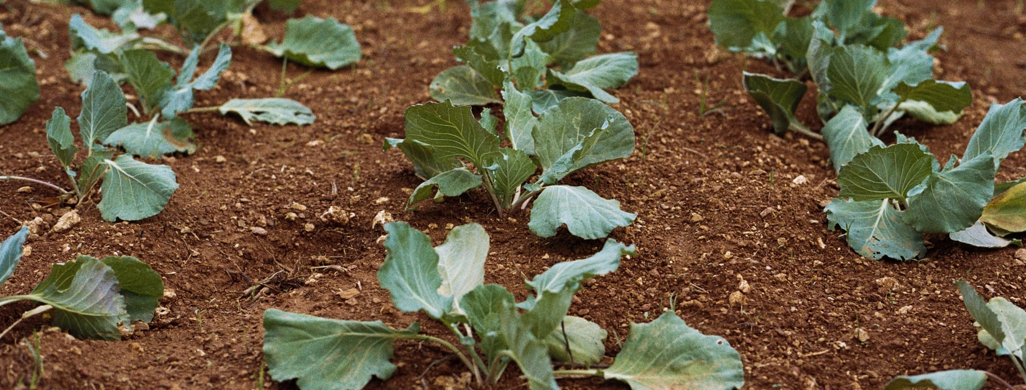
AGRO GEN – Public Reactions
Notes:
© Copyright PresentationGO.com – The free PowerPoint and Google Slides template library

Slide 9
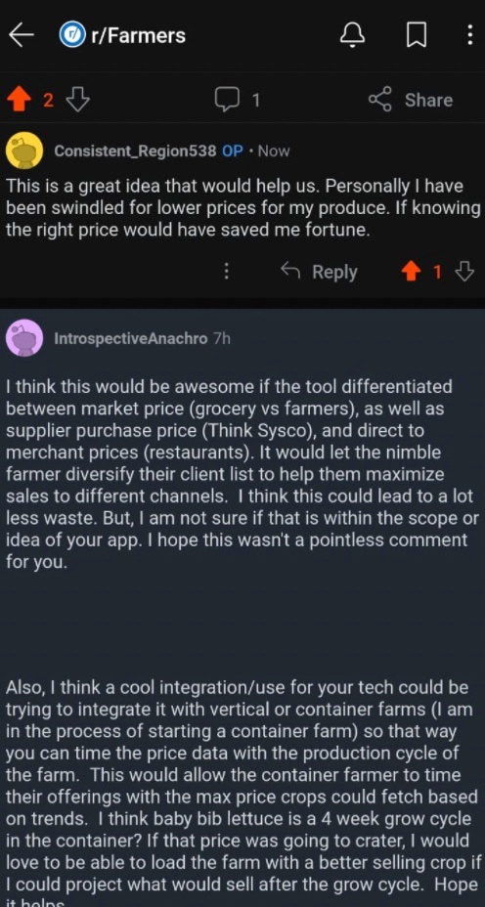
Public Reactions
Notes:
© Copyright PresentationGO.com – The free PowerPoint and Google Slides template library

Slide 10



What’s in Store for Farmers?
Predictive Metrics
Digital Agriculture
Make accurate guess about [5% error rate] when is the best time to sell their produce.
This will incentivize the younger generation to consider agriculture as solid career choice.
Best Location
Continous Integration
This also allows farmers to make the best estimate about where they would get the best value for their yield.
The model will ideally keep running with current data trends and improve continuously.
Notes:
© Copyright PresentationGO.com – The free PowerPoint and Google Slides template library

Slide 11
Thank You!
Notes:
© Copyright PresentationGO.com – The free PowerPoint and Google Slides template library

