Slide 1
Abstraction
Abstraction is a process of hiding the implementation details from the user, only the functionality will be provided to the user. In other words, the user will have the information on what the object does instead of how it does it.

Slide 2
Two ways to achieve abstraction
1.Using Abstract class
2.Using Interface

Slide 3
1.Using Abstract Class
A class which is declared as abstract is known as an abstract class. It can have abstract and non-abstract methods. It needs to be extended and its method implemented. It cannot be instantiated.
Syntax for abstract class:
abstract class A{
Syntax for abstract method:
abstract void run();
Void show();
}

Slide 4
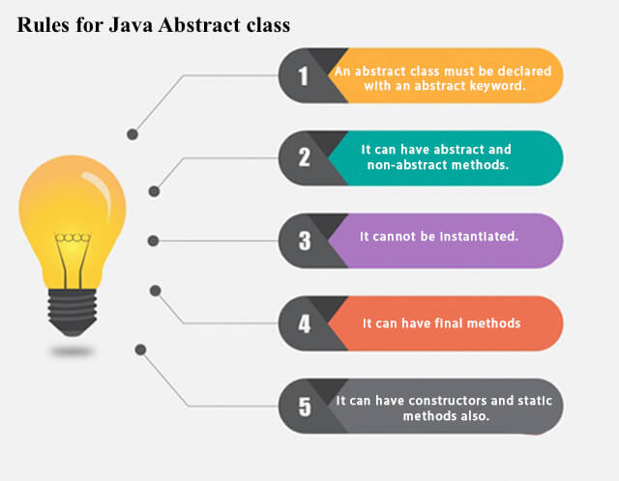

Slide 5
Abstraction in interface:
An interface in Java is a blueprint of a class. It has static constants and abstract methods.
The interface in Java is a mechanism to achieve abstraction.
In other words, you can say that interfaces can have abstract methods and variables. It cannot have a method body.
It cannot be instantiated just like the abstract class.

Slide 6
Abstract class | Interface
1) Abstract class can have abstract and non-abstract methods. | 1.Interface can have only abstract methods.
2) Abstract class doesn't support multiple inheritance. | 2.Interface supports multiple inheritance.
3) Abstract class can have final, non-final, static and non-static variables. | 3.Interface has only static and final variables.
5) The abstract keyword is used to declare abstract class. | 5.The interface keyword is used to declare interface.
6) An abstract class can extend another Java class and implement multiple Java interfaces. | 6.An interface can extend another Java interface only.

Slide 7
8) A Java abstract class can have class members like private, protected, etc. | Members of a Java interface are public by default.
9)Example: public abstract class Shape{ public abstract void draw(); } | Example: public interface Shape{ void draw(); }

Slide 8
Similarities:
Abstract class and interface both are used to achieve abstraction where we can declare the abstract methods. Abstract class and interface both can't be instantiated.

Slide 9
Final methods & variables:
If a variable declare with Final keyword that is known as final variables. It can not be changed.
Final methods can not be overridden from any class.
Static methods can access without using the object and no need to create any object for calling the method.
A constructor in Java is a special method whose name is same as the class name.
It is used to initialize objects.
Constructor is divided into two types .i.e:No-arguments constructor and parameterised constructor.

