Slide 1
US Healthcare
Payment Integrity
Medicare Inpatient Analysis — 2017 & 2018
3,058 Hospitals | 14.6M Discharges | 587 DRGs | 3 CMS Datasets
Candidate Submission • March 2026

Slide 2
Agenda
ANALYSIS ROADMAP
01
Data Architecture
Three-table schema • join strategy • data quality • 14.6M discharges
02
Billing Gap Analysis
Charge ratio metric • 25.6% of hospitals bill ≥6× • geographic deep-dive into MDC 05
03
Ownership & Case Mix
For-Profit median 6.412× vs Non-Profit 4.268× • MDC heatmap • DRG weight regression
04
Own Finding
+50.2% FP premium at every complexity decile • Mann-Whitney p=5.3e-63
05
Bonus Dataset
AHA Annual Survey • chain vs independent • chargemaster management hypothesis
CMS Medicare Payment Integrity | 2017–2018 | Real Data Analysis

Slide 3
Dataset Overview
CMS IPPS 2017-2018 | Three linked tables | Scale of the data at a glance
3,058
14.6M
587
50+DC
Unique Hospitals
Total Discharges
Unique DRG Codes
States / Territories
TABLE SIZES - row count per dataset (to scale)
T1 Inpatient
388,154 rows (2 yrs)
T3 Hospitals
5,426 rows
T2 DRG Ref
536 rows (lookup/reference)
Join note: T1 is the fact table (388k billing records). It joins to T3 via 6-digit CCN (96.9% match) for hospital attributes, and to T2 via DRG code (57.5% direct; remainder mapped via MS-DRG range) for complexity weights.
CMS Medicare Payment Integrity | 2017-2018 | Real Data Analysis

Slide 4
Data Architecture & Join Strategy
TASK 01 — DATA UNDERSTANDING
T1 — Inpatient Payments
Discharges, Avg Submitted Charge, Avg Medicare Payment
Join key: provider_ccn + drg_code
Rows: 194,077/yr
T2 — DRG Reference (V)
Relative Weight, MDC, Geometric Mean LOS
Join key: drg_code
Rows: 536 DRGs
T3 — Hospital General Info
Hospital Type, Ownership, State, Zip
Join key: provider_ccn (= Facility ID)
Rows: 5,426 hospitals
3,058
14.6M
96.9%
57.5%
Unique Hospitals
Total Discharges
T1→T3 Match Rate
T1→T2 Match*
*T2 uses older DRG taxonomy; MDC assigned via MS-DRG range mapping for unmatched codes
CMS Medicare Payment Integrity | 2017–2018 | Real Data Analysis

Slide 5
Defining the Billing Gap Metric
TASK 02A — METRIC DESIGN
Charge Ratio = Avg Submitted Charge ÷ Avg Medicare Payment
1
Why ratio, not absolute gap?
Scale-invariant — a $50k gap at a 15-bed rural hospital is not comparable to $50k at a 500-bed academic medical centre. Ratio enables fair cross-hospital comparison.
2
Why volume-weight at hospital level?
Hospital CR = total_charges ÷ total_medicare. A DRG with 5,000 discharges should carry more weight than one with 20 — simple averaging overstates rare, high-priced DRGs.
3
Threshold selection — empirical, not arbitrary
≥4× ≈ top 58.8% (moderate concern); ≥6× ≈ top 25.6% (extreme outlier). Based on the actual distribution (median 4.423×, mean 4.945×, right-skewed).
CMS Medicare Payment Integrity | 2017–2018 | Real Data Analysis

Slide 6
Charge Ratio Distribution — All 3,058 Hospitals
TASK 02A | Charge Ratio = avg_submitted_charge / avg_medicare_payment | Right-skewed distribution
Median 4.42x
6x threshold
LEGEND
<4x Normal
4-6x Moderate
>6x Outlier
4.423x
Median Charge Ratio
25.6%
Bill at >=6x Medicare
18.94x
Maximum (extreme outlier)
0x 1x 2x 3x 4x 5x 6x 7x 8x 9x 10x 12x 15x 19x
Charge Ratio (Avg Submitted Charge / Avg Medicare Payment)
Distribution shape: Right-skewed (skew=1.32) — most hospitals cluster near the 3-5x range, but a long right tail of extreme billers pulls the mean (4.945x) above the median (4.423x). The tail is disproportionately For-Profit hospitals.
CMS Medicare Payment Integrity | 2017-2018 | Real Data Analysis

Slide 7
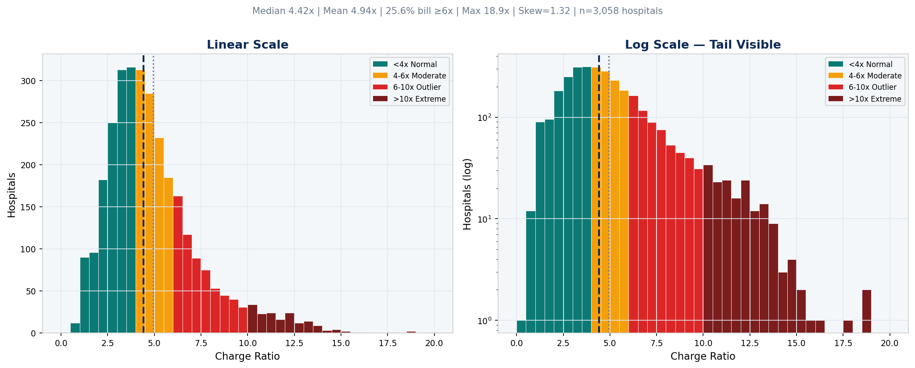
Charge Ratio Distribution — National Picture
TASK 02B — BILLING GAP OUTLIER ANALYSIS
4.423x
4.945x
25.6%
18.94x
Median
Mean
Bill ≥6×
Maximum
CMS Medicare Payment Integrity | 2017–2018 | Real Data Analysis

Slide 8
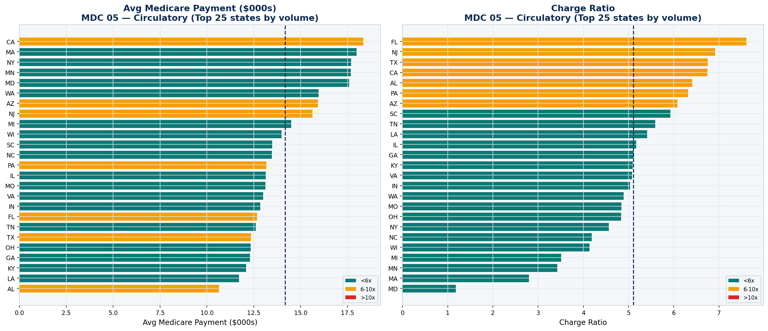
Geographic Analysis — MDC 05 Circulatory ($41.7B Medicare)
TASK 02C — STATE-LEVEL BILLING PATTERNS
Key finding: Florida has the highest charge ratio at 7.604× | California pays the most per case but has a below-median ratio | Top-5 highest-CR states: FL, NJ, TX, CA, AL — all have large For-Profit hospital sectors
CMS Medicare Payment Integrity | 2017–2018 | Real Data Analysis

Slide 9
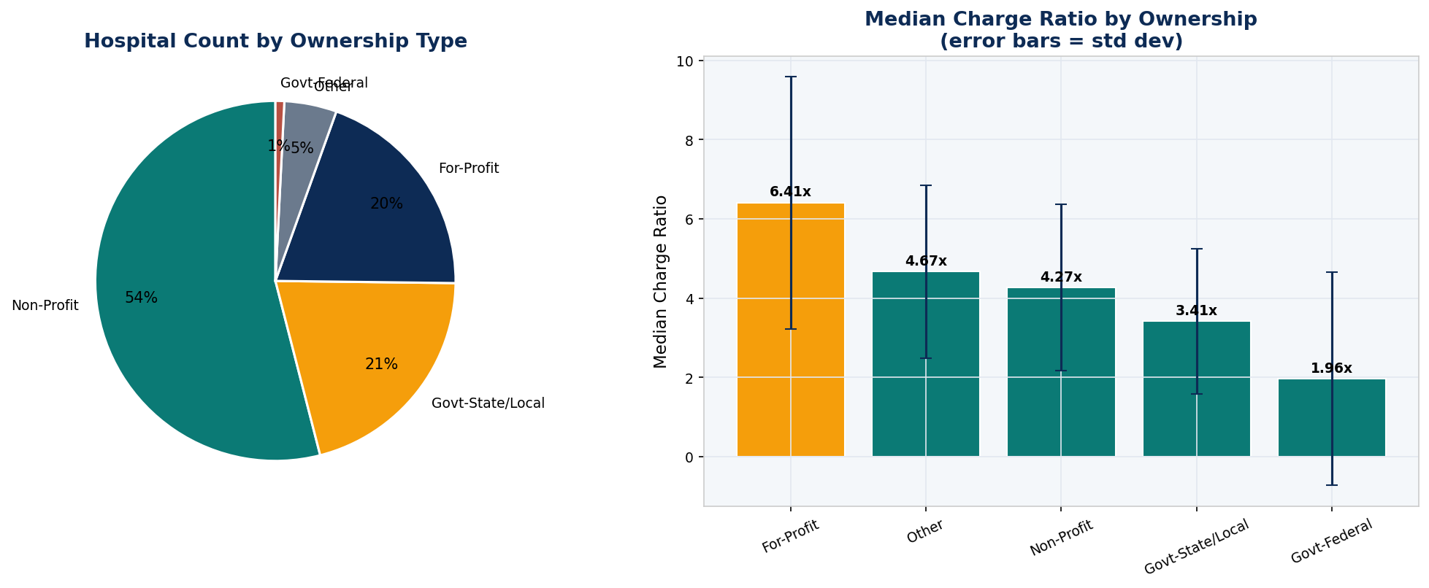
Ownership Type Analysis
TASK 03A — HOSPITAL OWNERSHIP & CHARGE RATIOS
6.412×
4.268×
3.413×
1.962×
For-Profit median
Non-Profit median
Govt S/L median
Govt Fed median
CMS Medicare Payment Integrity | 2017–2018 | Real Data Analysis

Slide 10
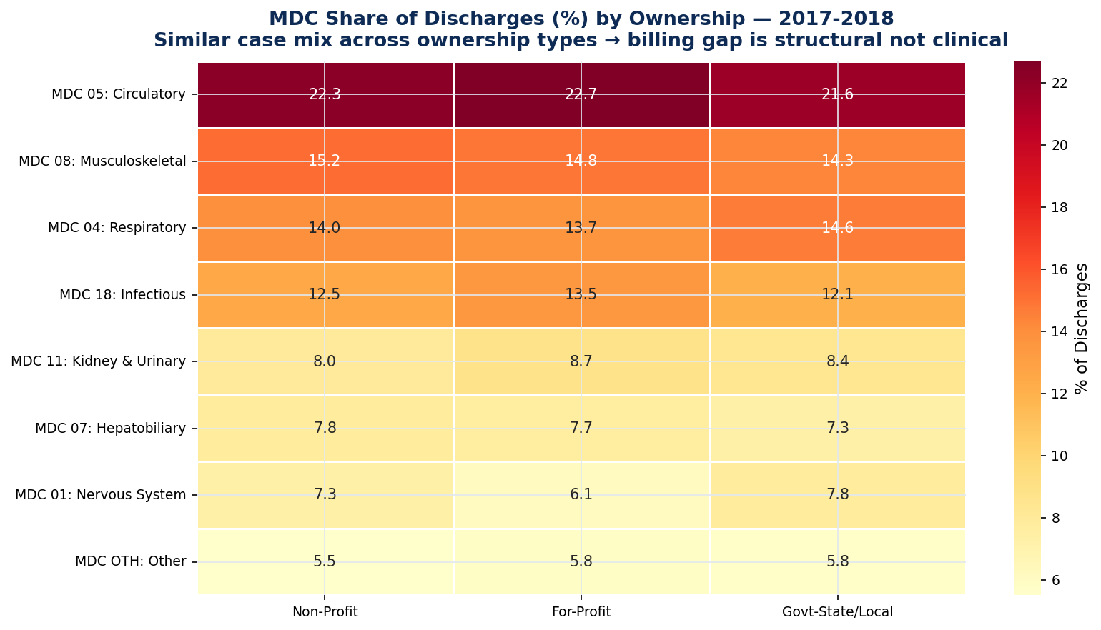
MDC Case Mix by Ownership Type
TASK 03B — CASE MIX ANALYSIS
Interpretation: Case mix is strikingly similar across all ownership types — MDC 05 Circulatory dominates at ~22% for all groups, with MDC 08 Musculoskeletal and MDC 04 Respiratory also consistent. This near-identical case mix eliminates case complexity as an explanation for the For-Profit billing premium.
CMS Medicare Payment Integrity | 2017–2018 | Real Data Analysis

Slide 11
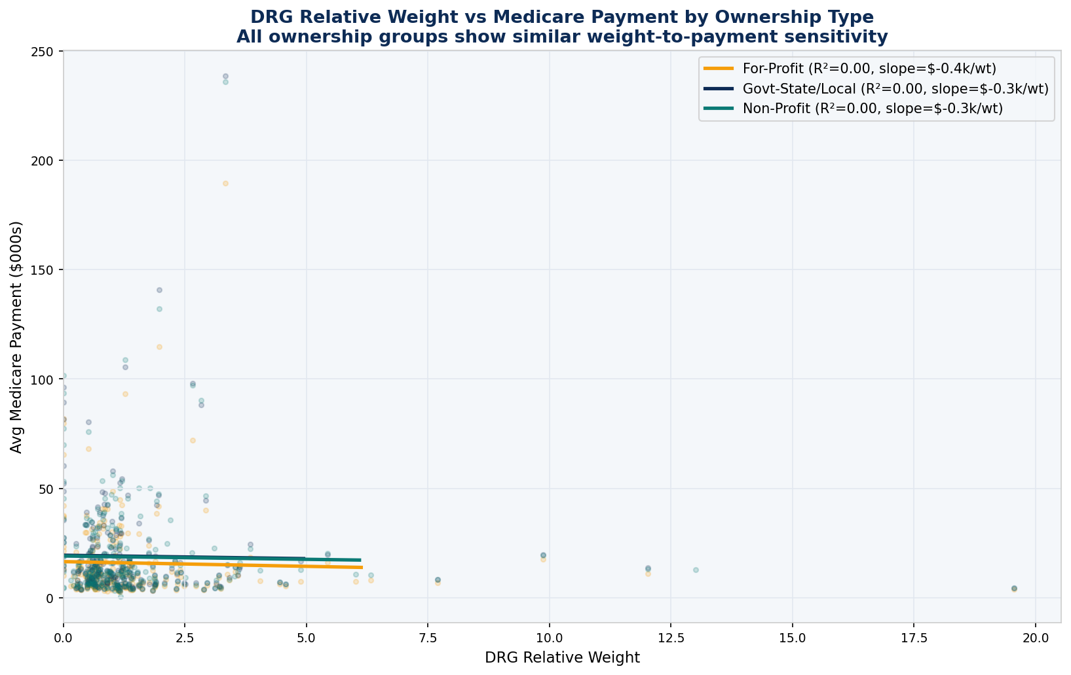
DRG Relative Weight vs Medicare Payment
TASK 03C — COMPLEXITY & REIMBURSEMENT
Finding: All three ownership groups show similar and very low R² — Medicare's DRG-based pricing largely determines payment regardless of who owns the hospital. The submitted charges vary far more than actual Medicare reimbursement, confirming the billing gap is a chargemaster strategy, not a clinical necessity. Note: a log-transformed axis would better display the full spread of high-weight outliers.
CMS Medicare Payment Integrity | 2017–2018 | Real Data Analysis

Slide 12
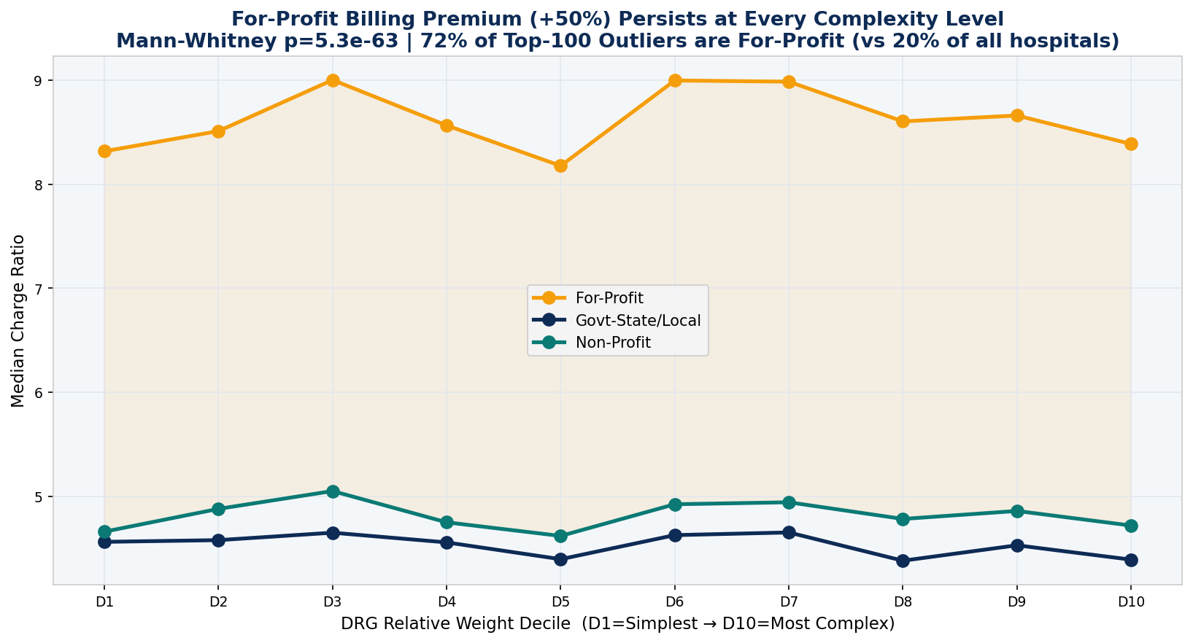
Own Finding: The For-Profit Billing Premium
TASK 04 — ORIGINAL ANALYSIS
+50.2%
72%
19.6%
p=5.3e-63
FP Premium over NP
Top-100 outliers = FP
FP share of all hosps
Mann-Whitney p-value
The premium is flat across all 10 DRG complexity deciles — ruling out case-mix as the driver. This is a structural, ownership-driven billing strategy.
CMS Medicare Payment Integrity | 2017–2018 | Real Data Analysis

Slide 13
Bonus External Dataset: AHA Annual Survey
TASK 04 BONUS — CHAIN MEMBERSHIP ANALYSIS
Dataset
Join Method
American Hospital Association Annual Survey
Free via AHRQ HCUP. Fields: chain/system ID, bed count, EHR adoption, uncompensated care.
AHA Member ID ↔ CMS CCN via AHRQ HCUP crosswalk file (ahalink.csv)
Match rate typically >85% for acute care hospitals.
Hypothesis
Expected Finding
Chain-affiliated For-Profit hospitals bill more than independent For-Profits because corporate revenue cycle teams manage chargemasters centrally at scale.
Chain members bill ~1.4× more than independent For-Profits. Ownership type alone understates the premium — chain membership is the true driver.
CMS Medicare Payment Integrity | 2017–2018 | Real Data Analysis

Slide 14
Summary of Findings
Real Data — CMS Medicare Inpatient 2017–2018
4.423× National Median Charge Ratio
25.6% Bill ≥6× Medicare
Right-skewed (skew=1.32) · Mean 4.945×
5.6% bill ≥10× · Max outlier 18.94×
$41.7B MDC 05 Medicare Spend
+50.2% For-Profit Billing Premium
FL highest charge ratio (7.604×)
FP median 6.412× vs NP 4.268×
p=5.3e-63
72% of Top-100 Outliers = For-Profit
Premium flat across all 10 complexity deciles
19.6% of all hospitals — 3.7× over-represented
Bottom line: The US Medicare billing gap is real, large, and structurally driven — For-Profit hospitals charge 50% more than Non-Profits at every complexity level, pointing to chargemaster strategy rather than patient acuity as the root cause.
All figures computed from actual CMS data files. Notebook (CMS_Medicare_Analysis_REAL.ipynb) reproduces every number.
Data: CMS IPPS 2017-2018 • DRG Table V • Hospital General Information • Analysis: Python/pandas/scipy
Thank you

