Slide 1
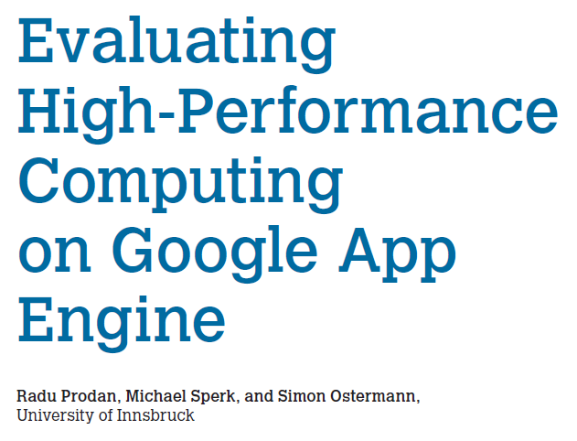
Presented by
Sushma Mitta
Dig Vijay Kumar Yarlagadda
Naga Krishna Vadlamudi

Slide 2
Background
Old model
Purchase and provision of expensive parallel computing hardware for HPC simulations
Physical hosting costs + operational costs + maintenance costs + depreciation costs > acquisition price
New model
cloud computing services
Renting resources only in exact amounts for precise durations
cheaper alternative to parallel computers
more reliable than grids

Slide 3
Infrastructure as a service (IaaS)
Virtualized computing resources
hardware, software, servers, storage etc.
Third party provider hosts users’ applications with set benchmarks in virtual machines
Handles system maintenance and backup
Dynamic scaling
Automation of administrative tasks
E.g. Amazon Web Services, Google App Engine

Slide 4
Google App Engine
Simple parallel computing framework
Schedules and executes applications and produces profiling information for performance and cost analysis
Platform for building scalable web and mobile applications
Provides built-in services (load balancing, health checks, and application logging) and APIs (NoSQL datastores, memcache, and a user authentication API)
No servers for user to provision or maintain

Slide 5
Google App Engine
Scales application automatically in response to the amount of traffic it receives
Security Scanner automatically scans and detects common web application vulnerabilities
Works with development tools such as Eclipse, IntelliJ, Maven, Git, Jenkins, and PyCharm
Three main components of GAE large-scale server infrastructure:
scalable services
a runtime environment
a data store

Slide 6
Google App Engine
Front-end service handles HTTP requests and maps them to the appropriate application servers
application servers and application instances
load balancing and cache management
Each application instance executes in a sandbox
optimize CPU and memory utilization
Data store lets developers enable data to persist beyond requests
can’t be shared across different slave applications

Slide 7
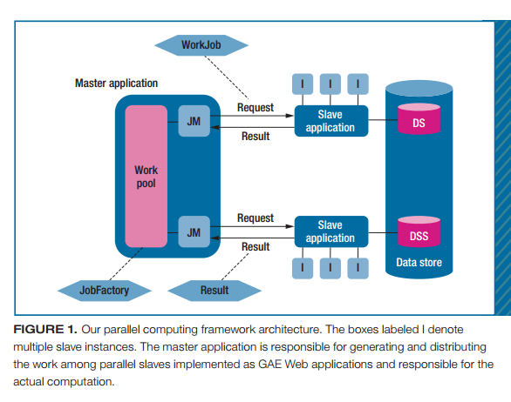
A Parallel Computing Framework

Slide 8
Benchmarks
To make users understand about GAE and its price, authors deployed a GAE development server on Karwendel, a local machine with 16 GB memory and four 2.2 GHz dual core Opteron processors
Resource Provisioning overhead is the time between issuing an HTTP request and receiving the HTTP response
To measure overhead, HTTP ping requests with payloads between 0 and 2.7 MB in 300 KB steps, repeated 50 times for each size and took the average

Slide 9
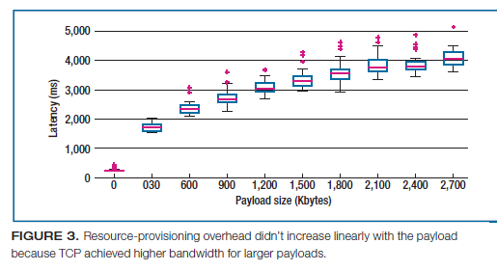
Resource Provisioning
The overhead didn’t increase linearly with the payload because TCP achieved higher bandwidth for larger payloads

Slide 10
Just-In-Time Compilation
Java Virtual machine’s just-in-time(JIT) compilation converts frequently used parts of byte code to native machine code, notably improving performance
To observe the JIT compilation effects, authors implemented a simple Fibonacci number generator , submitted it to GAE 50 times in sequence with a delay of 1 second
Has setup slave instance application with zero instances

Slide 11
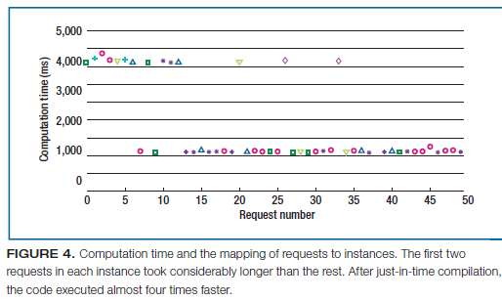
Just-In-Time Compilation

Slide 12
Monte Carlo Simulations
Monte Carlo simulation inscribes a circle into a square and generates ‘p’ uniformly distributed random points in the square, and counts m points that lie in the circle.
So approximate π = 4. m/p
Obtaining consistent measurements from GAE is difficult for two reasons
Programmer has not control on the slave instances
Two identical consecutive requests to the same Web application could execute on completely different hardware in different locations

Slide 13
Simulation
Started the execution of π calculation algorithm first sequentially and then with an increasing number of parallel jobs
A problem of 220 million random points is chosen, which produced a sequential execution time slightly below 30 second limit.
Following metrics are analysed
Computation time – average execution time of run()
Average over-head – difference b/w total execution time and computation time

Slide 14
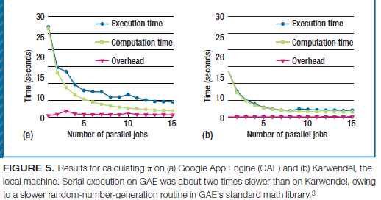
Simulation

Slide 15
Results
On Karwendel, transferring jobs and results incurred almost no overhead, owing to fast local network between slaves and master
Using more than eight parallel jobs generated a load imbalance that deteriorated speed as two jobs are to share same resources
GAE exhibited a constant data transfer and total overhead of approximately 700ms which explains its low speed
This classic scalability analysis method executed for only 30 seconds on relatively small problems
To eliminate this barrier and evaluate GAE’s potential for computing larger problems, Gustafson’s law is applied

Slide 16
Results
Distributed the jobs to 10 GAE slave applications instead of one to gain sufficient quotas
Started initial problem of 180 million random points to avoid exceeding the 30 second limit
Starting with 9 parallel jobs the execution time steadily increased proportionally to the problem size. GAE show similarly good scalability until 10 parallel jobs
The overhead of aborted request caused most irregularities

Slide 17
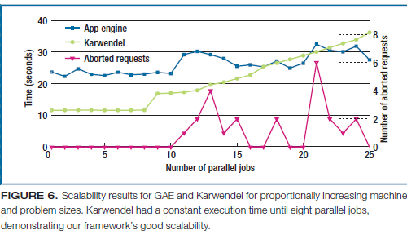
Results

Slide 18
Cost Analysis
Alongside with π approximation authors has implemented three algorithms with different computation and communication complexity.
Matrix multiplication, based on row-wise distribution of the first matrix and full broadcast of the second
Mandelbrot set generation, based on the escape time algorithm
Rank sort, based on each array elements operate rank computation

Slide 19
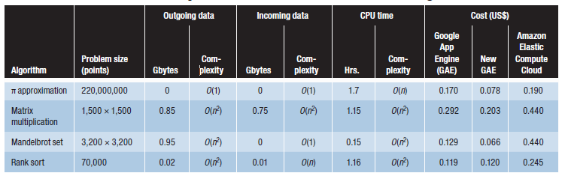
Resource consumption and estimated cost of four algorithms

Slide 20
Related Work in Cloud Performance
Cloud performance is lower than that of traditional scientific computing
Cloud computing is viable alternative when resources are needed instantly and temporarily
Alexandru Iosup and team examined long-term performance variability of GAE and EC2
Christian Vecchiola and team analyzed high-performance computing applications, emphasizing Aneka
Jie Li and team analyzed Windows Azure performance (suited for scientific problems)
MapReduce framework (suited for large-data processing)

Slide 21
Thank you!

