Slide 1


ML-25-26-02 AI-Document-Classification Agent-PlugIn
Semantic embeddings, OCR, and two-stage retrieval for automatic document classification and document-level search.
Information Technology Course
Software Engineering : Dr. Damir Dobric / Andreas Pech
Sneha Mallepalli (1630732)
Sushma Prabhugowda Patil (1628777)

Slide 2

Why This System Is Needed
Organisations produce large volumes of heterogeneous documents: reports, invoices, research papers, emails, and scans.
Keyword-based methods miss context, semantic similarity, and document meaning.
Manual categorisation does not scale, especially across mixed file formats and enterprise volumes.
The goal is to classify content automatically while preserving retrieval precision.

Slide 3


Core Idea: Embeddings Over Keywords
Each document is transformed into a high-dimensional embedding using the OpenAI Embeddings API. Similar documents cluster together in vector space, making cosine similarity a natural way to compare meaning rather than surface words.
Key principle: semantic proximity is more useful than exact term overlap for real-world document management.

Slide 4
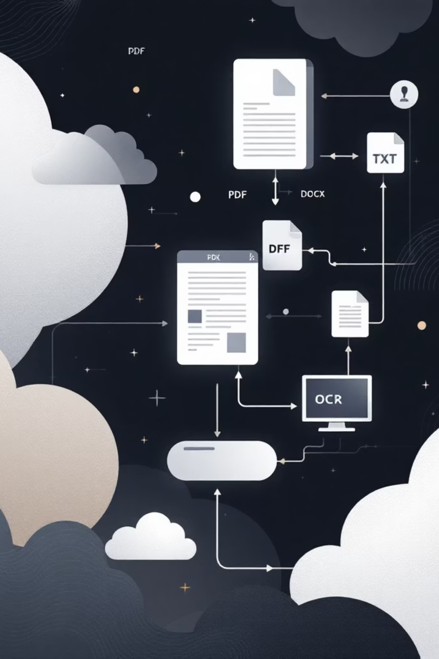
Input Pipeline: Parse, OCR, Normalise
01
02
Parse documents
OCR image files
Daenet Document Parser extracts text from PDF, DOCX, and TXT files.
Tesseract OCR 5.0 processes PNG and JPEG documents using the English language model.
03
Standardise text
Extracted text is passed into a single embedding workflow for uniform downstream handling.

Slide 5

Embedding Build and Centroid Storage
Document text is converted into embeddings and stored in SQL Server as JSON-serialised float arrays. For each class, the system computes a centroid by averaging all document vectors element-wise. These class centroids act as stable semantic prototypes for Stage 1 retrieval.
81 documents across 20 predefined categories
81 embedding records and 20 centroid records
.NET 9.0, Entity Framework Core, C# modular implementation

Slide 6

Two-Stage Semantic Retrieval
Document Ranking
Arranging documents based on their relevance and importance.
Class Selection
The initial phase of choosing the appropriate category.
The query embedding is first matched against all class centroids to identify the best category. The system then narrows the search to documents in that class, improving precision and reducing comparisons from full corpus search to a focused semantic shortlist.

Slide 7
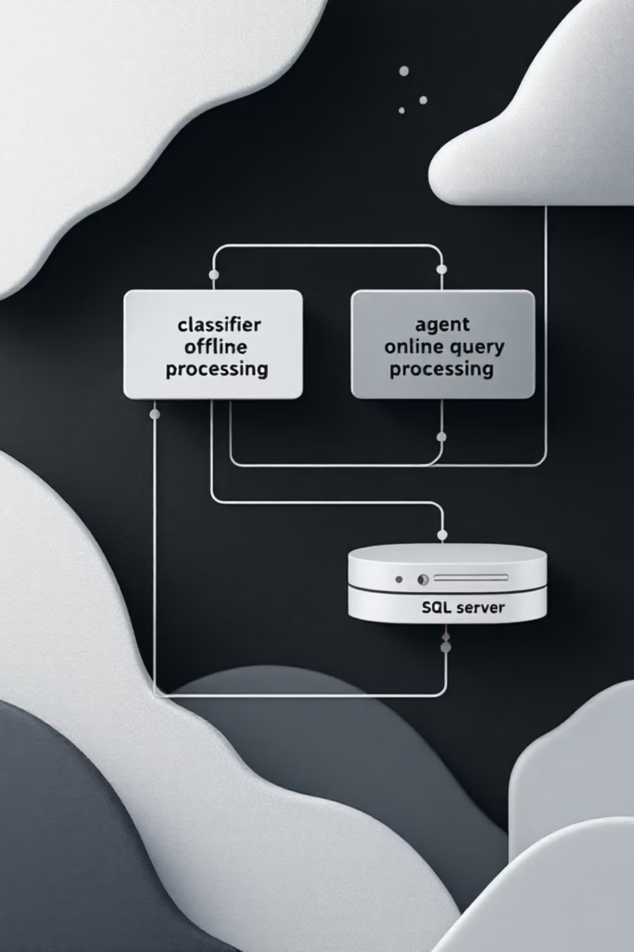
System Architecture
Classifier module
Shared foundation
Handles offline processing: document pre-processing, embedding generation, centroid computation, and persistence.
Both executables use the same SQL Server database through Entity Framework Core and the same cosine similarity logic.
Agent module
Design benefit
Handles interactive queries: intent embedding, similarity matching, result formatting, and startup modes.
Clear separation improves maintainability, extensibility, and testing.

Slide 8
Implementation Stack
C# / .NET 9.0
Application runtime and solution structure
SQL Server
Relational storage for documents, embeddings, and centroids
OpenAI Embeddings API
Semantic vector generation for documents and queries
Daenet Parser + Tesseract OCR
Text extraction across machine-readable and scanned files
xUnit + Moq + Spectre.Console
Testing, mocking, and interactive console experience

Slide 9
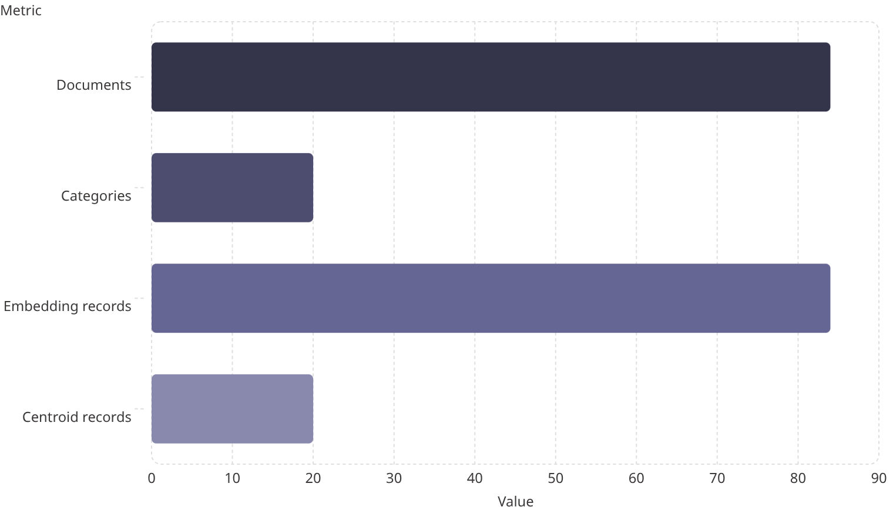
Evaluation Highlights
Representative queries were classified correctly across science, climate, energy, education, history, and space-related content. Image-based input also succeeded after OCR extraction.
81
Observed scores
20
Class similarity: 0.1662 to 0.4728
Document similarity: up to 0.4996
Best OCR case: History.png → GermanHistory
81
20

Slide 10

Conclusion and Future Work
The system shows that embedding-based semantic retrieval with precomputed class centroids is effective, accurate, and extensible for modern document classification. It handles heterogeneous formats, supports OCR, and performs focused retrieval with a modular .NET architecture.
Vector database integration for scale and lower latency
Retrieval-Augmented Generation for natural language answers
Real-time ingestion and REST or web access
Improved disambiguation for short or name-based queries

Slide 11
Thank You!

