Slide 1
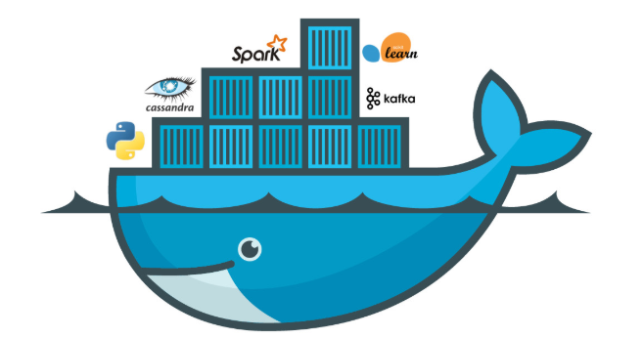
Docker
By-
Anuj Singh

Slide 2
Content
What is need of Docker
What is Docker
Feature of Docker
How Docker works
Difference b/w Docker Vs Virtual Machine Architecture
Basic Steps to write Dockerfile
Basic Docker Commands
Demo
Q & A

Slide 3
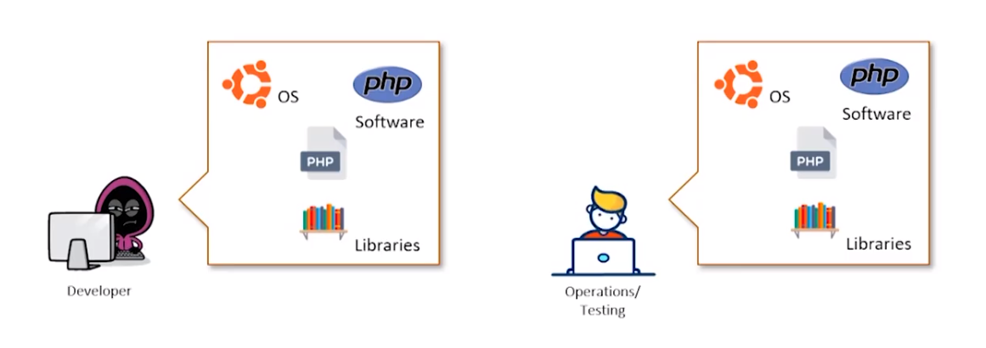
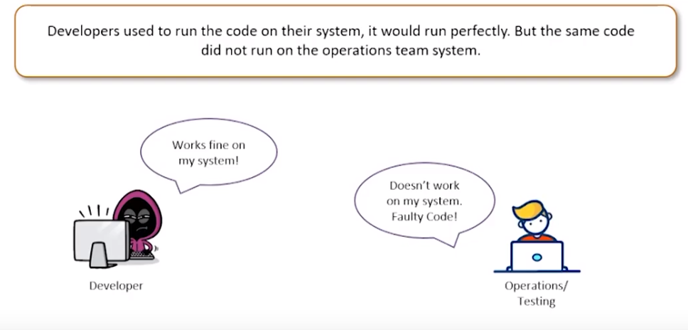
What is need of Docker
Imagine you are Developer, and you are creating a website in PHP

Slide 4
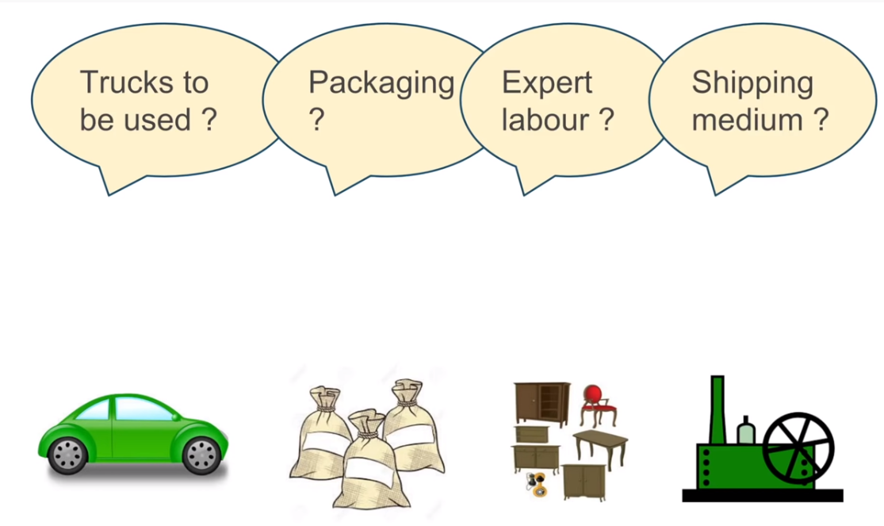
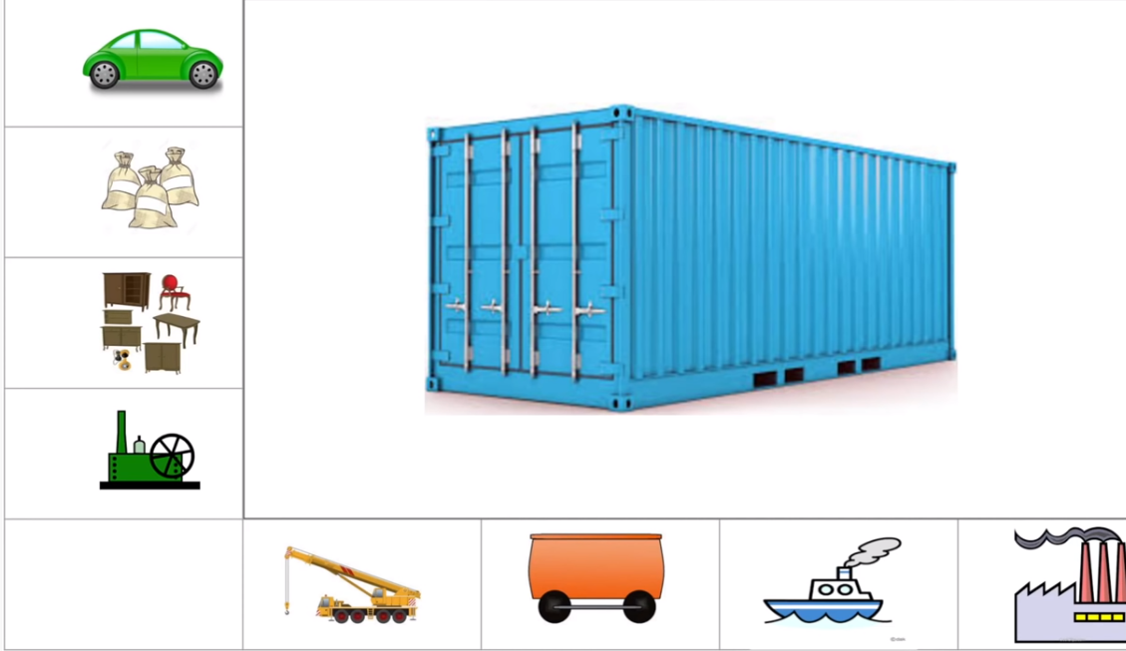
Classical problem in Shipping Industry
How to transport different goods having different size, shape and requirements
Container

Slide 5
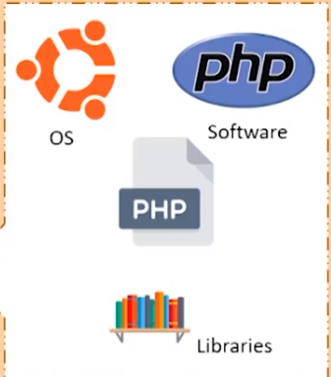
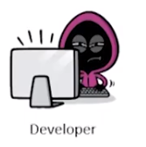
We need an entity that can
‘contain’ all the software dependencies, and can be ported on to other computers as plug & play package
Answer for problem

Slide 6
What is Docker ?
Docker makes the process of application deployment very easy and efficient and resolves a lot of issues related to deploying Applications.
Feature of Docker
1. Open Source Project
2. Docker is “Develop, Ship and Run application ,Anywhere
3. Allow fast deployment and testing
4. Light weighted

Slide 7
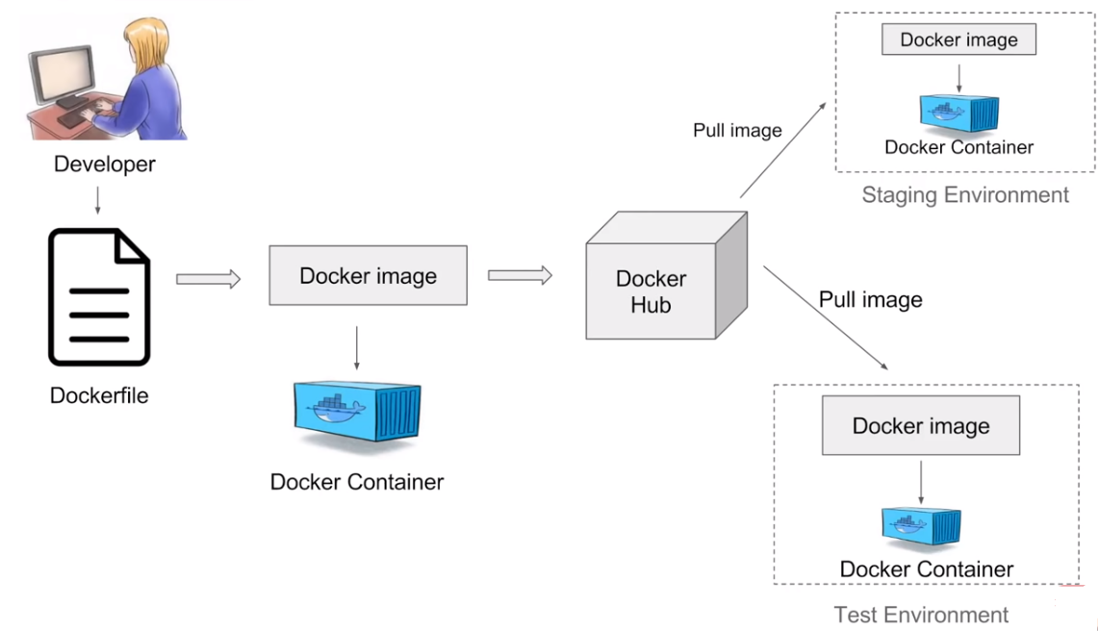
How Docker works

Slide 8
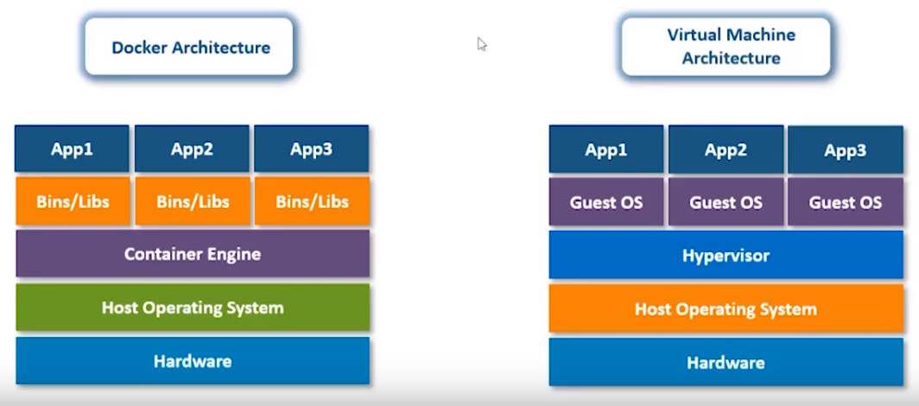
Difference b/w Docker vs Virtual Machine Architecture

Slide 9
Basic Steps to write Dockerfile
FROM - Specifies the base image that the Dockerfile will use to build a new image.
MAINTAINER - Specifies the Dockerfile Author Name and his/her email.
ARG – Its similar to declaration of variable in JAVA.
ENV - Sets the environment variables. For this post, JAVA_HOME is the variable that is set.
RUN - Runs any UNIX command to build the image.
ADD - This instruction copies the new files, directories into the Docker container file system at specified destination.
CMD - Provides the facility to run commands at the start of container. This can be overridden upon executing the docker run command.
COPY- Copy any file
WORKDIR – From which path want start work

Slide 10
Example to write Dockerfile
FROM ubuntu:18.04
RUN apt-get update && \
apt-get install -y \
openjdk-8-jre \
-qqy x11-apps
ENV DISPLAY :0
ENV RESOLUTION 1366x768x24
ADD apache-jmeter-5.1.1.tgz /home
CMD `sed -i -e '/^assistive_technologies=/s/^/#/' /etc/java-*-openjdk/accessibility.properties`

Slide 11
Basics Docker Commands
Basic > docker version > docker –version > docker info > docker –help Images > docker images > docker pull > docker rmi Container > docker ps > docker run > docker start > docker stop

Slide 12
dockerfile
FROM alpine:3.9
MAINTAINER Just van den Broecke<just@justobjects.nl>
ARG JMETER_VERSION="5.1.1"
ENV JMETER_HOME /opt/apache-jmeter-${JMETER_VERSION}
ENV JMETER_BIN ${JMETER_HOME}/bin
ENV JMETER_DOWNLOAD_URL https://archive.apache.org/dist/jmeter/binaries/apache-jmeter-${JMETER_VERSION}.tgz
RUN apk update \
&& apk upgrade \
&& apk add ca-certificates \
&& update-ca-certificates \
&& apk add --update openjdk8-jre tzdata curl unzip bash \
&& apk add --no-cache nss \
&& rm -rf /var/cache/apk/* \
&& mkdir -p /tmp/dependencies \
&& curl -L --silent ${JMETER_DOWNLOAD_URL} > /tmp/dependencies/apache-jmeter-${JMETER_VERSION}.tgz \
&& mkdir -p /opt \
&& tar -xzf /tmp/dependencies/apache-jmeter-${JMETER_VERSION}.tgz -C /opt \
&& rm -rf /tmp/dependencies
# Set global PATH such that "jmeter" command is found
ENV PATH $PATH:$JMETER_BIN
# Entrypoint has same signature as "jmeter" command
COPY entrypoint.sh /
WORKDIR ${JMETER_HOME}
ENTRYPOINT ["/entrypoint.sh"]

Slide 13
build.sh
#!/bin/bash
JMETER_VERSION="5.1.1"
# Example build line
# --build-arg IMAGE_TIMEZONE="Europe/Amsterdam"
sudo docker build --build-arg JMETER_VERSION=${JMETER_VERSION} -t "justb4/jmeter:${JMETER_VERSION}"

Slide 14
run.sh
#!/bin/bash
#
# Run JMeter Docker image with options
NAME="jmeter"
IMAGE="justb4/jmeter:5.1.1"
# Finally run
sudo docker stop ${NAME} > /dev/null 2>&1
sudo docker rm ${NAME} > /dev/null 2>&1
sudo docker run --name ${NAME} -i -v ${PWD}:${PWD} -w ${PWD} ${IMAGE} $@

Slide 15
Test.sh
#!/bin/bash
#
# Test the JMeter Docker image using a trivial test plan.
# Example for using User Defined Variables with JMeter
# These will be substituted in JMX test script
# See also: http://stackoverflow.com/questions/14317715/jmeter-changing-user-defined-variables-from-command-line
export TARGET_HOST="www.map5.nl"
export TARGET_PORT="80"
export TARGET_PATH="/kaarten.html"
export TARGET_KEYWORD="Kaartdiensten"
T_DIR=tests/trivial
# Reporting dir: start fresh
R_DIR=${T_DIR}/report
rm -rf ${R_DIR} > /dev/null 2>&1
mkdir -p ${R_DIR}
/bin/rm -f ${T_DIR}/test-plan.jtl ${T_DIR}/jmeter.log > /dev/null 2>&1
./run.sh -Dlog_level.jmeter=DEBUG \
-JTARGET_HOST=${TARGET_HOST} -JTARGET_PORT=${TARGET_PORT} \
-JTARGET_PATH=${TARGET_PATH} -JTARGET_KEYWORD=${TARGET_KEYWORD} \
-n -t ${T_DIR}/test-plan.jmx -l ${T_DIR}/test-plan.jtl -j ${T_DIR}/jmeter.log \
-e -o ${R_DIR}
echo "==== jmeter.log ===="
cat ${T_DIR}/jmeter.log
echo "==== Raw Test Report ===="
cat ${T_DIR}/test-plan.jtl
echo "==== HTML Test Report ===="
echo "See HTML test report in ${R_DIR}/index.html"

Slide 16
Demo of Docker

Slide 17
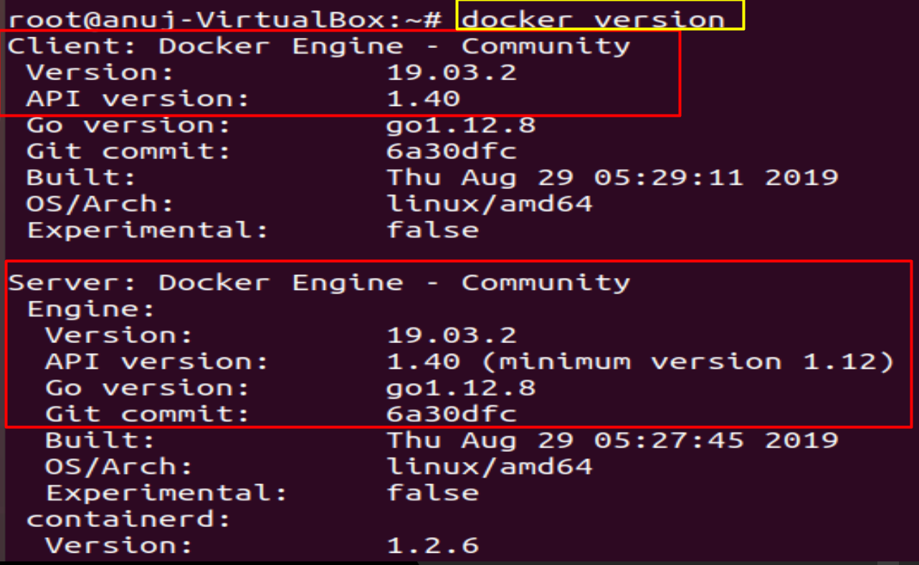
docker version

Slide 18
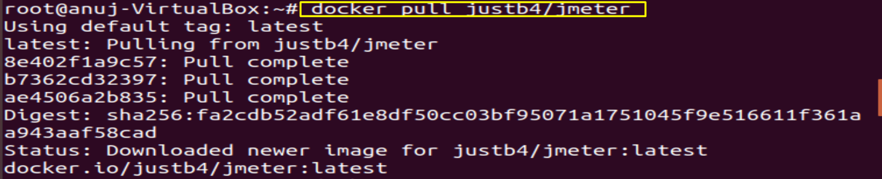
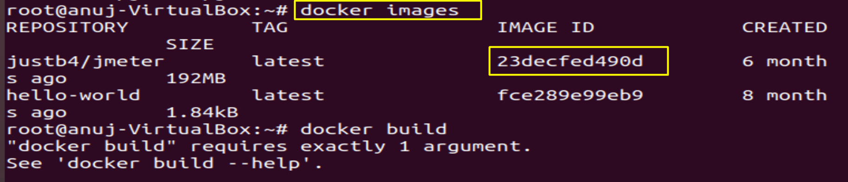
docker pull imagename- It will pull the image
docker images –It will show all images

Slide 19
1. Clone project from GitHub repository or any other git clone https://github.com/justb4/docker-jmeter.git 2. Run the Build script to download dependencies ./build.sh 3. Run the test script ./test.sh 4. Navigate into the report folder and open the index.html file to pop up a browser window displaying the run report. cd report open index.html
Step to execute script

Slide 20
What can we get info from execution
1.Save test result/report in folder
2.Type of Error Graphs
3.Response time
4.Logs
5.Server Utilization Graphs

Slide 21
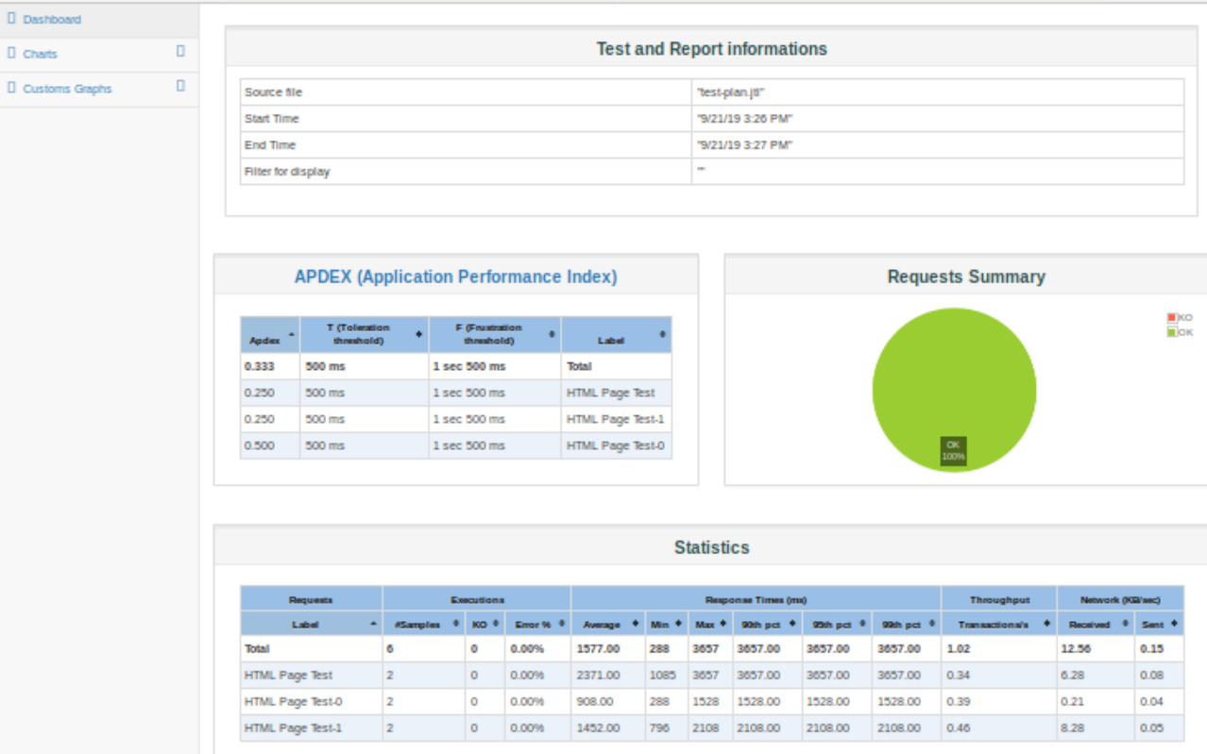
Test Result Report

Slide 22
Q & A

Slide 23
Thank you

