Slide 1

Amazon Sales Data Analysis
Created By: Sushma R

Slide 2

Project Goal
The objective of this analysis is to explore the Amazon Sales Dataset and gain deep insights into product ratings and reviews, exploring the various factors that influence sales.

Slide 3


Data Set Summary
The Amazon Sales Dataset has 1K+ Amazon product
This dataset contains information about Amazon products, ratings, and reviews, reflecting customer feedback and experiences.
The dataset consists of 1465 rows and 16 columns.
....

Slide 4
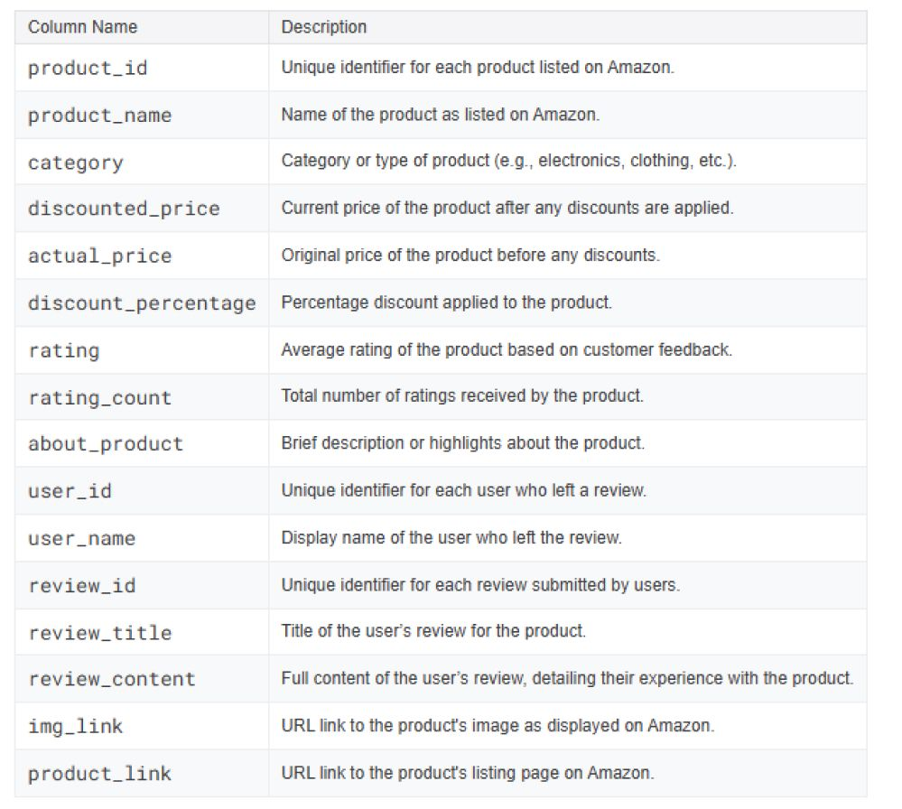
Dataset Columns

Slide 5





Approach & Methodology

Slide 6
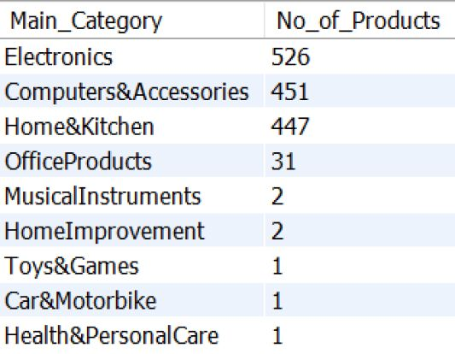


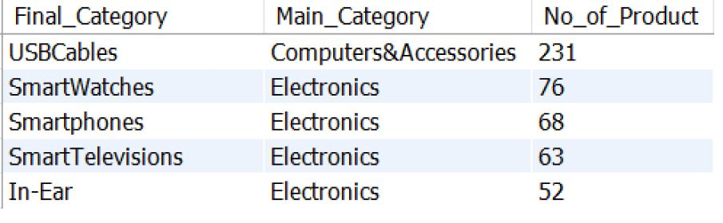


Display the Products count By Category
Distribution of product count by main category
Select distinct Main_Category , count(product_id) as No_of_Products FROM amazon.product group by Main_Category order by No_of_Products DESC;
Distribution of product count by Final category
Select distinct Main_Category , count(product_id) as No_of_Products FROM amazon.product group by Main_Category order by No_of_Products DESC;

Slide 7




Observation
The Electronics and Computers & Accessories categories have strong consumer preference on technology-related products.
For Computers & Accessories, USB Cables significantly contribute to the overall count.
Within the Electronics category, multiple subcategories contribute to the total product count like smart watches, smartphones, smart televisions, In-ear etc.
Categories like Health & Personal Care and Home Improvement have minimal product sales suggesting a lack of demand.
Musical Instrument, Home Improvement, Toys & Games, Car and Motorbike, Health & Personal Care has very less Product Count indicating either the Demand for these products are less or Lacks of Ads for these products
The data can help businesses identify the most popular subcategories and adjust their product offerings to meet customer demand. By focusing on these subcategories, businesses could increase their sales and improve their competitiveness in the market.

Slide 8
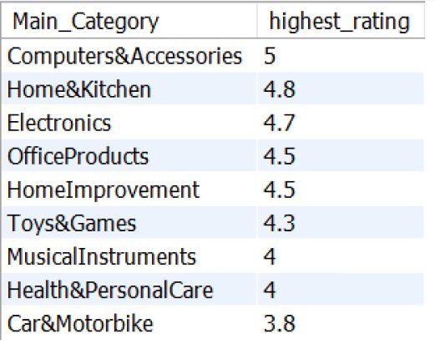



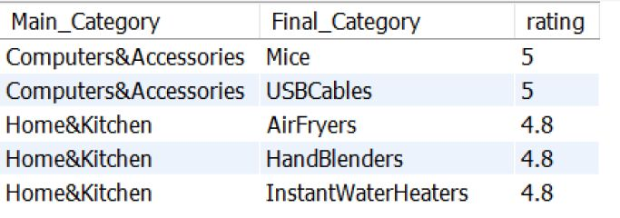

Top-Rated Categories
Distribution of Top-Rated Main Categories
select distinct Main_Category, max(rating) as highest_rating FROM amazon.product group by Main_Category Order by highest_rating Desc Limit 10;
Distribution of Top-Rated Final category
select Main_Category ,Final_Category, rating FROM amazon.product group by Main_Category ,Final_Category, rating, Order by Rating Desc Limit 5;

Slide 9

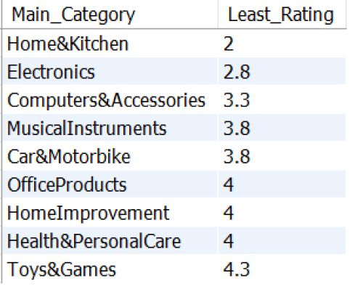

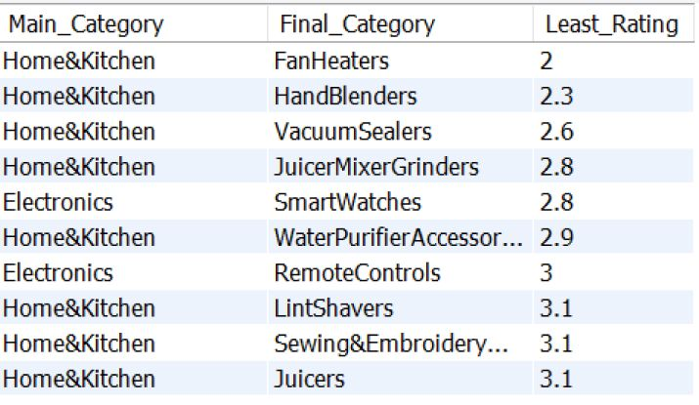


Least-Rated Categories
Distribution of Low-Rated Categories (Main Categories)
SELECT Main_Category, MIN(rating) AS Least_Rating FROM amazon.product GROUP BY Main_Category ORDER BY Least_Rating ASC LIMIT 10
Distribution of Low-Rated Categories (final Categories)
SELECT Main_Category,Final_Category, MIN(rating) AS Least_Rating FROM amazon.product GROUP BY Main_Category, Final_Category ORDER BY Least_Rating ASC LIMIT 10;

Slide 10

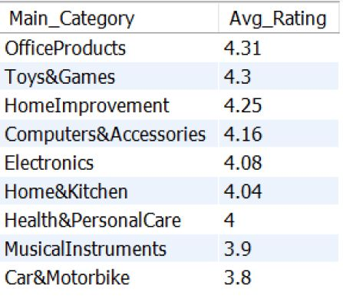
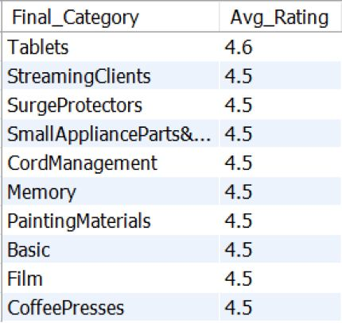

Average-Rated Categories
Distribution of Avg-Rated Main Categories
select distinct Main_Category, round(avg(rating),2) as Avg_Rating FROM amazon.product group by Main_Category Order by Avg_Rating Desc Limit 10;
Distribution of Avg-Rated Final category
select distinct Final_Category, round(avg(rating),2) as Avg_Rating FROM amazon.product group by Final_Category order by Avg_Rating Desc Limit 10

Slide 11

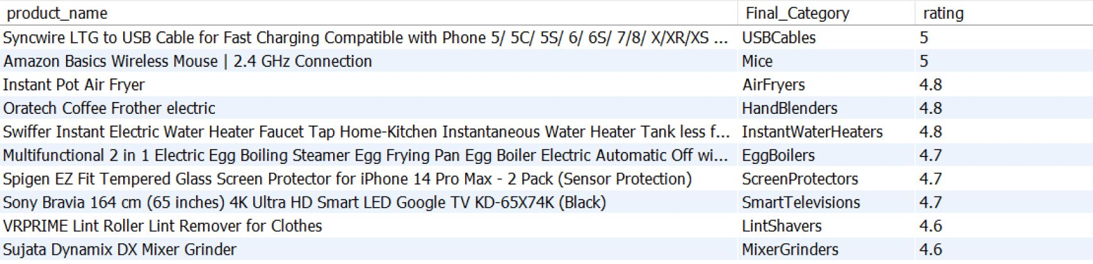
Top-Rated Products Across Categories
with RANKING AS (select SUBSTRING_INDEX(product_name, ",", 1) AS Product_name, Final_Category, -- Shortening the Product name row_number() over (Partition by Final_Category order by rating DESC) AS Ranking , rating FROM amazon.product) SELECT product_name, Final_Category, rating FROM RANKING WHERE Ranking = 1 ORDER BY rating DESC Limit 10;

Slide 12
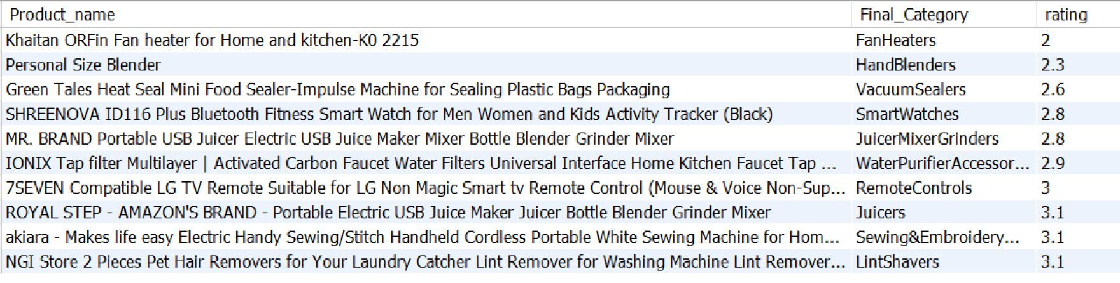
Low-Rated Products Across Categories
WITH RANKING AS (select SUBSTRING_INDEX(product_name, "," , 1) AS Product_name, Final_Category, rating, row_number() over(partition by Final_Category order by Rating ASC) AS Ranking FROM amazon.product ) SELECT Product_name, Final_Category, rating FROM RANKING WHERE Ranking = 1 ORDER BY rating ASC LIMIT 10;

Slide 13
Observation
Computers & Accessories, Home & Kitchen, and Electronics have the highest ratings, with a maximum rating of 5 for Computers & Accessories which indicates that these categories are popular and well-liked by customers who purchase them
Subcategories like Mice and USBCables under Computers & Accessories received the highest ratings of 5. It indicates that these categories are popular and well-liked by customers who purchase them
Air Fryers, Hand Blenders, and Instant Water Heaters under Home & Kitchen are highly rated with a score of 4.8.
Fan Heaters, Hand Blenders, and Instant Water Heaters under Home & Kitchen with the minimum rating of 2. Products in the Hand Blenders subcategory display a wide range of ratings, from high (4.8) to low (2)
The main categories with the highest avg ratings are Office Products, Toys & Games, and Home Improvement, with ratings above 4.0.This suggests that customers are generally satisfied with the products offered in these categories. Other category with low rating indicate improvements could be made to better meet customer expectations.
Overall insight can help businesses make informed decisions to improve their offerings and satisfy their customers.

Slide 14

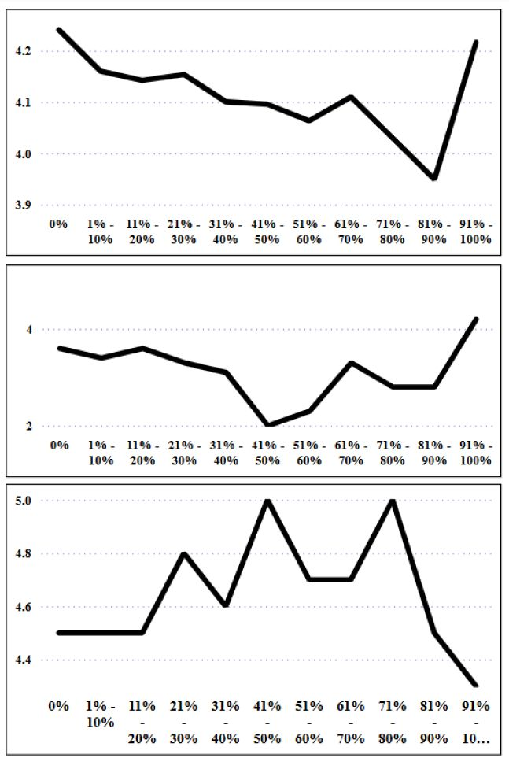




Rating Trend by discounted %
Observation
Average Rating by Discounted %: The average rating slightly decline as the discount percentage increases, especially between 41%-70% discounts. A sharp spike in average ratings is seen for products in the 91%-100% discount range.
Avg Rating by discounted%
1
Lowest Rating by Discounted %: The lowest ratings remain consistent between 0%-60% discounts, but there is a visible dip around the 41%-60% discount range and increase at the 91%-100% discount range.
2
Lowest Rating by discounted%
Highest Rating by Discounted %: The highest ratings remain stable around 4.5-5 up to a 70% discount. Ratings drop beyond 71%-90% discounts, but spike back at the 91%-100% discount range.
3
Highest Rating by discounted%

Slide 15


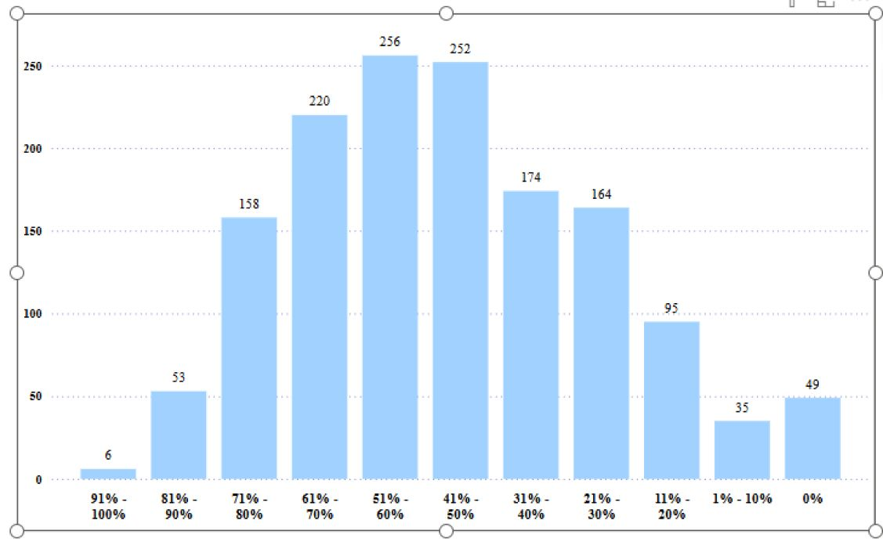


Observation
Product Distribution by Discount %
The 51%-60% discount range has the highest number of products (256), followed closely by the 41%-50% discount range (252).
The number of products decreases for both extreme discounts (91%-100%) and low discounts (1%-10%).
The least number of products (6) falls in the 91%-100% discount range.
Discounts between 31%-70% dominate, having majority of the products.
Discounts in the 0%-20% range account for fewer products compared to the middle discount tiers.

Slide 16


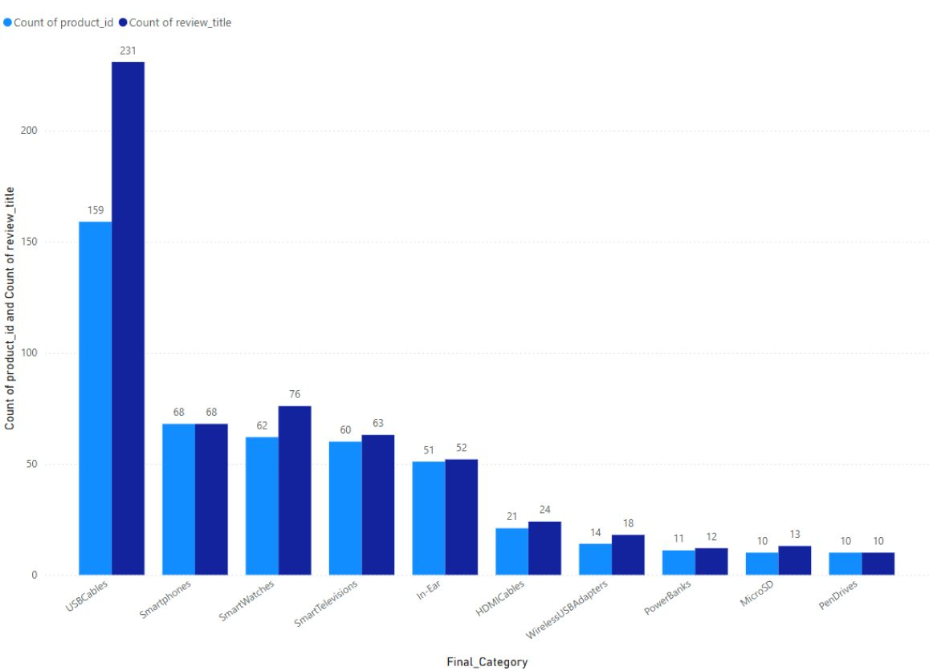

Observation
Product # and Reviews based on category
USB Cables have the highest count of both products and reviews,
other categories (Smart Televisions, In-Ear, HDMI Cables, Wireless USB Adapters, Power Banks, MicroSD, Pen Drives) have relatively low review

Slide 17

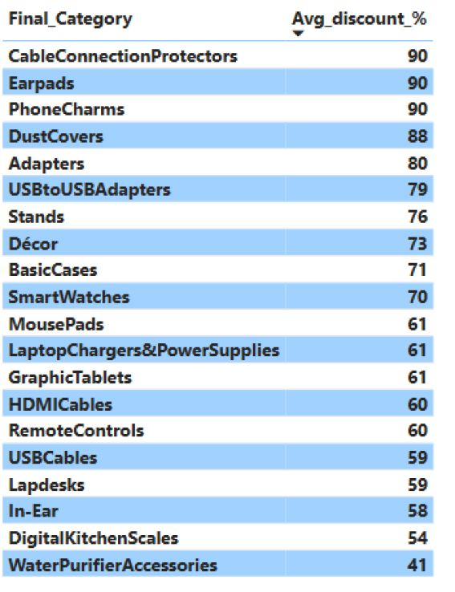
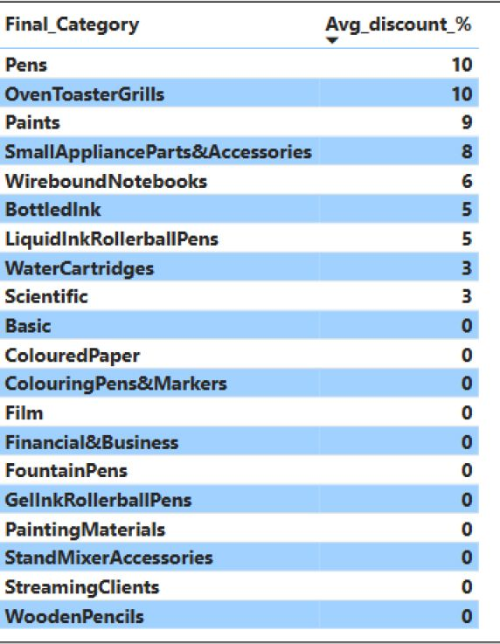


Observation
Highest & lowest Discount on category
Cable Connection Protectors, Earpads, and Phone Charms have the highest discounts (90%).
Dust Covers, Adapters, and USB to USB Adapters, also receive significant discounts (above 75%).
Smartwatches, HDMI Cables, Remote Controls, and USB Cables receive moderate discounts.
Pens, Oven Toaster Grills, and Small Appliance Parts have very low discounts.
Painting Materials, Streaming Clients, and Wooden Pencils, receive no discounts at all, suggesting either they do not need to be discounted heavily to attract buyers. or lack of demand for the products.

Slide 18
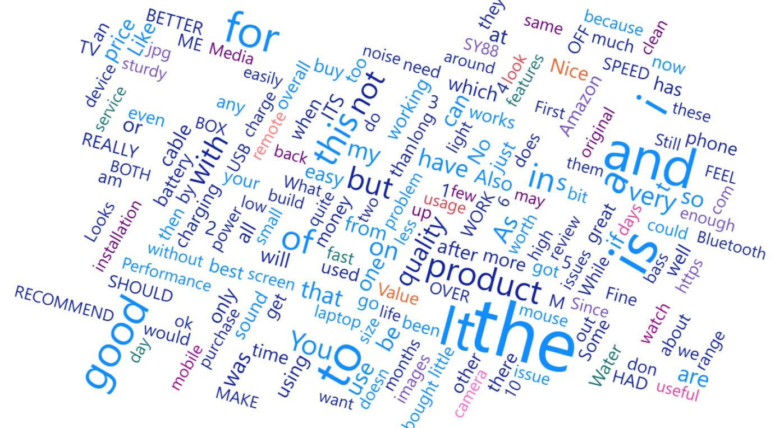
Review Content
This can provide insights into the overall sentiment of the customers

Slide 19
Power BI Dashboard

Slide 20
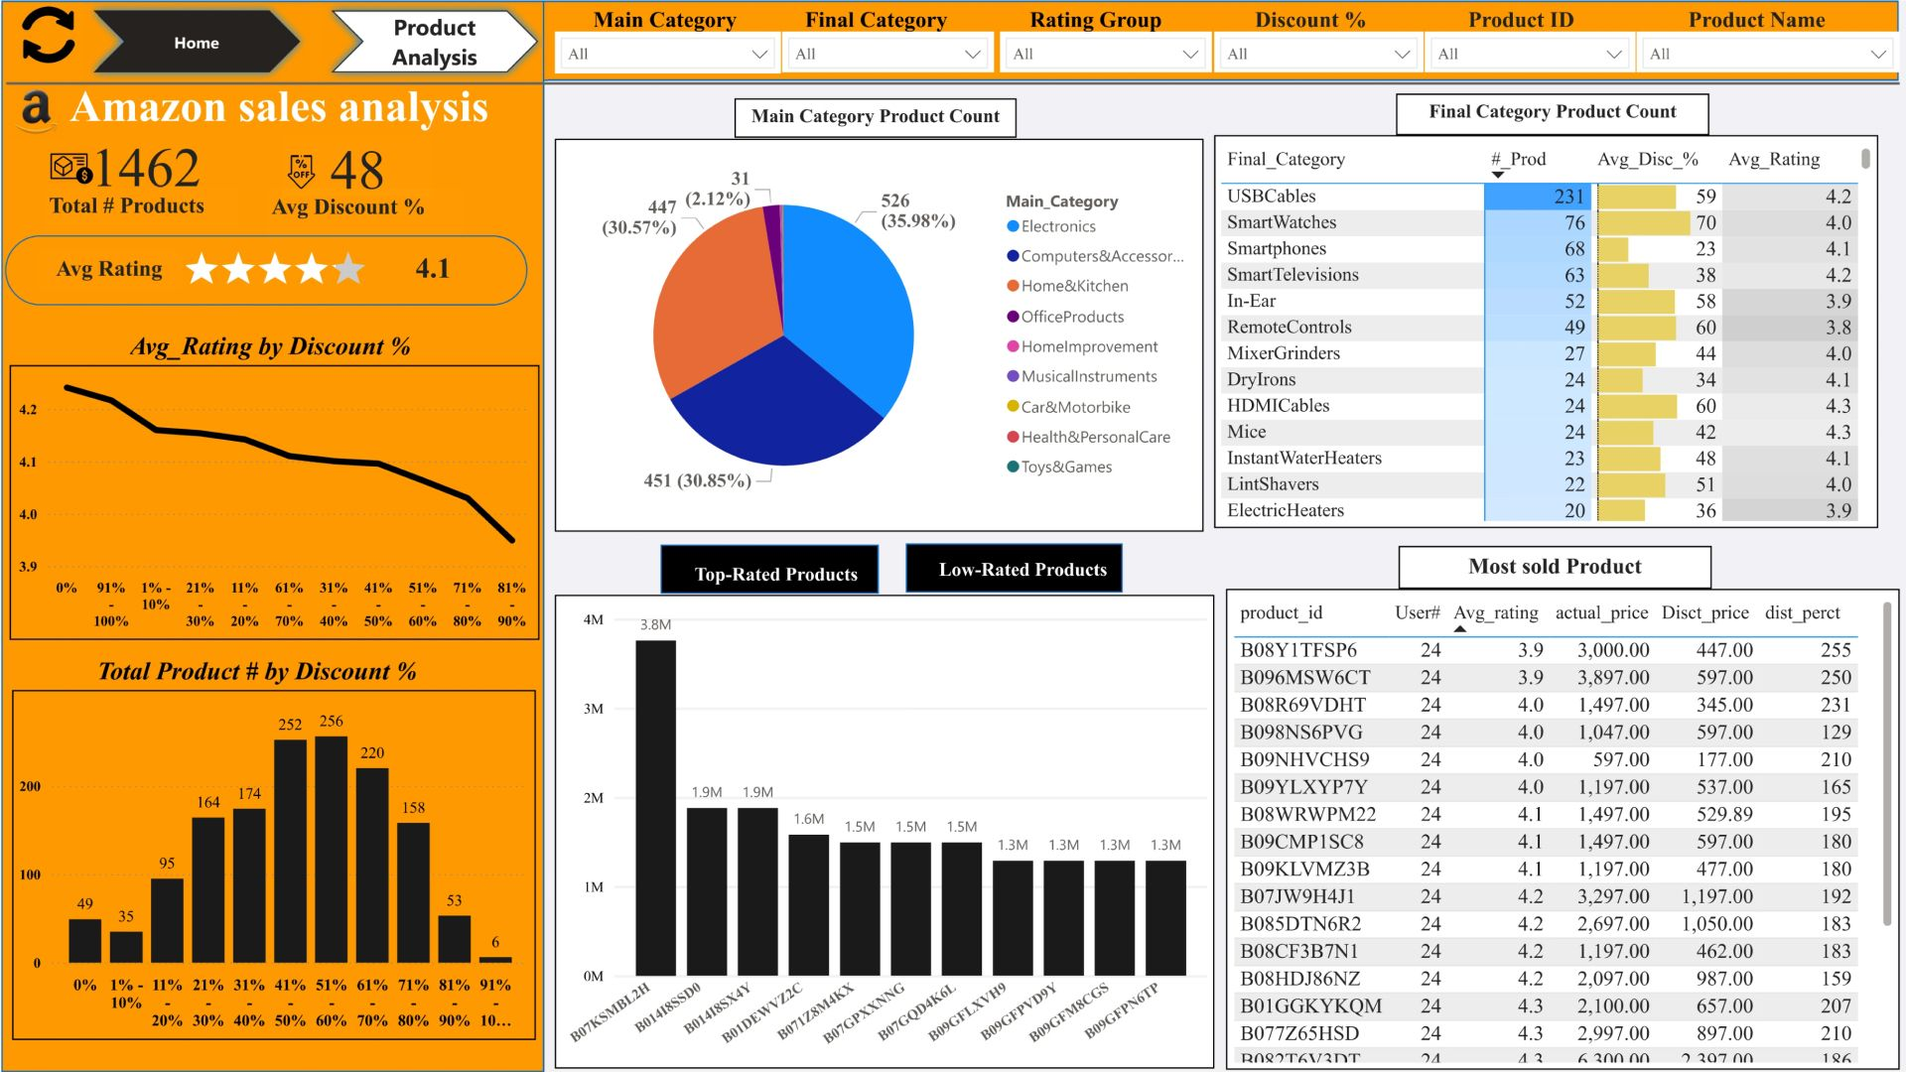

Slide 21
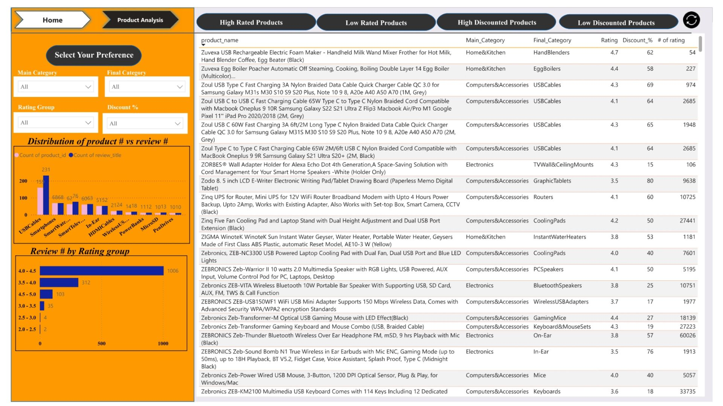

Slide 22
Thank you
Sushma R | Business Analyst
LinkedIn: https://www.linkedin.com/in/sushma-raj/
GitHub: https://github.com/SushmaRaj012?tab=repositories

