Slide 1
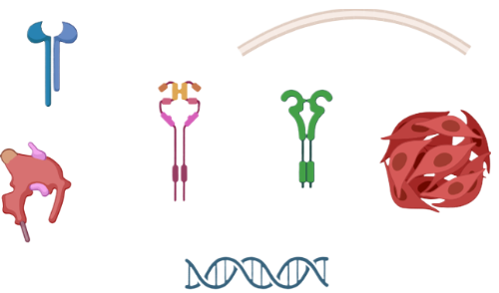
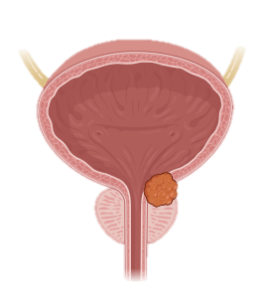
PI3K/AKT/mTOR Pathway
RAS/RAF/MEK/MAPK Cascade
Cell survival
BLADDER
CANCER
Metabolic reprogramming
RAS
MEK
PI3K
Snail/S
IL-6/IL-8
Cancer Stemness
MAPK
AKT
RTK crosstalk
mTOR
Therapeutic resistance
Androgen Receptor (AR)
AR
Wnt/β-Catenin Signalling
CCND1, MYC transcription
FGFR3 Transcription
Chemoresistance
Cancer stemness

