Slide 1
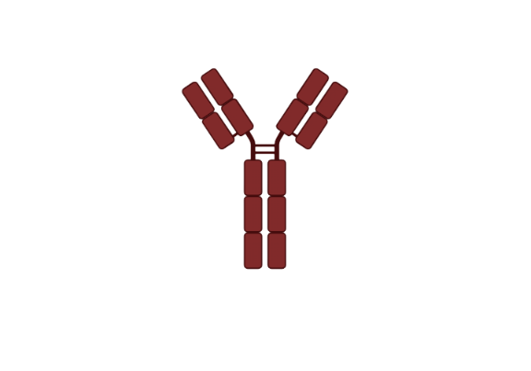
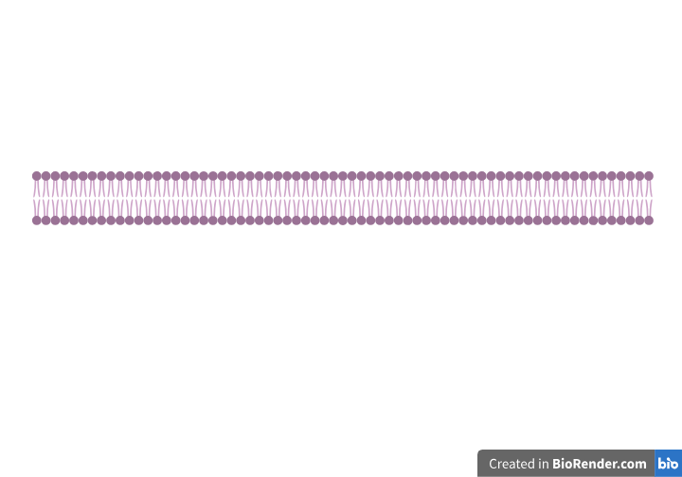
EGFR
ER
HER2
IGF-1R
Estrogen
JAK
RAS
RAF
STAT
RAS
STAT
GRB2
PIP3
SRC
AKT
PIP3
SRC
Cell Survival
mTOR
Apoptosis
Cell Proliferation
Angiogenesis

