Slide 1


Diamond security system in museums with loud 60db siren
Under the Guidance of
Mr.Md.Feroz
(Assistant Professor)
Sreyas Institute of Engineering and Technology
An Autonomous Institution
Approved by AICTE, Affiliated to JNTUH
Accredited by NAAC-A Grade, NBA (CSE, ECE & ME) & ISO 9001:2015 Certified
DEPARTMENT OF ELECTRONICS & COMMUNICATION ENGINEERING
Presented by Batch A-13:
A.HAARIKA(22VE1A0402)
B.SUSHMA SREE (22VE1A0404)
D.BALADITYA (22VE1A0417)
Title of the Topic

Slide 2
Abstract
This project presents a diamond security system designed for museums to protect valuable exhibits. It uses infrared sensors to detect unauthorized movement near the secured area. On detection, a 60dB loud siren is triggered to alert security personnel and deter intruders. The system is controlled by a microcontroller for quick and reliable response. It provides non-intrusive and continuous monitoring without affecting the museum’s environment. The design is compact, energy-efficient, and easy to install. It enhances exhibit safety while keeping operational costs low. This system can be adapted for other high-value security applications as well.

Slide 3
Components Utilized
Arduino UNO(DIP) - 1
12v adapter-1
5v relay module -1
Siren- 1
LCD -1
I2C module -1
LASER-1
LDR SENSOR MODULE-1

Slide 4
Plank-1
Male to female jumpers - 15
Female to female jumpers - 5
7805 regulator -1
Title of the Project

Slide 5
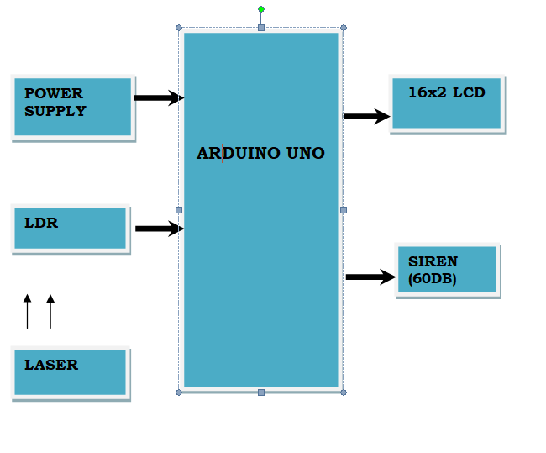
Block Diagram

Slide 6
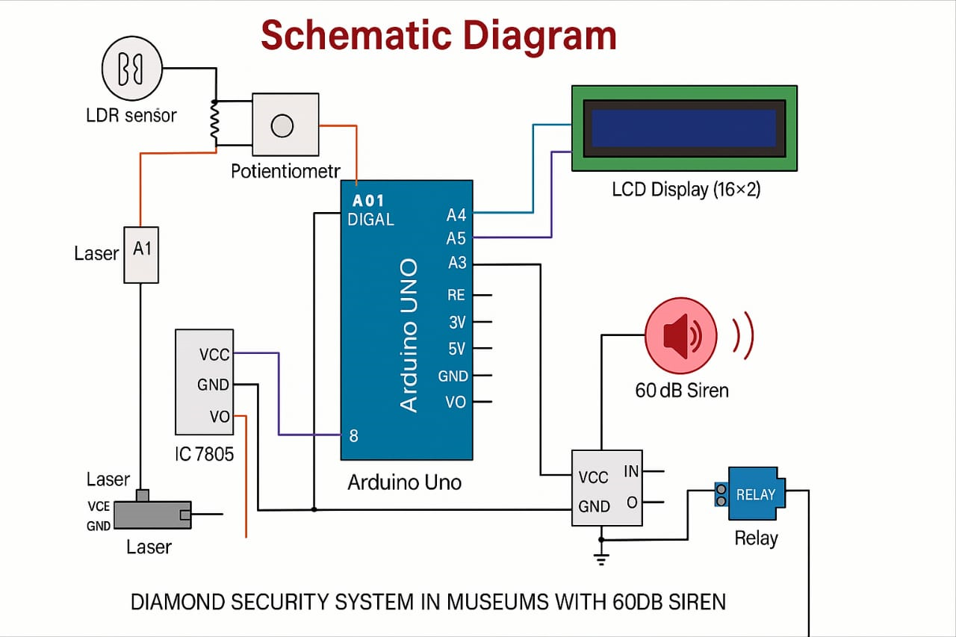
Schematic Diagram (Pin Level Interfacing of Components with the Controller)
Title of the Project

Slide 7
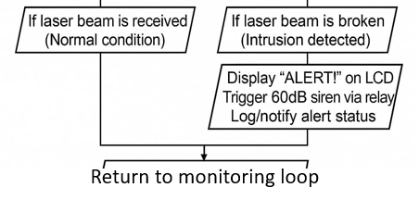
Flow Chart
START
INITIALISE SYSTEM
CHECK LDR SENSOROR
YES
NO
Title of the Project

Slide 8
Introduction
Museums preserve and display priceless artifacts, including diamonds, which are highly susceptible to theft or unauthorized handling.
Ensuring their protection is critical, but traditional security systems are often expensive, bulky, or complex to operate. This project aims to design a cost-effective and reliable security system specifically for museums.
The system uses infrared (IR) sensors to detect any unauthorized movement near the secured object. Upon detection, a 60dB siren is activated to alert the authorities and deter intruders instantly. It is compact, energy-efficient, and can be integrated into various display setups.

Slide 9
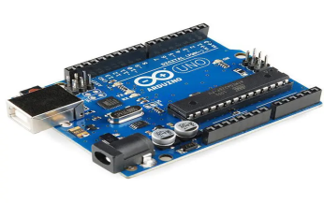
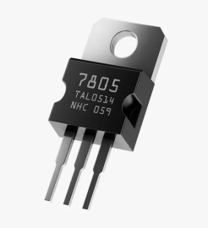

Specifications of the Components
1. Arduino UNO (DIP)
Type: Microcontroller Board (ATmega328P)
Function: Acts as the brain of the system. It reads the LDR sensor's values and processes logic to trigger the siren and display alerts on the LCD.
Role: Takes analog input from the LDR, controls the relay module, and sends messages to the LCD.
2. 7805 Voltage Regulator
Type: Linear Voltage Regulator (12V to 5V)
Function: Converts 12V input to a stable 5V output for safe operation of Arduino and sensors.
Role: Prevents overvoltage damage to 5V components like Arduino, relay, and LDR module.
4. 5V Relay Module
Function: Acts as an electronic switch to control high-power devices using a low-power signal.
Role: Arduino signals the relay to close the circuit and power ON the siren when an intrusion is detected.
Title of the Project

Slide 10
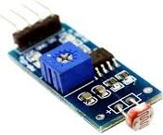

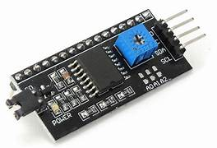
4.LDR Sensor Module
Type: Light-Dependent Resistor
Function: Detects light intensity changes.
Role: When the laser beam is blocked, light falling on LDR drops → resistance changes → analog signal to Arduino changes → triggers alert.
5. Laser Module
Type: Light Source (Red Laser)
Function: Continuously emits a narrow laser beam towards the LDR.
Role: Acts as the invisible tripwire; any obstruction triggers a drop in LDR reading, signaling a breach.
6. I2C module:
Function: The I2C (Inter-Integrated Circuit) module enables communication between the microcontroller and multiple
peripherals using just two wires (SDA and SCL).

Slide 11
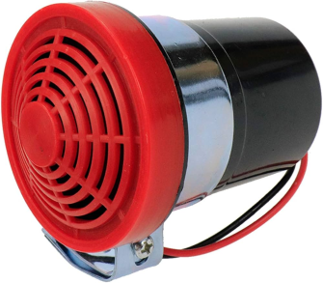

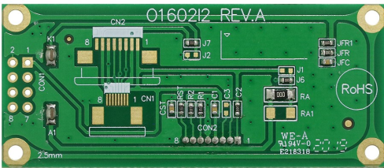
7. Siren (60dB)
Type: Buzzer/Sound Alarm
Function: Produces a loud audible alert (60 decibels).
Role: Activated by the relay when the laser beam is interrupted, warning security personnel of possible theft.
8. LCD (16x2) with I2C Module
Type: Display Unit
Function: Shows messages like "System Active", "Intrusion Detected".
Role: Gives real-time visual feedback based on the sensor data processed by the Arduino.
9. LCD PCB
Type: Custom circuit board
Function: Mounts and connects the LCD and I2C module neatly.
Role: Supports cleaner wiring and easy integration of the display into the prototype.

Slide 12
Working mechanism
1. System Power-On:The system is powered using a 12V adapter. A 7805 voltage regulator is used to convert this voltage down to 5V to safely power the Arduino and all connected components. Once powered, the Arduino starts running the programmed logic.
2. Laser and LDR Alignment:A laser module is fixed to continuously shine a light beam onto the LDR sensor. As long as the beam is uninterrupted, the LDR detects constant light and sends a stable analog value to the Arduino.
3. Monitoring Phase:The Arduino constantly monitors the LDR’s analog values. If the light intensity remains above a set threshold, the system remains in standby mode, indicating no intrusion.
4. Intrusion Detection:If someone or something interrupts the laser beam, the light on the LDR drops suddenly.
Title of the Project

Slide 13
This change in light causes a voltage variation, which the Arduino detects as a potential intrusion.
5. Triggering the Alarm:Once an intrusion is detected, the Arduino sends a HIGH signal to the relay module. The relay activates the 60dB siren, which produces a loud alert to warn nearby staff or guards.
6. Display Alert:Alongside the siren, the Arduino also updates the LCD display with a warning message such as “Intrusion Detected!”. This helps in identifying the trigger event quickly on the spot.
7. System Reset:After the situation is handled, the laser beam is realigned and the system returns to normal. The Arduino resumes monitoring and the siren can be reset either automatically or manually.

Slide 14
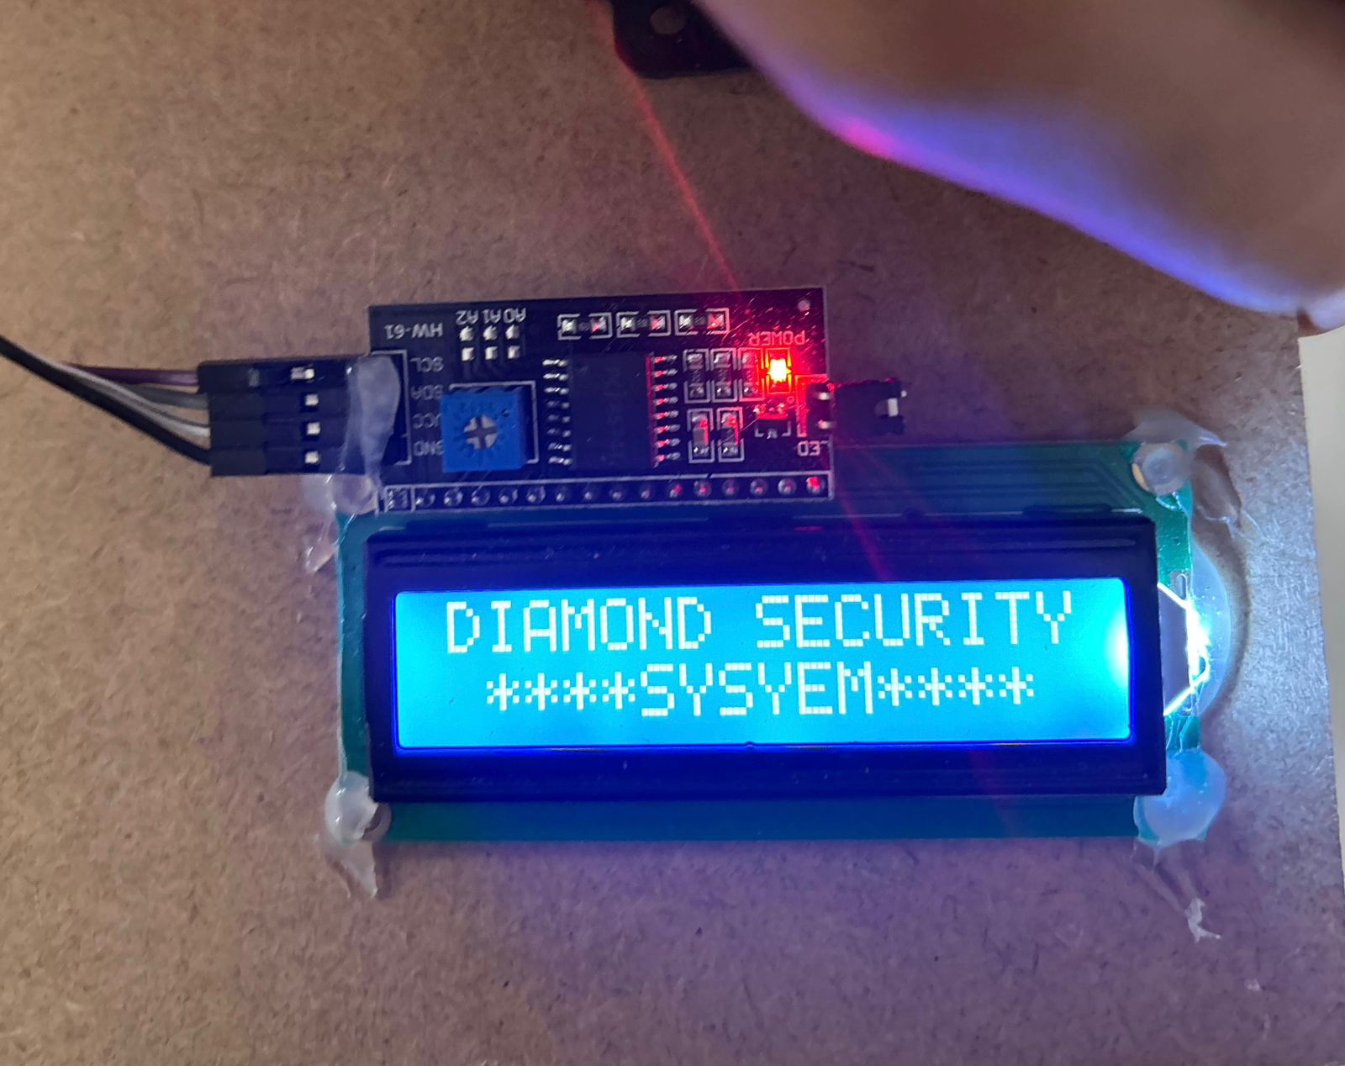
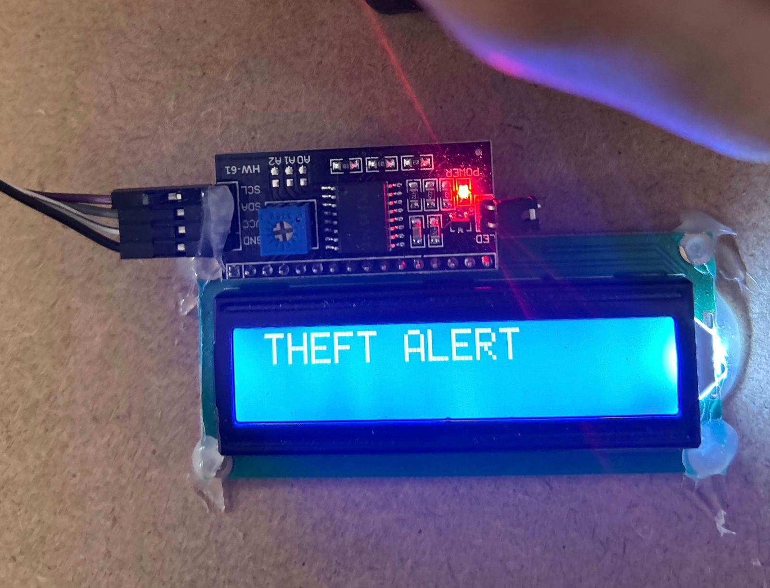
Simulation results
Title of the Project

Slide 15
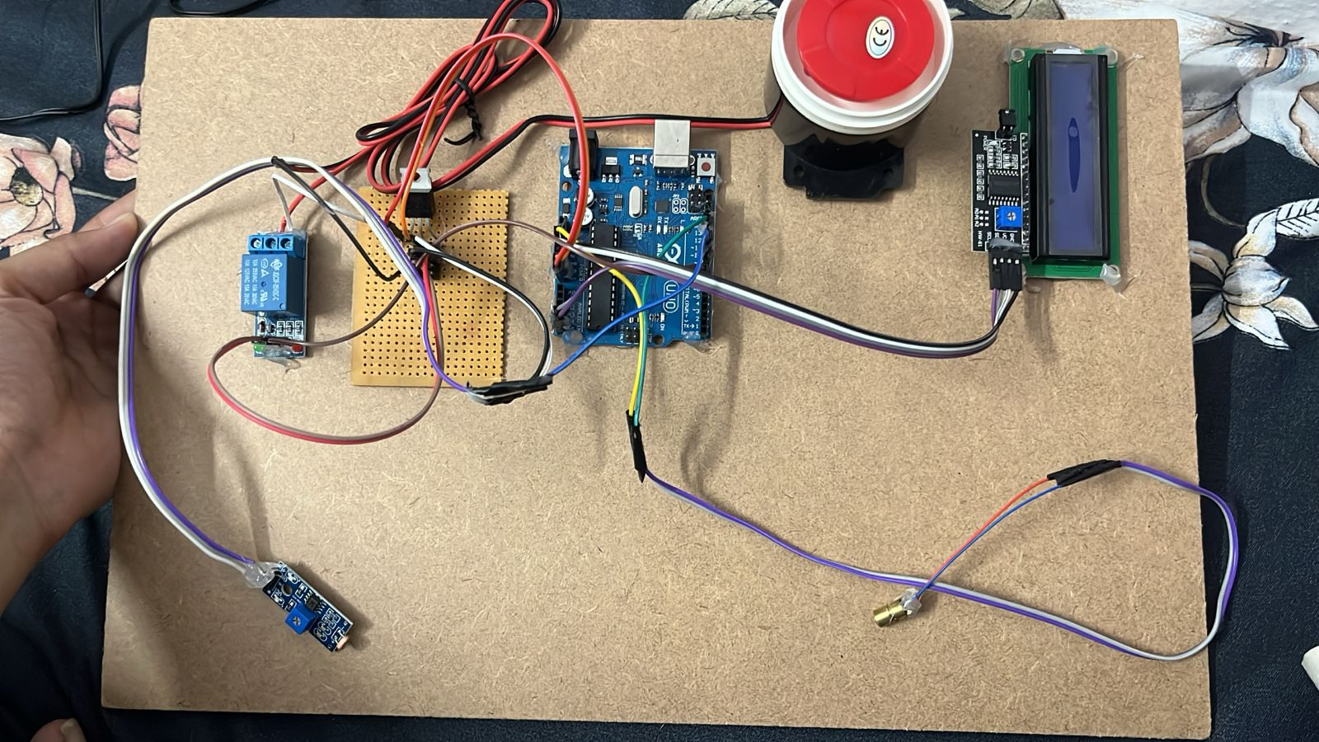
Hardware picture during simulation

Slide 16
Advantages
Real-Time Intrusion Detection:Any interruption in the laser beam is instantly detected by the LDR.
This enables immediate response through the siren and LCD alert.
Easy to Build and Maintain:The circuit and code are simple, making the system easy to assemble, troubleshoot, and modify.No complex programming or hardware is required.
Compact and Portable:The components are lightweight and occupy very little space.
The system can be discreetly installed without altering museum aesthetics.
Low Power Consumption:The system operates on low voltage (5V), consuming minimal power during standby.

Slide 17
Applications
Home Security:
Can be installed in personal safes or drawers holding valuable items. Offers a budget-friendly solution for homeowners concerned about theft.
Bank Lockers and Vaults:
Acts as an additional layer of security by detecting unauthorized access. Can be integrated with cameras and remote alerts for enhanced protection.
Museums and Exhibition Halls:
Used to protect high-value artifacts like diamonds and paintings. The system instantly alerts staff if anyone tries to tamper with the displayed items.

Slide 18
Conclusion
The developed system successfully demonstrates a simple, low-cost, and effective security solution for protecting valuable items like diamonds in museum environments.
Using a laser and LDR sensor, it reliably detects any interruption in the monitored zone and instantly triggers a 60dB siren and visual LCD alert.
The Diamond Security System effectively enhances asset protection by detecting unauthorized access through precise light-based intrusion sensing
Title of the Project

Slide 19
Future Scope
The diamond security system designed in this project has strong potential for future enhancement and real-world application. In the next phase, the system can be upgraded by integrating a GSM module to send SMS alerts to security personnel during intrusions
These enhancements can make the system more intelligent, responsive, and suitable for large-scale deployment in museums, banks, or jewelry stores.
Title of the Project

Slide 20
References
Arduino Official Documentation.(Internet)
Basic Electronics by D.P. Kothari and I.J. Nagrath
(Standard textbook for understanding electronic components and circuits)
Laser Module Details and Applications
YouTube Tutorials and DIY Projects

