Slide 1


TensorFlow Ops
Tensor Flow for Deep Learning Research

Slide 2
Feedback is greatly appreciated!

Slide 3

Overview
Overfitting
Dropout
Data augmentation
Callbacks
Word Embeddings (representation of text data)

Slide 4
Overfitting and Good Fitting
Overfitting
Good fitting
Overfitting function can not generalize well to unseen data.

Slide 5
Preventing Overfitting
Standard ways to limit the capacity of a neural net:
Limit the number of hidden units.
Limit the size of the weights.
Stop the learning before it has time to overfit.
G. Hinton, 2006

Slide 6



Dropout
Training:
Each time before updating the parameters
Each neuron has p% to dropout

Slide 7


Dropout
Training:
Thinner!
Each time before updating the parameters
Each neuron has p% to dropout
The structure of the network is changed.
Using the new network for training
For each mini-batch, we resample the dropout neurons

Slide 8






Dropout - Intuitive Reason
When teams up, if everyone expect the partner will do the work, nothing will be done finally.
However, if you know your partner will dropout, you will do better.

Slide 9

















Let’s try it
……
500
……
model.add( dropout(0.8) )
500
……
model.add( dropout(0.8) )
Softmax
y₁
y₂
^{y}10
……

Slide 10
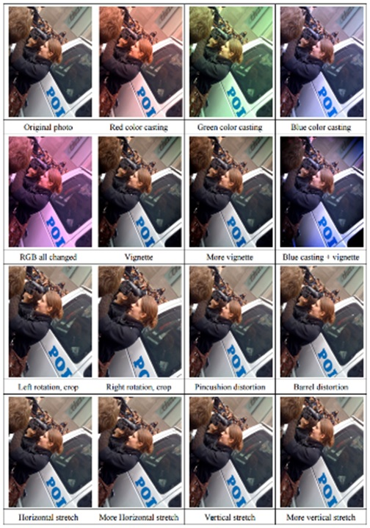
Data Augmentation (Jittering)
Create virtual training samples
Horizontal flip
Random crop
Color casting
Geometric distortion
Deep Image [Wu et al. 2015]

Slide 11
Programming

Slide 12
callbacks
A callback is a set of functions to be applied at given stages of the training procedure
You can use callbacks to get a view on internal states and statistics of the model during training
keras.callbacks.Callback()

Slide 13
callbacks
History
ModelCheckpoint
EarlyStopping
TensorBoard
ReduceLROnPlateau

Slide 14
History
keras.callbacks.History()

Slide 15
ModelCheckpoint
keras.callbacks.ModelCheckpoint(filepath, monitor='val_loss', verbose=0, save_best_only=False, save_weights_only=False, mode='auto')

Slide 16
Early Stopping
keras.callbacks.EarlyStopping(monitor='val_loss', min_delta=0, patience=0, verbose=0, mode='auto', baseline=None, restore_best_weights=False)

Slide 17
ReduceLROnPlateau
keras.callbacks.ReduceLROnPlateau(monitor='val_loss', patience=10, verbose=0, mode='auto', min_delta=0.0001, min_lr=0)

Slide 18
Tensorboard
Tensorflow, the deep learning framework from Google comes with a great tool to debug
It hosts a website on your local machine in which you can monitor things like accuracy, cost functions
and visualize the computational graph that Tensorflow is running based on what you defined in Keras
Pip install tensorboard

Slide 19
Tensorboard
tensorboard = TensorBoard(log_dir="logs/{}".format(time())) model.fit(x_train, y_train, verbose=1, callbacks=[tensorboard])
You need to create a new TensorBoard instance and point it to a log directory where data should be collected.
Next you need to modify the fit call so that it includes the tensorboard callback.
Then the following command in the separate terminal
tensorboard --logdir=logs/
http://localhost:6006/

Slide 20
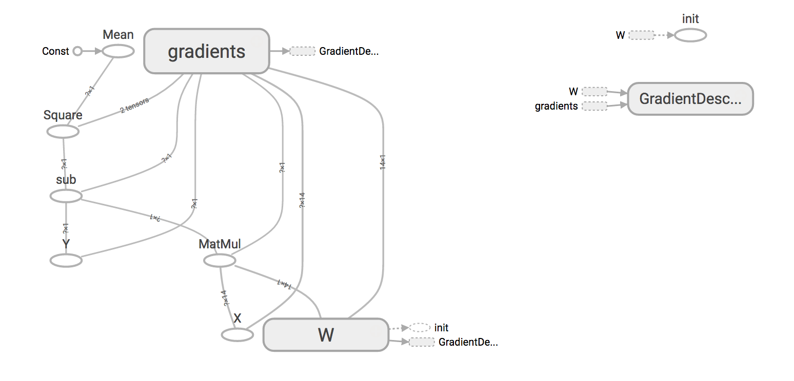
Tensorboard

Slide 21
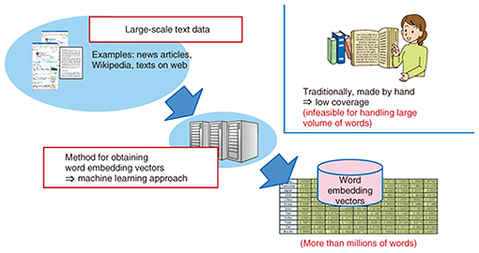
Why Word Embeddings: Essential for text processing with DL
It is an essential part of text processing with Deep Learning because Machine Learning algorithms, and almost all Deep Learning architectures, are incapable of processing strings or plain text in their raw form.
TEXT processing
Source: https://www.analyticsvidhya.com/blog/2017/06/word-embeddings-count-word2veec/
https://www.ntt-review.jp/archive/ntttechnical.php?contents=ntr201711fa4.html

Slide 22
Types of Word Embeddings
Word embeddings can be broadly classified into two categories
Frequency based Embedding
Count Vector
TF-IDF Vector
Co-Occurrence Vector
Prediction based Embedding
word2vec
CBOW (Continuous Bag of words)
Skip-Gram Model
GloVe: Global Vectors for Word Representation
Source: https://www.analyticsvidhya.com/blog/2017/06/word-embeddings-count-word2veec/

Slide 23
References
https://deeplearning4j.org/word2vec.html
https://towardsdatascience.com/tagged/word2vec
https://medium.com/@Aj.Cheng/word2vec-3b2cc79d674
https://medium.com/tag/word2vec
https://www.analyticsvidhya.com/blog/2017/06/word-embeddings-count-word2veec/
http://mccormickml.com/2016/04/19/word2vec-tutorial-the-skip-gram-model/
https://becominghuman.ai/how-does-word2vecs-skip-gram-work-f92e0525def4

