Slide 1
Symfony CRUD Project: Product Management System
By Sushma Vem

Slide 2
Project Overview
The project is a simple web application to manage products.
It performs CRUD (Create, Read, Update, Delete) operations.
It exposes RESTful APIs that can be tested via Postman.
Developed using Symfony 6, PHP 8, and MySQL.

Slide 3
Why Symfony??
Modern PHP framework with built-in structure (MVC).
Faster and more maintainable than plain PHP/XAMPP.
Doctrine ORM simplifies database interaction.
Built-in security, routing, and templating features.

Slide 4
REAL WORLD APPS
Application | Domain | How Symfony Helps
Spotify | Music Streaming | Scalability & background processing
BlaBlaCar | Ride Sharing | Secure booking & APIs
Drupal | CMS | Modular & modern architecture
Magento | E-commerce | Scalable backend & modular design
Joomla | CMS | Extensible with reusable components
Dailymotion | Video Platform | API handling & performance
Trivago | Travel & Booking | High-speed search and caching
National Geographic | Digital Media | Fast content rendering & APIs

Slide 5
Project Requirements
PHP 8.0 or higher
Symfony CLI
Composer (for package management)
MySQL / XAMPP
Postman (for API testing)

Slide 6
Project Structure
Controller: Handles user/API requests.
Entity: Defines database tables (Product).
Repository: Interacts with the database.
Routes: Define API endpoints.
Public folder: Web-accessible resources.

Slide 7
MVC Architecture
1. Model (Data & Database Layer)
➡ Folder: src/Entity/
2. Controller (Logic Layer)
➡ Folder: src/Controller/
3. View (Presentation Layer)
➡ Folder: templates/

Slide 8
Database Setup
Database: product_management
Tables: product, messenger_messages
Columns: id, name, inventory_count, cost, selling_price, created_at

Slide 9
COMMANDS USED
# 1️⃣ Create a new Symfony project
symfony new product_management_system --version=6.4 --webapp # Creates a new Symfony 6.4 web application project
# 2️⃣ Move into your project directory
cd product_management_system # Navigate into your project folder
# 3️⃣ Start the local Symfony development server
symfony server:start -d # Starts the server in the background (daemon mode)
# OR if that doesn’t work:
php -S 127.0.0.1:8000 -t public # Starts PHP’s built-in web server manually
# 4️⃣ Create a new database (configure DATABASE_URL in .env first)
php bin/console doctrine:database:create # Creates the MySQL database defined in your .env file
# 5️⃣ Generate an Entity (Model) for Product
php bin/console make:entity Product # Opens an interactive tool to define entity fields
# ➤ Example fields created:
# name (string)
# inventoryCount (integer)
# cost (float)
# sellingPrice (float)
# createdAt (datetime_immutable)
# 6️⃣ Generate the migration file for database structure
php bin/console make:migration # Creates migration file (schema changes)
# 7️⃣ Apply migrations to the database (creates tables)
php bin/console doctrine:migrations:migrate # Executes migration and creates database tables

Slide 10
# 8️⃣ Verify your database schema
php bin/console doctrine:schema:validate # Checks if entity and database schema match
# 9️⃣ Create a Controller to handle CRUD logic
php bin/console make:controller ProductController # Generates a new controller file under src/Controller/
# 1️⃣0️⃣ Add CRUD API methods manually inside ProductController
# - index() → GET (fetch all)
# - create() → POST (add new)
# - update() → PUT (edit existing)
# - delete() → DELETE (remove)
# 1️⃣1️⃣ Check routing setup
php bin/console debug:router # Lists all routes and their paths (verify /api/products routes)
# 1️⃣2️⃣ Run server again (if stopped)
symfony server:start # Run again if you stopped it

Slide 11
SHORT SUMMARY
Folder | Role | Example
src/Entity/ | Model – Represents your data structure (like Product.php) | Product.php
src/Controller/ | Controller – Handles requests & responses | ProductController.php
templates/ | View – Contains HTML/Twig templates (optional in APIs) | Not used much in API projects
config/routes.yaml | Routing configuration | Defines endpoints
public/ | Web root directory | Entry point (index.php)

Slide 12
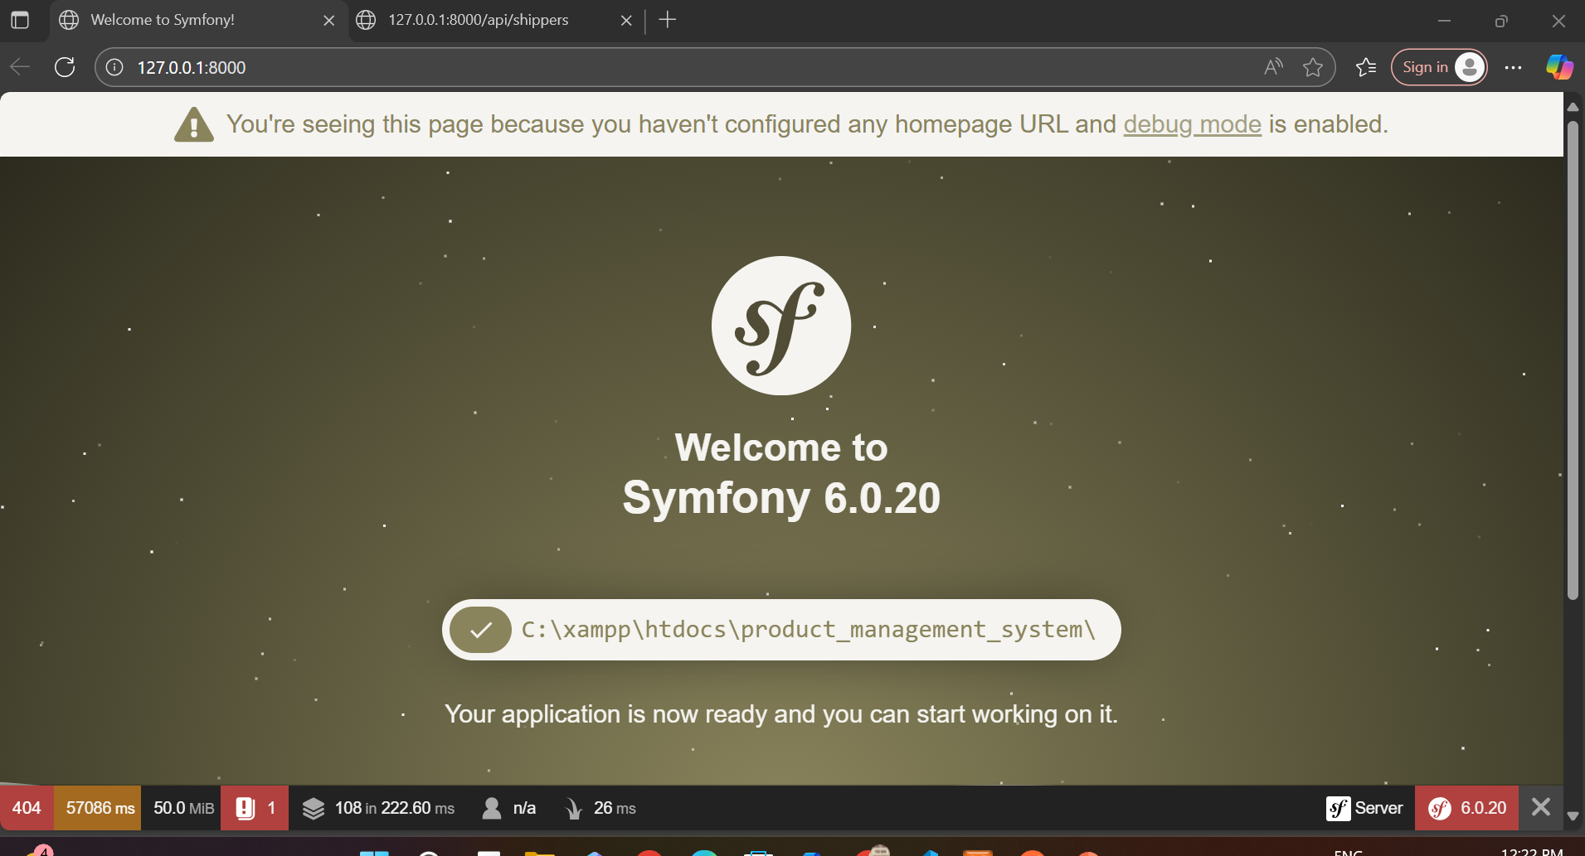
Symfony Connection

Slide 13
Entity: Product.php
Defines the structure of a product entity with fields and getter/setter methods.

Slide 14
Creating the Table
Commands used:
php bin/console make:migration
php bin/console doctrine:migrations:migrate

Slide 15
API Endpoints
• GET /api/products – List all products
• POST /api/products – Create new product
• PUT /api/products/2 – Update product
• DELETE /api/products/2– Delete product

Slide 16
ProductController.php
Handles API requests using index(), create(), update(), and delete() methods.

Slide 17
Testing APIs in Postman
Tips: Disable SSL verification if needed.

Slide 18
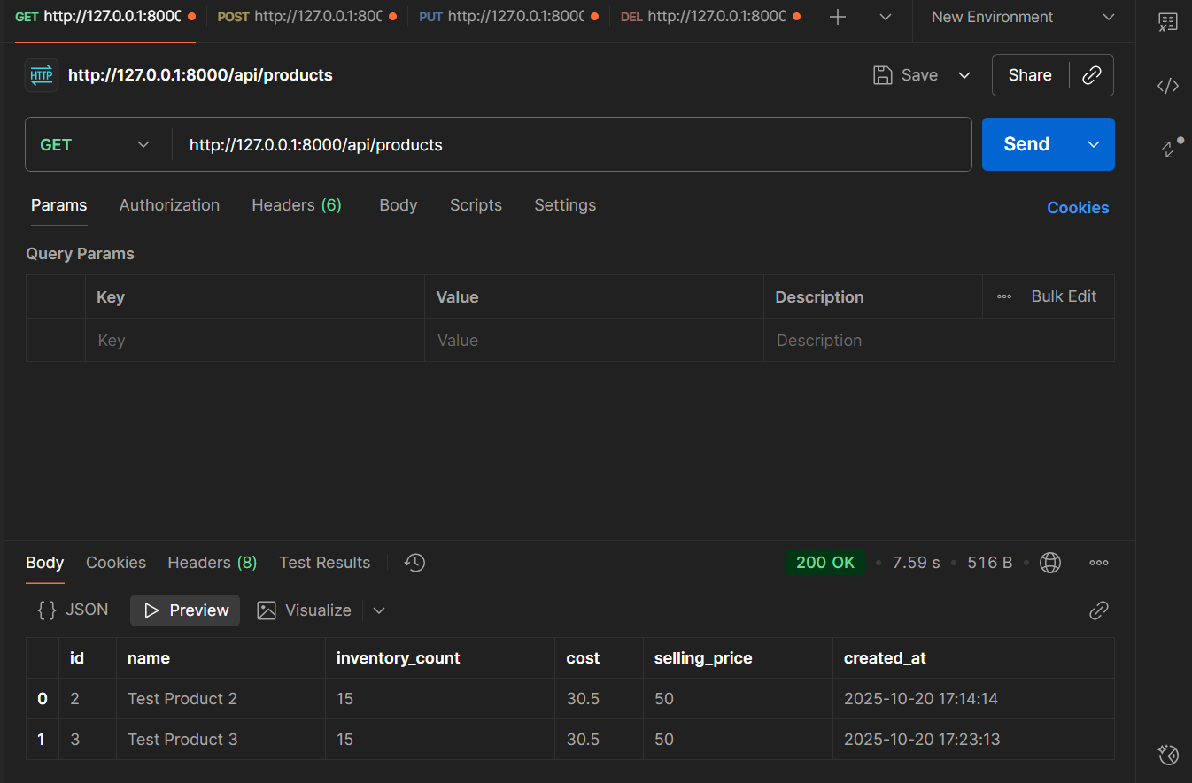
GET METHOD

Slide 19
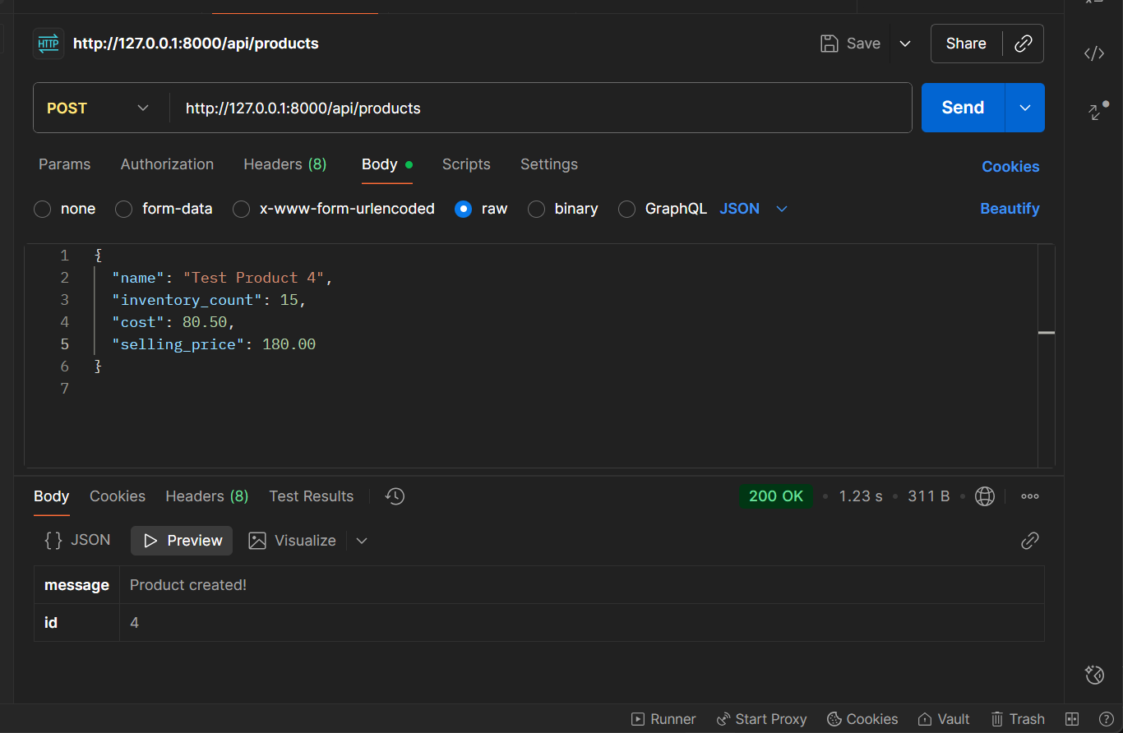
POST METHOD

Slide 20
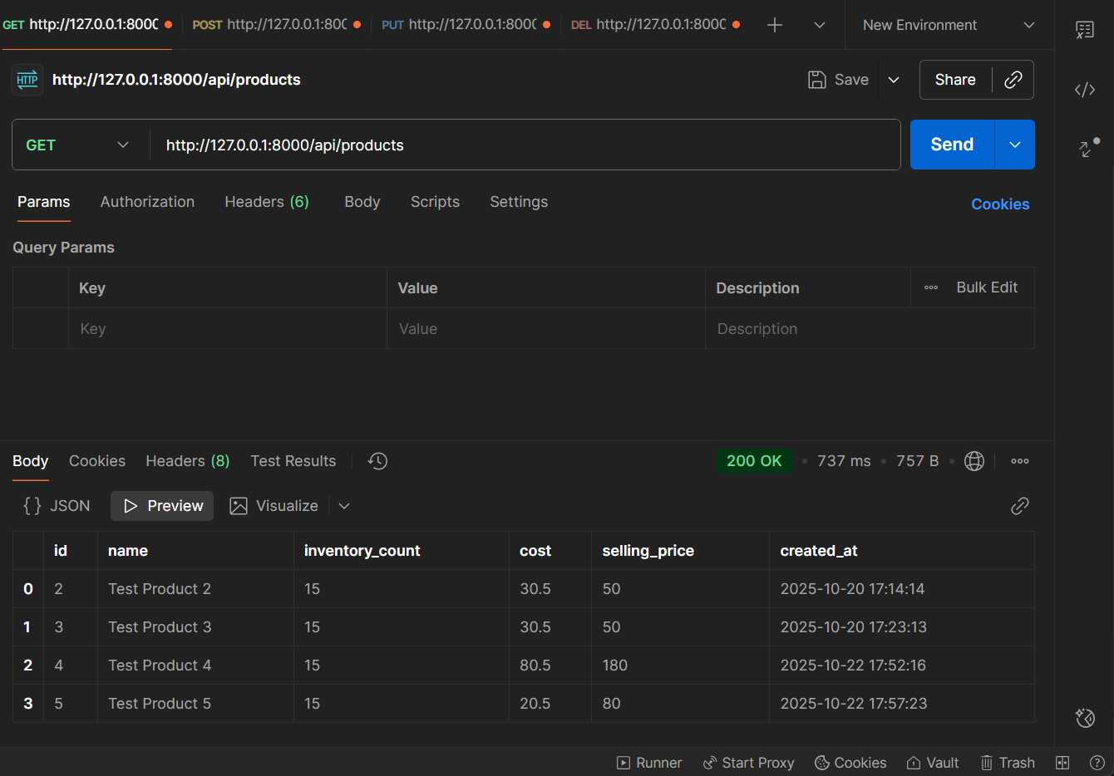
GET after adding an Item

Slide 21
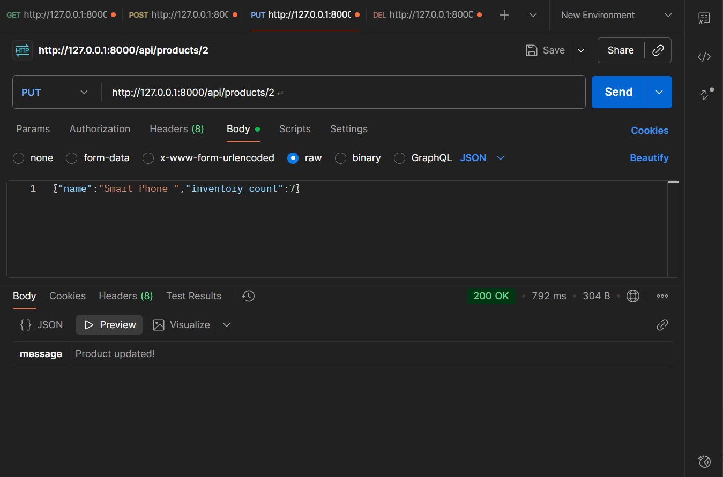
PUT METHOD

Slide 22
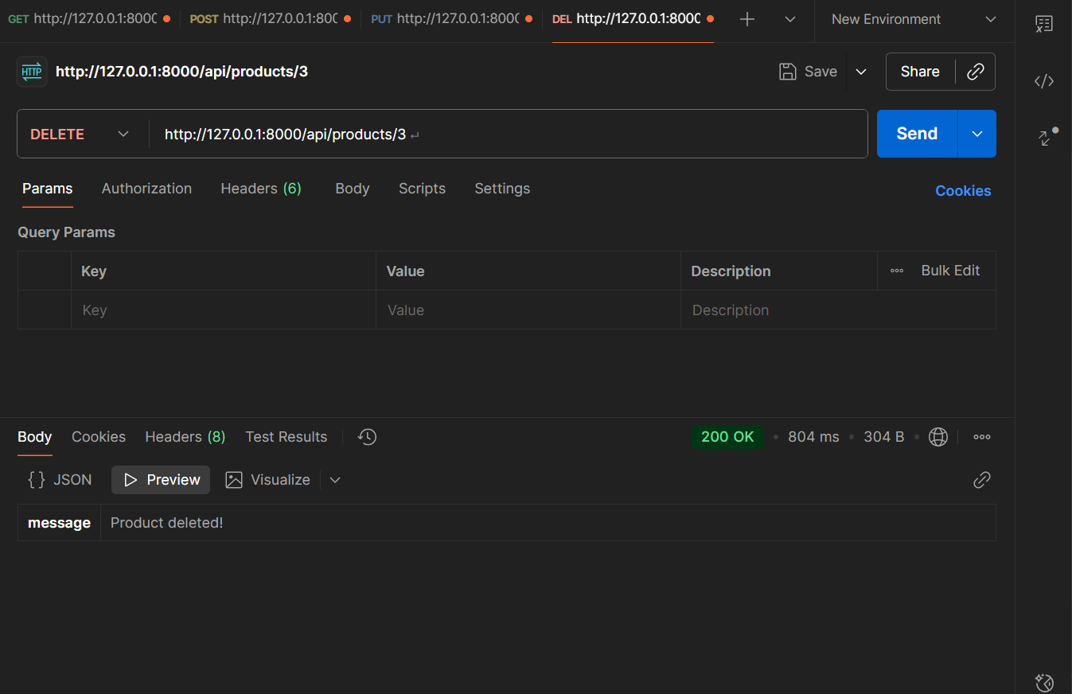
DEL METHOD

Slide 23
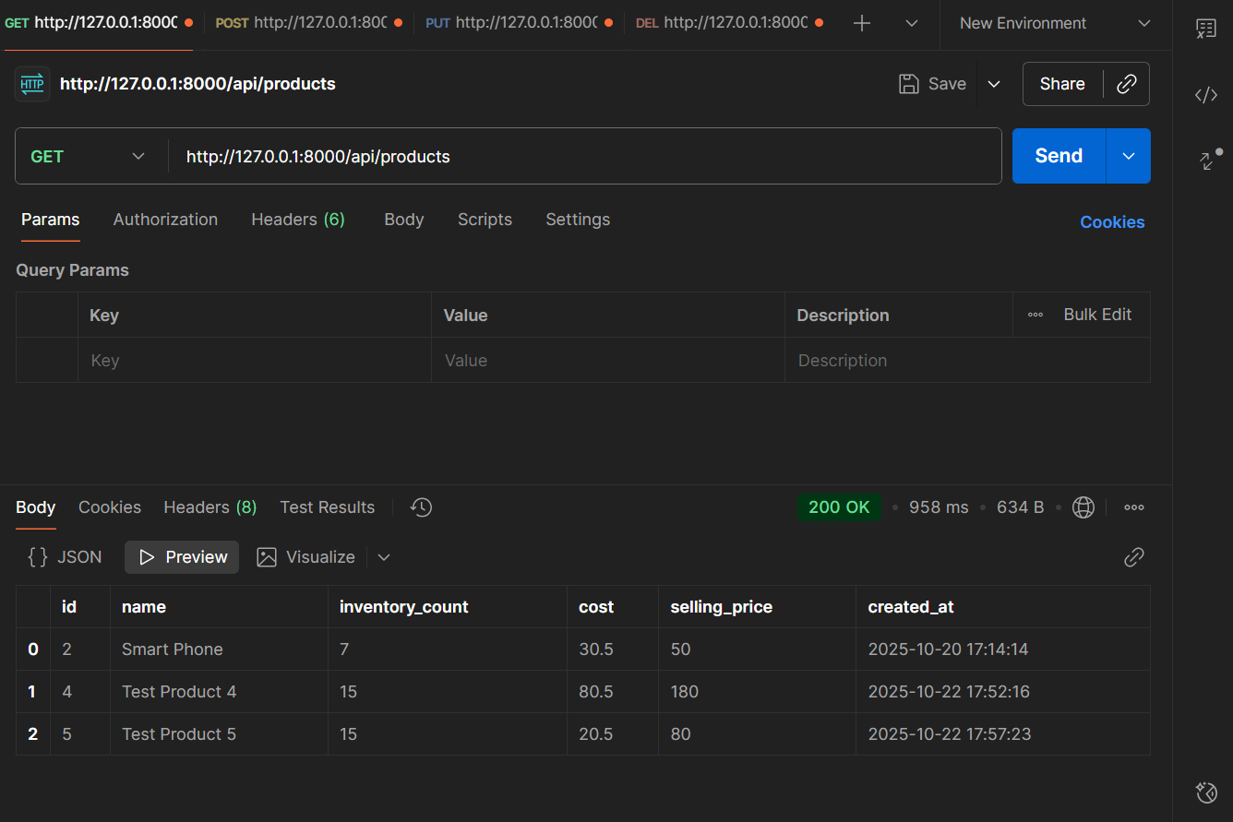
FINAL RESULTS
After all CRUD operations :

Slide 24
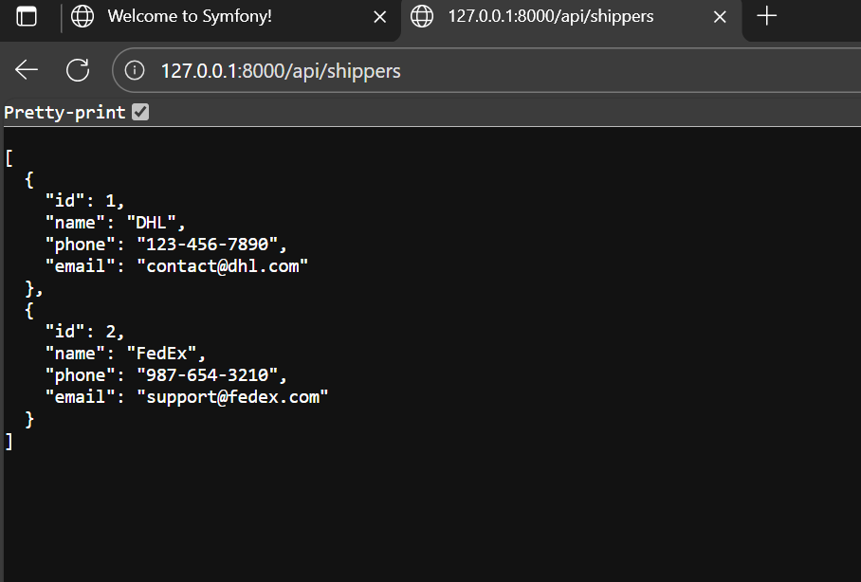
SHIPPERS TABLE
Let’s see a demo of shippers table creation :

Slide 25
Challenges Faced
• Doctrine migrations not creating tables initially
• Metadata errors
• Mapping entities correctly
• Proxy/SSL issues in Postman

Slide 26
Key Learnings
• Symfony project structure and routing
• Doctrine ORM and migrations
• REST API creation
• Debugging in Symfony and Postman

Slide 27
Conclusion
• Successfully created a Symfony-based Product Management API.
• Learned Symfony, Doctrine, REST APIs, and Postman testing.

Slide 28
Thank you!!☺

