Slide 1
Ecommerce web app for grocery shopping
Final presentation

Slide 2


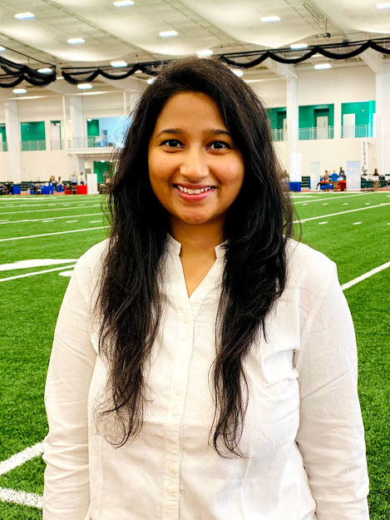

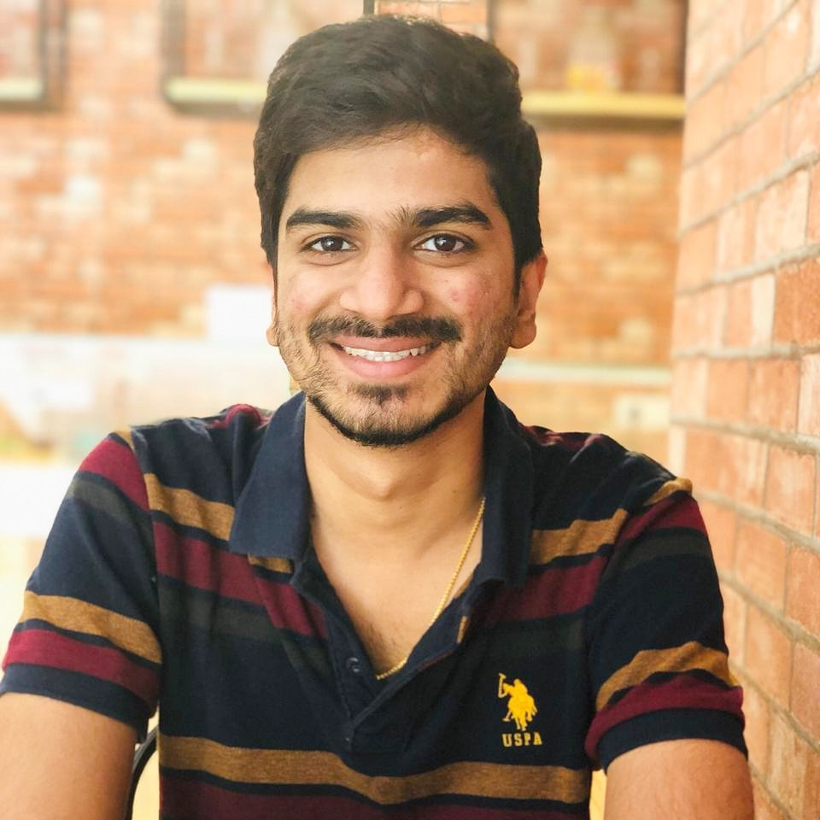
Team members
Deepak Malempati | Gangadhar Yerramsetti | Omkar Abhiteja Badda | Sushmita Rudra | Kamal Reddy Donthireddy

Slide 3
Outline
Introduction
Technologies used
Brief discussion of features Implemented
Individual tasks
Demo
Summary

Slide 4
Introduction
Due to COVID-19 pandemic, many customers are preferring to shop online with convenience of staying at home.
This web application will be an ecommerce store which enables the customers to buy groceries online.
This web application saves a lot of time of customers in terms of visiting the grocery store and roam around the aisles in search of the products.

Slide 5
Technologies used
Angular.js
Firebase
Bootstrap
Typescript
Tawk.io (3rd party live chat)

Slide 6
Features/Functions
User friendly and interactive user interface
Popular categories section in the homepage for the most used products
Search bar feature to search for the products
Order management and profile management
Online chat facility for constant help to our customers
Product Management and check out.

Slide 7
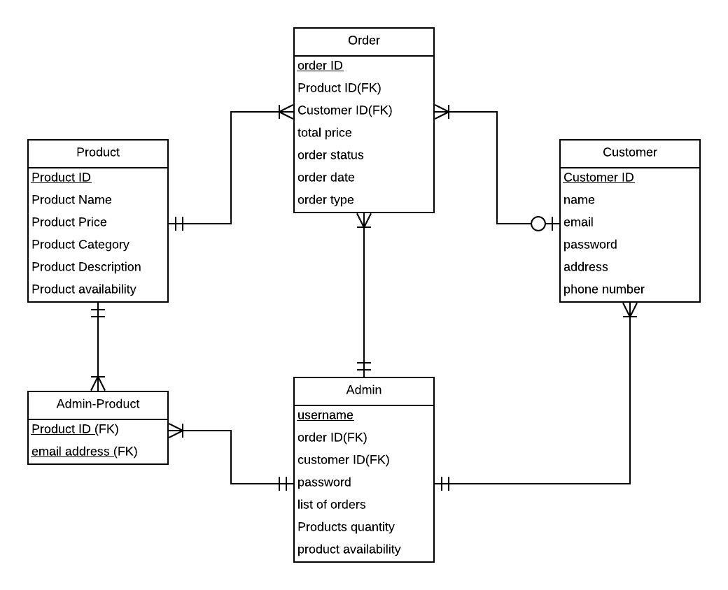
ER Diagram

Slide 8
Objectives - Deepak
Admin Products management – 100% completed
Create new products
Update existing products
Delete existing products
Viewing the Products
Search Functionality – 100% completed
All the users should be able to search the products that are available based on title and description of the item
Password Reset Functionality – 100% completed

Slide 9
Shared Objectives - Deepak
User order history
Shopping cart

Slide 10
Demo - Deepak

Slide 11
Objectives - Kamal
Admin order Management – 100% completed
Admin should be able to view new orders.
Able to view customer details and items orders.
Shopping cart – 100% completed
Able to update items in the cart.
Able to calculate the total amount of the order.
Able to clear all the items in the cart.
Navigation menu with routing – 100% Completed

Slide 12
Shared objectives - Kamal
Admin product management
Live chat and support page

Slide 13
Demo - Kamal

Slide 14
Objectives – Gangadhar
Home Page and User Profile – 100% completed
Read and display products to the homepage.
Adding products from homepage to cart.
User order details can be observed.
Shipping page and Payment– 100% completed
Individual products are identified in the shipping page.
User billing address details are recorded.
User Signup – 100% completed

Slide 15
Shared Objectives - Gangadhar
Search Functionality
Admin – Order Management

Slide 16
Demo - Gangadhar

Slide 17
Objectives – Abhiteja
Product display component– 100% completed
Display products to the homepage
Add pictures to the product
Edit product information
Live Chat– 100% completed
Users can chat with admin regarding their queries
User can share files and pictures
Admin can chat with multiple users
Support Page – 100% completed
Answers to the frequently asked questions are provided

Slide 18
Shared Objectives - Abhiteja
User profile
Filters and categories

Slide 19
Demo - Abhiteja

Slide 20
Objectives - Sushmita
Filters and Categories– 100% completed
Display the products on home page based on category selection by user.
User order history– 100% completed
To retrieve data based on the user id.
To list all the orders placed by the user.
To display the order details.
User Login Functionality – 100% completed

Slide 21
Shared Objectives - Sushmita
Products display component
Shipping page and checkout

Slide 22
Demo - Sushmita

Slide 23
Summary
100% of the project requirements are covered and implemented.
Every member in the project has given their contribution to complete this project.
Web application is hosted on AWS cloud and accessible by anyone.

Slide 24
Any questions?
Deepak Malempati | Gangadhar Yerramsetti | Omkar Abhiteja Badda | Sushmita Rudra | Kamal Reddy Donthireddy

Slide 25
Thank you!

