Slide 1
Google Cloud Platform

Slide 2
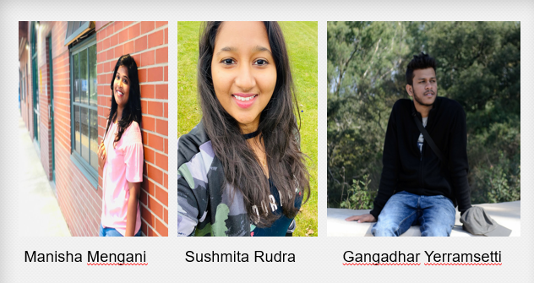
Team Members

Slide 3
Agenda
What is Cloud?
Why cloud?
What is Cloud Computing?
Service Models
Cloud Providers
What is GCP?
Why GCP ?
GCP Resources
Project in GCP
Google Cloud platform console
Command – line interface
Google Cloud platform Services
Firms using GCP
References

Slide 4
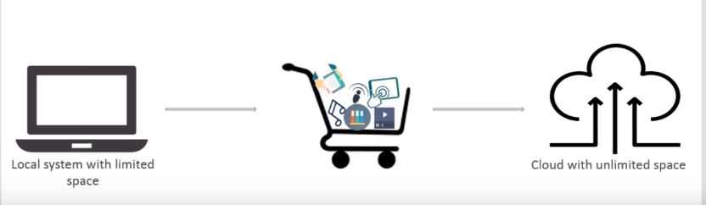
What is Cloud ?
Cloud is a collection of servers and computers connected by a network which is owned by a third party vendor somewhere on the globe.

Slide 5
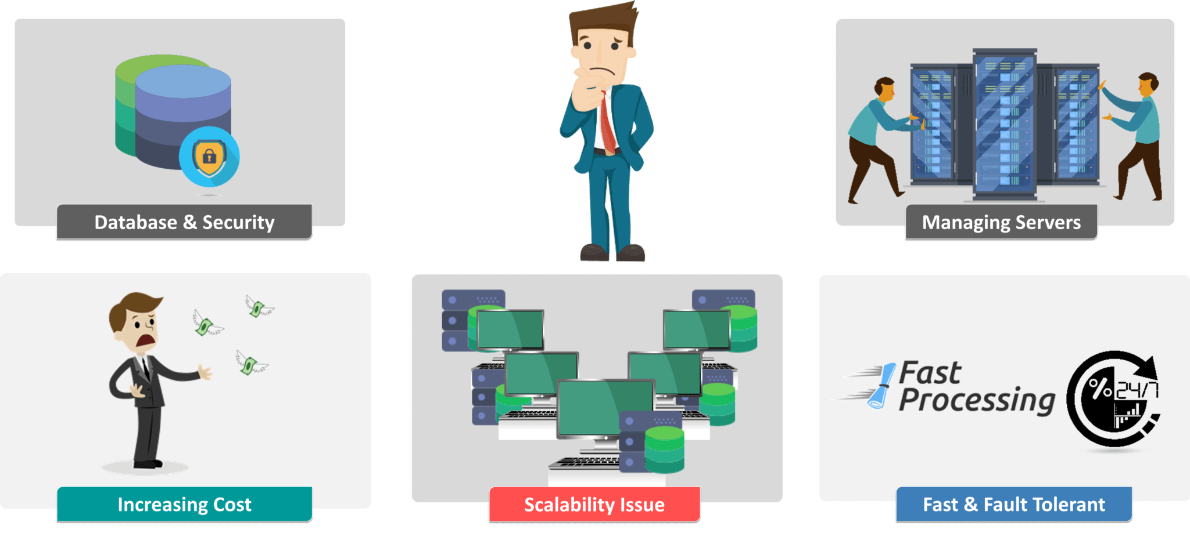
Why Cloud?
Before Cloud :

Slide 6
Data Security
Ensures use of Dynamically Scalable Servers
Provide you with Fast Computation and Remote Access to devices
Flexible Pricing ensures high Cost Optimization

Slide 7
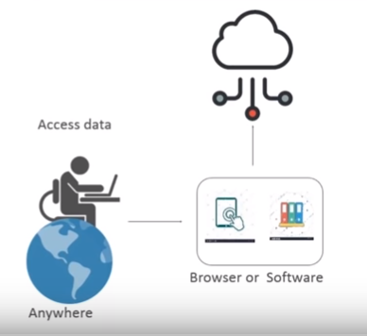
What is Cloud Computing ?
With cloud computing, users can access files and use applications from any device that can access the Internet.
Ex: Google’s Gmail

Slide 8
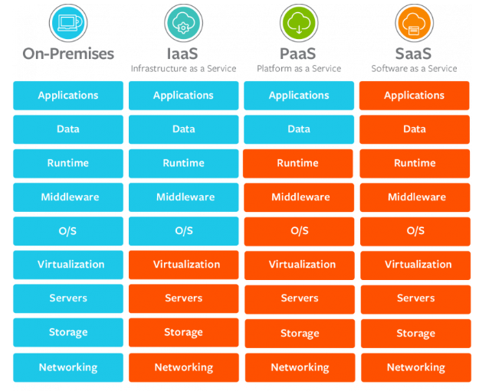
Service Models

Slide 9
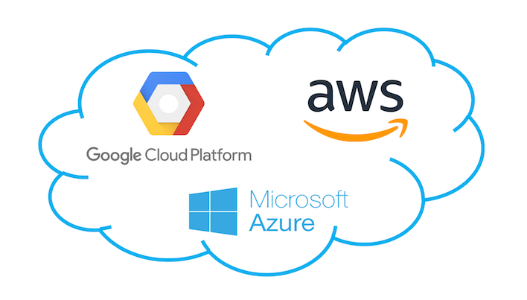
Cloud Providers

Slide 10
What is Google Cloud Platform ?
Google Cloud Platform , offered by Google , is a suite of cloud computing services that runs on the same infrastructure that Google uses internally for its end-user products such as Google Search and YouTube.

Slide 11
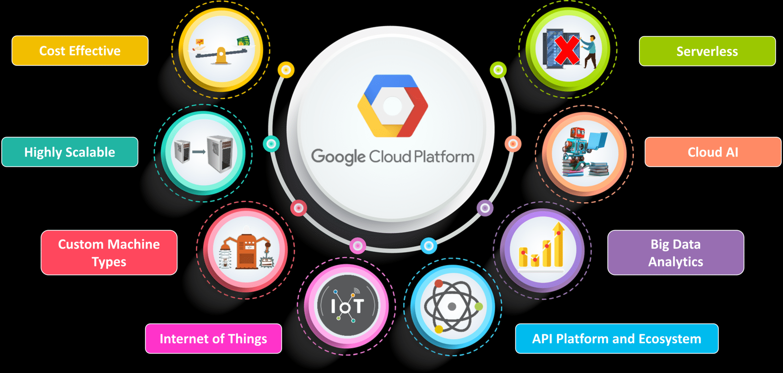
Why GCP ?

Slide 12
GCP resources
GCP consists of a set of physical assets such as computers and hard disk drives, and virtual resources, such as virtual machines (VMs), that are contained in Google's data centers around the globe. Each data center location is in a global region. Regions include Central US, Western Europe, and East Asia.

Slide 13
Project in GCP
A project in GCP is an organizing entity for what is being built. A project is made up of the permissions, settings and other meta data that describe your applications. Any resource that you allocate must belong to a single project.

Slide 14
Each GCP project has:
A project name.
A project ID-(unique across GCP), which we can provide or GCP can provide for you.
A project number, which GCP provides.
As we work with GCP, we'll use these identifiers in certain command lines and API calls. A project serves as a namespace. This means every resource within each project must have a unique name, but you can usually reuse resource names if they are in separate projects. Some resource names must be globally unique.

Slide 15
Google Cloud platform console
The Google cloud platform console provides a web-based, graphical user interface that you we use to manage your GCP projects and resources. When you use the GCP Console, you create a new project, or choose an existing project, and use the resources that you create in the context of that project. You can create multiple projects, so you can use projects to separate your work in whatever way makes sense for you.

Slide 16
Command – line interface
If you prefer to work in a terminal window, the Google Cloud SDK provides the Gcloud command line tool, that provides access to the commands you need. Cloud Shell provides:
A temporary Compute Engine virtual machine instance.
Command-line access to the instance from a web browser.
A built-in code editor.
Pre-installed Google Cloud SDK and other tools.
Language support for Java, Go, Python, Node.js, PHP, Ruby and .NET.
Web preview functionality.
Built-in authorization for access to GCP Console projects and resources.

Slide 17
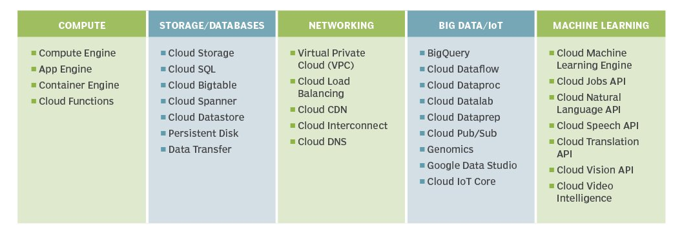
Google Cloud platform Services

Slide 18
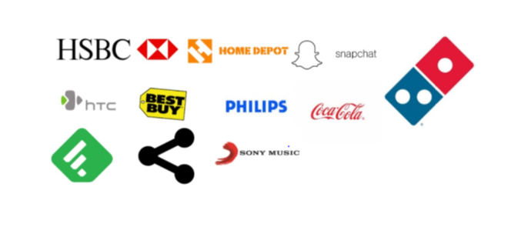
Firms using GCP

Slide 19
References
https://cloud.google.com/docs/
https://www.edureka.co/blog/google-cloud-platform-tutorial/
https://en.wikipedia.org/wiki/Google_Cloud_Platform

Slide 20


