Slide 1

ASSETFLOW – ENTERPRISE IT ASSET MANAGEMENT PLATFORM WITH INTELLIGENT ASSET TRACKING & LIFECYCLE MONITORING
ADAPTIVE SOFTWARE ENGINEERING(24I3201)
Project Review - 1
S.no | Roll No. | Name
1 | 2420030249 | Anakala Sarayu
2 | 2420030269 | Manduri Varshitha
3 | 2420030468 | Nidumolu Veda Samhita
4 | 2420090076 | Sushmita Sallam
Under the Guidance of
Ms. G Lavanya
Department of Computer Science and Engineering

Slide 2

ABSTRACT
AssetFlow is a centralized web-based system designed to simplify and automate IT asset and inventory management. It helps organizations efficiently track devices such as laptops, desktops, monitors, printers, networking equipment, and accessories.
The system allows authorized users to add, update, categorize, assign, transfer, and monitor assets. It maintains details such as asset ID, category, purchase information, employee, location, condition, availability, and status. A dashboard provides insights into total, available, assigned, and maintenance assets.
The frontend uses React.js, while Spring Boot 3 provides RESTful APIs and backend services. PostgreSQL stores asset and user data securely. Docker supports deployment, while GitHub and Jira enable version control, collaboration, and Agile project management.
.

Slide 3
Existing Model
Existing System | Main Features | Limitation / Gap
Snipe-IT | Asset tracking, assignments, licenses, locations, and inventory management | Mainly focused on asset tracking with limited workflow automation
ManageEngine AssetExplorer | IT asset tracking, lifecycle management, software and hardware inventory | Complex for small organizations and requires extensive configuration
ServiceNow ITAM | Asset lifecycle, service management, procurement, and tracking | Expensive and more suitable for large enterprises
Asset Panda | Asset tracking, barcode scanning, custom workflows, and reporting | Customization can be complex and costly
Spreadsheet-Based Systems | Basic asset records, employee assignments, and inventory tracking | Manual updates, duplicate data, data inconsistency, and poor real-time tracking

Slide 4
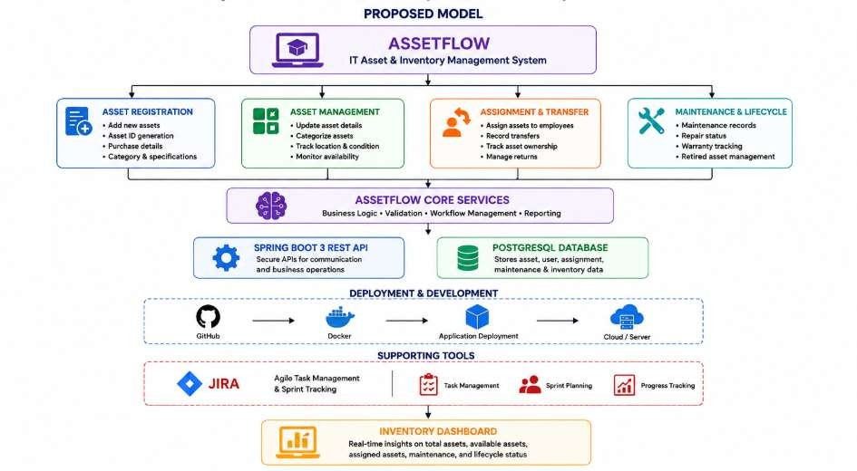
PROPOSED MODEL
AssetFlow integrates asset registration, inventory tracking, assignment, transfer, maintenance, and lifecycle monitoring into a single centralized system.
Admin/User → Asset Registration → Asset Categorization → Asset Assignment → Asset Tracking → Maintenance Monitoring → Asset
Return/Transfer → Lifecycle Status → Inventory Dashboard

Slide 5
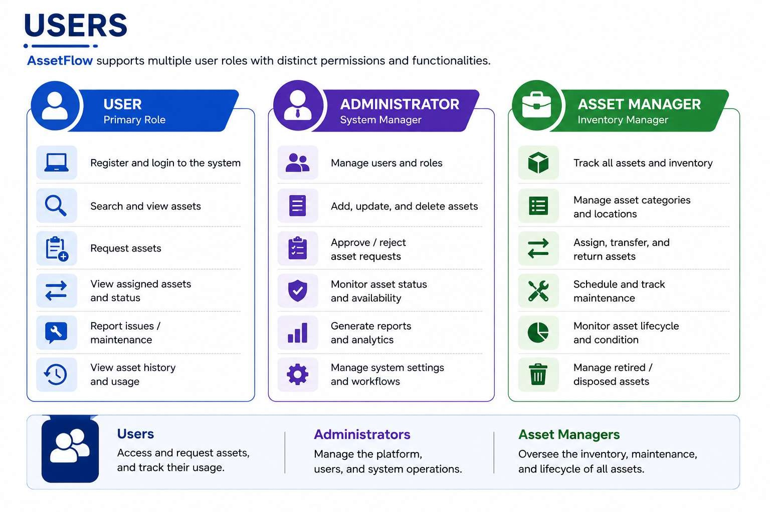
Users
AssetFlow integrates asset registration, inventory tracking, assignment, transfer, maintenance, and lifecycle monitoring into a single centralized system.
Admin/User → Asset Registration → Asset Categorization → Asset Assignment → Asset Tracking → Maintenance Monitoring → Asset
Return/Transfer → Lifecycle Status → Inventory Dashboard

Slide 6
Methodology
Requirement Analysis
↓
Agile / Scrum Planning
↓
System Design & Database Design
↓
Frontend & Backend Development
↓
Asset Management Module Integration
↓ Testing & Validation
↓
Docker Deployment & GitHub Integration
↓
Monitoring & Continuous Improvement

Slide 7
Process Model
Agile Scrum Model
Why Agile Scrum?
Product Backlog
↓
Sprint Planning
↓
Asset Module Development
↓
Testing & Validation
↓ Sprint Review
↓
Sprint Retrospective
↓
Working Increment
↓ Next Sprint
Iterative development – Build AssetFlow in small functional modules.
Continuous feedback – Get regular feedback from users and team members.
Easy adaptation – Quickly adapt to changing asset-management requirements.
Frequent testing – Test and improve each module after every sprint.
Team collaboration – Supports coordination among developers and stakeholders.

Slide 8
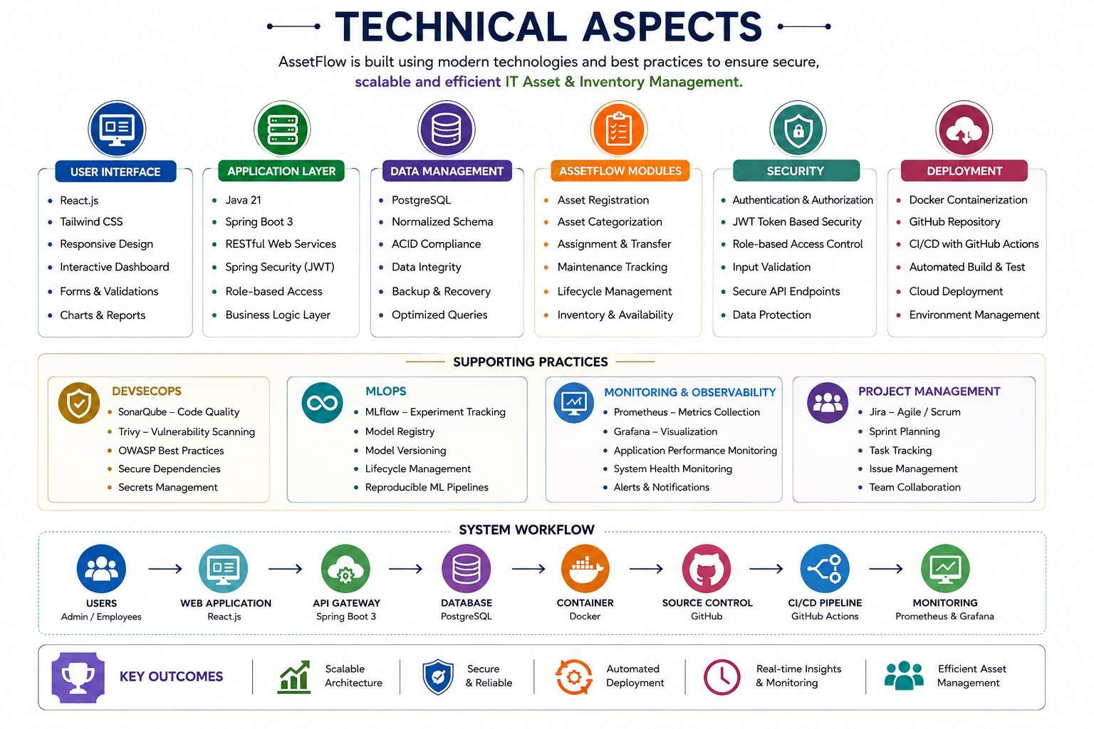
Technical Aspects

Slide 9
CONCLUSION
AssetFlow provides a centralized and efficient solution for managing an organization’s IT assets throughout their complete lifecycle. By combining React.js, Spring Boot, PostgreSQL, Docker, GitHub, and Jira, the system enables secure asset tracking, assignment, maintenance, and inventory management.
It reduces manual effort, improves data accuracy, and provides better visibility into asset availability and usage. The modular and scalable architecture also allows AssetFlow to be extended with additional features in the future.
AssetFlow ultimately helps organizations achieve smarter asset utilization, improved accountability, and more efficient IT operations.

Slide 10
THANK YOU

