Slide 1


Employee Data Analysis
By Sushmita Enjmuri

Slide 2

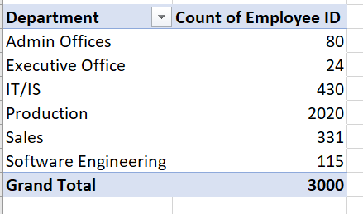
1. Can you create a pivot table to summarize the total number of employees in each department?

Slide 3
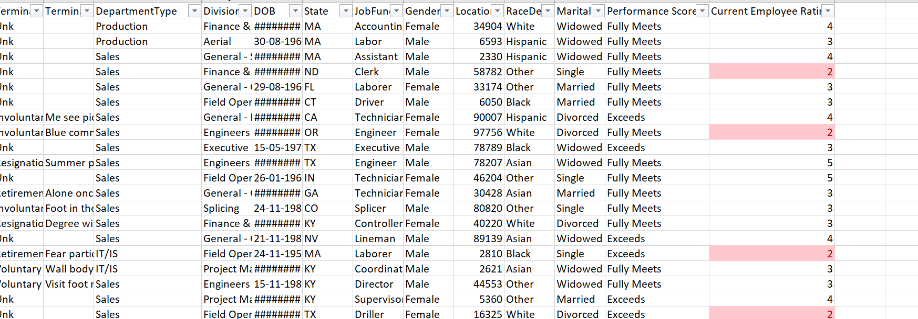
2. Apply conditional formatting to highlight employees with a "Performance Score" below 3 in red.

Slide 4
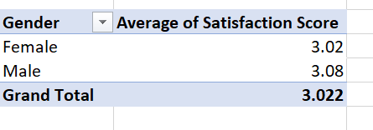
3. Calculate the average "Satisfaction Score" for male and female employees separately using a pivot table.

Slide 5
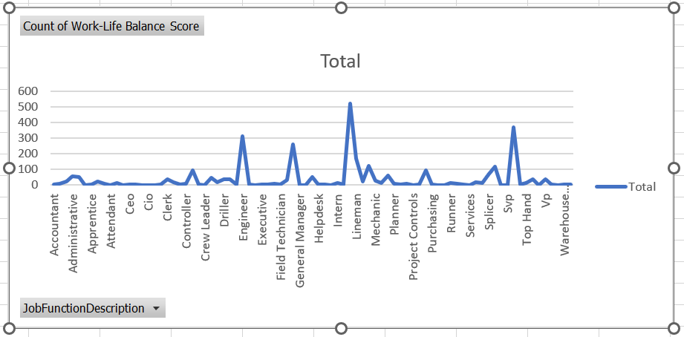
4. Create a chart to visualize the distribution of "Work-Life Balance Score" for different job functions.

Slide 6
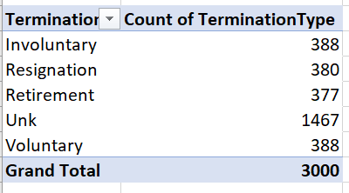
5. Filter the data to display only terminated employees and find out the most common "Termination Type."

Slide 7
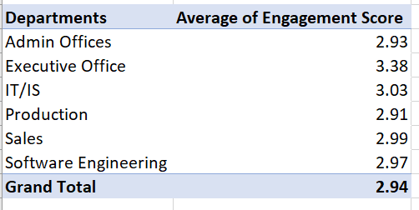
6. Calculate the average "Engagement Score" for each department using a pivot table.

Slide 8
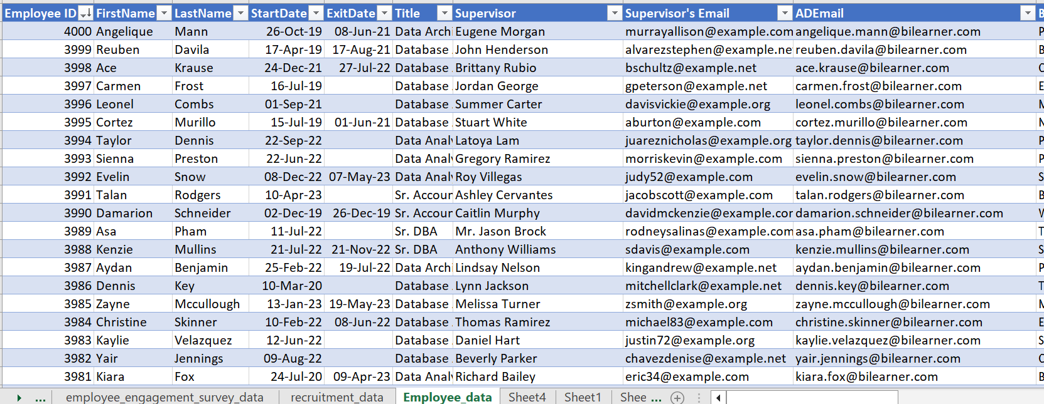
7. Use VLOOKUP to find the supervisor's email address for a specific employee.

Slide 9
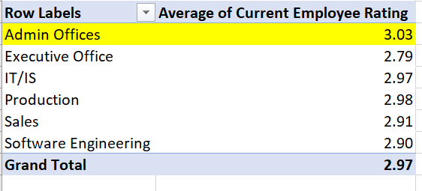
8. Can you identify the department with the highest average "Employee Rating?"

Slide 10
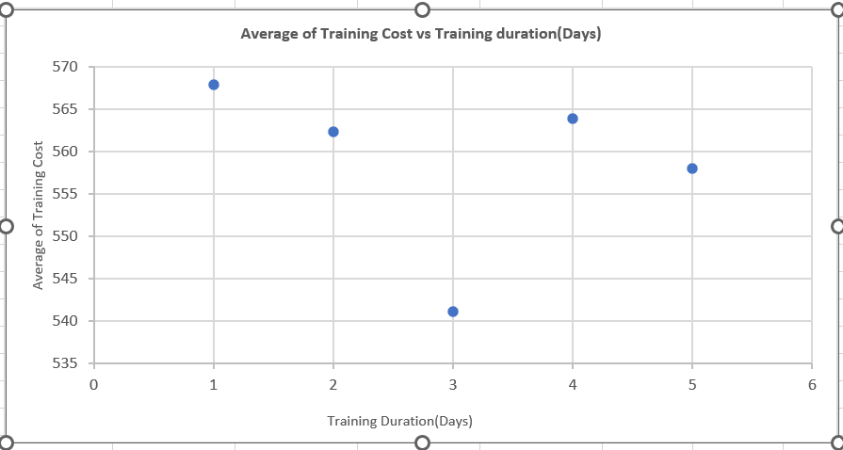
9. Create a scatter plot to explore the relationship between "Training Duration (Days)" and "Training Cost."

Slide 11
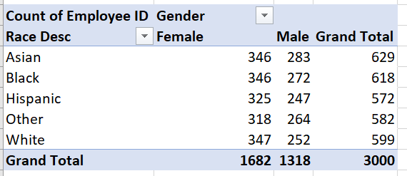
10. Build a pivot table that shows the count of employees by "RaceDesc" and "GenderCode."

Slide 12
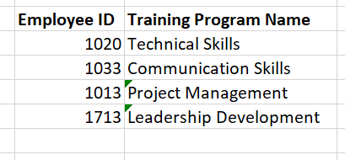
11. Use INDEX and MATCH functions to find the "Training Program Name" for an employee with a specific ID.
=INDEX(A1:I3001,MATCH(L4,A1:A3001,0),3)

Slide 13
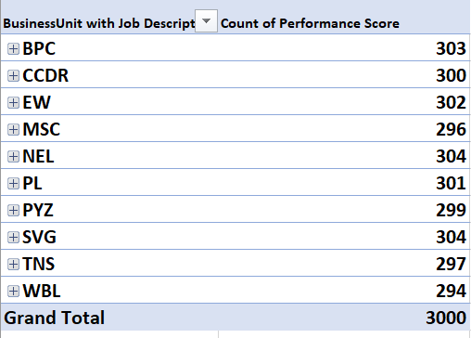
12. Create a multi-level pivot table to analyze the "Performance Score" by "BusinessUnit" and "JobFunctionDescription."

Slide 14
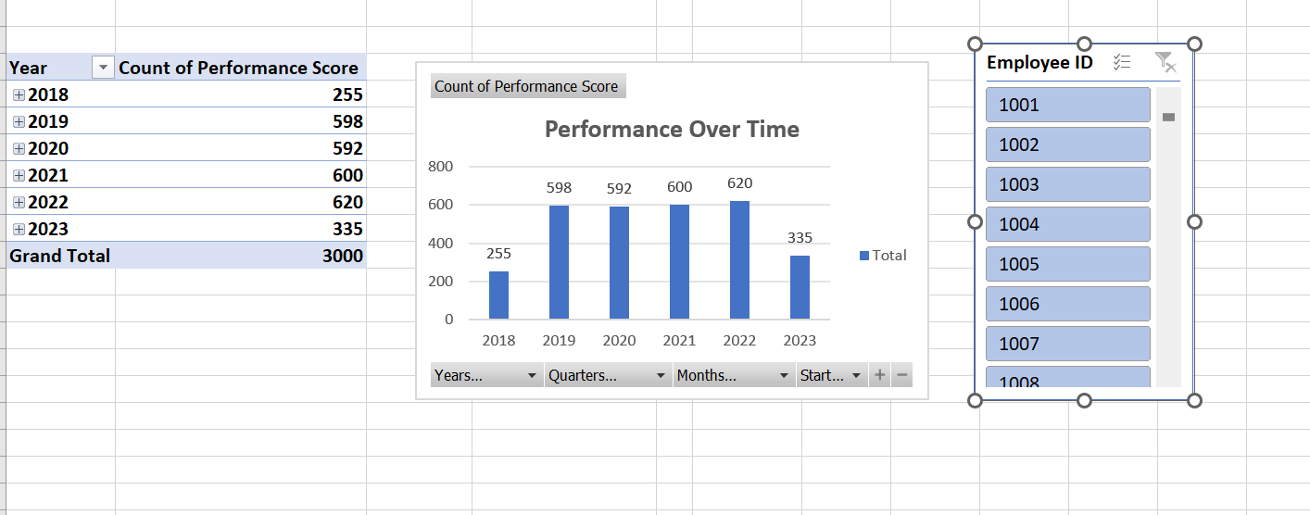
13. Design a dynamic chart that allows users to select and visualize the performance of any employee over time.

Slide 15
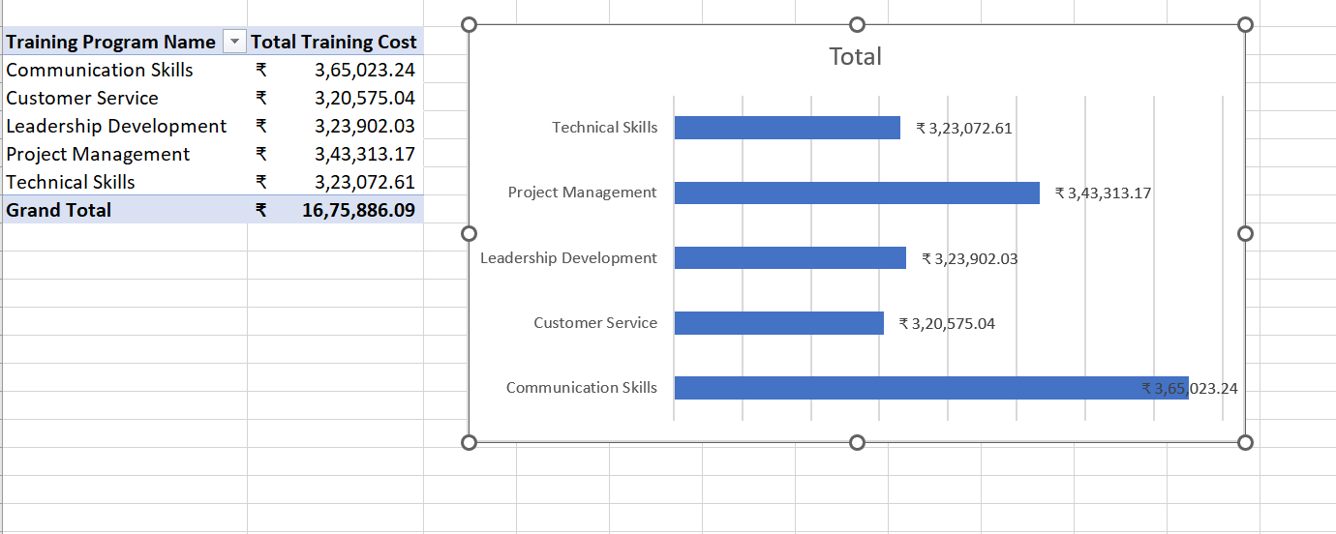
14. Calculate the total training cost for each "Training Program Name" and display it in a bar chart.

Slide 16
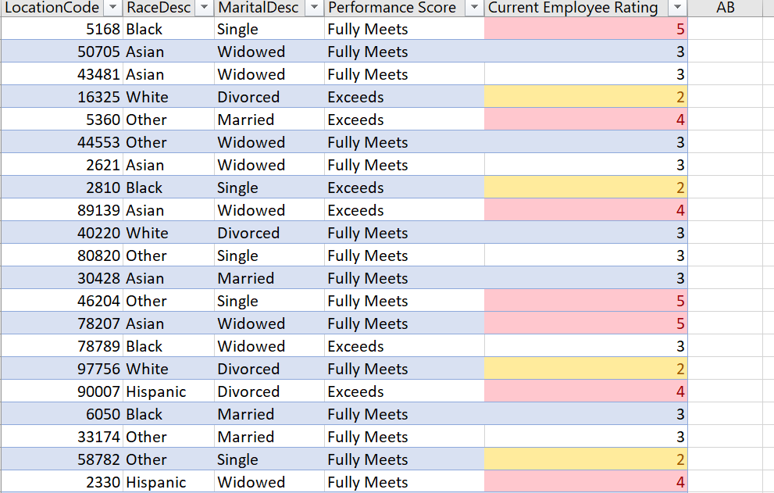
15. Apply advanced conditional formatting to highlight the top 10% and bottom 10% of employees based on "Current Employee Rating."

Slide 17
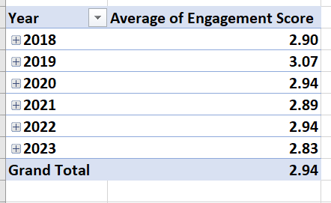
16. Use a calculated field in a pivot table to determine the average "Engagement Score" per year.

Slide 18
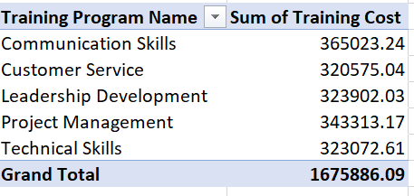
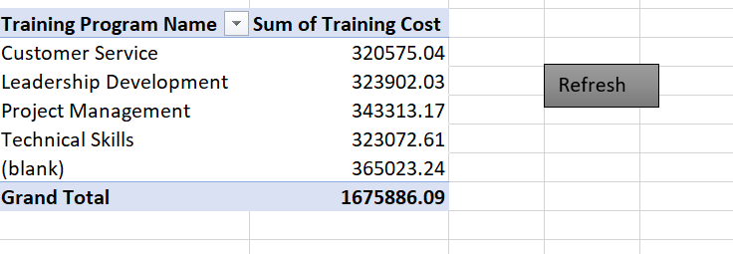
17. Can you build a macro that automates the process of updating and refreshing all pivot tables in the workbook?
Here I have summarized the Total training cost of training programs.
Here I have created a macro that will refresh the table.
First of all, I will turn on the developer option and then I will record a macro and refresh the pivot table by clicking any cell in the pivot table and then I will stop recording a macro.
I will insert a button for refreshing the table. After that, From the source table, I will delete the communication training program.
I will come back to the pivot table and click on the Refresh button.

Slide 19
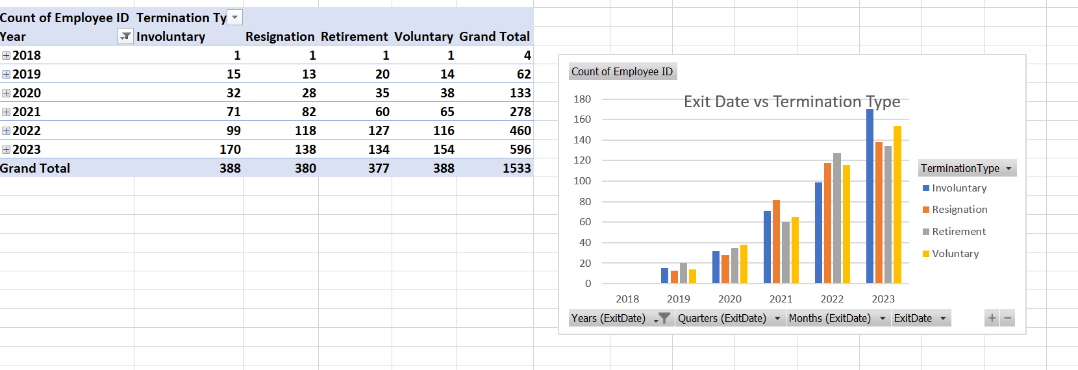
18. Create a histogram to understand the distribution of "ExitDate" for terminated employees.

Slide 20
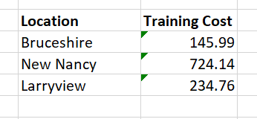
19. Utilize the SUMPRODUCT function to calculate the total training cost for employees in a specific location
=SUMPRODUCT((F6:F2994=K69)*I6:I2994)

Slide 21
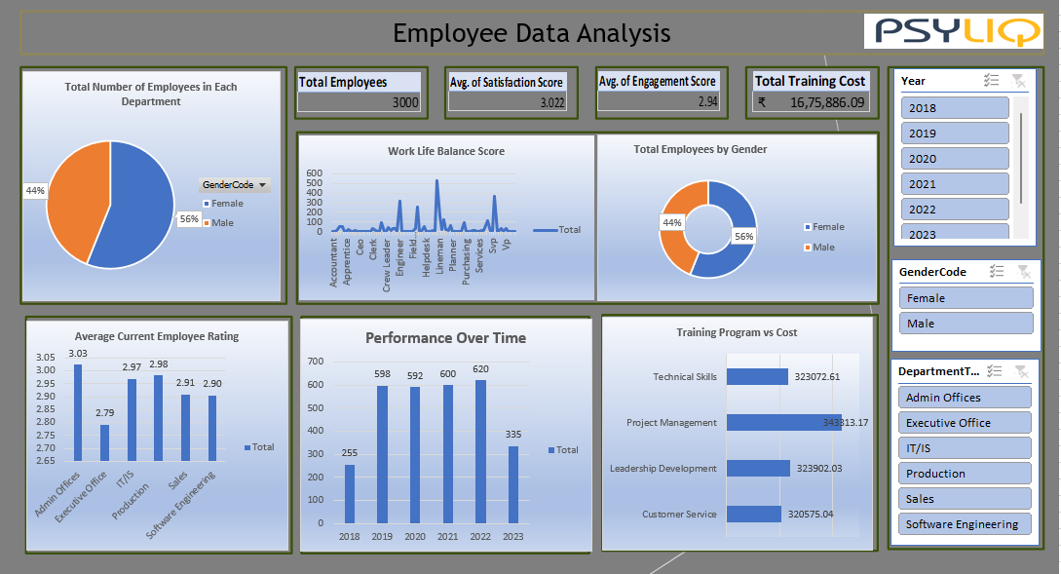

Slide 22
Thank You

