Slide 1
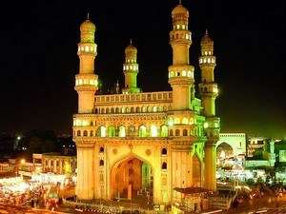
Telangana Tourism Analysis
Here is where your presentation begins

Slide 2
Table of contents
01
02
03
04
05
06
About Telangana
Goals and Objectives
Stages in this Project
Preliminary Research
Secondary Research
Recommendations

Slide 3

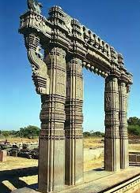
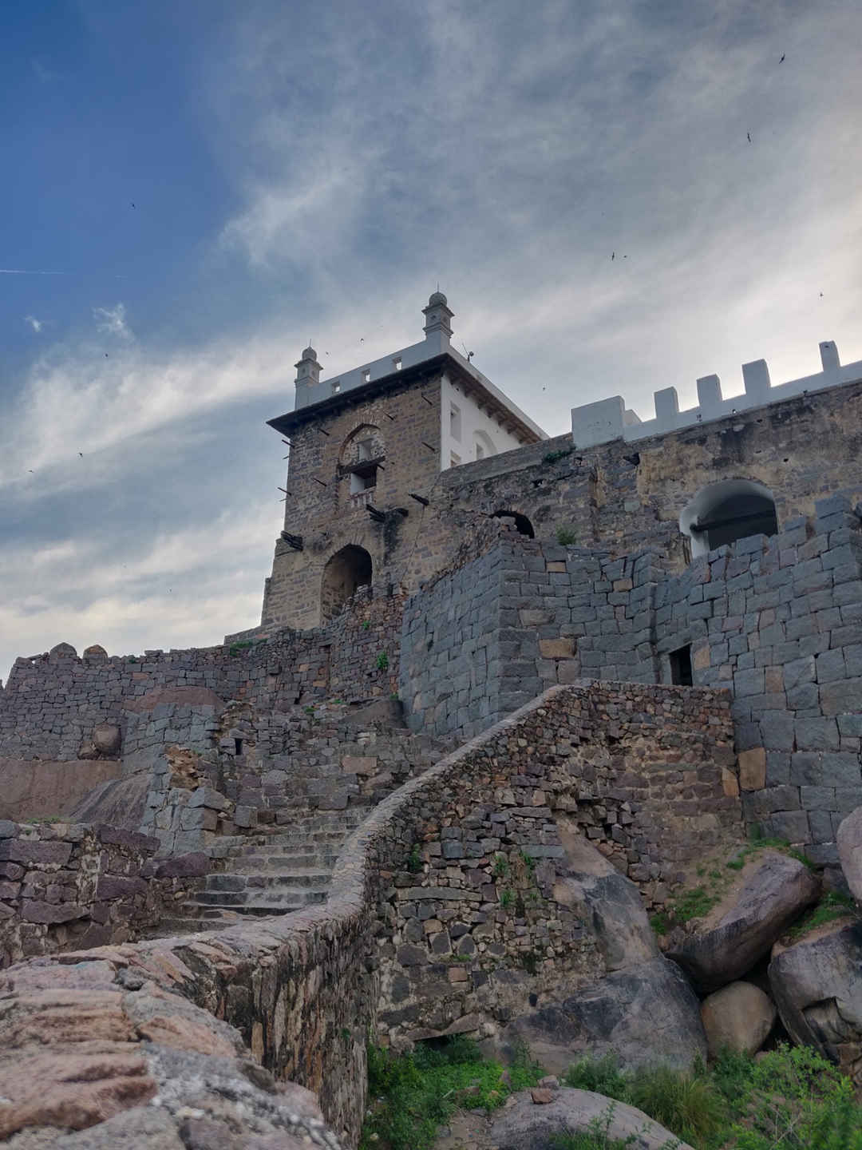
About Telangana
Telangana is India’s youngest state and was born on June 2nd 2014, as the 29th state of India.
The most beautiful thing about the State is, it shows good blend of culture and traditions with peaceful co-existence of different religions.
As Hyderabad is capital city of Telangana and It has a rich history and culture , and it is known for its iconic monuments , delicious cuisine, and vibrant markets.
Telangana is a famous tourist destination with historical landmarks such as Warangal Fort and Charminar, Ramappa Temple, the UNESCO heritage site, and Taj Falaknuma Palace.

Slide 4
Goals and Objectives
Objective 2
Objective 1
Objective 3
To analyse Domestic and Foreign Visitors
To Synergies the footfall districts with low
footfall districts and bring the exponential growth
To support Telangana State for Amplifications of Tourism

Slide 5
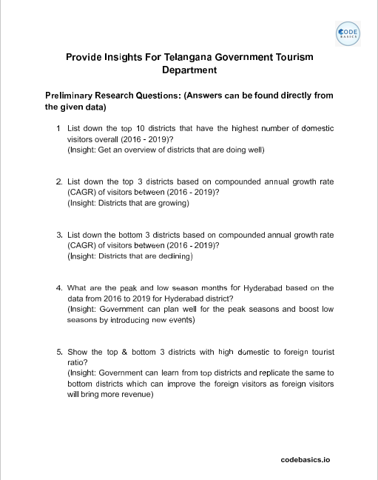
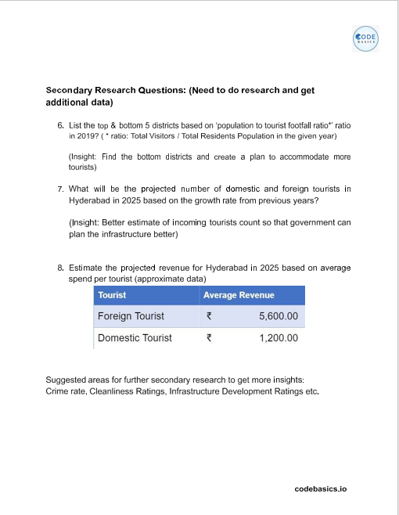
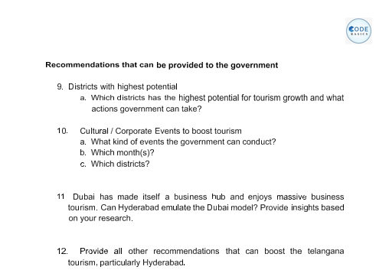
Stages in this Project
1
Preliminary Research Questions
2
Secondary Research Questions
3
Recommendations for Government

Slide 6
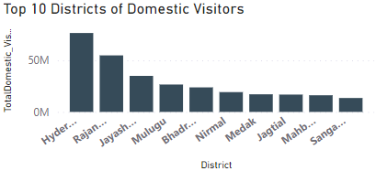
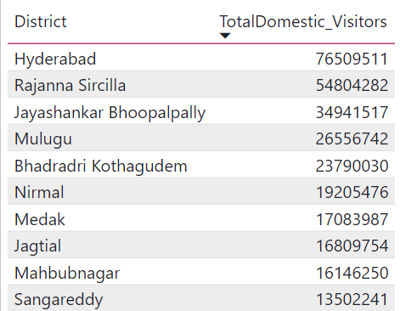
1. List down the Top 10 districts that have the highest number of domestic visitors overall (2018-2022)
Highlights :
Hyderabad has the highest 76.5M followed by Rajanna Sircilla and Jayashankar Bhoopalpallly with 54.8M and 34.9M.
Hyderabad a city that attracts visitors for various purposes beyond just tourism, such as Education, Employment, or healthcare.

Slide 7
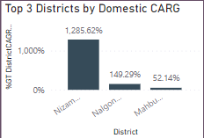
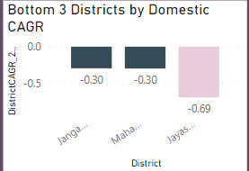
2. List down the top 3 districts based on compounded annual growth rate(CAGR) of visitors between (2018-2022)
3. List down the top 3 districts based on compounded annual growth rate(CAGR) of visitors between (2018-2022)
Highlights :
CAGR stands for the compound annual growth rate. It is the measure of an investments' annual growth rate over time .
CAGR = (ending value/starting value) ^ 1/ (no.of years) – 1
High CAGR indicates Districts are growing and low CAGR indicates Districts are declining.
Nizambad (1.285.62%) , Nalgonda(149%) and Mahabubnagar(52.14%)
Jangaon(-0.30), Mahabubabad(-0.30) and Jayashankar bhoopapally(-0.69)

Slide 8
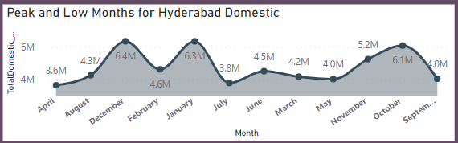
4. What are the peak and low season months for Hyderabad based on the data from 2018 to 2022 for Hyderabad district.
Peak Season – January n December
Low Season – March, April, July, May
We can see highest peak in the month of December due to New year and Sankranti festival vacation.
Family - Children have exams in the month of march and preparation start from February.

Slide 9
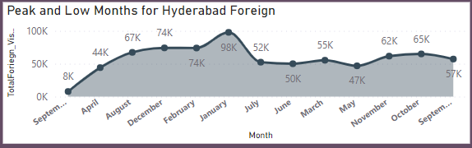
4. What are the peak and low season months for Hyderabad based on the data from 2018 to 2022 for Hyderabad district.
Peak Season – January n December
Low Season – April n September
The winter vacations for the foreign visitors starts from the month of December to February.
As per the Average trend, summers in Hyderabad records 45.C - 47.C which is not so preferred weather condition.

Slide 10
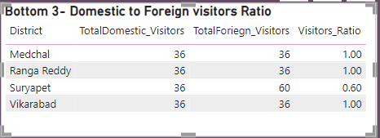
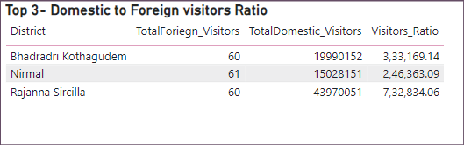
5. Show the top 3 & bottom 3 districts with high domestic to foreign tourist ratio?
Highlights :
Domestic to Foreign tourist ratio means the place is more popular among domestic visitors rather than foreign visitors.
Bhadradri Kothagudem, Nirmal and Rajanna Sircilla are having more domestic visitors.
Medchal, Ranga Reddy, Suryapet and Vikarabad are having less popular among domestic visitors.

Slide 11
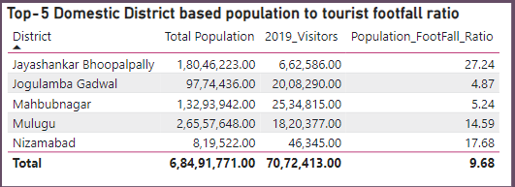
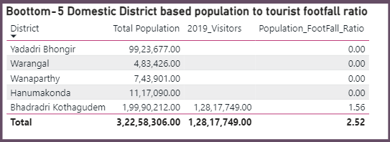
6.List the top & bottom 5 districts based on ‘population to tourist footfall ratio’ in 2019?
(ratio: Total Visitors / Total Residents population in the given year)
Highlights :
Jayashankar Bhoopalpally, Jogulamba Gadwal, Mahbubnagar, Mulugu and Nizamabad are top 5 districts based on population to tourist footfall ratio for 2019.
Yadadri bhongir, Warangal, Wanaparthy, Hanumakonda and Bhadradri Kothagudem are bottom 5 districts based on population to tourist footfall ratio for 2019.

Slide 12
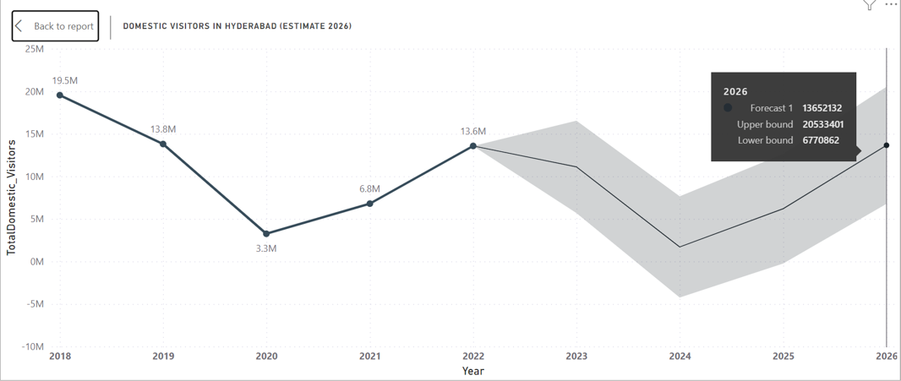
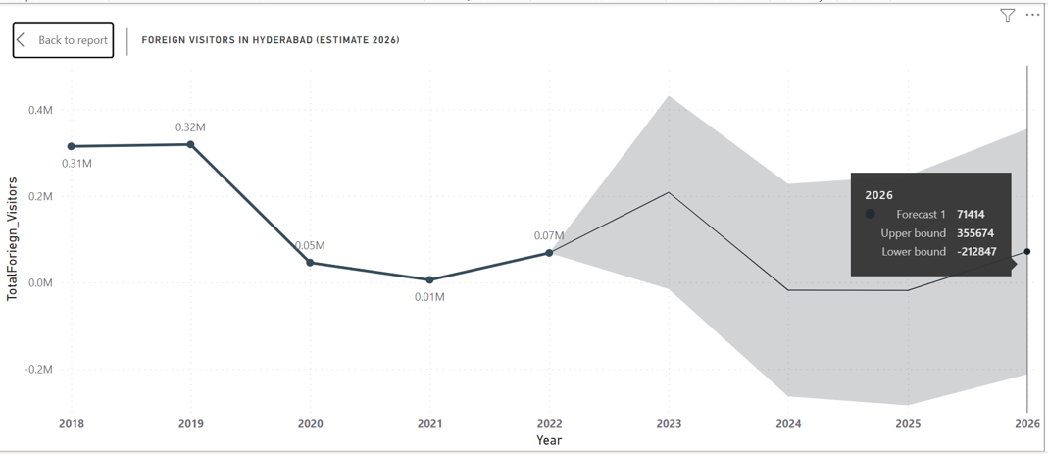
7. What will be the projected number of domestic and foreign tourists in Hyderabad in 2026 based on the growth rate from previous year?
Domestic Visitors
Based on the given data, the graph representing the total number of domestic visitors from 2018 to 2020 shows a decreasing trend.
In 2022, there were 13.6 million domestic visitors, and the projected number of domestic visitors in 2026 is 14 million.
However, due to the Covid-19 pandemic, the number of tourists has decreased in 2020-2021.
Foreign Visitors
Based on the given data, the graph representing the total number of foreign visitors from 2018 to 2022 shows a increasing trend.
In 2022, there were 0.07 million foreign visitors, and the projected number of foreign visitors in 2026 is 0.08 million.
However, due to the Covid-19 pandemic, the number of tourists has decreased in 2020-2021.

Slide 13
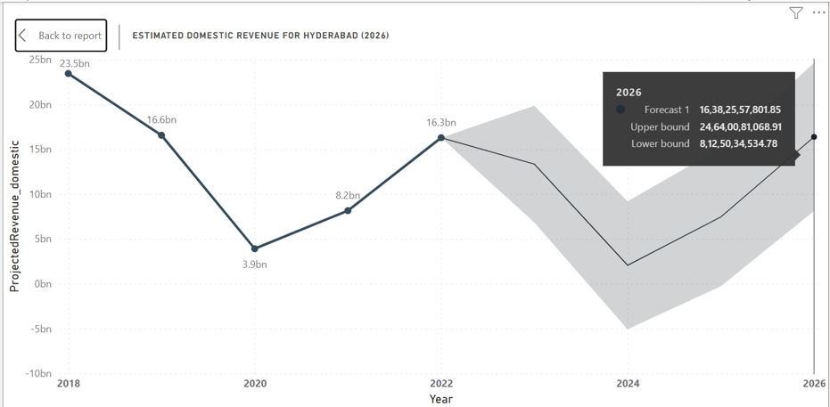
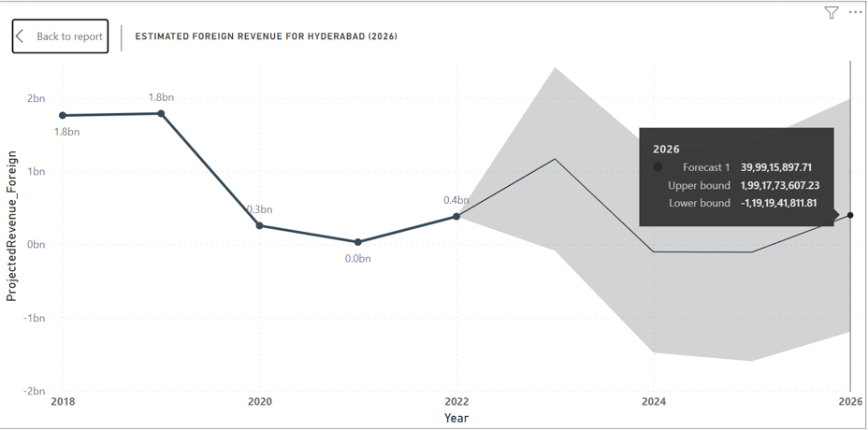
8. Estimate the projected revenue for Hyderabad in 2026 based on Average spend per tourist.
Revenue from Domestic Visitors
Average spend per Tourist – 1200 INR
Based on the given data, the graph representing the revenue generated by the domestic visitors from 2018 to 2022 shows a average trend.
In 2018, the revenue generated by domestic visitors was 23.5bn, and the projected revenue in 2026 is 17bn.
The trend suggest that the revenue may decline.
Revenue from Domestic Visitors
Average spend per Tourist – 5600 INR
Based on the given data, the graph representing the revenue generated by the foreign visitors from 2018 to 2022 shows a good hype in trend.
In 2018, the revenue generated by foreign visitors was 1.8bn, and the projected revenue in 2026 is 0.5bn.
The trend suggest that the revenue may decline and even become negative.

Slide 14
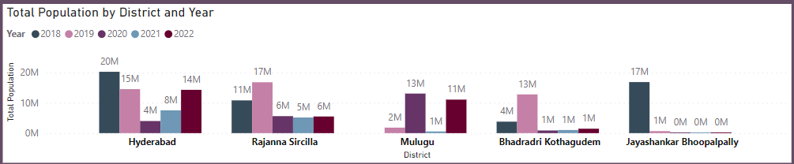
9. Which districts has the highest potential for tourism growth and what actions government can take?
Highlights :
Based on the available data, it can be inferred that
Mulugu
Bhadradri Kothgudem
Jayashankar Bhoopalpally
Districts have the high potential for tourism growth after Hyderabad and Rajanna Sircilla.
To boost tourism in districts, the Telangana Government can take several actions:
Mulugu
Government can promote Mulugu's natural beauty and cultural attractions such as Medaram Jatara and Bogatha Waterfall.
Bhadradri Kothagudem
The tourism department can initiate several schemes and policies to promote tourism in the state, like promoting historical temples : Parnashala, Peddamma talli temple,Kinnerasani wildlife sanctuary and Sri Seetha Ramachandra Swamy Devasthanam.
Jayashankar Bhoopalpally
The tourism department can promote the tourist places through digital marketing, TV advertisements and social media.
The Government can also collaborate with private players to develop tourist-friendly facilities.

Slide 15

10. Cultural / Corporate Events to boost tourism.
What kind of events the government can conduct?
Which months?
Which districts?
a.Events that government can conduct:
1.Cultural Dance and Music Events:
The state is celebrated for its splendid culture and dance.some of the most famous folk dances of Telanagana are Perini Sivathandavam, Lambadi Dance, Dhimsa dance, Dappu dance and many more.
2. Arts and Crafts Exbibitions:
Telanagana is a great place for arts and crafts with many outstanding handicrafts.
Bidri crafts
Banjara Needle Crafts
Nirmal Arts and many more
3.Corporate Events:
Organize Conferences, Seminars and workshops to showcase the Heritage of the state and how to preserve it.

Slide 16
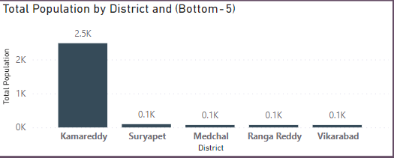
10. Cultural / Corporate Events to boost tourism.
What kind of events the government can conduct?
Which months?
Which districts?
b. Government can plan different events in following months:
Domestic Visitors – August and September.
Foreign Visitors – April and September
c. Districts
→Least visited districts – Kamareddy
Suryapet
Medchal
Ranga Reddy
Vikarabad

Slide 17
11. Dubai has made itself a business hub and enjoys massive business tourism. Can Hyderabad emulate Dubai model? Provide Insights based on your research.
Hyderabad has the potential to emulate the Dubai model In certain ways here are some few examples:
Strategic locations
Business- friendly policies
Tourism Infrastructure
Smart city initiative
Branding and Marketing
In conclusion, While Dubai’s success as a global business and tourism hub cannot be replicated in its entirely.
Hyderabad can learn from its example and implement strategies that can help it become a more attractive destination for businesses and tourists.
Hyderabad can position itself as a major player in the global business and tourism landscape.

Slide 18
12. Provide all other recommendations that can boost the Telangana tourism, particularly Hyderabad.
Government can organize different events like:
Cultural Festivals
Promote local culture and heritage
Offer tourist-friendly services
Food Festivals
Wellness and Ayurvedic Retreats
Develop Infrastructure and amenities
Increase marketing efforts
Offering discounts & packages
Promote Eco-Tourism

Slide 19
