Slide 1
Data Breach Analysis
From 2004 - 2019

Slide 2
Objective
Analyze patterns in data breaches and investigate historic data breaches to help surface potential loopholes that would help strategize data center security systems.
About Data
This is a data breach information over the years for various organizations that includes the intensity of loss, methods deployed as well as Sources that reported these breaches.
Assumptions
Assuming the sector of company to be domain specific (industry) and thus just keeping one sector for one company
The data breach incidents occurred in the same time period as mentioned in the story

Slide 3
Data Description
Attribute | Description | Data Type
Entity | name of the organization (public or private) that had the breach | String
Alternative Name | other known names of the entity | String
Story | tells a summary of what happened | String
Year | year of the breach | Date
Records Lost | number of records that breach compromised | Integer
Sector | organization's main sector (or field of business) | String
Data Sensitivity | tells about the sensitity level of the data lost | String
Method | main cause of the breach | String
1st Source Link | 1st. url with more info about the breach | String
2nd Source Link | 2nd. url with more info about the breach | String
Source Name | name of the source of news, official reports, blog, etc. included | String

Slide 4
Data Cleansing and Validation
Column names labeling
Dropped rows and columns
Used Regex to clean few column values
Utilized story to impute missing records value
Replaced data sensitivity levels to category names
Assigned correct Data Types
Validated data

Slide 5
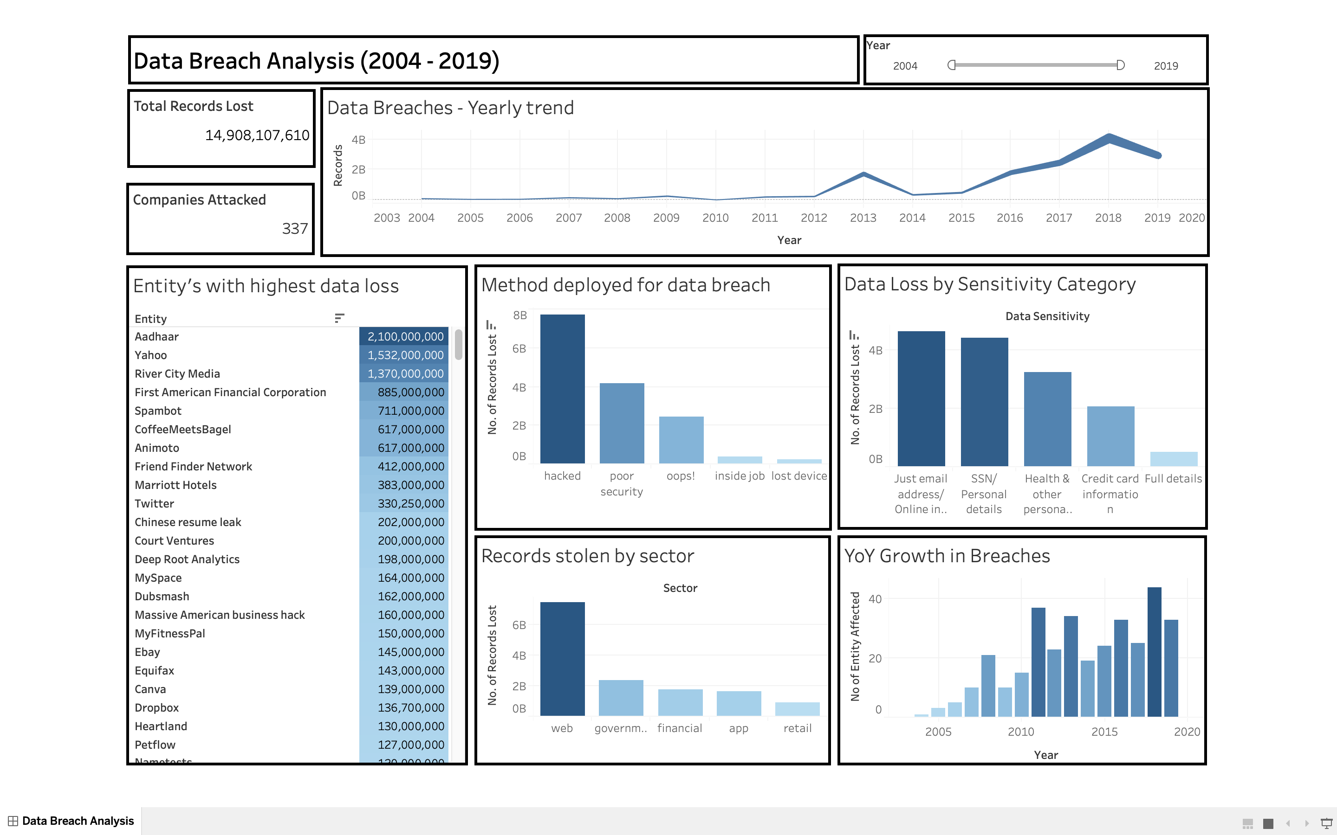

Slide 6
Insights
From the yearly trend, we can see that the number of records lost have increased over time from 2004 – 2019 (~15Bn records lost)
“Hacked” method has led to maximum data loss (52%) followed by “Poor Security” (28% ) and “Oops”(16%)
Entities from “web” sector have been affected most where most of the records lost were most sensitive like “SSN/ Personal Details”
Entity “Aadhaar” has seen tremendous data loss of more than 2Bn records with maximum in 2018, followed by “Yahoo” (1.5Bn) and “River City Media” (1.4Bn)

