Slide 1
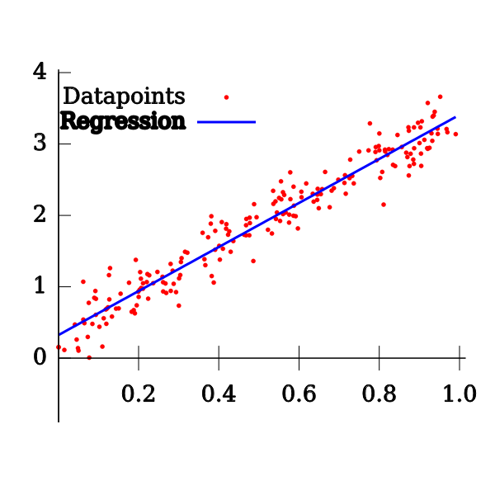
Explain the linear regression algorithm in detail.
Linear Regression is a machine learning algorithm based on supervised learning. It performs a regression task. Regression models a target prediction value based on independent variables. It is mostly used for finding out the relationship between variables and forecasting. Different regression models differ based on – the kind of relationship between dependent and independent variables they are considering, and the number of independent variables getting used. Linear regression performs the task to predict a dependent variable value (y) based on a given independent variable (x). So, this regression technique finds out a linear relationship between x (input) and y(output). Hence, the name is Linear Regression. In the figure above, X (input) is the work experience and Y (output) is the salary of a person. The regression line is the best fit line for our model.

Slide 2
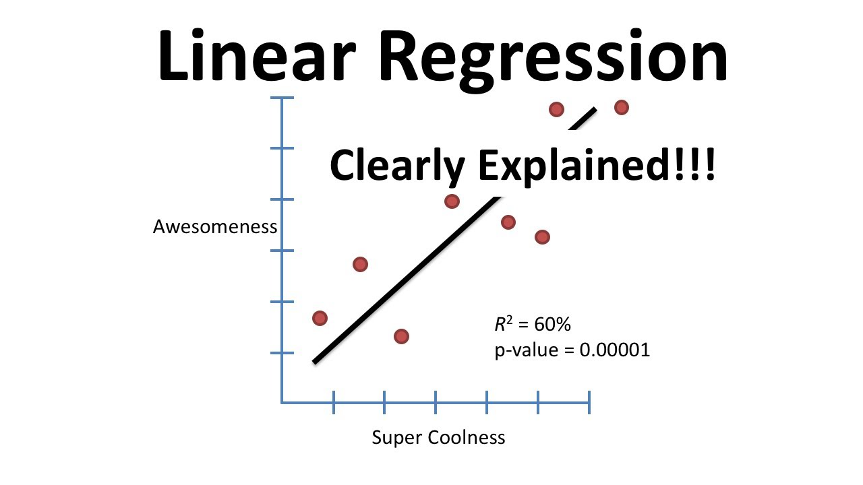
Linear Regression
You will learn primarily about the following two types of linear regression models:
Simple linear regression
You will learn about the generic steps that are required to build a simple linear regression model. You will first read and visualise the dataset. Next, you will split the dataset into train and test sets. After that, you will build the model on the training data and draw inferences. We have used the dataset and example from the ISLR book. You will use the advertising dataset given in ISLR and analyse the relationship between 'TV advertising' and 'sales' using a simple linear regression model. You will learn to make a linear model using two different libraries: statsmodels and SKLearn.
Multiple Linear Regression
Multiple Linear Regression. So far, we have discussed the simple linear regression, where the model is built using one independent variable only. But, what if you have multiple independent variables? How do you make a predictive model in such a case? Build a multiple linear regression on top of such a data is one such solution.

Slide 3
Hypothesis function for Linear Regression :
When training the model – it fits the best line to predict the value of y for a given value of x. The model gets the best regression fit line by finding the best θ₁ and θ₂ values. θ₁: intercept θ₂: coefficient of x
Once we find the best θ₁ and θ₂ values, we get the best fit line. So when we are finally using our model for prediction, it will predict the value of y for the input value of x.
x: input training data (univariate – one input variable(parameter)) y: labels to data (supervised learning)

Slide 4
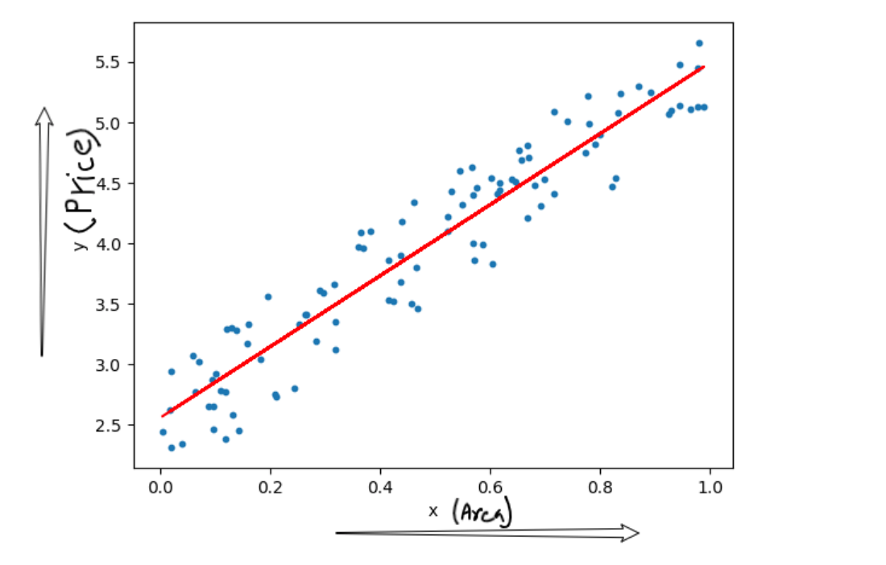
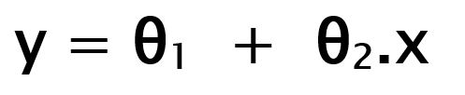
Hypothesis function for Linear Regression is function for Linear Regression

Slide 5
Null Hypothesis and Alternate Hypothesis
You start by saying that β1 is not significant, i.e. there is no relationship between X and y.
So in order to perform the hypothesis test, we first propose the null hypothesis that β1 is 0. And the alternative hypothesis thus becomes β1 is not zero.
Null Hypothesis (H0): β1=0
Alternate Hypothesis (HA): β1≠0
Let's first discuss the implications of this hypothesis test. If you fail to reject the null hypothesis that would mean that β1 is zero which would simply mean that β1 is insignificant and of no use in the model. Similarly, if you reject the null hypothesis, it would mean that β1 is not zero and the line fitted is a significant one.

Slide 6
Building a Linear Model
F-statistic
You were introduced to a new term named F-statistic and Prob(F-statistic). Now, recall that in the last segment, you did a hypothesis test for beta to determine whether or not the coefficient β1 outputted by the model was significant or not. Now, F-statistic is similar in the sense that now instead of testing the significance of each of the betas, it tells you whether the overall model fit is significant or not. This parameter is examined because many a time it happens that even though all of your betas are significant, but your overall model fit might happen just by chance.

Slide 7
R-squared
R-squared value tells you exactly how much variance in the data has been explained by the model. In our case, the R-squared is about 0.816 which means that the model is able to explain 81.6% of the variance which is pretty good.
Coefficients and p-values:
The p-values of the coefficients (in this case just one coefficient for TV) tell you whether the coefficient is significant or not. In this case, the coefficient of TV came out to be 0.0545 with a standard error of about 0.002. Thus, you got a t-value of 24.722 which lead to a practically zero p-value. Hence, you can say that your coefficient is indeed significant.

Slide 8
Residual Analysis and Predictions
Recall that one of the assumptions that you studied was that the error terms should be normally distributed with mean equal to 0. So once you have built the model, you'd need to verify if your model is not violating this assumption. And doing this is fairly simple: you just plot a histogram of the error terms to check whether they are normally distributed. And another assumption was that the error terms should be independent of each other. Again for this, you need to plot the error terms, this time with either of X or y to check for any patterns.

Slide 9
Cost Function :
By achieving the best-fit regression line, the model aims to predict y value such that the error difference between predicted value and true value is minimum. So, it is very important to update the θ₁ and θ₂ values, to reach the best value that minimize the error between predicted y value (pred) and true y value (y).
Cost function(J) of Linear Regression is the Root Mean Squared Error (RMSE) between predicted y value (pred) and true y value (y).

Slide 10
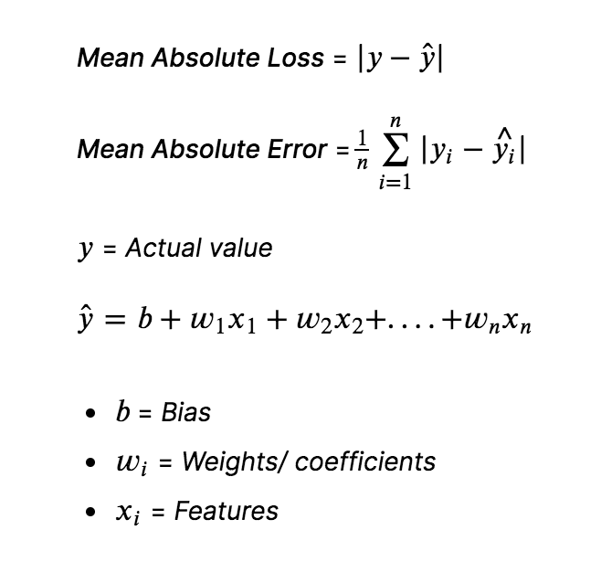
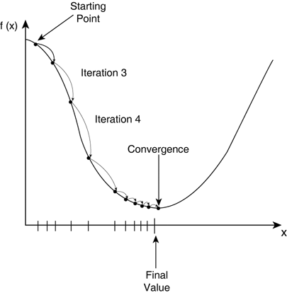
Cost Function

Slide 11
Gradient Descent:
To update θ₁ and θ₂ values in order to reduce Cost function (minimizing RMSE value) and achieving the best fit line the model uses Gradient Descent. The idea is to start with random θ₁ and θ₂ values and then iteratively updating the values, reaching minimum cost.

Slide 12
Explain the Anscombe’s quartet in detail.
Anscombe’s quartet comprises four datasets that have nearly identical simple statistical properties, yet appear very different when graphed. Each dataset consists of eleven (x,y) points. They were constructed in 1973 by the statistician Francis Anscombe to demonstrate both the importance of graphing data before analyzing it and the effect of outliers on statistical properties.
Simple understanding:
Once Francis John “Frank” Anscombe who was a statistician of great repute found 4 sets of 11 data-points in his dream and requested the council as his last wish to plot those points. Those 4 sets of 11 data-points are given below.

Slide 13
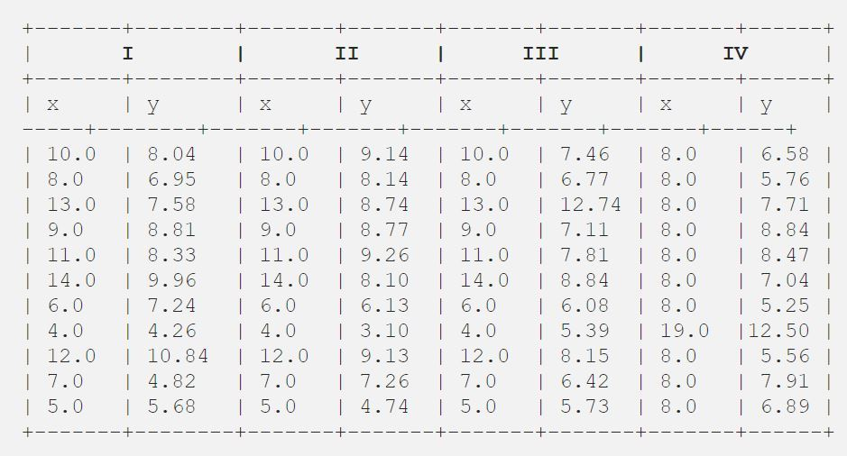
After that, the council analyzed them using only descriptive statistics and found the mean, standard deviation, and correlation between x and y.

Slide 14
What is Pearson’s R?
In statistics, the Pearson correlation coefficient (PCC), also referred to as Pearson's r, the Pearson product-moment correlation coefficient (PPMCC), or the bivariate correlation, is a measure of linear correlation between two sets of data. It is the covariance of two variables, divided by the product of their standard deviations; thus it is essentially a normalised measurement of the covariance, such that the result always has a value between −1 and 1.

Slide 15
The Pearson's correlation coefficient varies between -1 and +1 where:
r = 1 means the data is perfectly linear with a positive slope ( i.e., both variables tend to change in the same direction)
r = -1 means the data is perfectly linear with a negative slope ( i.e., both variables tend to change in different directions)
r = 0 means there is no linear association
r > 0 < 5 means there is a weak association
r > 5 < 8 means there is a moderate association
r > 8 means there is a strong association

Slide 16
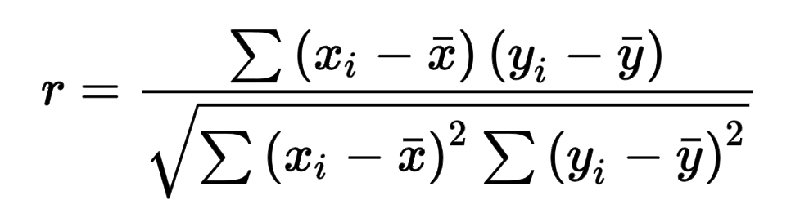
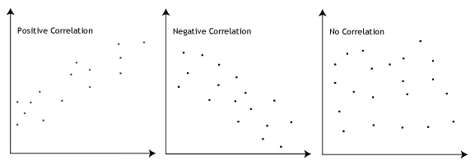
Pearson r Formula
r =correlation coefficient
x =values of the x-variable in a sample
x =mean of the values of the x-variable
y =values of the y-variable in a sample
y =mean of the values of the y-variable

Slide 17
What is the difference between normalized scaling and standardized scaling?
Normalization typically means rescales the values into a range of [0,1]. Standardization typically means rescales data to have a mean of 0 and a standard deviation of 1 (unit variance).
S.NO. | Normalisation | Standardisation
1. | Minimum and maximum value of features are used for scaling | Mean and standard deviation is used for scaling.
2. | It is used when features are of different scales. | It is used when we want to ensure zero mean and unit standard deviation.
3. | Scales values between [0, 1] or [-1, 1]. | It is not bounded to a certain range.
4. | It is really affected by outliers. | It is much less affected by outliers.
5. | Scikit-Learn provides a transformer called MinMaxScaler for Normalization. | Scikit-Learn provides a transformer called StandardScaler for standardization.
6. | This transformation squishes the n-dimensional data into an n-dimensional unit hypercube. | It translates the data to the mean vector of original data to the origin and squishes or expands.
7. | It is useful when we don’t know about the distribution | It is useful when the feature distribution is Normal or Gaussian.
8. | It is a often called as Scaling Normalization | It is a often called as Z-Score Normalization.

Slide 18
You might have observed that sometimes the value of VIF is infinite. Why does this happen?
If there is perfect correlation, then VIF = infinity. This shows a perfect correlation between two independent variables. In the case of perfect correlation, we get R2 =1, which lead to 1/(1-R2) infinity. To solve this problem we need to drop one of the variables from the dataset which is causing this perfect multicollinearity.
An infinite VIF value indicates that the corresponding variable may be expressed exactly by a linear combination of other variables (which show an infinite VIF as well).

Slide 19
Q-Q plot in linear regression-Explained
Quantile-Quantile (Q-Q) plot, is a graphical tool to help us assess if a set of data plausibly came from some theoretical distribution such as a Normal, exponential or Uniform distribution. Also, it helps to determine if two data sets come from populations with a common distribution.
This helps in a scenario of linear regression when we have training and test data set received separately and then we can confirm using Q-Q plot that both the data sets are from populations with same distributions

Slide 20
Few advantages:
A. It can be used with sample sizes also.
B.Many distributional aspects like shifts in location, shifts in scale, changes in symmetry, and the presence of outliers can all be detected from this plot.
It is used to check following scenarios:-
i. come from populations with a common distribution
ii. have common location and scale
iii. have similar distributional shapes
iv. have similar tail behavior

Slide 21
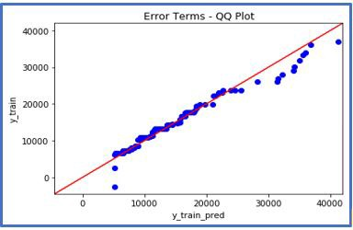
Interpretation:
A q-q plot is a plot of the quantiles of the first data set against the quantiles of the second data set.
Below are the possible interpretations for two data sets.
a) Similar distribution: If all point of quantiles lies on or close to straight line at an angle of 45 degree from x -axis
b) Y-values < X-values: If y-quantiles are lower than the x-quantiles.

Slide 22
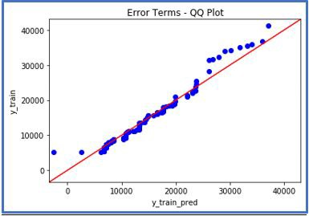
X-values < Y-values: If x-quantiles are lower than the y-quantiles.
d) Different distribution: If all point of quantiles lies away from the straight line at an angle of 45 degree from x –axis

Slide 23

Thank You

