Slide 1
AI Agent for Smart Farming Advice
CAPSTONE PROJECT
Presented By:
1. SUSHMITHA DEVI V - VIT Vellore - BCA

Slide 2
OUTLINE
Problem Statement
Proposed System/Solution
System Development Approach
Result
Conclusion
Future Scope
References

Slide 3
Problem Statement
Small-scale farmers often face challenges in accessing timely, localized, and trustworthy agricultural advice. They lack easy access to information on crop selection, pest management, fertilizer usage, and real-time weather or market price updates. This limits their ability to make data-driven decisions, leading to reduced yields and financial instability.

Slide 4
Proposed Solution
We propose an AI Agent powered by RAG (Retrieval-Augmented Generation) using IBM Watsonx.ai (Granite model) that delivers real-time agricultural advice. This intelligent assistant retrieves data from trusted sources like government agricultural departments, weather APIs, and agri-market databases. It answers user queries in natural/local language, providing relevant suggestions on:
Suitable crops for current conditions
Weather-based irrigation tips
Pest control strategies
Mandi (market) price updates
The system reduces risk, improves yield, and empowers small-scale farmers with knowledge-driven decision-making.

Slide 5
System Approach
Component | Technology Used
Platform | IBM Cloud (Lite plan)
AI Model | Granite-3-8b-instruct (Watsonx.ai)
Agent Architecture | ReAct + LangGraph
Core Technique | Retrieval-Augmented Generation (RAG)
Build Interface | Watsonx Agent Builder
Language Support | Natural language input (local-friendly)
Tools (optional) | Google Search, Weather, Market Rate APIs

Slide 6
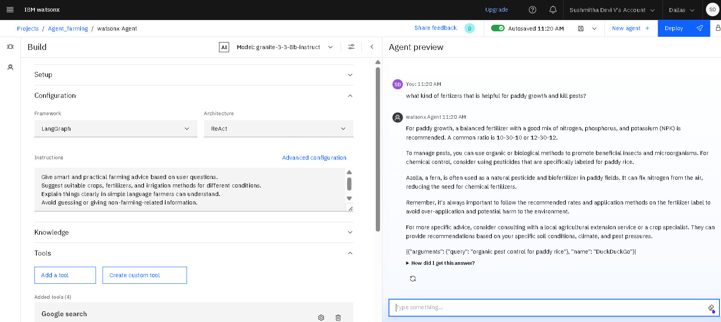
Result

Slide 7
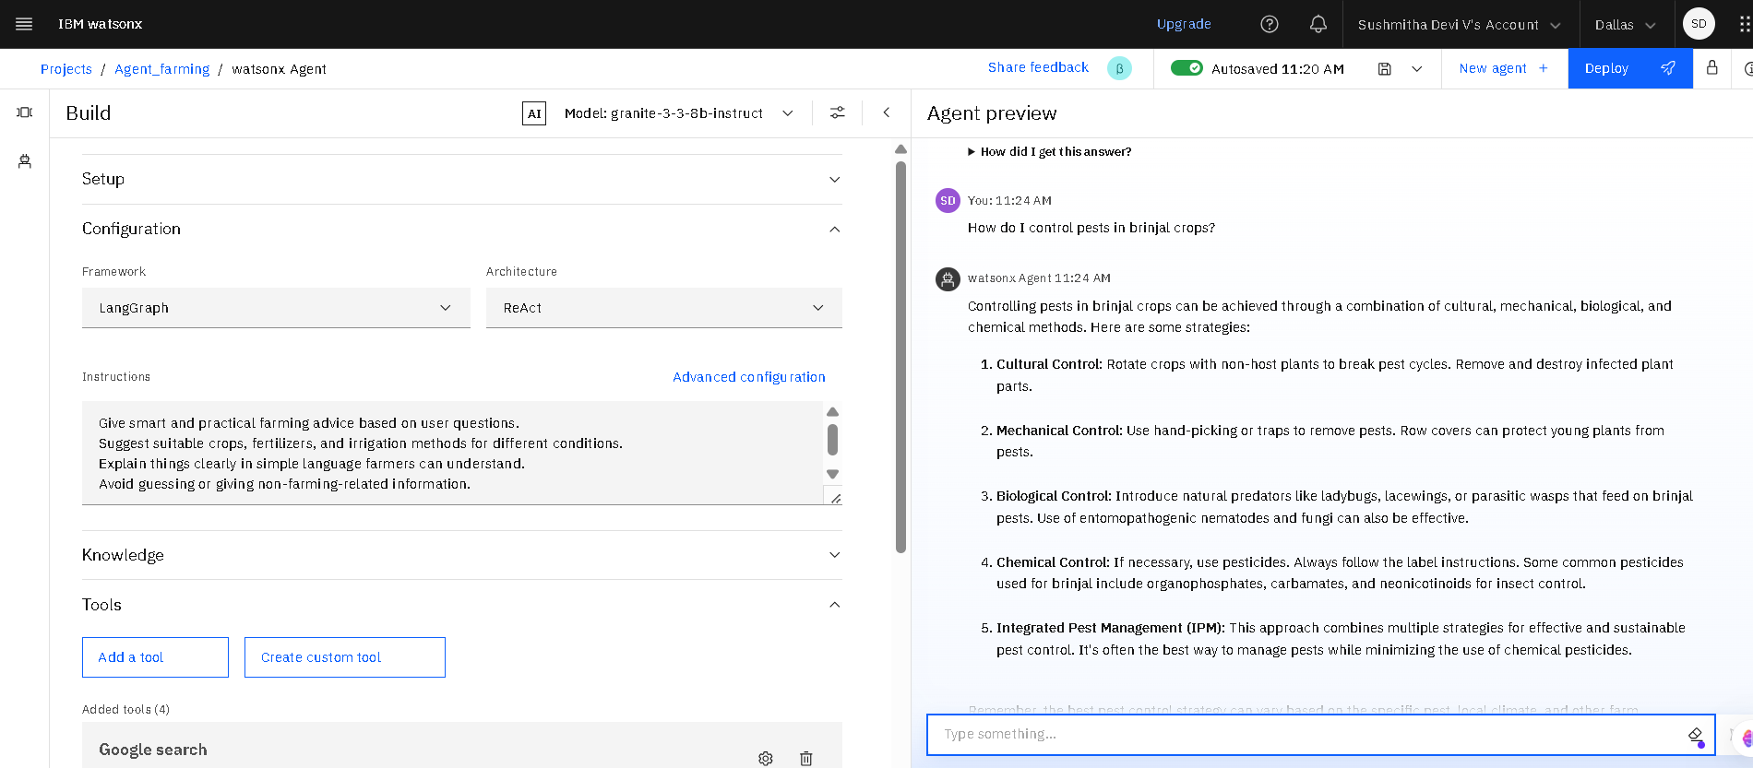
Result

Slide 8
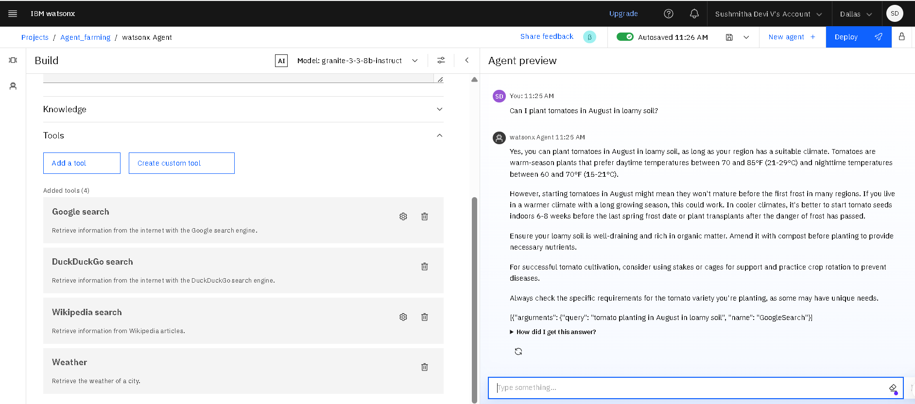
Result

Slide 9
Result
The AI Agent successfully delivered accurate and farmer-friendly responses to real-time queries on crop selection, fertilizer usage, and pest control using the Granite model within IBM Watsonx.ai.
Retrieval-Augmented Generation (RAG) was effectively demonstrated through integrated tools like Google, DuckDuckGo, Wikipedia, and Weather, enabling the agent to fetch and generate localized, real-world farming advice.

Slide 10
Conclusion
This AI Agent bridges the digital knowledge gap for small farmers. It delivers personalized and localized farming advice through natural language interaction. Using IBM Watsonx.ai and RAG architecture, the system provides smart, real-time guidance — increasing yield and reducing farming risk.

Slide 11
Add support for Tamil and other Indian languages
Integrate weather APIs and soil sensors (IoT)
Provide WhatsApp/SMS interface for rural users
Enable voice-based interaction
Connect with government subsidy/scheme portals
Future scope
.

Slide 12
References
IBM Watsonx.ai Docs – https://dataplatform.cloud.ibm.com
IBM Granite Model Details – IBM Cloud
RAG Concept – Facebook AI Research
OpenWeather API – https://openweathermap.org
Agmarknet (Mandi Prices) – https://agmarknet.gov.in
Ministry of Agriculture, Government of India.

Slide 13
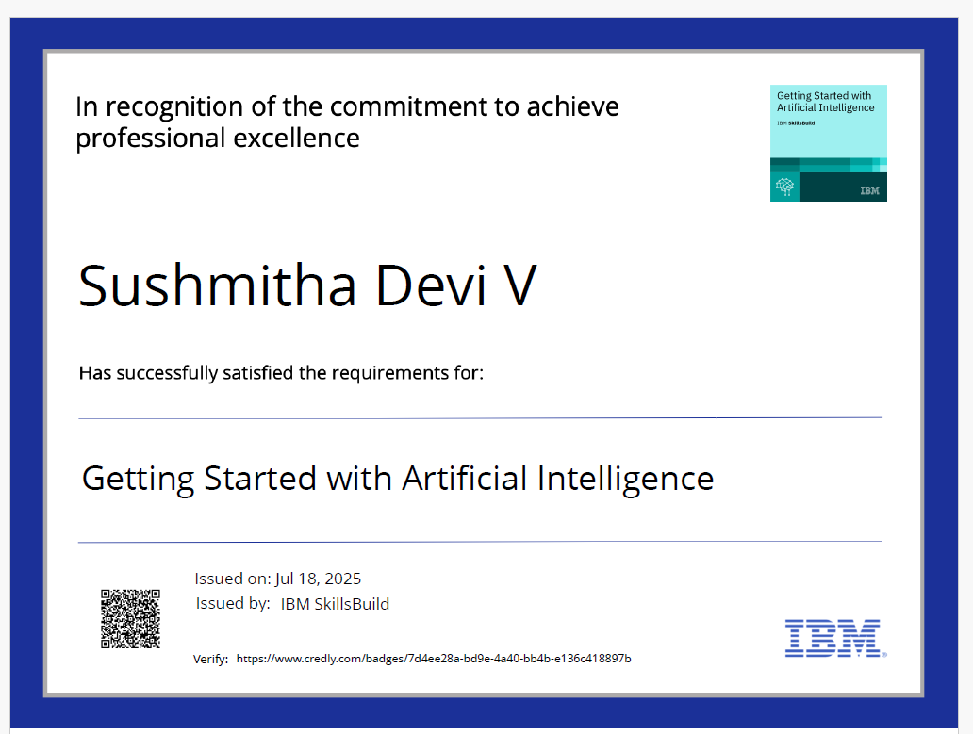
IBM Certifications

Slide 14
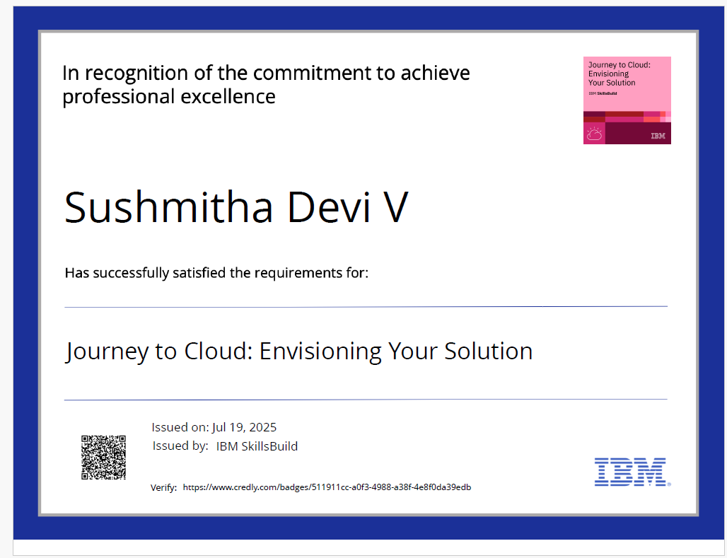
IBM Certifications

Slide 15
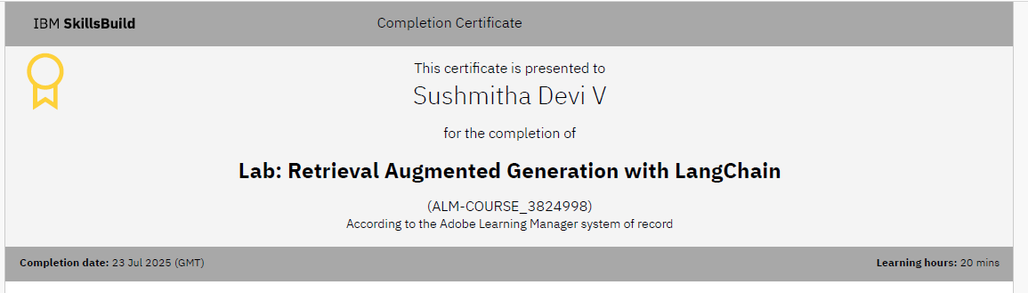
IBM Certifications

Slide 16
THANK YOU

