Slide 1

JAWAHARLAL NEHRU NATIONAL COLLEGE OF ENGINEERING
DEPARTMENT OF COMPUTER SCIENCE AND ENGINEERING
Final phase presentation
On
“COLLEGE WALLET - A mobile based smart cashless assistant for a student in the college scenario”
By
RASHMI S J 4JN12CS077
SUSHMITHA MANJUNATH 4JN12CS108
SHWETHA I P 4JN12CS121
SRIDEVI M 4JN12CS123
Project Co-ordinators Under the guidance of
2.Mr.Ravindra _{B.E, M.Tech}
Asst. Prof, Dept. of CSE
3.Dr.Poornima K M _{B.E, M.Tech .,Ph..D}
Professor, Dept. of CSE
1.Mr.Narendra Kumar S _{B.E, M.Tech} Mr. Chethan K R _{B.E, M.Tech}
Asst. Prof, Dept. of CSE Asst. Prof, Dept. of CSE

Slide 2
ABSTRACT
The project aims to “replace the physical wallets in the hands of students by digital wallets”. Instead of following the traditional payment mechanism which is tedious and time consuming , all the payments like of library, hostel fee ,college fee ,fees related to examination ,payment for canteen coupons could be done easily under one single application which is most appropriate for students.
This project can be applied in any educational institutions as well as organizations where day to day money transactions are involved. The reduction in the unwanted queues during operations of the institutions and taking care of the theft of cash is also another important application of this wallete. Digitization is an important trending factor and this project is one product that aims at complete paperless and cashless product.

Slide 3
OVERVIEW
INTRODUCTION
PROBLEM DESCRIPTION
LITERATURE REVIEW
OBJECTIVE
ARCHITECTURE
IMPLEMENTATION
REFRENCES

Slide 4
INTRODUCTION
The manual accounting system in colleges is time and energy consuming, students need to wait in queues for hours. Power cuts and fake notes are also the major issue.
Existing library management system maintains students database of all semesters. Beginning of each semester books will be issued to students depending upon their branches and semesters by general book bank section. Present library system contains mainly 2 sections GBB and Lending sections.
Payments at account section includes college fee (yearly basis),examination fee and revaluation fee(semester basis). In addition to this study certificate fee, fee for obtaining duplicate marks card and if any due charges
Existing hostel fee payment is done at hostel office on yearly basis. There are four schemes like single seater (Rs.23000), double seater (Rs.20000), three seater (Rs.18000) and four seater (Rs.17000). Mess fee payment is done on monthly basis (Rs.1200)
Students have to stand in queue to buy coupons using which students can get desired food. Hence to overcome these corns COLLEGE WALLET is a solution which overcomes traditional manual money transactions.

Slide 5
PROBLEM DESCRIPTION
Manual systems put pressure on people to be correct in all details of their work at all times. It can be easy to accidentally switch details and end up with inconsistency in data entry or in hand written orders. Manual system is time consuming for students since they will have to spend their precious time waiting in queues for general book bank dues, examination fee, revaluation fee, library due payments, hostel bill payments, canteen bill payments. Reporting and checking these data can be timely and expensive. This is often an area where significant money can be saved by automation. If manual record book is lost data will be completely lost

Slide 6
LITERATURE REVIEW
TITLE | AUTHOR | METHODOLOGY | ADVANTAGES | DISADVANTAGES
Cashless transactions | Jashim Khan Margaret Craig-Lees | Cashless transactions, Mobile transactions, Money , Debit cards, Credit cards | Cashless society , “unmanned” vending machine, PDA, Electronic payment systems. | Increase in overall consumption, personal debt levels, over-consumption.
White paper- banking on mobile wallet | Anjani–kumar , Sai Prasad Seri | Saving oriented customer segments. | Tech savvy, Saving oriented customer segments. | Appealing to fraudsters, Key personal information, Theft during wireless transmission.

Slide 7
TITLE | AUTHOR | METHODOLOGY | ADVANTAGES | DISADVANTAGES
Cashless society : Drives and challenges in Nigeria | Maitanmi Olusola, Awodele Oludele, Ogbonna Chibueze and Osundina Samuel | ATM, Base Money, Cashlite, Cashless, and POS. | Economic uniformity, time, ease of use, reduction in card production cost | Remembering pin and passwords, unstable electronic value of money, possibility of theft.
The Future Of Mobile Wallets Lies Beyond Payments | Thomas Husson | Marketing platform, value to marketers, contextual offerings. | More convinient payment solution. | Need to win consumers’ trust.

Slide 8
OBJECTIVES
The following are the objectives of our project – College Wallet:
To enable the payment for various sections of the college like library, Exam, Accounts, Hostel and Canteen using smart phones
Generation of appropriate receipts for each billing transaction
Maintaining accurate accounting of each transactions for each section
Allowing flexible recharging and lending facilities.
Ensuring each transaction is secure using authentication and One Time Password (OTP) mechanisms
Making provisions for speedy and internet free transactions
Designing an easy to use and attractive interface for the users and providers
Designing and development of a normalized database for the proper interaction of all the modules involved.
Allowing location and timing constraints to be incorporated in the billing mechanism

Slide 9



ARCHITECTURE
SERVER DISPATCHER
WEB DATA
SMS
PAY FEES
PAY RV FEES
CANTEEN BILL
HOSTEL MESS
SOCIETY BILL
LIBRARY BILL
OTHER BILLS
INTERNET APP PROCESSOR
APP
SMS PROCESSOR
WALLETDB
STUDENT
LIBRARY
ACCOUNT
HOSTEL
EXAM
CANTEEN

Slide 10
This project is proposed to be implemented using a modular architecture with the following modules:
User Interface : This module is intended to develop easy to use and attractive UI for both students and server side operators/administrators
Business Logic: This module implements all the cashless payment functionalities interacting with client and server side components. It includes provisioning both wallet amount deductions and recharging facilities
Security: Most of the transactions exchanged in this project are sensitive and this module implements security functionalities using encryption, digest and One Time Passwords (OTP) schemes
Database: This module is intended to develop a core database to store all billing, auditing, and each service modules data like Exam, Library, Canteen and others

Slide 11
Receipts/Reports: The module that performs post processing of various transactions and allows generation of frequently needed report by organizations/institutions for auditing purpose.
Student: It is the user of the application. Submodules of student are library, canteen, account section, hostel section.
Maintenance personnel: It is the database administrator who is responsible for creation, updation and maintenance of database. Rather than storing all the information manually or in a single computer, we store it in on a server for fast and better retrieval of information effectively.
Network is an interface that connects student and the server. Student can access the server either through the internet or through sms.

Slide 12
Server Dispatchers : Server dispatchers are communications personnel responsible for receiving and transmitting pure and reliable messages and recording other important information. Essentially, the dispatcher is the “conductor" of the force, and is responsible for the direction of all units within it.
Internet processor: A processor is the logic circuitry that responds to and processes the basics instructions that drive a computer. Internet processor processes the instructions from server dispatcher and sends it to the wallet database.
SMS Processor: The SMS Processor monitors an SMS Queue and is monitoring the Inbox folder for new files and when one is detected it is read and written into the database via Server.

Slide 13
REQUIREMENT ANALYSIS

Slide 14
FUNCTIONAL REQUIREMENT
A functional requirement defines functions of the software system or its components. A function is described as a set of inputs, the behavior, and outputs. The College Wallet services for a student must have two major functionalities.
They are:
Register
Login
Exam section
Canteen
Society

Slide 15
NON FUNCTIONAL REQUIREMENT
There are a number of constraints that need to be satisfied. A few of them may be stated as follows:
The phone should have internet connection.
The platform used must need to be Android only.
The balance has to be checked before every transaction. .
The application must be user friendly for the user to understand it.
The application must be updated with the addition of new items in the canteen.
The Android versions must support the application.
The user’s phone should be GPS connected.

Slide 16
IMPLEMENTATION

Slide 17
WALLET TABLE
USN | BALANCE

Slide 18
start
Signup
Name, Pwd,Phno, EmailId, Branch, Semester
Send to server side registration script
Failure
Status
success
login

Slide 19
Algorithm for server side "registration script"
Step 1: Receive input (usn, name, password, phone no, email, branch, sem,parentno)
Step 2: If any of the field is invalid, send failure message(some fields are invalid). goto step1
Step 3: Check if usn exist
Step 4: If yes send failure message(usn already exists). stop
Step 5: Insert information into registration table
Step 6: Send message(registration successful)

Slide 20
Start
LOGIN
USN, password
Send to server side login
script
Status
Failure
success
Login

Slide 21
Algorithm for “login script”
Step 1:Receive USN and Password from user mobile devices.
Step 2:If USN or Password is invalid send failure message "STOP".
Step 3. Check if USN exists in database, if yes goto 6.
Step 4. If no send failure message as "Invalid username or password".
Step 5. Check if password matches with username if yes goto 9.
Step 6. If no send failure message "Invalid password" and display message "Forgot password".
Step 7. Send "Change password" link to the registered email id by fetching it from the registration table then goto1.
Step 8. Login successful.

Slide 22
Login and signup table
USN | NAME | PASSWORD | PHONE NO | EMAIL ID | BRANCH | SEMESTER | PANRENT_PHONENO

Slide 23
Start
HOSTEL
Select category monthly/annual fee
Monthly fee
Annual fee
Mess bill
Room rent+others
Confirmation
No
Yes
OTP
Validation
No
Yes
Script update
Successfull

Slide 24
Algorithm for hostel
STEP 1: Receive category input(monthly or annual)
Step 2: Calculate amount
Step 3: Ask for confirmation, If no goto 1.
Step 4: Successful [Deduct calculated amount from user valid] show remaining balance.
Step 5: Add transaction details to the monthly/ yearly hostel table

Slide 25
MONTHLY HOSTEL TABLE
USN | MESS BILL | MONTH | YEAR | DATE & TIME
YEARLY HOSTEL TABLE
USN | RENT | YEAR | DATE & TIME

Slide 26
Canteen
CANTEEN
Proximity?
No
Yes
Order
Order/Cancel
Cancel
If items ordered
No
No items in list
Display items from server
Yes
Items,
Quantity
Display ordered items
Calculate price
No
Confirmation
B
Yes
A

Slide 27
CONTINUED…
Canteen
A
B
Send usn,item,qty to script
Select items to cancel
OTP
If items selected
No
No
Yes
Validate
Successful
Yes
Delete items
Script Update

Slide 28
Algorithm for "ordering"
Step 1:Available items list and price is fetched from server and displayed to user
Step 2: Receive input(usn,item, quantity) from user's mobile
Step 3: Calculate total amount
Step 4: Ask for confirmation. if no goto step1
Step 5: Deduct calculated amount from wallet
Step 6: Send confirmation message
Step 7: Stop

Slide 29
Algorithm for "cancel order"
Step 1: Receive input(items to be cancelled) from user's mobile
Step 2: Calculate new total
Step 3: Ask for confirmation. if no goto step1
Step 4: Add cancelled items amount into wallet
Step 5: Send confirmation message
Step 6: Stop

Slide 30
CANTEEN_FOOD
Item_name | Available_no | Price | Type
USER_CANTEEN
Usn | Item_name | Quantity_ordered | Date_Time
CANTEEN_TRANSACTION
Usn | Date_Time | Amount_paid

Slide 31
Library
Library
Select options
GBB
Lending
Others

Slide 32
Continued..
GBB
No. Of books issued
Total amount
No
Library
Confirmation
Yes
OTP
Validation
Yes
Successful
Script
Update
No

Slide 33
Lending
Continued..
No of days delayed
Calculate amount
No
Confirmation
Library
Yes
OTP
NO
Validation
Yes
Successful
Script
Update

Slide 34
Continued..
Others
Select
ID/Book misplaced
Books
ID
No. Of books
Calculate amount
Library
NO
Confirmation
YES
OTP
NO
Validation
YES
Successful
Script update

Slide 35
Algorithm for library
Step 1: Receive input(GBB, lending or others) if "lending" goto step6 if "others" goto step7
Step 2: Fetch number of books issued in GBB
Step 3: Calculate total amount
Step 4: Ask for confirmation, If NO goto step1
Step 5: Deduct calculated amount from user's wallet.
Step 6: Calculate number of days delayed goto step3
Step 7: Receive input(id lost or book misplaced) if "id lost" goto step3
Step 8: Receive input(no of books misplaced) goto step3
Step 9: Stop

Slide 36
Lending section table
USN | No of books issued | Amount | Date & Time
GBB table
USN | Return date | No of books | Amount

Slide 37
Account Section
Accounts
Select category
RV/Exam/Others
RV
Exam
others

Slide 38
Continued..
Exam
Display possible subs
Select subjects
Confirmation
calculate amount
No
Yes
OTP
Add to script
success
Yes
Validate
No

Slide 39
RV
Continued..
Display possible subject
select sub codes to apply
Check
For
fine
No
Total amount=fees
Yes
Confirmation
Total amount=fees+fine
No
Yes
OTP
Add to script
Yes
No
success
Validate

Slide 40
Continued..
Others
Select
ID/convocation/certificate
Calculate amount
confirmation
No
Yes
OTP
Add to script
Yes
success
Validate
No

Slide 41
Algorithm exam
step 1: display the sub codes of possible subjects for the user based on his current semester, also including back subjects from previous semester
step 2: receive input ( selected subject code that user wants to apply)
step 3: calculate total amount
step 4: ask for confirmation, if no goto step1
step 5: deduct amount from user's wallet and send confirmation message
step 6: end

Slide 42
Algorithm RV
Step1: display list of subject codes that user attempted in last exam
step 2: receive input (selected subject codes that user wants to apply for RV)
step 3: calculate total amount
step 4: ask for confirmation, if no goto step1
step 5: deduct amount from user's wallet and send confirmation message
step 6: end

Slide 43
Algorithm “Others”
step 1: receive input(ID, Convocation or certificate)
step 2: calculate total amount
step 3: ask for confirmation, if no goto step1
step 4: deduct amount from user's wallet and send confirmation message
step 5: end

Slide 44
TABLE EXAM
USN | SUBCODE | FEES_PAID | DATE _TIME
TABLE RV
USN | SUBCODE | FEES_PAID | DATE_TIME
TABLE CERTIFICATE
USN | CERTIFICATE_TYPE | FEES_PAID | DATE_TIME

Slide 45
Society
SOCIETY
Proximity?
No
Yes
Order
Order/Cancel
Cancel
If products ordered
No
No items in list
Display products from server
Yes
Items,
Quantity
Display ordered items
Calculate price
No
Confirmation
B
Yes
A

Slide 46
CONTINUED…
Canteen
A
B
Send usn,product,qty to script
Select products to cancel
OTP
If products selected
No
No
Yes
Validate
Successful
Yes
Delete product
Script Update

Slide 47
Algorithm for "ordering“
Step 1:Available items list and price is fetched from server and displayed to user
Step 2: Receive input(usn,item, quantity) from user's mobile
Step 3: Calculate total amount
Step 4: Ask for confirmation. if no goto step1
Step 5: Deduct calculated amount from wallet
Step 6: Send confirmation message
Step 7: Stop

Slide 48
Algorithm for "cancel products"
Step 1: Receive input(items to be cancelled) from user's mobile
Step 2: Calculate new total
Step 3: Ask for confirmation. if no goto step1
Step 4: Add cancelled items amount into wallet
Step 5: Send confirmation message
Step 6: Stop

Slide 49
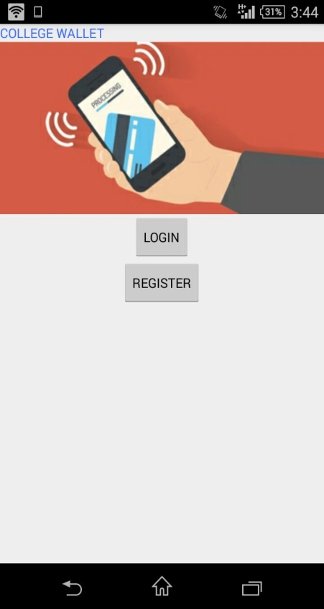
RESULTS AND ANALYSIS
snapshot of registration and login

Slide 50
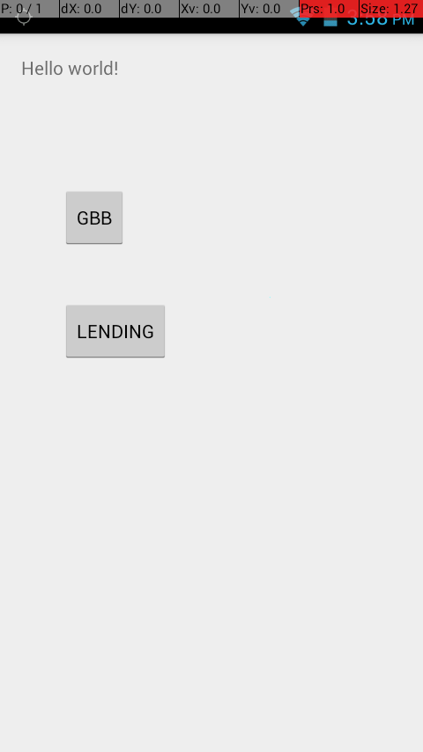
Snapshot of library module

Slide 51
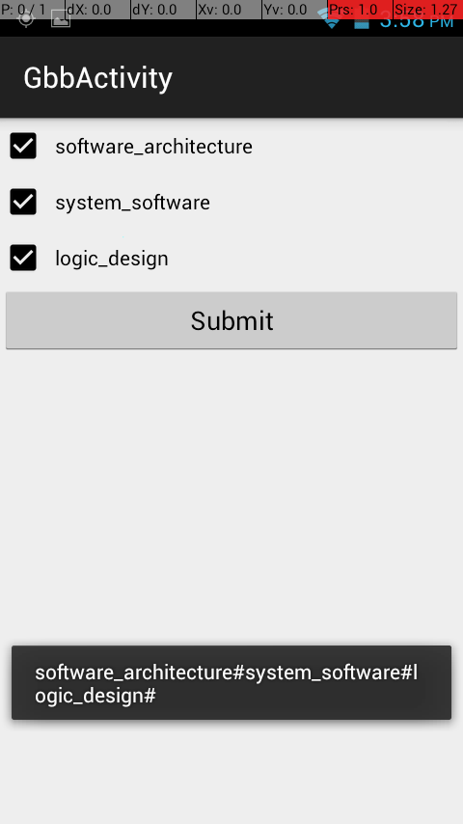
Snapshot of general book bank submodule

Slide 52
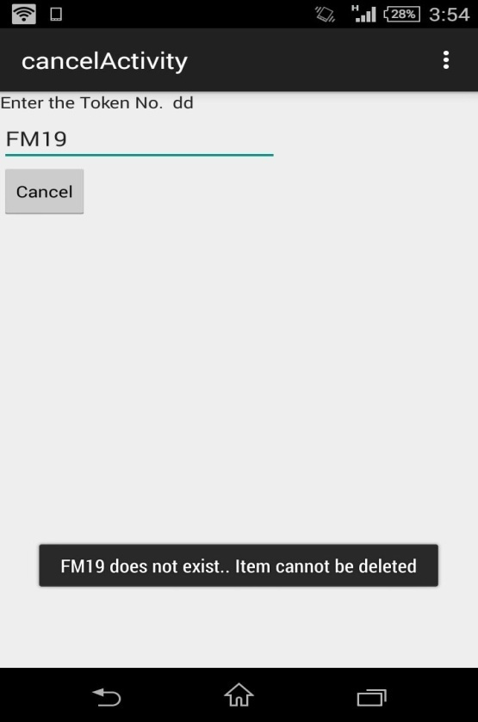
Snapshot of cancelling an item in canteen module

Slide 53
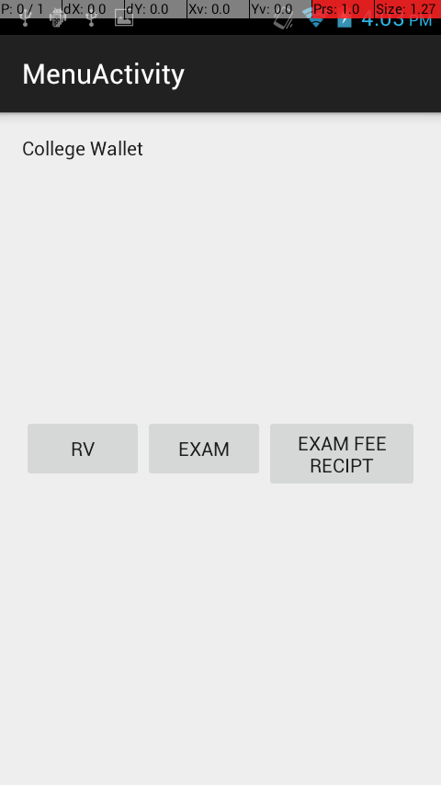
Snapshot of exam module

Slide 54
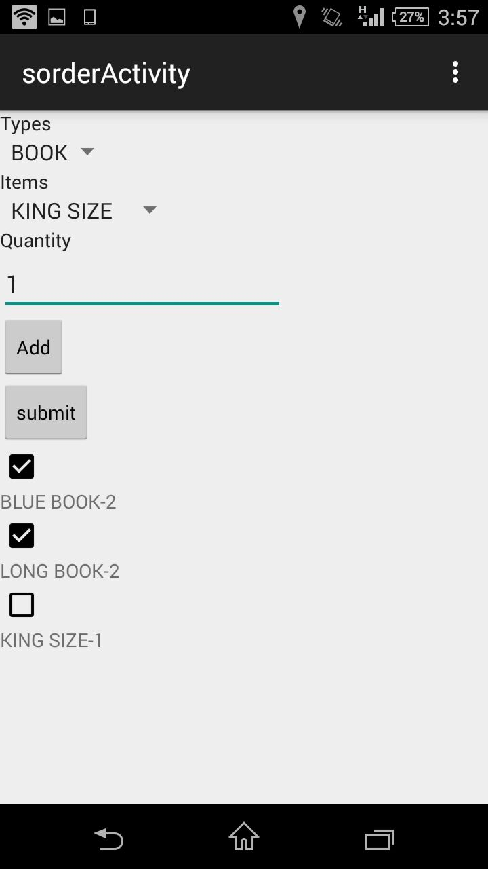
Snapshot of society module

Slide 55
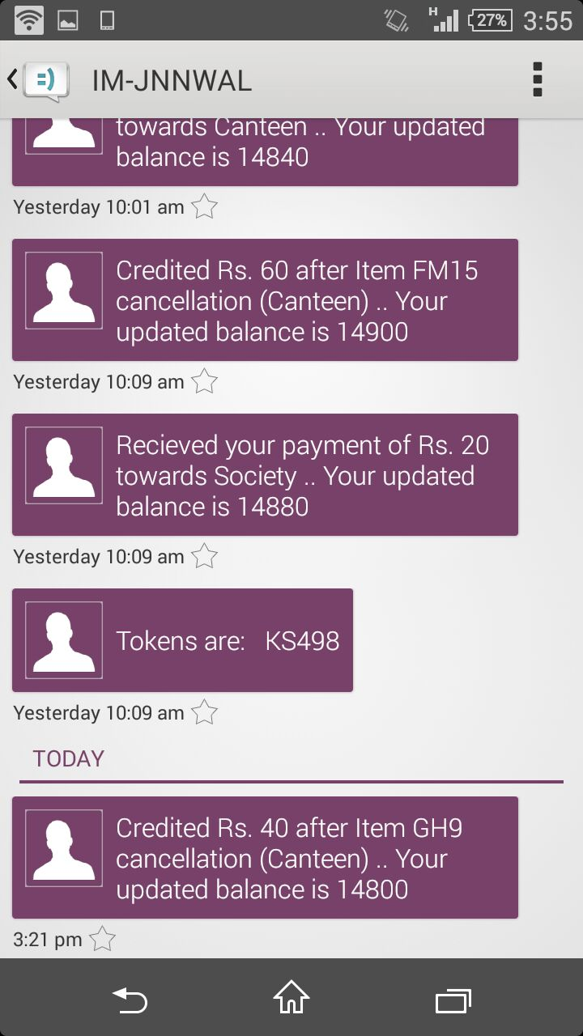
Fig8. Snapshot of admin messages sent to student

Slide 56
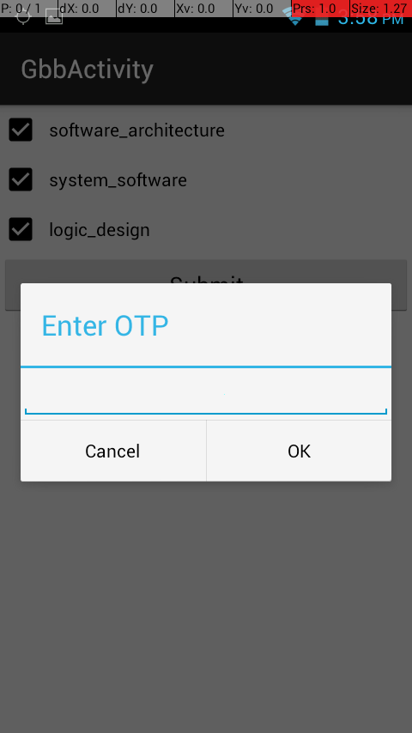
Snapshot of OTP

Slide 57
Future Scope
This project can be applied in any educational instituions as well as organizations where day to day money transactions are involved. The reduction in the unwanted queues during operations of the institutions and taking care of the theft of cash is also another important application of this wallete. Digitization is an important trending factor and this project is one product that aims at complete paperless and cashless product.

Slide 58
REFERENCES
[1] “Cashless” transactions: perceptions of money in mobile payments by Jashim Khan and Margaret Craig
[2] WHITE PAPER – Banking on the Mobile Wallet by Anjani Kumar and Sai Prasad Seri
[3] The Future Of Mobile Wallets Lies Beyond Payments by Thomas Husson
[4] CASHLESS SOCIETY: DRIVE’S AND CHALLENGES IN NIGERIA by Maitanmi Olusola ,Awodele Oludele , Ogbonna Chibueze,and Osundina Samuel
[5]android basics at http://www.tutorialspoint.com/android/

Slide 59
THANK YOU…

